Slide 1



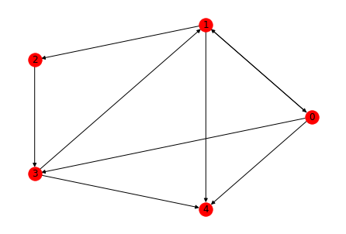
Pre-Processing.py
Ladesaeulenregister
ChargingStationCleaned
2009.rf
prediction.py
optimization.py
…
ChargingStationCleaned
2022.rf
{year+1}.graphml
2009.graphml
User Input
network_gen.py
…
ChargingStationCleaned
2022.graphml

