Slide 1
Direct Preference Optimization (DPO): Your Language Model is Secretly a Reward Model
Giovanni Filomeno
Rafailov R., Sharma A., Mitchell E., Ermon S., Manning C. D., Finn C.

Slide 2
The impact and Cost of Leading AI Models
OpenAI’s ChatGPT and Google’s Gemini are revolutionizing the world. Goldman Sachs projects Generative AI could boost global GDP by 7% over next decade. The results the models achieved are unbelievable:
ChatGPT: First service to reach 100M users in only 2 months
Gemini: First to surpass humans on the MMLU benchmark
Despite their success, training costs and complexity remain high: $78M for GPT-4 (2023) and $191M for Gemini (2024).
→ Optimizing training can achieve significant cost savings and performance gains

Slide 3
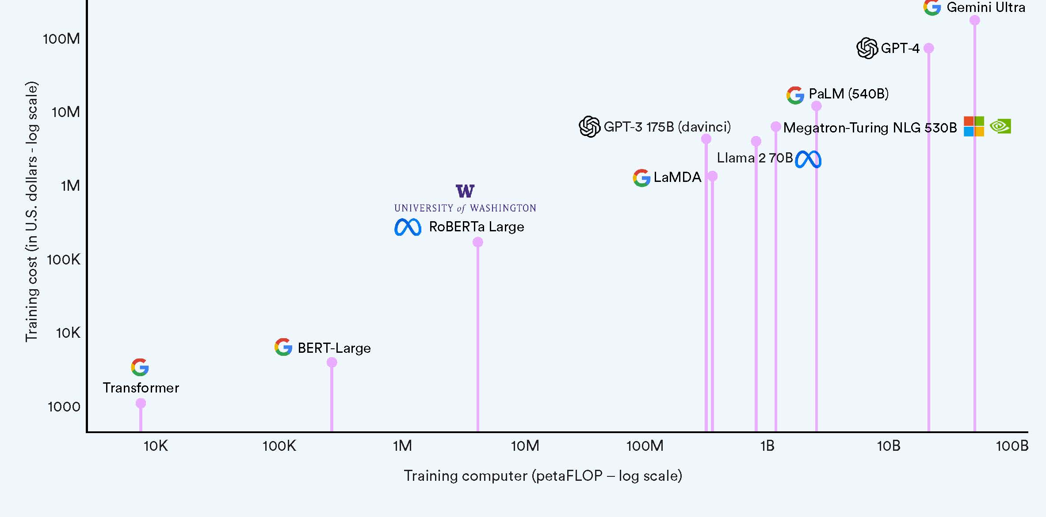
Training Cost vs Model Scale

Slide 4
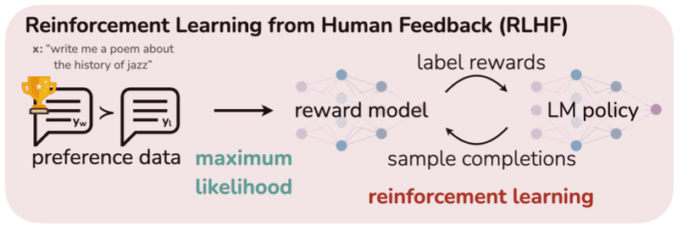
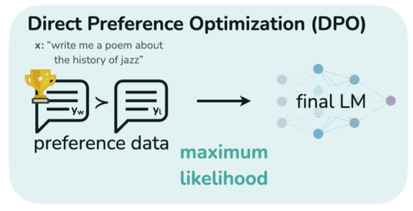
Challenges in Steering Pre-trained LMs
Pre-trained Large Models (LMs) learn general knowledge and reason skills from unsupervised data.
Main challenge: difficult to control their behaviour precisely and align it with human preferences.
RLHF Pipeline
Traditional solution: RLHF (Reinforcement Learning with Human Feedback).
Main problem: complexity, instability, high computational cost.
RLHF Pipeline

Slide 5
Research objective: Direct Preference Optimization (DPO)
Main Problem: complexity, instability, high computational cost.
Research objective: proposing a direct and stable method to allign language models to human preferences.
RLHF Pipeline
Main contribution: eliminate direct use of Reinforcement Learning (RL), direct policy optimization with a simple ranking function
Result: better or comparable performance to RLHF, but with a much simpler pipeline.
RLHF Pipeline

Slide 6
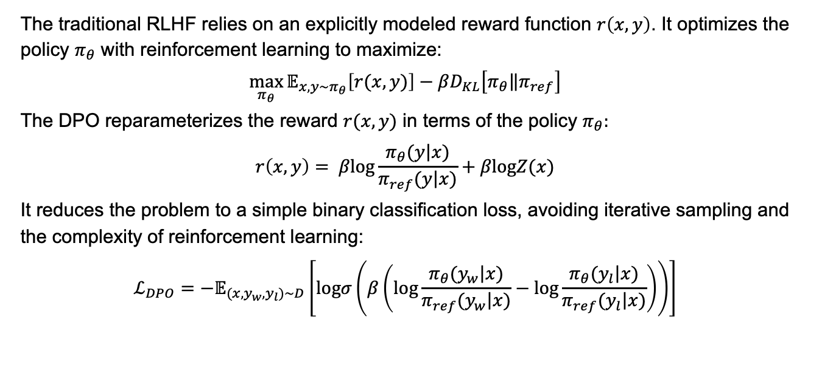
Direct Preference Optimization: Technical Insight
The traditional RLHF relies on an explicitly modeled reward function $r\left(x,y\right)$. It optimizes the policy $π_{θ}$ with reinforcement learning to maximize:
$$\max_{π_{θ}}{𝔼_{x,y\sim π_{θ}}\left[r(x,y)\right]−βD_{KL}\left[\left.π_{θ}\right\|π_{ref}\right]}$$
The DPO reparameterizes the reward $r(x,y)$ in terms of the policy $π_{θ}:$
$$r\left(x,y\right)= β\text{log}\frac{π_{θ}(\left.y\right|x)}{π_{ref}(\left.y\right|x)}+β\text{log}Z(x)$$
It reduces the problem to a simple binary classification loss, avoiding iterative sampling and the complexity of reinforcement learning:
$$ℒ_{DPO}=−𝔼_{(x,y_{w},y_{l})\sim D}\left[\text{log}σ\left(β\left(\text{log}\frac{π_{θ}(\left.y_{w}\right|x)}{π_{ref}(\left.y_{w}\right|x)}−\text{log}\frac{π_{θ}(\left.y_{l}\right|x)}{π_{ref}(\left.y_{l}\right|x)}\right)\right)\right]$$

Slide 7
How DPO Simplifies the Process
Complexity:
RLHF involves training a reward model and applying RL to optimize the policy.
DPO replaces this with direct optimization approach.
Stability:
RLHF can suffer from unstable training, depending on reward function accuracy and hyperparameters.
DPO achieves stability through its straightforward loss formulation.
Computational Efficiency:
RLHF is computationally intensive due to iterative sampling and reward model training.
DPO is lightweight and avoids costly iterations

Slide 8
Comparison RLHF and DPO
Features | RLHF | DPO
Pipeline Complexity | Reward Model + RL | Direct Loss Optimization
Stability | Sensitive to hyperparameters | Stable
Sampling | Requires iterative sampling | Not required
Comp. cost | High | Low
Performance | Strong but unstable | Comparable or better

Slide 9
Experiments and Benchmark Tasks
Task Evaluated:
Sentiment Modulation: Fine-tuning a model to produce text with a desired sentiment (positive/negative)
Summarization (TL;DR): Generating short and relevant summaries for long passages.
Dialogue (Single-turn Chat): Producing contextually relevant responses in a conversational setting.
Models Compared:
Baseline: Pre-trained Language Model (Reference Policy).
RLHF: Policy fine-tuned with reinforcement learning.
DPO: Policy fine-tuned with direct preference optimization.
Metrics:
Win Rate: Percentage of cases where human annotators prefer DPO
Reward vs. KL: Tradeoff between reward maximization and divergence from the reference policy.
Human Feedback: Evaluating generated outputs based on human preferences

Slide 10
Experimental Results: DPO vs RLHF
Sentiment Modulation (Positive/Negative Text Generation):
DPO achieves higher reward with lower KL divergence compared to RLHF.
DPO consistently outperforms PPO in balancing sentiment generation and maintaining policy stability.
Summarization (TL; DR):
DPO achieves a 61% win rate over human-written summaries (evaluated by GPT-4).
Performance is robust across sampling temperatures, outperforming RLHF (57% win rate).
Dialogue (Single-Turn Chat):
DPO matches or outperforms RLHF while avoiding computational overhead.
Win rates remain stable across evaluation scenarios.

Slide 11
Disadvantages of DPO (from Paper)
Limited Empirical Scaling:
DPO has been tested on models up to 6B parameters.
Further experiments are needed to confirm its effectiveness on state-of-the-art models like GPT-4 or Gemini.
Lack of Explicit Reward Modeling:
While DPO simplifies optimization by removing reward modeling, it may limit interpretability of the reward structure
Understanding why a model prefers certain outputs could be less clear
Generalization Under Distribution Shifts
Initial results suggest DPO performs well on out-of-distribution tasks, but comprehensive testing is still required.
Potential vulnerabilities in unseen input distributions need further analysis.

Slide 12
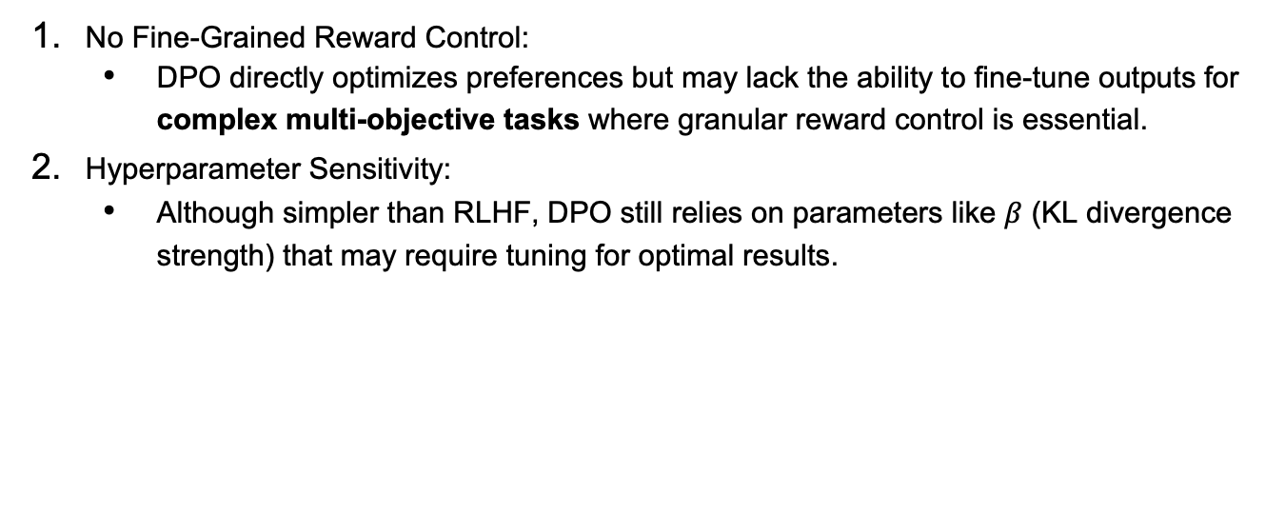
Disadvantages of DPO (from me)
No Fine-Grained Reward Control:
DPO directly optimizes preferences but may lack the ability to fine-tune outputs for complex multi-objective tasks where granular reward control is essential.
Hyperparameter Sensitivity:
Although simpler than RLHF, DPO still relies on parameters like $β$ (KL divergence strength) that may require tuning for optimal results.

Slide 13
Summary
The Problem:
RLHF is complex, unstable, and computationally costly.
The Solution:
DPO (Direct Preference Optimization) simplifies alignment with no RL or reward modeling and lower cost and improved stability.
Key Results:
Comparable or better performance than RLHF.
Higher win wates and lower KL divergence.
Takeaway:
DPO: a simpler, stable, and cost-efficient alternative to RLHF.

Slide 14
Question Time

Slide 15
Backup

Slide 16
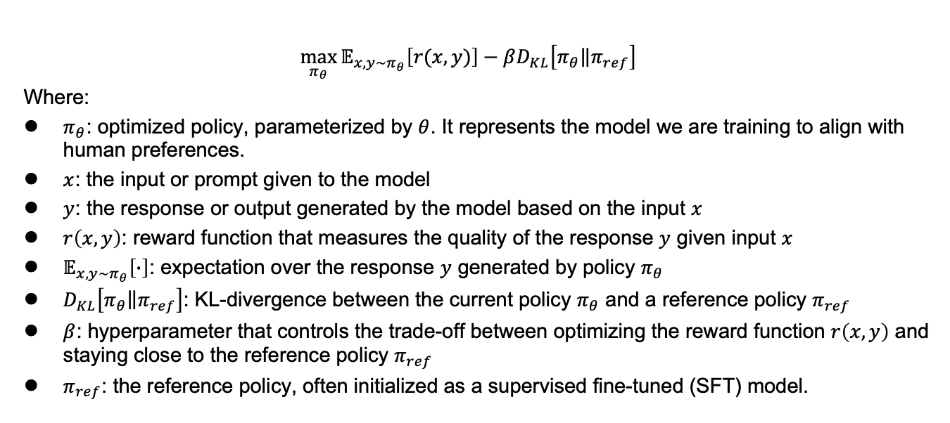
Math Explanations - 1
$$\max_{π_{θ}}{𝔼_{x,y\sim π_{θ}}\left[r(x,y)\right]−βD_{KL}\left[\left.π_{θ}\right\|π_{ref}\right]}$$
Where:
$π_{θ}$: optimized policy, parameterized by $θ$. It represents the model we are training to align with human preferences.
$x$: the input or prompt given to the model
$y$: the response or output generated by the model based on the input $x$
$r\left(x,y\right)$: reward function that measures the quality of the response $y$ given input $x$
$𝔼_{x,y\sim π_{θ}}\left[∙\right]$: expectation over the response $y$ generated by policy $π_{θ}$
$D_{KL}\left[\left.π_{θ}\right\|π_{ref}\right]$: KL-divergence between the current policy $π_{θ}$ and a reference policy $π_{ref}$
$β$: hyperparameter that controls the trade-off between optimizing the reward function $r\left(x,y\right)$ and staying close to the reference policy $π_{ref}$
$π_{ref}$: the reference policy, often initialized as a supervised fine-tuned (SFT) model.

Slide 17
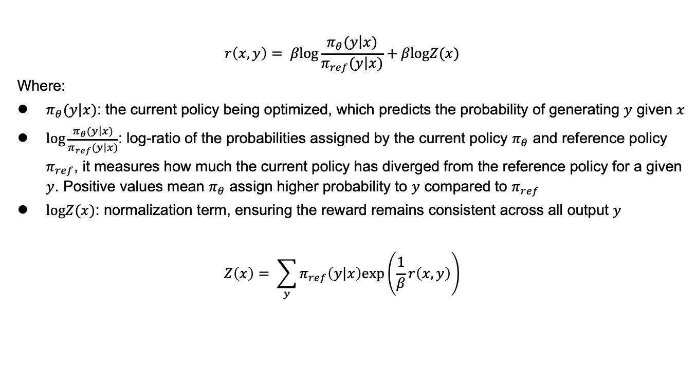
Math Explanations - 2
$$r\left(x,y\right)= β\text{log}\frac{π_{θ}(\left.y\right|x)}{π_{ref}(\left.y\right|x)}+β\text{log}Z(x)$$
Where:
$π_{θ}(\left.y\right|x)$: the current policy being optimized, which predicts the probability of generating $y$ given $x$
$\text{log}\frac{π_{θ}(\left.y\right|x)}{π_{ref}(\left.y\right|x)}$: log-ratio of the probabilities assigned by the current policy $π_{θ}$ and reference policy $π_{ref}$, it measures how much the current policy has diverged from the reference policy for a given $y$. Positive values mean $π_{θ}$ assign higher probability to $y$ compared to $π_{ref}$
$\text{log}Z(x)$: normalization term, ensuring the reward remains consistent across all output $y$
$$Z\left(x\right)= \sum_{y}{π_{ref}\left(\left.y\right|x\right)\text{exp}\left(\frac{1}{β}r\left(x,y\right)\right)}$$

Slide 18
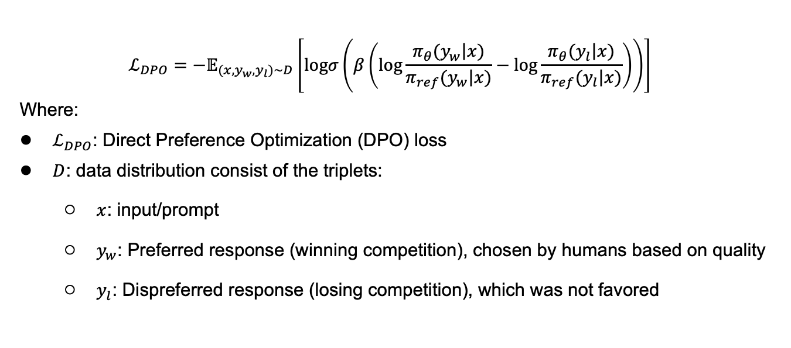
Math Explanations - 3
$$ℒ_{DPO}=−𝔼_{(x,y_{w},y_{l})\sim D}\left[\text{log}σ\left(β\left(\text{log}\frac{π_{θ}(\left.y_{w}\right|x)}{π_{ref}(\left.y_{w}\right|x)}−\text{log}\frac{π_{θ}(\left.y_{l}\right|x)}{π_{ref}(\left.y_{l}\right|x)}\right)\right)\right]$$
Where:
$ℒ_{DPO}$: Direct Preference Optimization (DPO) loss
$D$: data distribution consist of the triplets:
$x$: input/prompt
$y_{w}$: Preferred response (winning competition), chosen by humans based on quality
$y_{l}$: Dispreferred response (losing competition), which was not favored

Slide 19

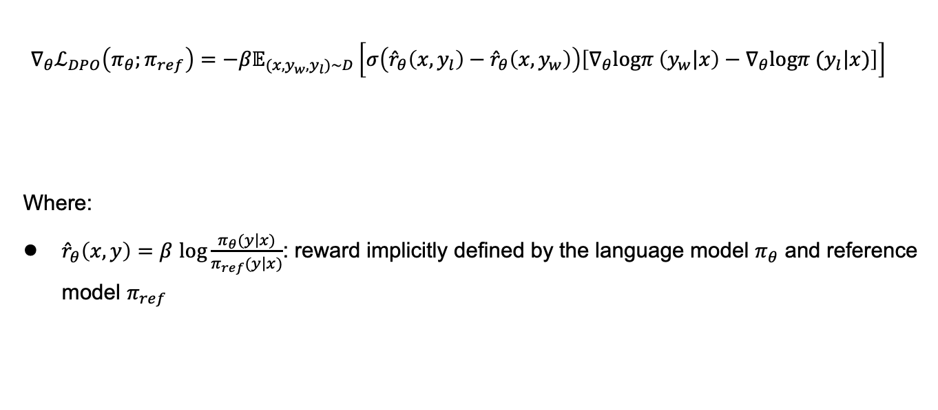

Math Explanations - 4
$${∇_{θ}ℒ}_{DPO}\left(π_{θ};π_{ref}\right)=−{β𝔼}_{(x,y_{w},y_{l})\sim D}\left[σ\left({\hat{r}}_{θ}\left(x,y_{l}\right)−{\hat{r}}_{θ}\left(x,y_{w}\right)\right)\left[∇_{θ}\text{log}π \left(\left.y_{w}\right|x\right)−∇_{θ}\text{log}π (\left.y_{l}\right|x)\right]\right]$$
Where:
${\hat{r}}_{θ}\left(x,y\right)=β$ $\text{log}\frac{π_{θ}(\left.y\right|x)}{π_{ref}(\left.y\right|x)}$: reward implicitly defined by the language model $π_{θ}$ and reference model $π_{ref}$
Higher weight when reward estimate is wrong
Increase likelihood of $y_{w}$
decrease likelihood of $y_{l}$

