Slide 1
Direct Preference Optimization (DPO): Your Language Model is Secretly a Reward Model
Giovanni Filomeno
Rafailov R., Sharma A., Mitchell E., Ermon S., Manning C. D., Finn C.

Slide 2
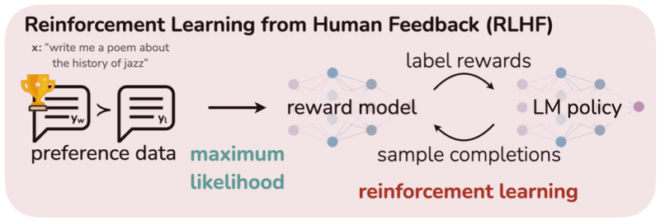
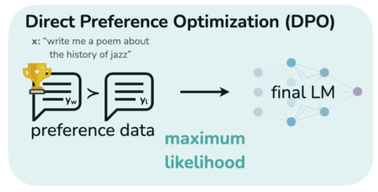
Challenges in Steering Pre-trained LMs
Pre-trained Large Models (LMs) learn general knowledge and reason skills from unsupervised data.
Main challenge: difficult to control their behaviour precisely and align it with human preferences.
RLHF Pipeline
Traditional solution: RLHF (Reinforcement Learning with Human Feedback).
Main problem: complexity, instability, high computational cost.
RLHF Pipeline

Slide 3
Research objective: Direct Preference Optimization (DPO)
Main Problem: complexity, instability, high computational cost.
Research objective: proposing a direct and stable method to allign language models to human preferences.
RLHF Pipeline
Main contribution: eliminate direct use of Reinforcement Learning (RL), direct policy optimization with a simple ranking function
Result: better ror comparable performance to RLHF, but with a much simpler pipeline.
RLHF Pipeline

Slide 4
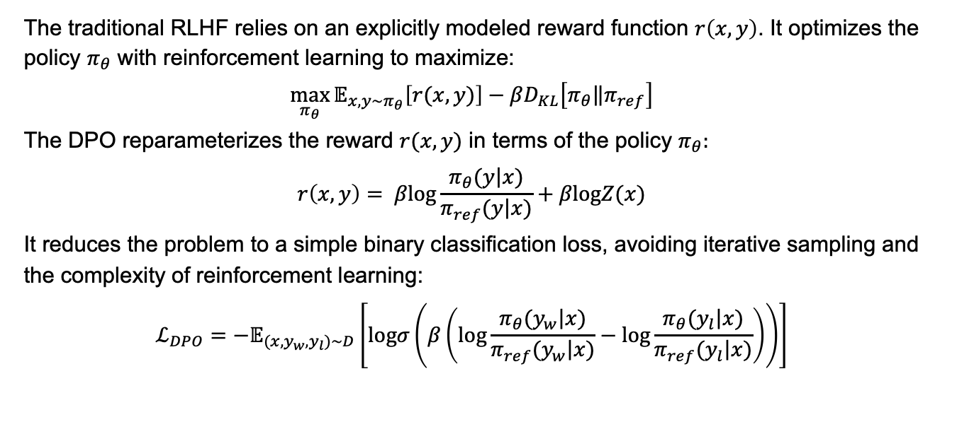
Direct Preference Optimization: Technical Insight
The traditional RLHF relies on an explicitly modeled reward function $r\left(x,y\right)$. It optimizes the policy $π_{θ}$ with reinforcement learning to maximize:
$$\max_{π_{θ}}{𝔼_{x,y\sim π_{θ}}\left[r(x,y)\right]−βD_{KL}\left[\left.π_{θ}\right\|π_{ref}\right]}$$
The DPO reparameterizes the reward $r(x,y)$ in terms of the policy $π_{θ}:$
$$r\left(x,y\right)= β\text{log}\frac{π_{θ}(\left.y\right|x)}{π_{ref}(\left.y\right|x)}+β\text{log}Z(x)$$
It reduces the problem to a simple binary classification loss, avoiding iterative sampling and the complexity of reinforcement learning:
$$ℒ_{DPO}=−𝔼_{(x,y_{w},y_{l})\sim D}\left[\text{log}σ\left(β\left(\text{log}\frac{π_{θ}(\left.y_{w}\right|x)}{π_{ref}(\left.y_{w}\right|x)}−\text{log}\frac{π_{θ}(\left.y_{l}\right|x)}{π_{ref}(\left.y_{l}\right|x)}\right)\right)\right]$$

Slide 5
How DPO Simplifies the Process
Complexity:
RLHF involves training a reward model and applying RL to optimize the policy.
DPO replaces this with direct optimization approach.
Stability:
RLHF can suffer from unstable training, depending on reward function accuracy and hyperparameters.
DPO achieves stability through its straightforward loss formulation.
Computational Efficiency:
RLHF is computationally intensive due to iterative sampling and reward model training.
DPO is lightweight and avoids costly iterations

Slide 6
Comparison RLHF and DPO
Features | RLHF | DPO
Pipeline Complexity | Reward Model + RL | Direct Loss Optimization
Stability | Sensitive to hyperparameters | Stable
Samplying | Requires iterative sampling | Not required
Comp. cost | High | Low
Performance | Strong but unstable | Comparable or better

Slide 7
Experiments and Benchmark Tasks
Task Evaluated:
Sentiment Modulation: Fine-tuning a model to produce text with a desired sentiment (positive/negative)
Summarization (TL;DR): Generating short and relevant summaries for long passages.
Dialogue (Single-turn Chat): Producing contextually relevant responses in a conversational setting.
Models Compared:
Baseline: Pre-trained Language Model (Reference Policy).
RLHF: Policy fine-tuned with reinforcement learning.
DPO: Policy fine-tuned with direct preference optimization.
Metrics:
Win Rate: Percentage of cases where human annotators prefer DPO
Reward vs. KL: Tradeoff between reward maximization and divergence from the reference policy.
Human Feedback: Evaluating generated outputs based on human preferences

Slide 8
Outline
[Try to structure it somehow like this:]
[Icebreaker: Introduction to provide intuition, etc.]
[Problem description (use formulas if needed), e.g. Object Centric learning]
[Describe the main Method(s) you want to present]
[Advantages of the method, in comparison to what other method’s do]
[Disadvantages … - THINK CRITICALLY HERE !!!! ]
[Conclusion, outlook, summary]

Slide 9
Summary
[I often like to just repeat again what we heard in the outline; hopefully people then draw a clear thread through the discussed topics:]
[Icebreaker: Introduction to provide intuition, etc.]
[Problem description (use formulas if needed), e.g. Object Centric learning]
[Describe the main Method(s) you want to present]
[Advantages of the method, in comparison to what other method’s do]
[Disadvantages … - THINK CRITICALLY HERE !!!! ]
[Conclusion, outlook, summary]

Slide 10
References
[Make sure to mention number, paper name, authors (if 1 or 2 authors mention both, if 3 or more, name the first author and “et.al”)]
[1]: Attention is all you need (Vaswani et al): https://arxiv.org/abs/1706.03762
[2]: TinyBERT: Distilling BERT for Natural Language Understanding (Jiao et al).: https://arxiv.org/abs/1909.10351
[3]: …
[4]: …

