Slide 1
Cylinder-based Approximation of 3D-Objects
Ahmad M. Belbeisi
Taimoor Niaz
Christian C. Saenz
Benjamin Sundqvist
München, 26. April 2021

Slide 2
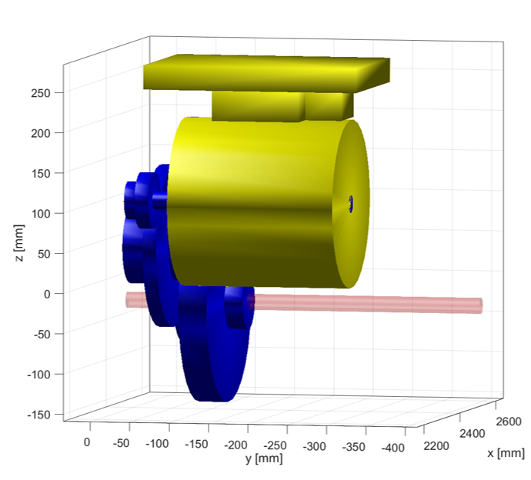
Motivation
Fast development of new systems. For example, components need to be placed automatically in certain space.
Approximate geometry of container first
Here, approximation by cylinders

Slide 3
Task
Approximate STL-File by cylinders
Approximation strictly inside given geometry
Use few cylinders but cover main features of original geometry

Slide 4
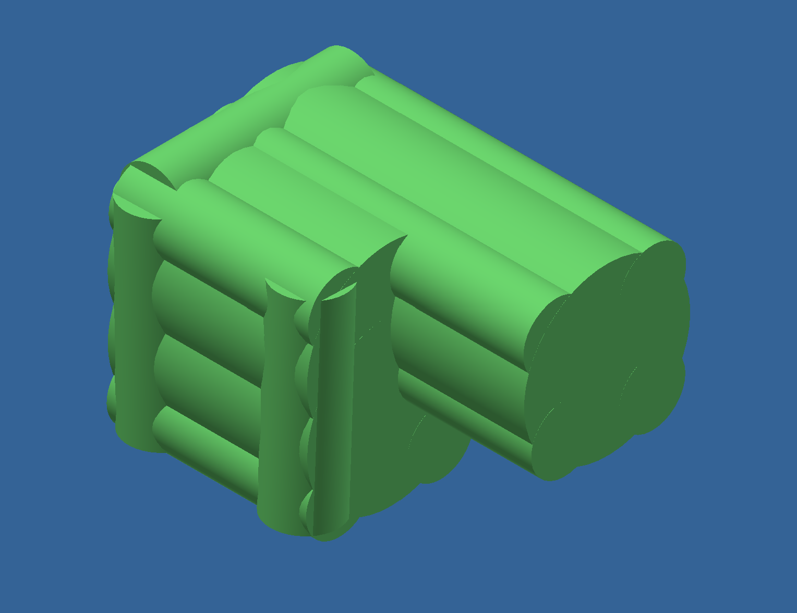
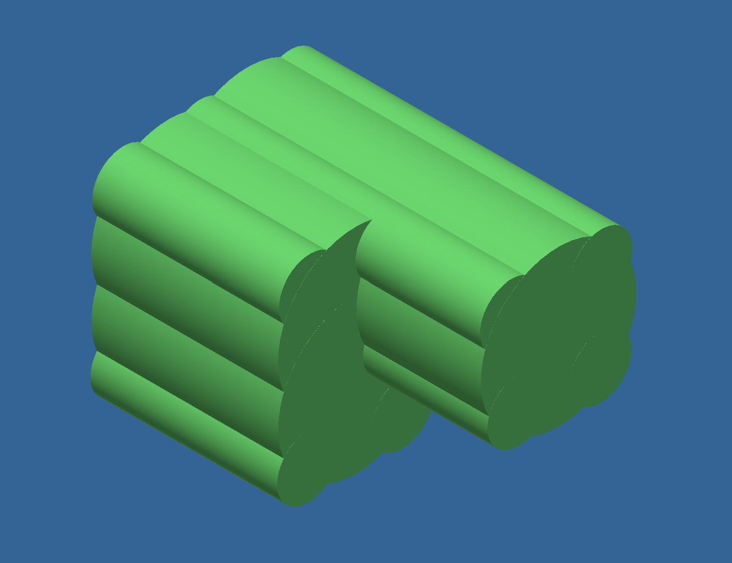
Rules
Center lines of cylinders need to be parallel

Slide 5
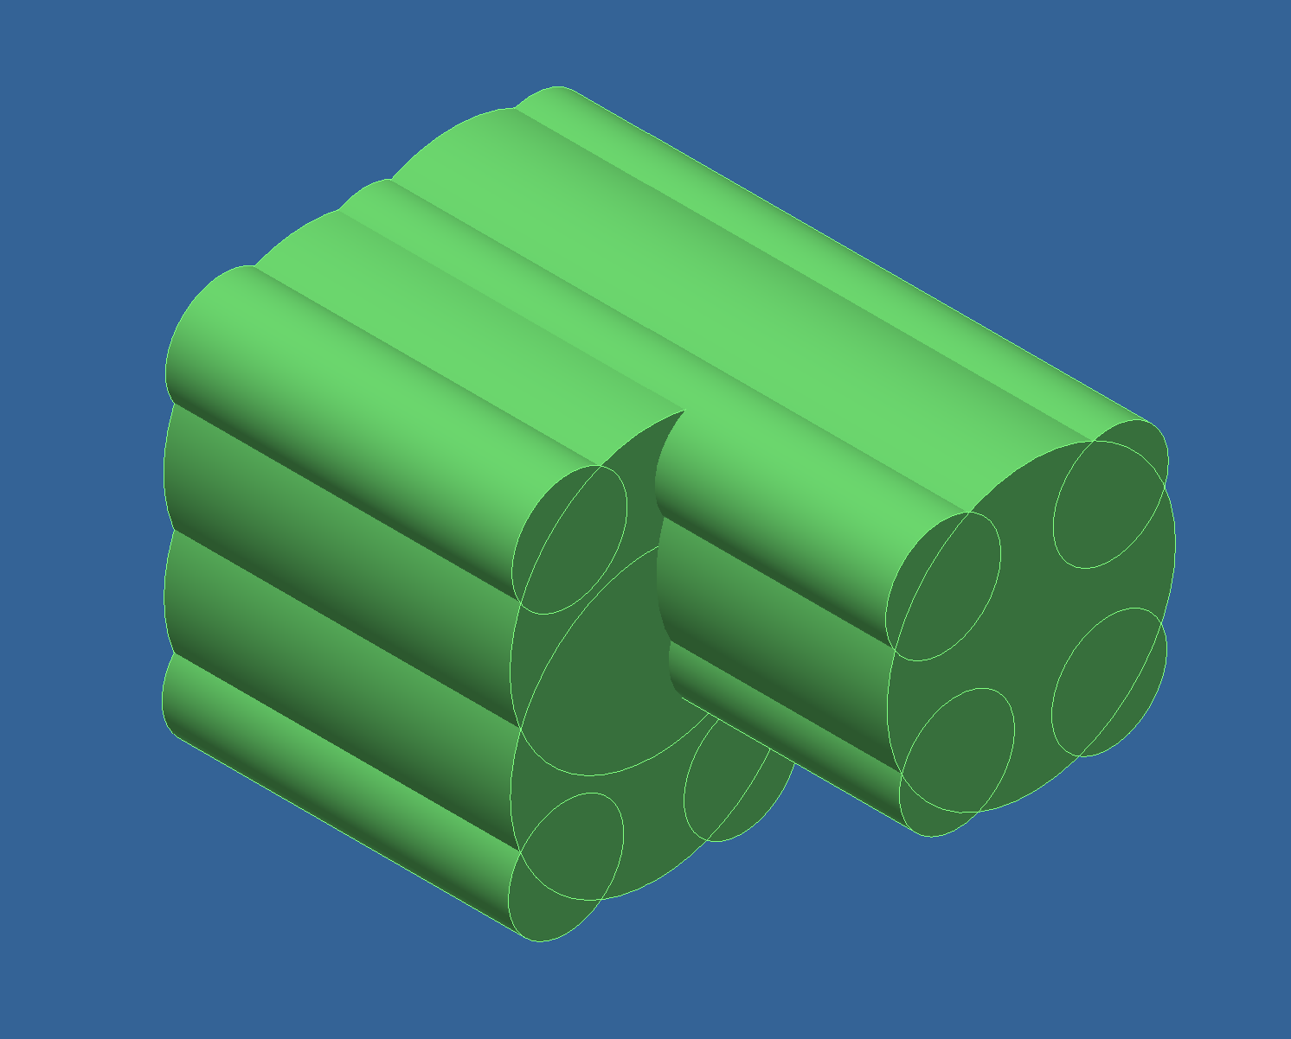
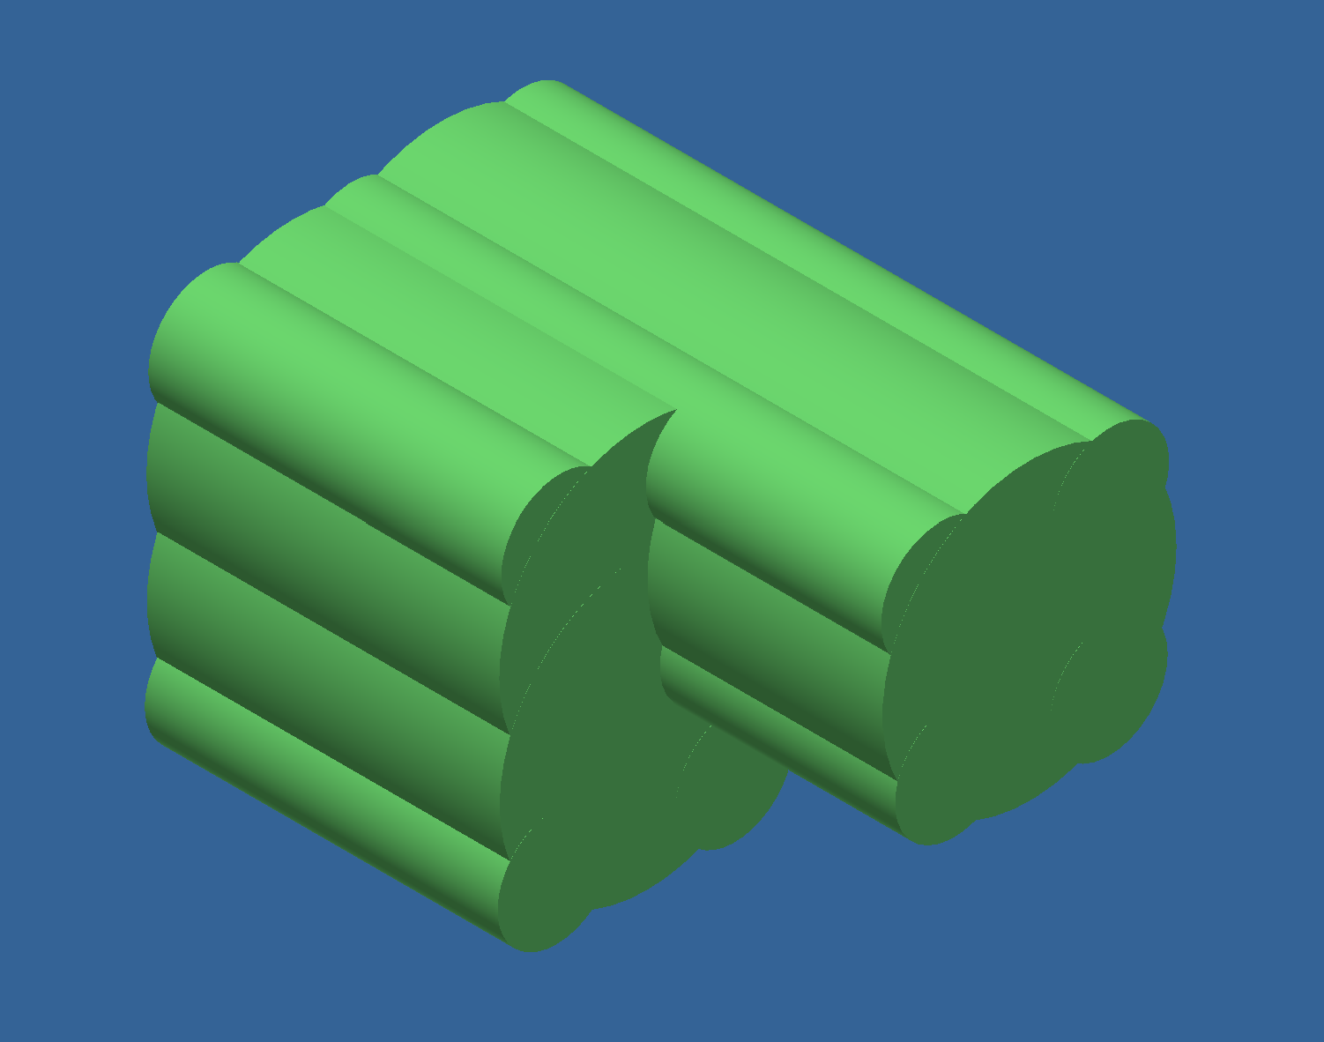
Rules
Geometry defined by union of cylinders

Slide 6
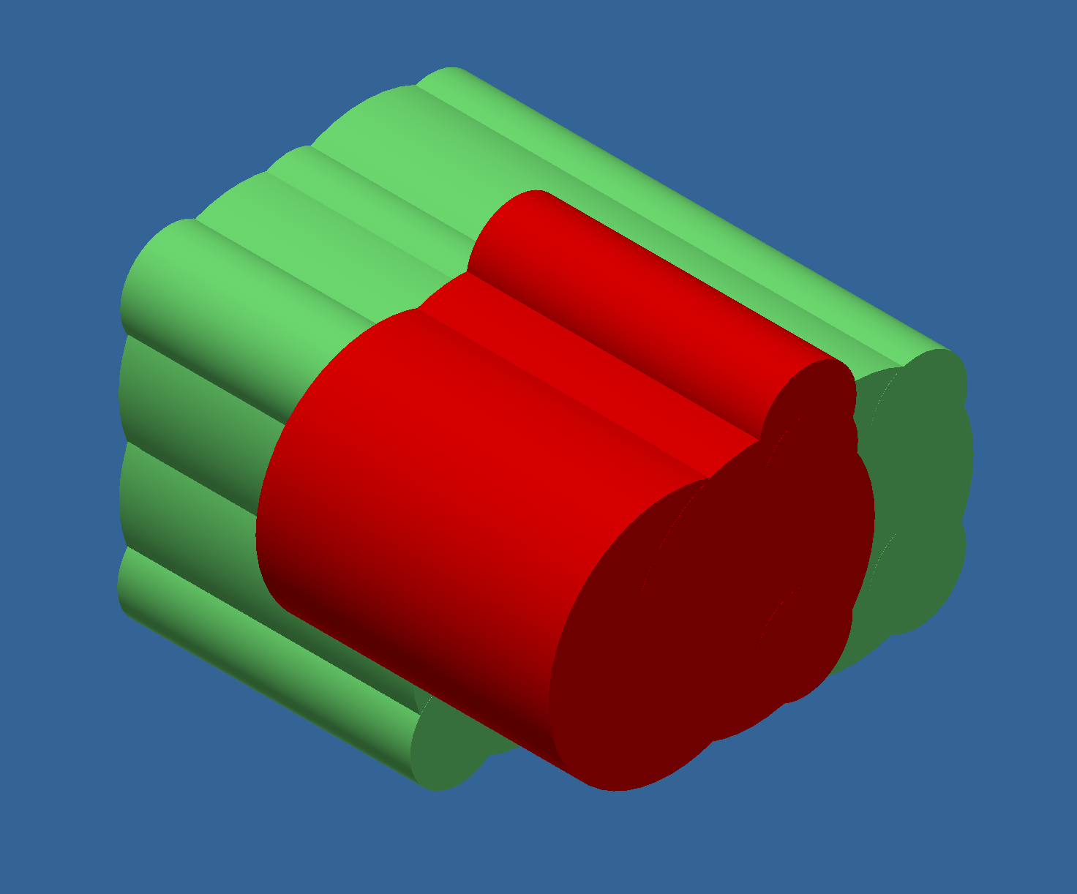
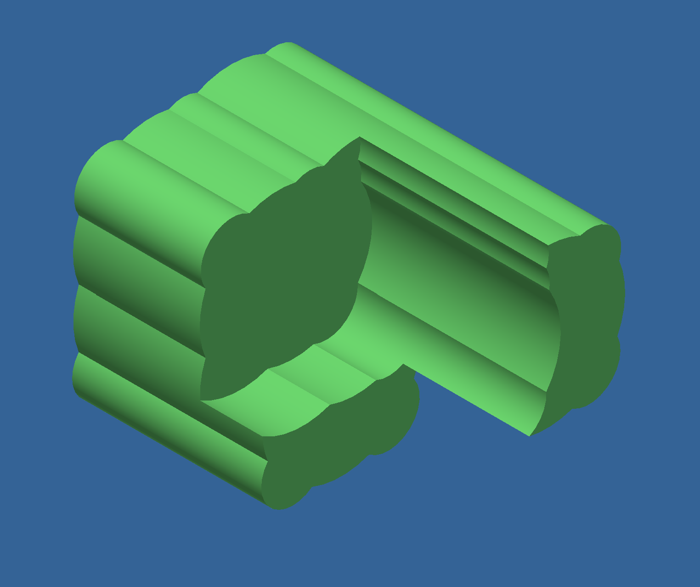
Rules
Another set of cylinders may be substracted

Slide 7
Steps
Program in Matlab
Read stl-file into matlab
Criteria for quality of approximation
Volume compared to initial volume
number of cylinders,
main features maintained

