Slide 1


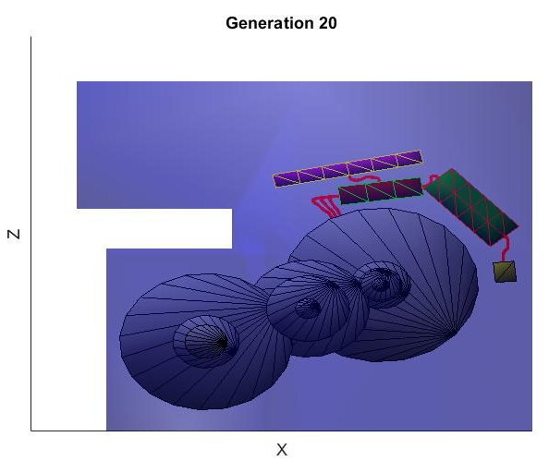
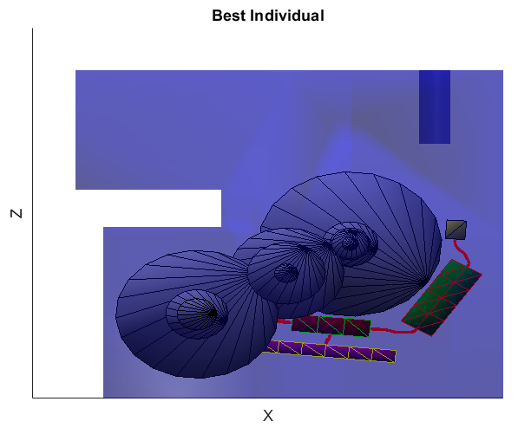
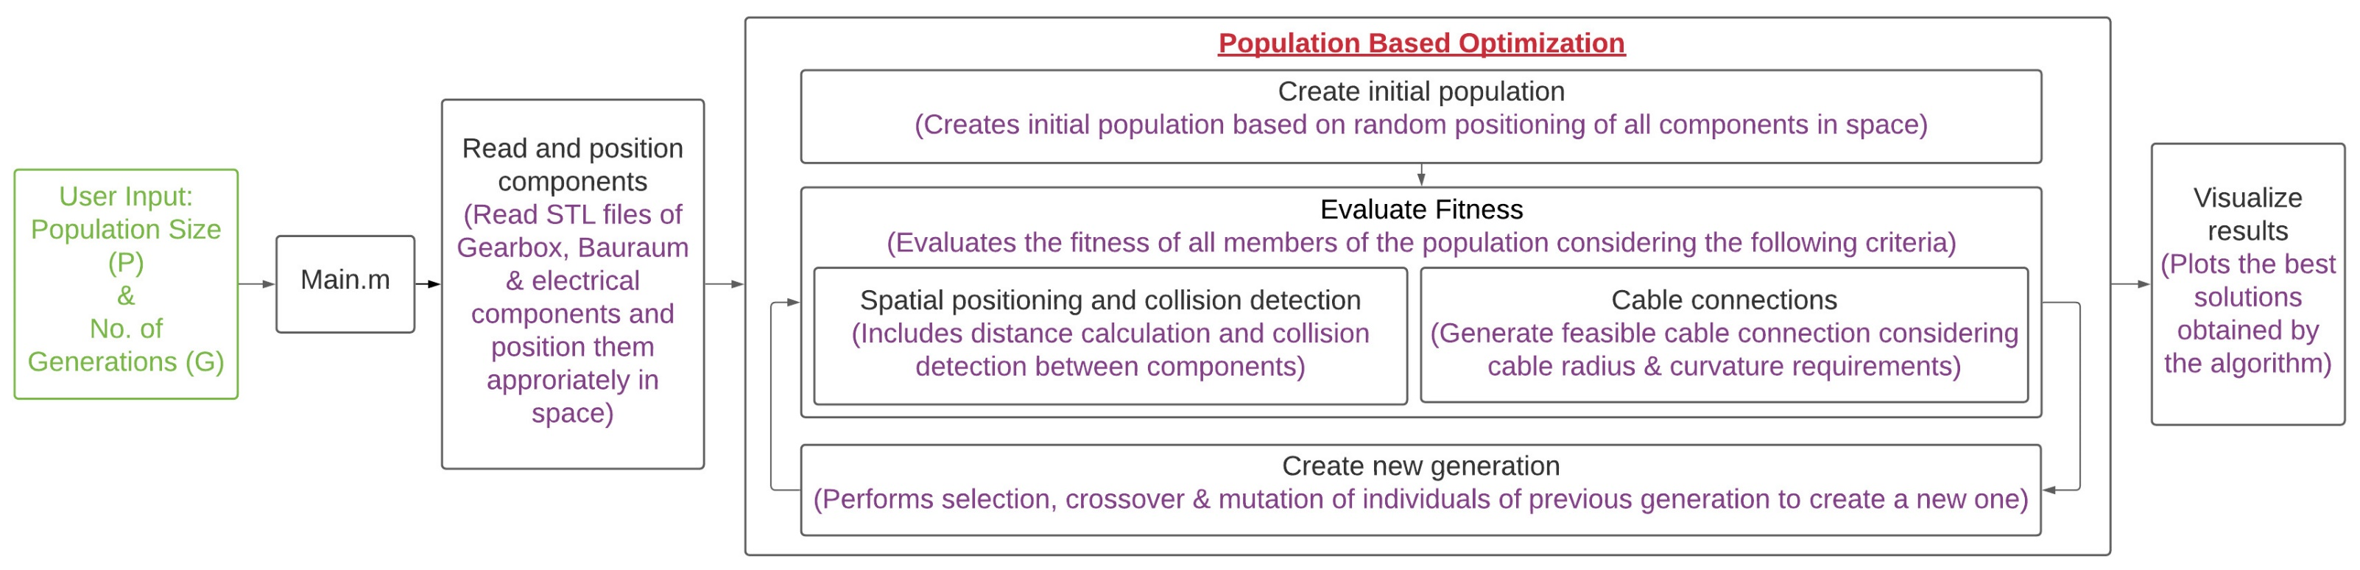
3D Box Topology Optimization with Constrained Space Software Lab Project 2021
Chair of Computational Modeling and Simulation TUM School of Engineering and Design Technical University of Munich
Ansari, Talhah; Dawod, Ahmed; Rueda Arreguin, Luis Dario
Supervisors: Filomeno, Giovanni; Alsayed-Ahmad, Moustafa
Abstract
An efficient algorithm based on population-based optimization (Evolutionary Algorithm) for positioning a transmission assembly comprised of a gearbox and associated electrical components in a constrained assembly space was developed.
Methodology
The design of the transmission assembly consists of different components interacting with each other including the gearbox assembly and the electrical components, which work in close proximity. The algorithm read the components’ STL files and prepared them for the Evolutionary Algorithm by positioning them in space. The main functional objective was to minimize the distance between the electrical components (IGBT, Control Board, Capacitor, EMI-filter) individually and place them close to the electric motor. The cable length and the total bounded volume are minima.
Evolutionary Algorithms are a class of population-based optimization approaches based on biological evolution mechanisms such as selection, crossover and mutation. A generation of population consisting of a set of individuals/ designs undergo the above-mentioned processes to generate a new generation of designs. The initial population of designs was generated by random placement of components in the assembly space.
The fitness function evaluated each design of a generation and calculated the fitness value that determined the design’s quality. The fitness function consisted of the parameters to be minimized, i.e., distances between components, cable length, and a penalty factor accounting for constraint violations such as collisions. Designs were selected, mixed, and mutated to generate the next generation based on the fitness values. The fitnesses were re-evaluated, and the process was repeated until the prescribed number of generations.
Results and Conclusion
After the algorithm goes through the optimization process in the defined number of iterations, the components are shown in their new positions, which the individual defines in the last generation with the lowest fitness value. Figure 2(a) and Figure 3(a) show the optimal solution of the positioning objective.
Figure 2(b) and Figure 3(b) show the average fitness of the individuals in a generation. As the algorithm progresses, the average fitness decreases, indicating that more and more individuals move towards optimal solutions.
References
[1] Bonisoli, E., Velardocchia, M., Moos, S., Tornincasa, S., & Galvagno, E. (2010). Gearbox Design by means of Genetic Algorithm and CAD/CAE Methodologies (No. 2010-01-0895). SAE Technical Paper.
[2] Lyu, N., & Saitou, K. (2005). Topology optimization of multicomponent beam structure via decomposition-based assembly synthesis. J. Mech. Des., 127(2), 170-183.
[3] Li, P., & Shen, Z. (2019, November). 3D line matching model and optimization for rigid pipeline assembly. In IOP Conference Series: Earth and Environmental Science (Vol. 384, No. 1, p. 012104). IOP Publishing.
(a) Components configuration
(b) Mean fitness vs generation
Figure 2: Results of the algorithm on Bauraum configuration 1; Population=100, Generations=20
(a) Components configuration
(b) Mean fitness vs generation
Figure 3: Results of the algorithm on Bauraum configuration 2; Population=500, Generations=20
Figure 1: Algorithm structure

