Slide 1


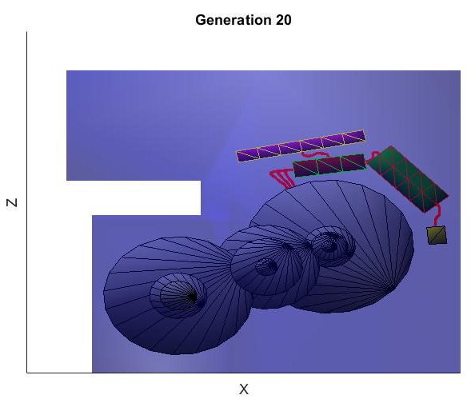
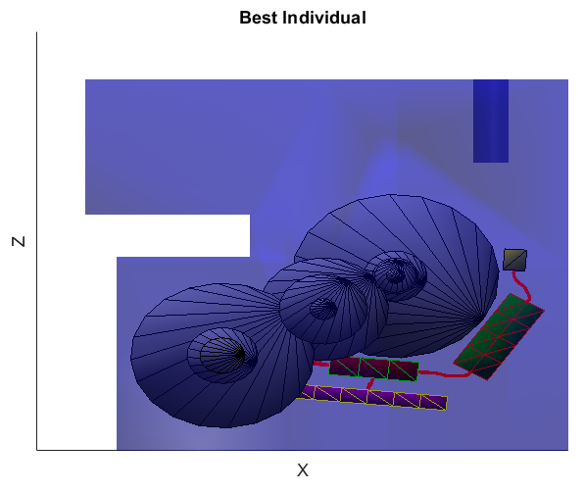
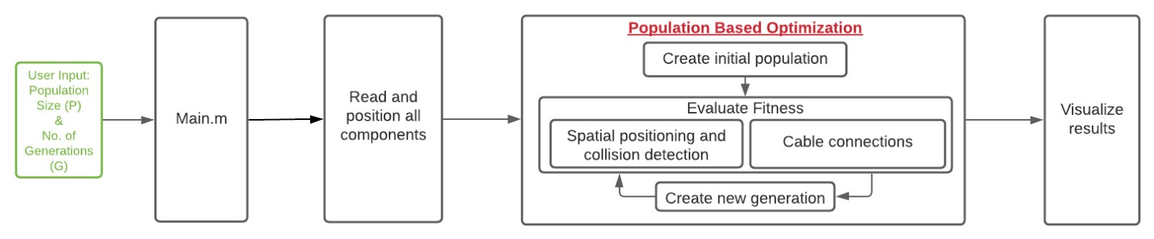
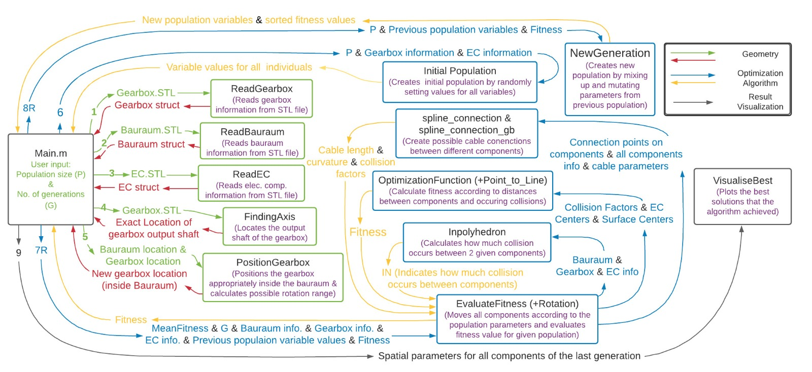
3D Box Topology Optimization with Constrained Space
Software Lab Project 2021
Chair of Computational Modeling and Simulation
TUM School of Engineering and Design
Technical University of Munich
Ansari, Talhah; Dawod, Ahmed; Rueda Arreguin, Luis Dario
Supervisors: Filomeno, Giovanni; Alsayed-Ahmad, Moustafa
  Abstract
An efficient algorithm based on population based optimization (Evolutionary Algorithm) for positioning a transmission assembly comprised of a gearbox and associated electrical components in a constrained assembly space was developed.
  Methodology
The design of the transmission assembly consists of different components interacting with each other including the gearbox assembly and the electrical components which work in close proximity. The algorithm read the components STL files and prepares them for the Evolutionary Algorithm by positioning them in space. The main functional objective was to minimize the distance between the electrical components (IGBT, Control Board, Capacitor, EMI-filter) individually and place them close to the electric motor such that the cable length and the total bounded volume is minimum.
  Results and Conclusion
  After the algorithm goes through the optimization process in the defined number of iterations, the components are shown in their new positions, which are defined by the individual in the last generation that got the lowest fitness value. Figures 3 & 4 show the optimal solution of the positioning objective.
  Figures 3 & 4 show the average fitness of the individuals in a generation. It can be observed that as the algorithm progresses the average fitness decreases indicating that more and more individuals move towards optimal solutions.
Figure 1: Results of the algorithm on Bauraum configuration 1; Population=100, Generations=20
Figure 2: Results of the algorithm on Bauraum configuration 2; Population=500, Generations=20
  References
[1] Bonisoli, E., Velardocchia, M., Moos, S., Tornincasa, S., & Galvagno, E. (2010). Gearbox Design by means of Genetic Algorithm and CAD/CAE Methodologies (No. 2010-01-0895).
[2] Lyu, N., & Saitou, K. (2005). Topology optimization of multicomponent beam structure via decomposition-based assembly synthesis. J. Mech. Des., 127(2), 170-183.
Figure 1: Brief overview of the algorithm
Figure 2: Detailed Algorithm structure

Slide 2
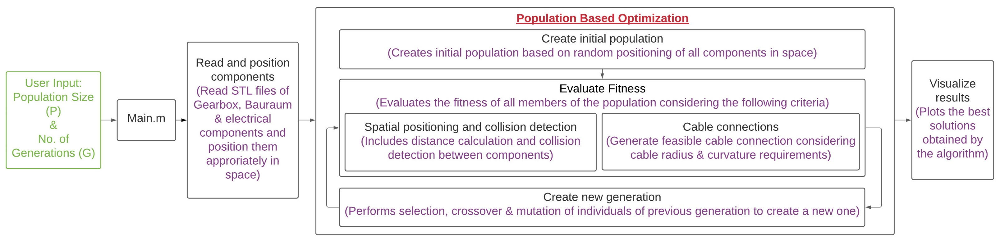
3D Box Topology Optimization with Constrained Space
Software Lab Project 2021
Chair of Computational Modeling and Simulation
TUM School of Engineering and Design
Technical University of Munich
Ansari, Talhah; Dawod, Ahmed; Rueda Arreguin, Luis Dario
Supervisors: Filomeno, Giovanni; Alsayed-Ahmad, Moustafa
  Abstract
An efficient algorithm based on population based optimization (Evolutionary Algorithm) for positioning a transmission assembly comprised of a gearbox and associated electrical components in a constrained assembly space was developed.
  Methodology
The design of the transmission assembly consists of different components interacting with each other including the gearbox assembly and the electrical components which work in close proximity. The algorithm read the components STL files and prepares them for the Evolutionary Algorithm by positioning them in space. The main functional objective was to minimize the distance between the electrical components (IGBT, Control Board, Capacitor, EMI-filter) individually and place them close to the electric motor such that the cable length and the total bounded volume is minimum.
Evolutionary Algorithms are a class of population-based optimization approaches based on biological evolution mechanisms such as selection, crossover and mutation. A generation of population consisting of a set of individuals/ designs undergo the above-mentioned processes to generate a new generation of designs. The initial population of designs was generated by random placement of components in the assembly space.
The fitness function evaluated each design of a generation and calculated the fitness value which determined the quality of the design. The fitness function consisted of the parameters to be minimized i.e distances between components, cable length and a penalty factor accounting for constraint violations such as collisions. Based on the fitness values designs were selected, crossovered and mutated to generate the next generation. The fitnesses were evaluated again and the process repeated until the prescribed number of generations.
The project was designed and implemented using Matlab® 2018b environment.
  Results and Conclusion
  After the algorithm goes through the optimization process in the defined number of iterations, the components are shown in their new positions, which are defined by the individual in the last generation that got the lowest fitness value. Figure 2(Left) and Figure 3(Left) show the optimal solution of the positioning objective.
  Figure 2(Right) and Figure 3(Right) show the average fitness of the individuals in a generation. It can be observed that as the algorithm progresses the average fitness decreases indicating that more and more individuals move towards optimal solutions.
  References
[1] Bonisoli, E., Velardocchia, M., Moos, S., Tornincasa, S., & Galvagno, E. (2010). Gearbox Design by means of Genetic Algorithm and CAD/CAE Methodologies (No. 2010-01-0895). SAE Technical Paper.
[2] Lyu, N., & Saitou, K. (2005). Topology optimization of multicomponent beam structure via decomposition-based assembly synthesis. J. Mech. Des., 127(2), 170-183.
[3] Li, P., & Shen, Z. (2019, November). 3D line matching model and optimization for rigid pipeline assembly. In IOP Conference Series: Earth and Environmental Science (Vol. 384, No. 1, p. 012104). IOP Publishing.
Figure 2: Results of the algorithm on Bauraum configuration 1; Population=100, Generations=20
Figure 3: Results of the algorithm on Bauraum configuration 2; Population=500, Generations=20
Figure 1: Algorithm structure

