Slide 1
Data Exploration
Giovanni Filomeno,
Katharina Hehenwarter,
Elīna Emīlija Ungure,
Kathrin Hofmarcher
Machine Learning and Pattern Classification

Slide 2
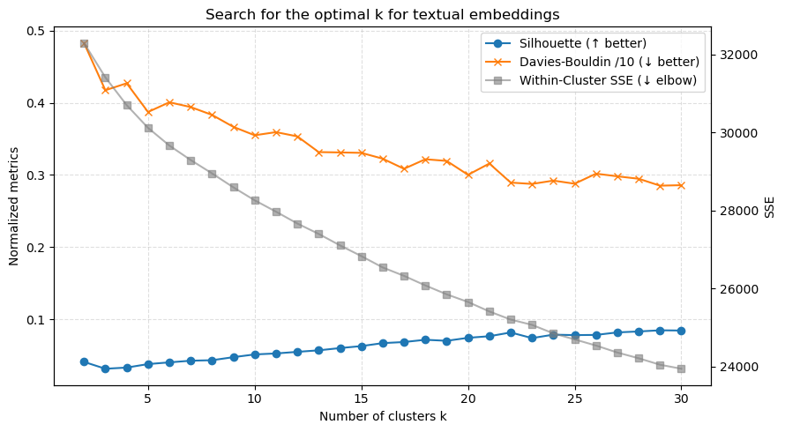
Are text-clusters meaningful? (Question a)
• 35 826 annotation embeddings
• Internal validity scan k ∈ [2…30]
– Silhouette ↑, DB ↓, SSE elbow ↓
• Trade-off chosen ➔ k = 15
– coherent keywords per cluster
– still interpretable (< 4000 notes / cluster)
* DB – Davies-Bouldin index
** SSE – Sum of Squared Errors

Slide 3
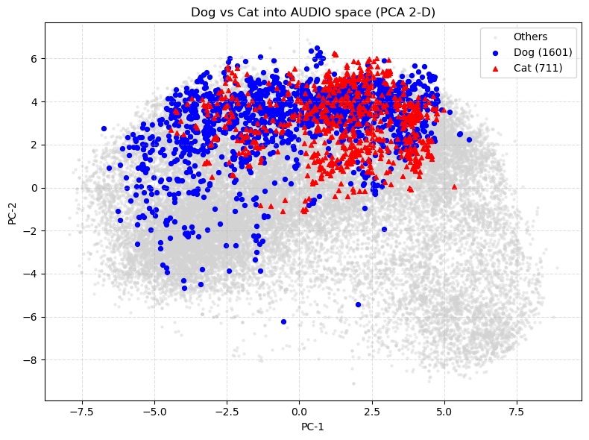
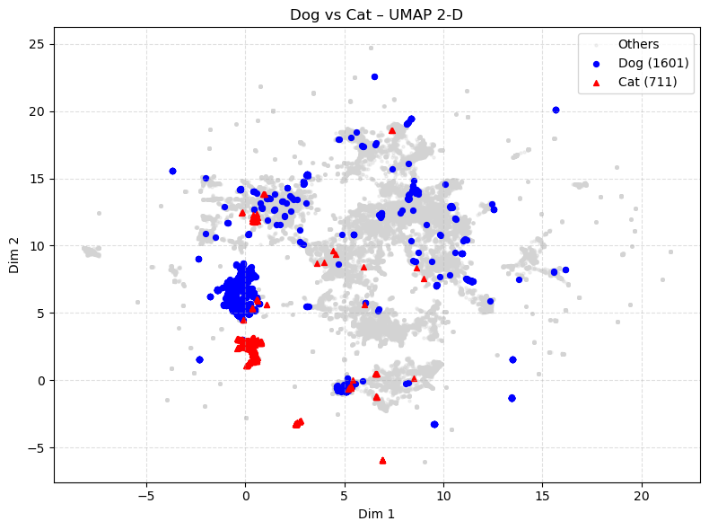
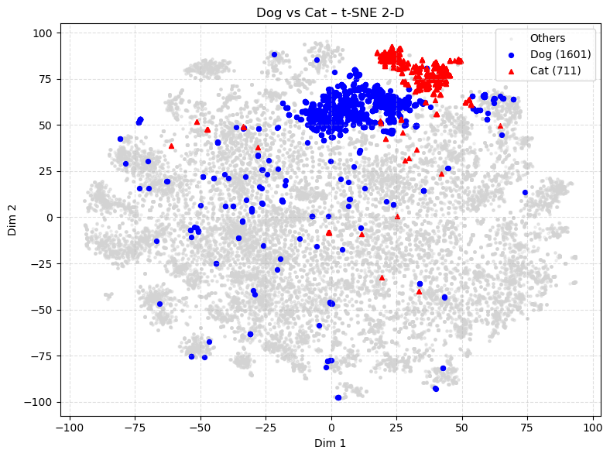
Dog & Cat labelling function (Question b)
Regex Formula:
\b(?:dog|dogs)\b
\b(?:cat|cats)\b
⇒ 1 601 “dog” • 711 “cat”
Silhouette global 0.16
Dog 0.15
Cat 0.19
t-SNE: best local separation
UMAP shows cat sub-clusters

Slide 4
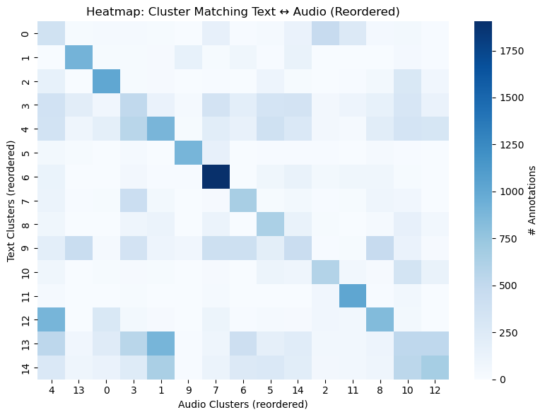
Text ↔ Audio cluster alignment (Question c)
Text & audio re-clustered with the same k = 15
Metrics ARI 0.13
NMI 0.26
Good matches:
T6 ↔ A7 (74 %)
T11 ↔ A11 (81 %)
Others scatter → semantic gap between narration & acoustics
* ARI – Adjusted Rand Index
** NMI – Normalized Mutual Information

