Slide 1








EULER: Overview
User Prompt
2. Combine filtered material with user’s prompt
4. Output answer
Answer
Semantic Search
Large Language Model
Cross Encoding
(precise)
Cosine similarity
(fast)
3. Define system’s behavior
System Prompt
(Behavior setting)
1. Filter relevant material based on user’s prompt
Course handouts, lecture notes, textbooks, (videos)

Slide 2

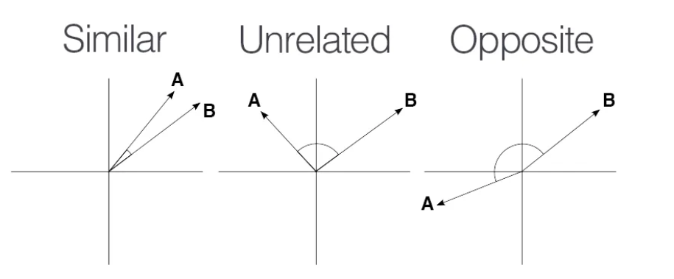


RAG: Cosine Similarity
User Prompt
Vector Embedding
Sentence Transformer
(e.g., MiniLM)
2. Transform user’s prompt and chunks into vector representations
Cosine
Similarity
1. Break long documents into chunks
Likely useful chunks
Sentence Transformer
Vector Embeddings
3. Filter useful chunks (e.g., similarity threshold)
Document chunks
Course handouts, lecture notes, textbooks, (videos)

Slide 3


RAG: Cross Encoding
User Prompt
score
Rank and filter only top-k text chunks
Pre-trained model for context classification
Classifier
Cross Encoder
(e.g., MS MARCO)
BERT
Sentence A
Sentence B
Ranked chunks
Selected with cosine similarity

Slide 4
Assembling
User Prompt
Answer
Large Language Model
(e.g., LLaMA2, Mixtral)
3. Generate answer
1. Define system’s behavior
System Prompt
2. Combine relevant text and user’s prompt
Top-k ranked chunks

Slide 5



Socratic Interactions
Prompt Engineering
Large Language Model
RLHF
Reward Model
System Prompt
B
>
C
>
A
=
D
LLM
Preference Data
Reinforcement Learning
Finetuning
DPO
B
>
C
>
A
=
D
LLM
What’s special about Mars?
A
B
>
>
=
Maximum Likelihood
B
C
A
D
Preference Data
C
D
/
Sampled answers
Ranking

Slide 6
Examples of Socratic questions
What assumptions are you making?
Are you asking the right question? Is there a better question to ask?
Can you support the claim you’re making?
What are the long-term implications of your proposal?
How might one see this issue from a different point of view?
How would this situation affect the various people involved?
What do you mean by…?

Slide 7



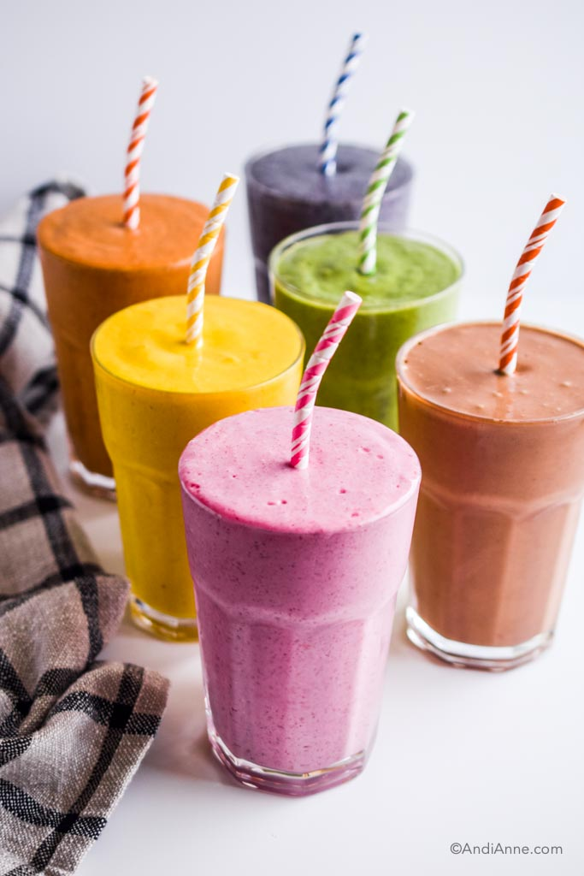
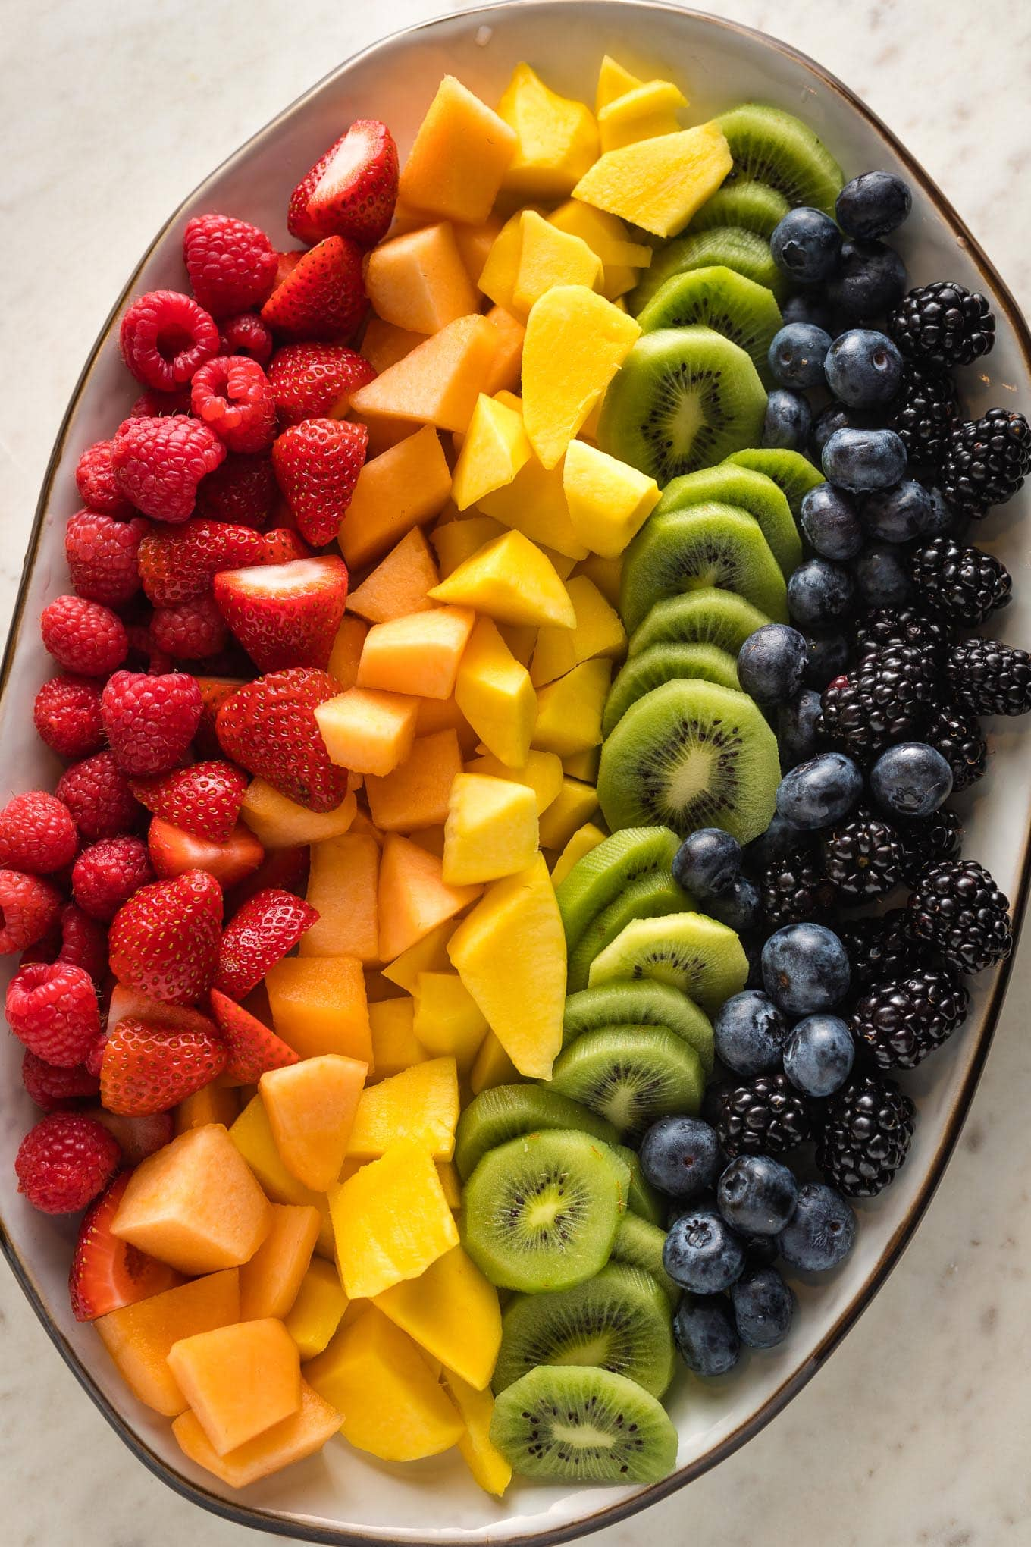
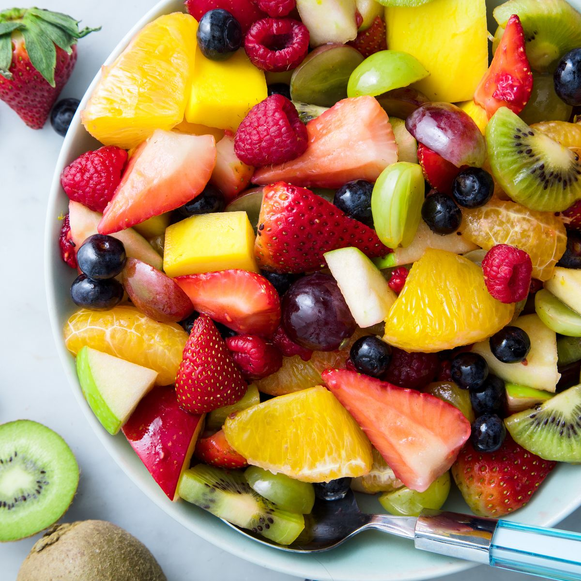
Knowledge Graph vs Search Engine vs LLM
Credits: Gherard Weikum – Keynote ISWC 2023
Representation | crisp | mixed | latent
Correctness | high | mixed | mixed
Freshness | mostly | fresh | stale
Coverage | limited | everything | huge
Cost/Query | low | low | high
Provenance | tangible | tangible | intangible
Coolness | nerdy | mundane | amazing

