Slide 1

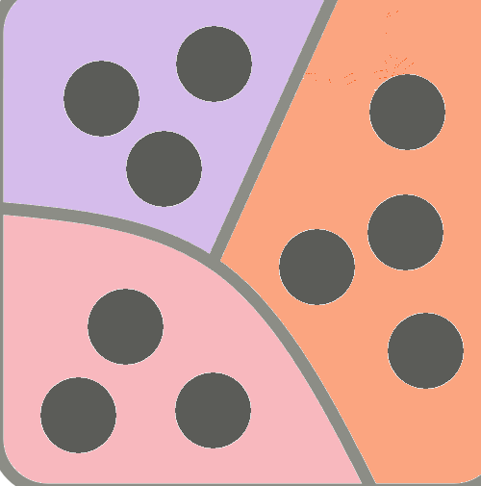

TALENT SCOUT ALGORITHM
Students’ background
Background profiles
Division into quantiles
Class matching
REACHED OBJECTIVE
Students’ repartition into classes based on skill test performance while keeping the backgroud as variable as per random split.
ALGORITHM LOGIC
1
2
2
1
1
3
1
1
3
3
3
2
2
1
2
2
3
3
3
3
MAIN ADVANTAGES
Possibility to personalize teaching while keeping the chances of complains on background repartition low.
Similar class size by design, as well as low variability in skills test performance inside each class.
Fast repartition of students into classes.

