Slide 1

Headstrong
Apache Camel
Product Engineering Group

Slide 2


Agenda
01 Getting started
02 Architecture
03 Configuration
04 Message Routing
05 Error Handling

Slide 3
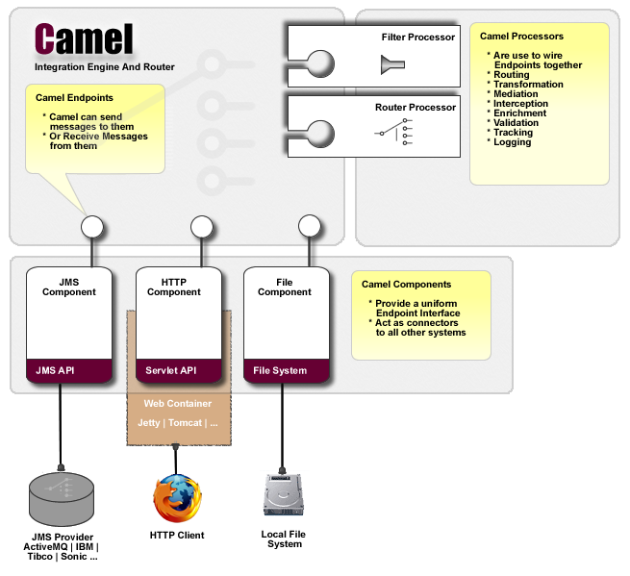
Getting Started
01

Slide 4
Getting Started
01
Apache Camel is a powerful Spring based Integration Framework.
Camel implements the Enterprise Integration Patterns allowing you to configure routing and mediation rules in either a Java based Domain Specific Language (or Fluent API) or via Spring based Xml Configuration files.
Apache Camel uses URIs so that it can easily work directly with any kind of Transport or messaging model such as HTTP, ActiveMQ, JMS, JBI, MINA or CXF together with working with pluggable Data Format options. Apache Camel is a small library which has minimal dependencies for easy embedding in any Java application.
http://www.enterpriseintegrationpatterns.com/toc.html

Slide 5
Architecture - Component
02
Component is a factory of Endpoint instances.
Component can be explicitly configured and added to the Camel Context.
Camel comes with support for multiple component some of these are.
  JMS
  File
  FTP
  TCP/IP
  FIX
  Hibernate
  Mina

Slide 6
Architecture - Endpoint
02
Camel supports message endpoint pattern using the Endpoint interface.
Endpoints are usually created by a component.
Following methods are defined in an Endpoint.
  createProducer
    Creates a producer for sending message exchanges to the endpoint.
  createConsumer
    Implements the Event Driven Consumer pattern for consuming message exchanges from the endpoint via a Processor when creating a Consumer
  createPollingConsumer
    Implements the Polling Consumer pattern for consuming message exchanges from the endpoint via a PollingConsumer

Slide 7
Architecture - Routes
02
Camel supports the definition of routing rules using a Java DSL.
RouteBuilder builder = new RouteBuilder() {
public void configure() {
errorHandler(deadLetterChannel("mock:error"));
from("seda:a").to("seda:b");
}
};

Slide 8
Apache Camel - Configuration
03
<camelContext xmlns="http://camel.apache.org/schema/spring">
<route>
<from uri="file:src/test/data?noop=true"/>
<filter>
<xpath>/person/city = 'London'</xpath>
<to uri="mock:matched"/>
</filter>
</route>
</camelContext>

Slide 9
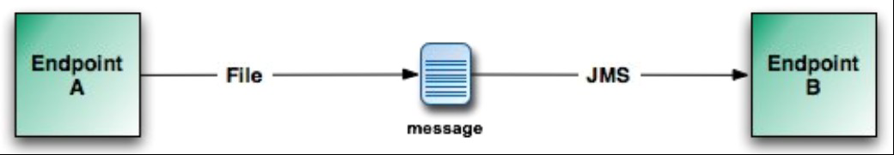
Message Routing
04

Slide 10
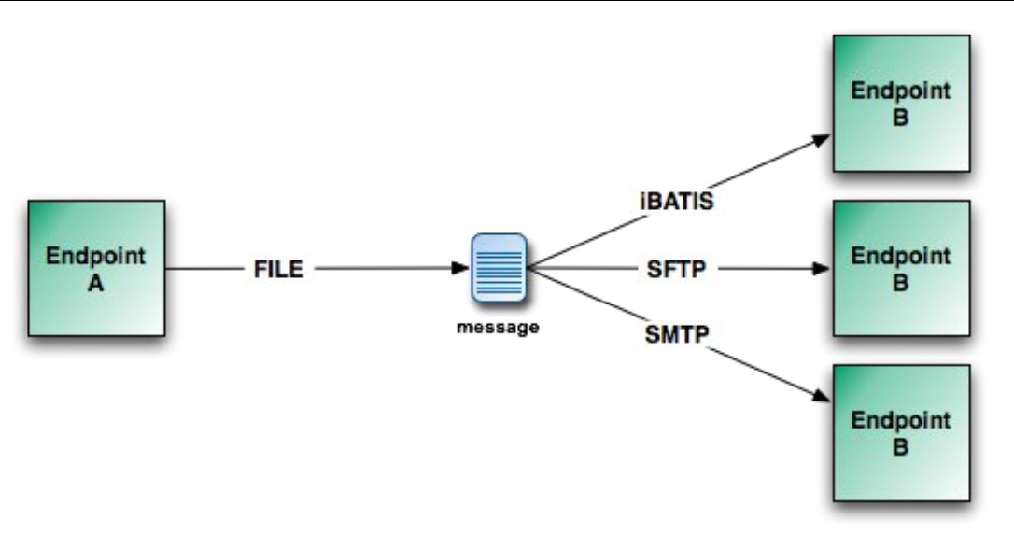
Message Routing - Multicasting
04

Slide 11
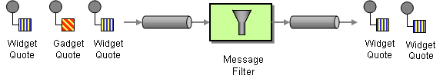
Message Routing - Filter
04

Slide 12
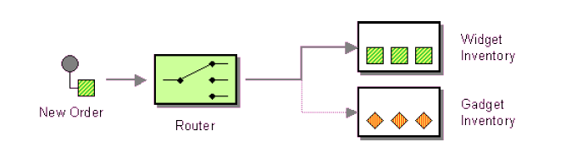
Message Routing – Content Based Router
04

Slide 13
Apache Camel – Error handling
05
Camel supports pluggable error handling strategies to deal with errors processing and Event Driven Consumer.
Error handling can be specified directly in DSL using Exception clause.
Error handler is scoped as either
  Global
  Per Route

Slide 14
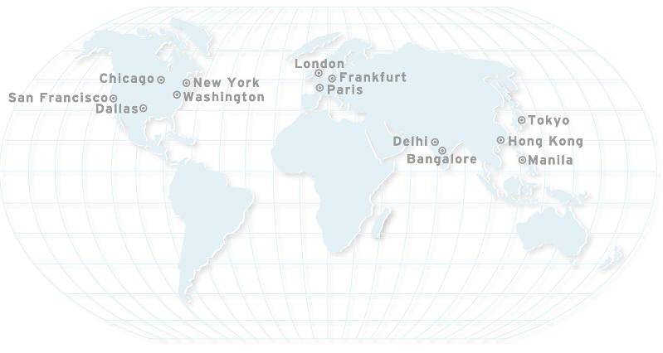
Thank You

