Slide 1
D-Language
By: Gio Raso, Tyler Souders

Slide 2
Background
Objectives and goals
simple
Inspiration/ influences
Drag and drop coding (scratch)

Slide 3
Tokens
Assignment Operations
ASSIGN (=)
Arithmetic Operations
PLUS (add)
MINUS (sub)
MULTIPLY (mult)
DIVIDE (div)
MODULUS (mod)
Comparison Operations
EQUAL (==)
NOT_EQUAL (!=)
GREATER_THAN (>)
LESS_THAN (<)
GREATER_THAN_OR_EQUAL (>=)
LESS_THAN_OR_EQUAL (<=)
Logical Operations
AND (and)
OR (or)
NOT (not)
IDENTIFIER (e.g., myVariable, functionName)
FUNCTION (function)
IF (if)
ELSE (else)
FOR (for)
WHILE (while)
RETURN (return)
VAR (var)
CONST (const)
TRUE (true)
FALSE (false)
LEFT_PARENTHESIS (() and RIGHT_PARENTHESIS ())
LEFT_CURLY_BRACE ({) and RIGHT_CURLY_BRACE (})
LEFT_SQUARE_BRACKET ([) and RIGHT_SQUARE_BRACKET (])
COMMA (,)
SEMICOLON (;)
COLON (:)
DOT (.)
RIGHT_ARROW (->) and LEFT_ARROW(<-)

Slide 4
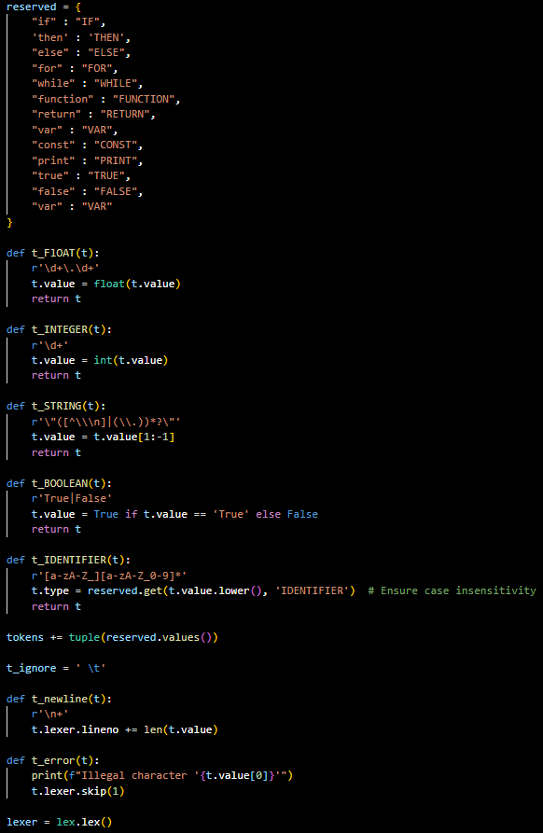
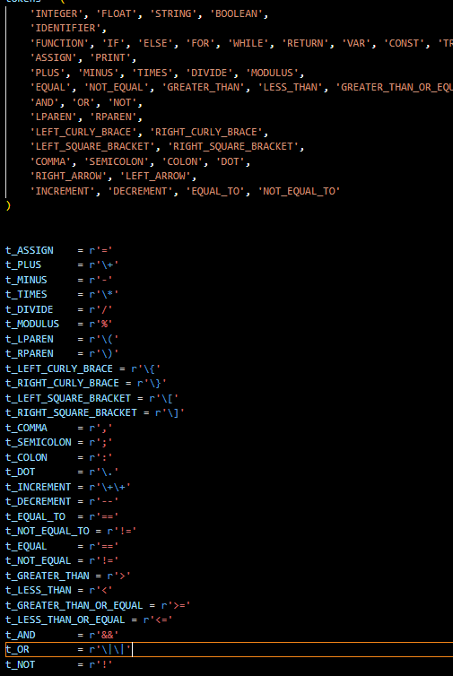
Lexer

Slide 5
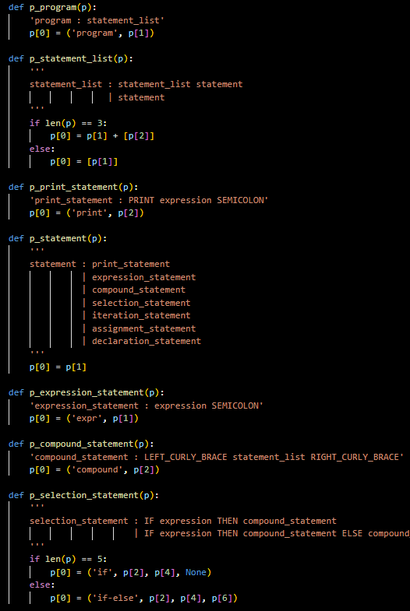
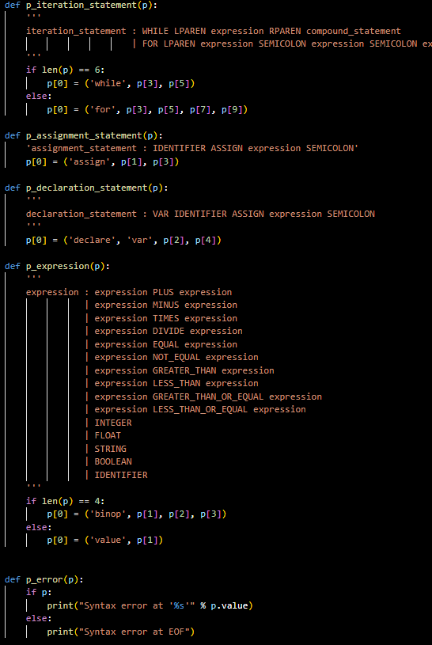
Parser

Slide 6
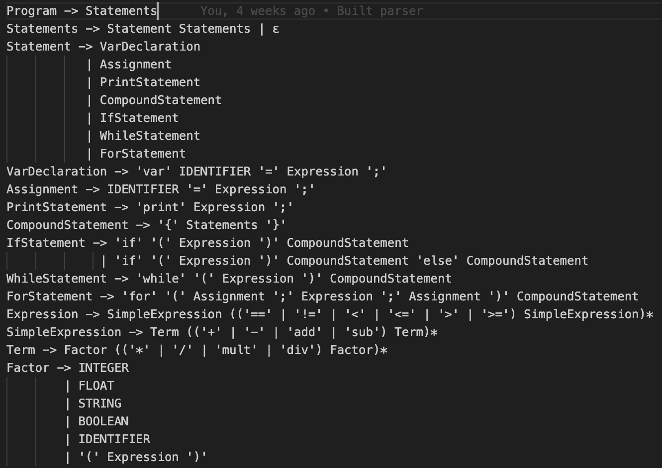
Grammar

Slide 7
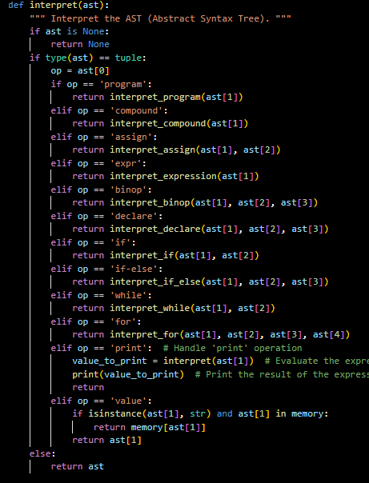
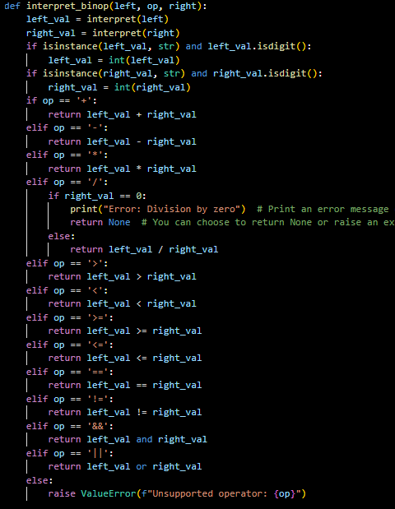
Interpreter

Slide 8
Demo

Slide 9
Strengths and advantages
Easy to learn
Clean looking code
Is everything you would want a programming language to be
Better than OCaml

Slide 10
Use Cases and Target audience
Anyone who wants to have good looking code
Goal was to be widely used by programmers
Simple language for beginners with no knowledge

Slide 11

Future Roadmap
If we were to work on it more, what would our plans be?
Make it even more simple
Make the input more like typing a sentence

Slide 12
Challenges

Slide 13
Conclusion

Slide 14
Questions?

