Slide 1
Design Document (DD)
Delivery
Scotti Giovanni, Trabucchi Marco
Lab 14/12/2016

Slide 2
Structure of the document
IEEE standard 1016:2009
5 sections:
Introduction;
Architectural Design: gradual analysis of the system components with a top-down approach, description of architectural choices;
Algorithm Design: description of the most crucial algorithms for the application;

Slide 3
User Interface Design: description and mock-ups of the desired appearance of the final product;
Requirements Traceability: one-to-one map of requirements described in the RASD and the design choices in the DD.

Slide 4
Let's see the design process by analyzing the decision tree for the PowerEnJoy application project...

Slide 5
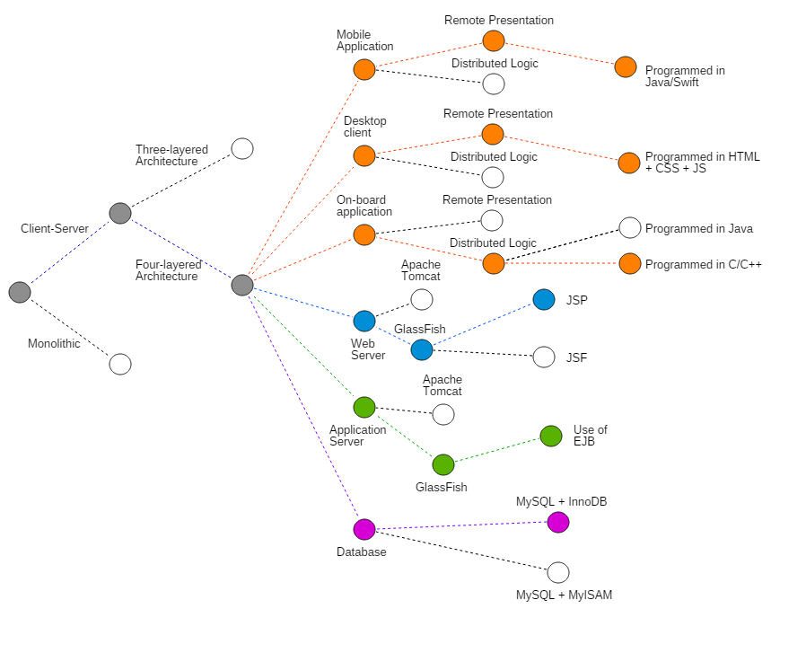

Slide 7
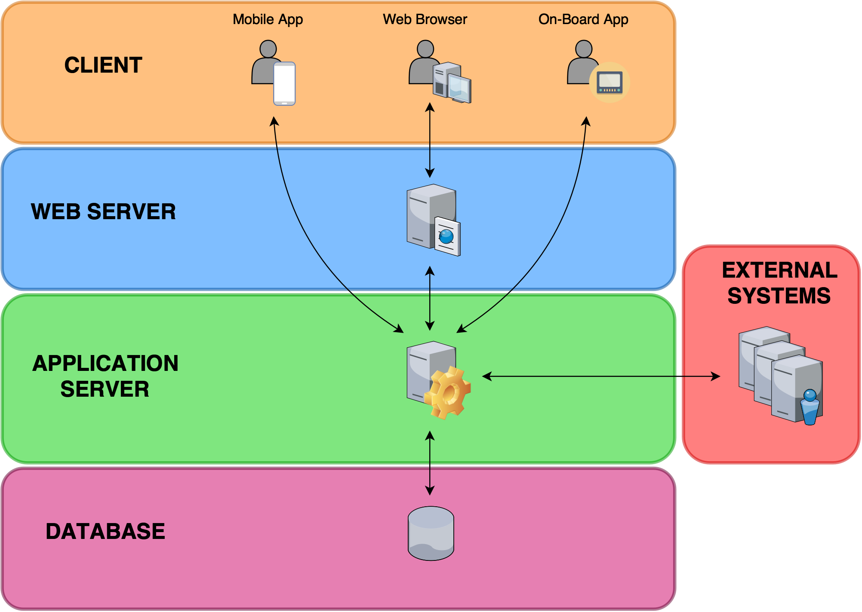

Slide 8
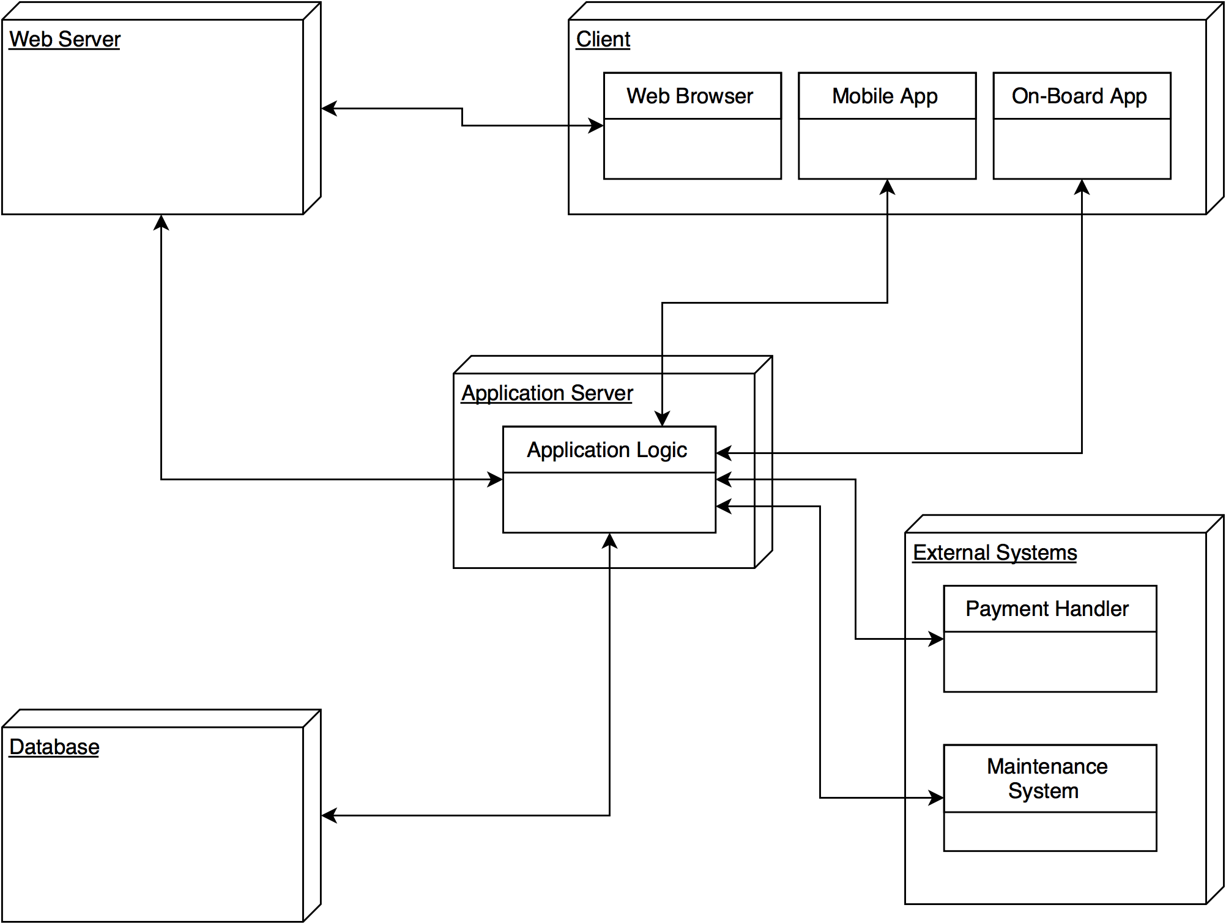

Slide 9
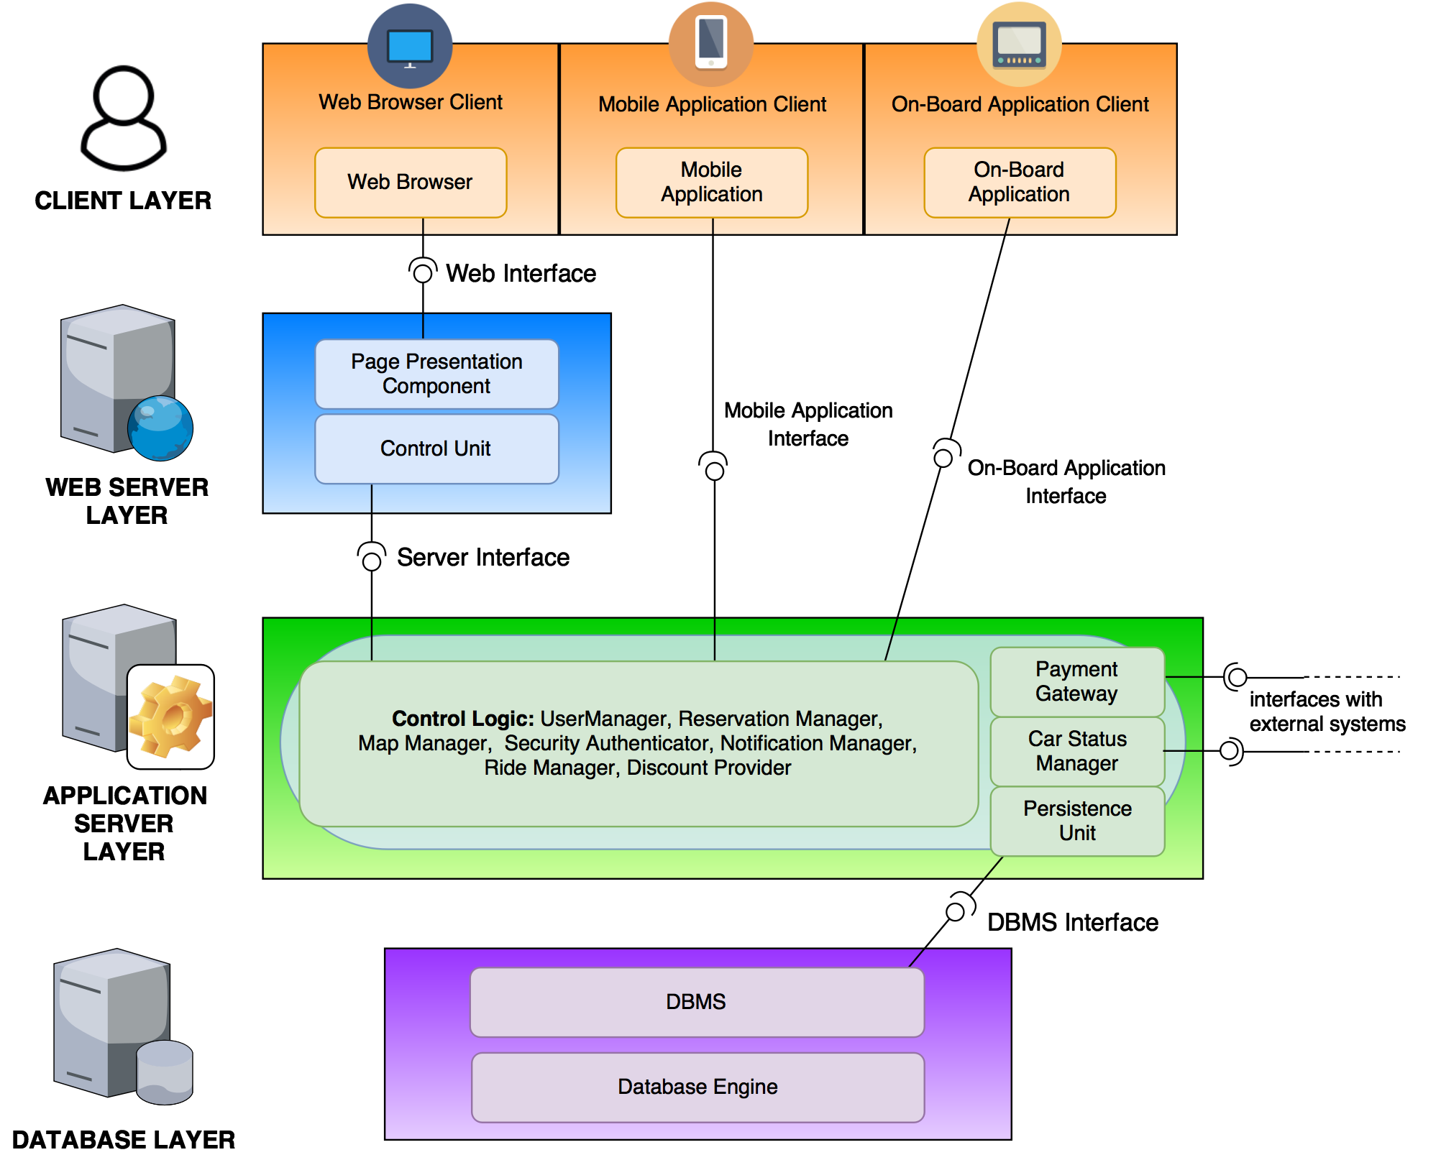

Slide 11
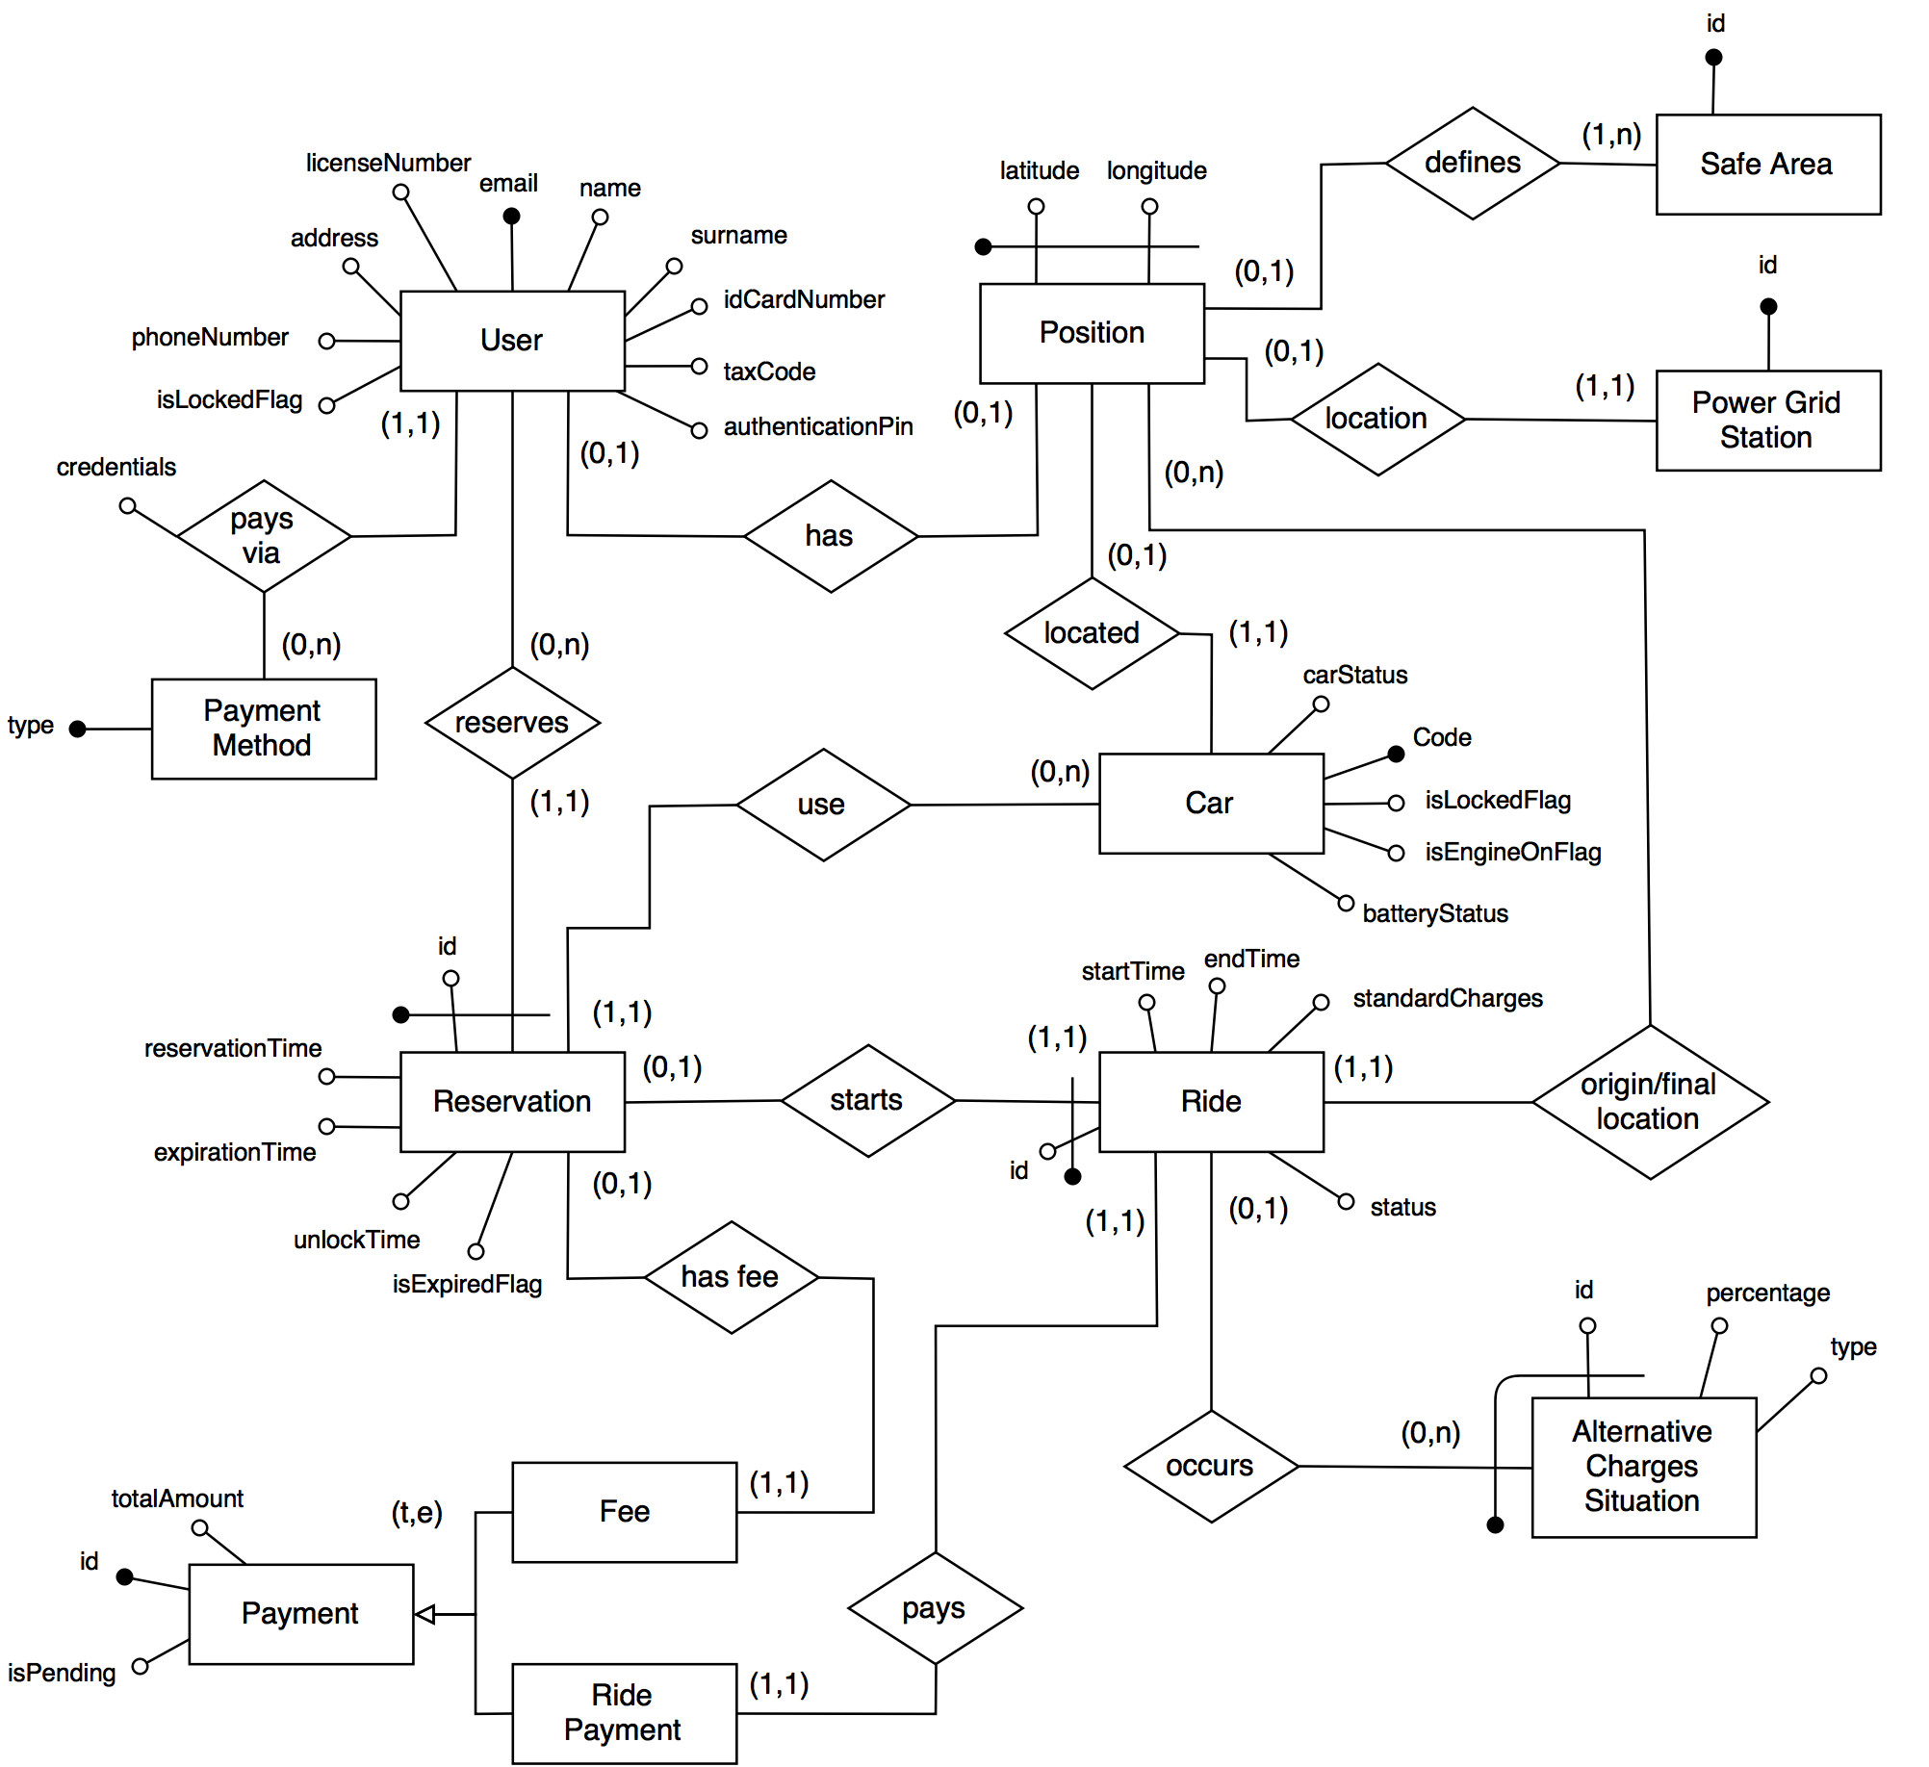

Slide 13
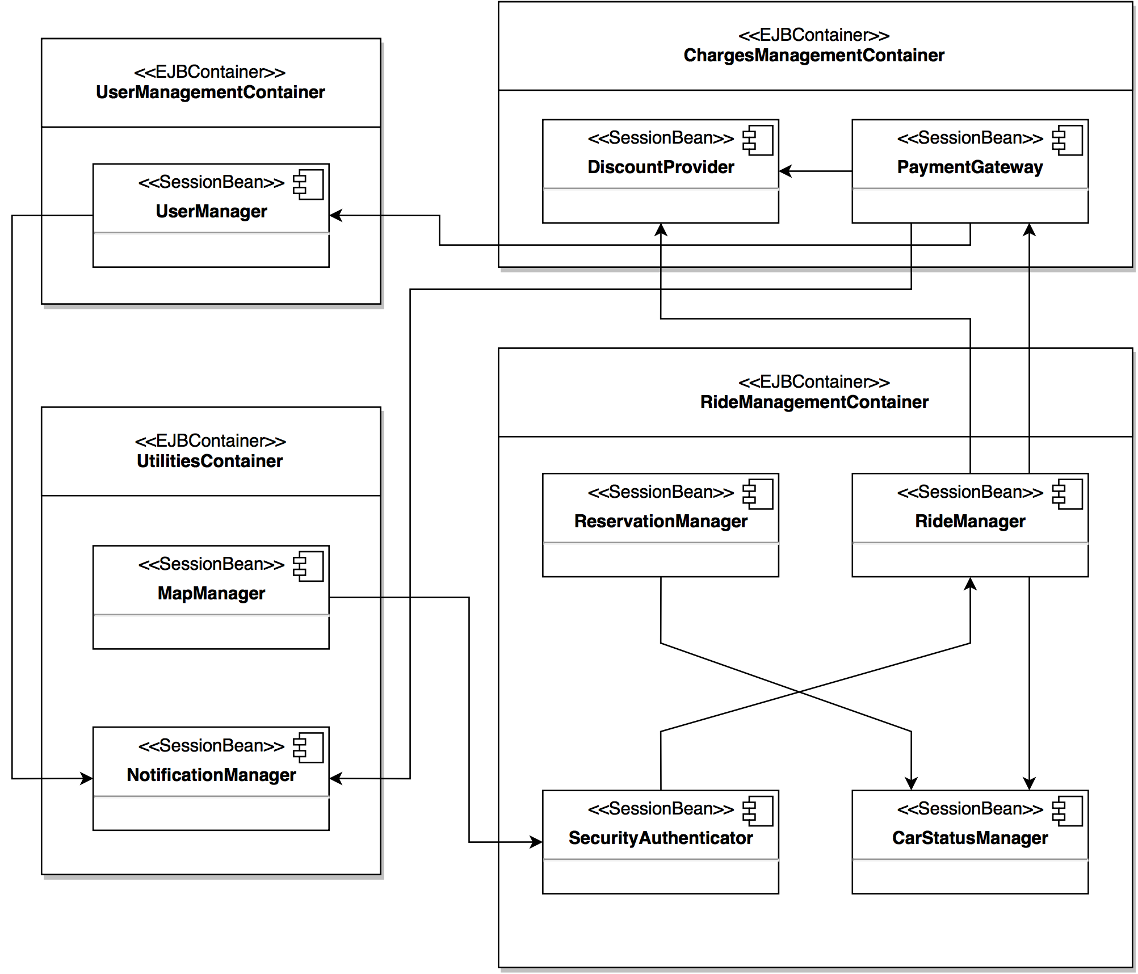

Slide 15
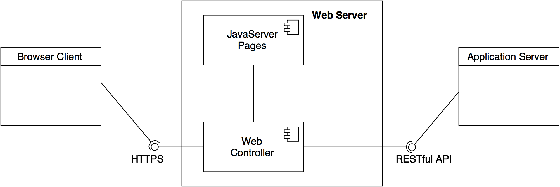

Slide 17
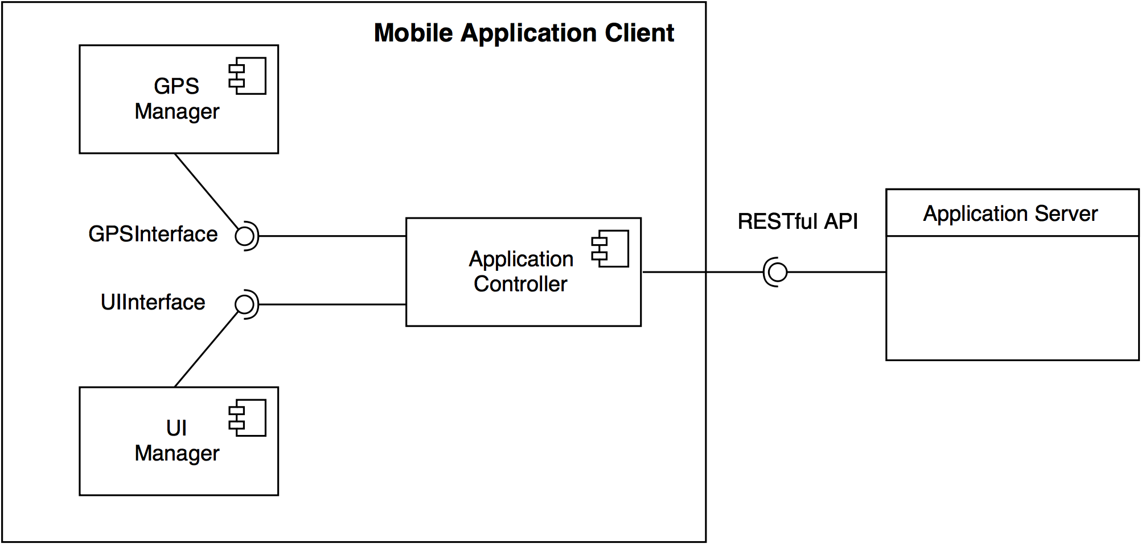

Slide 19
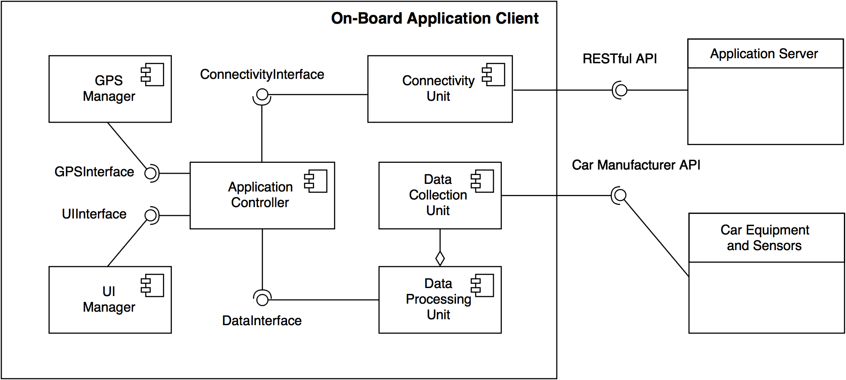

Slide 21
Now that we have seen the specific design decisions, let's have a look at the deployment choices for all the components...

Slide 22
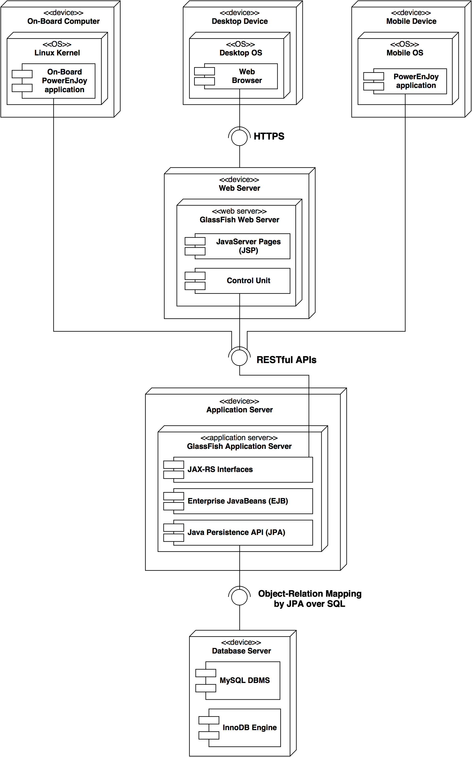

Slide 24
Let's see the document for some insight on the runtime view for the most relevant aspects of the application...
...and an overall view of how the User Interface for the application should look like.

Slide 25
QUESTIONS?

