Slide 1

Inventory Management Solutions
App
CEN4010
Giovanni
Omar
Tyler
Shawn
Diego
Mikenson
This Photo by Unknown author is licensed under CC BY-NC.

Slide 2
Introduction
When living in a retirement home and being elderly, it becomes more difficult to find the support to keep track of valuable belongings such as furniture, jewelry, and electronics.
Inventory Management Solutions have dedicated solutions to benefiting the senior community at West Boca Make-Believer Retirement Community by providing access to a management application to maintain their inventory of tangible and household property.

Slide 3
Background
The IMS was developed using an Agile process. We chose this method because we developed our application in a series of versions and deployments. With the needs for West Boca Make-Believer Retirement Community being extremely dynamic it was important that we met all the requirements while still being able to "scale" and add more features.

Slide 4
Use Cases
The inventory System shall allow residents to manage their property and keep track of their tangible items at the same time.
The user shall be able to search for inventory by item description, title, and metadata to visualize the inventory based off a query search.
The staff member using the system shall be able to manage each user's inventory account to have the ability to manage residential accounts. This way, if a resident forgets user credentials or needs to troubleshoot application, the staff has full access to backend with admin privileges.

Slide 5
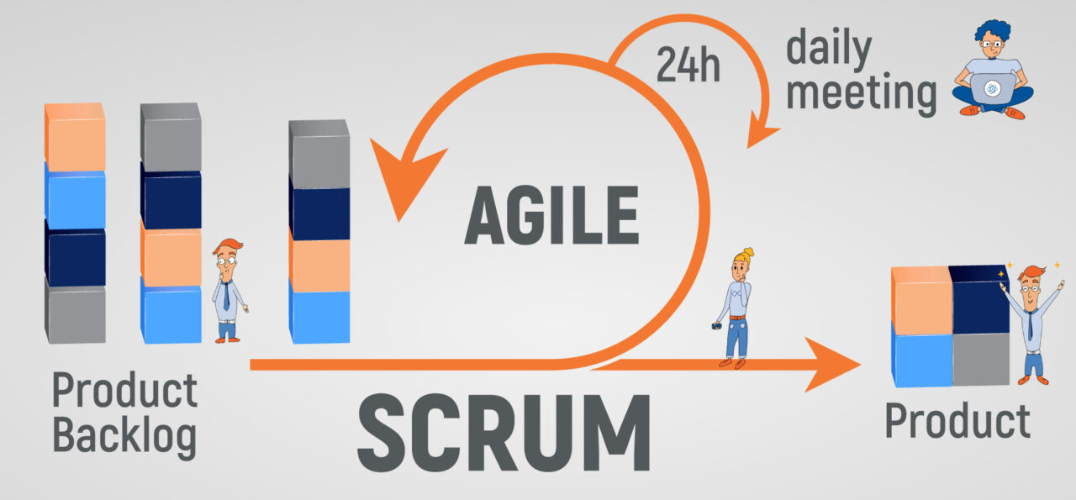
Development Process
Distributed the project requirements for each team member.
Each new feature or requirement was added based on priority and outputting deliverables.
The apps functionality was created using REST APIs.

Slide 6
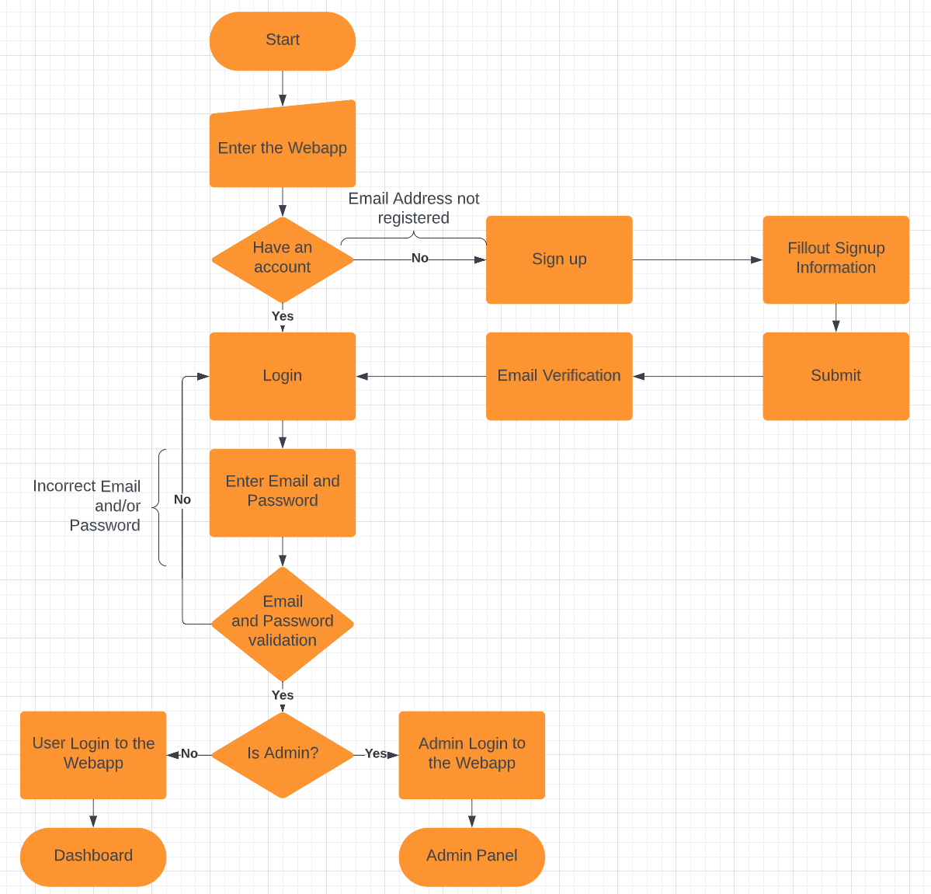
Set Up Account
Login with Credentials

Slide 7
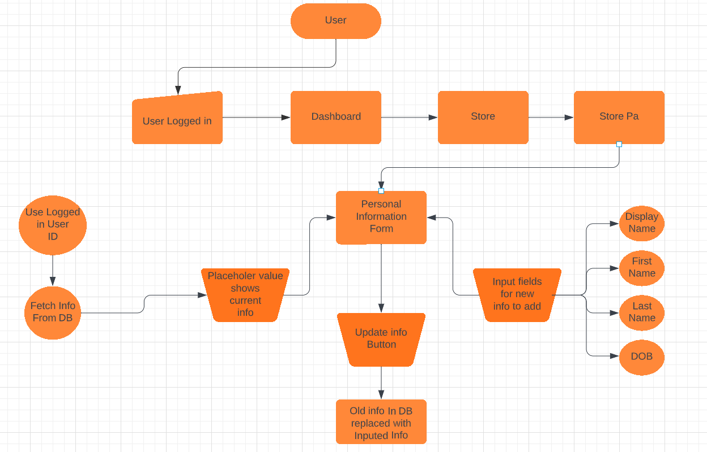
Update Personal Information

Slide 8
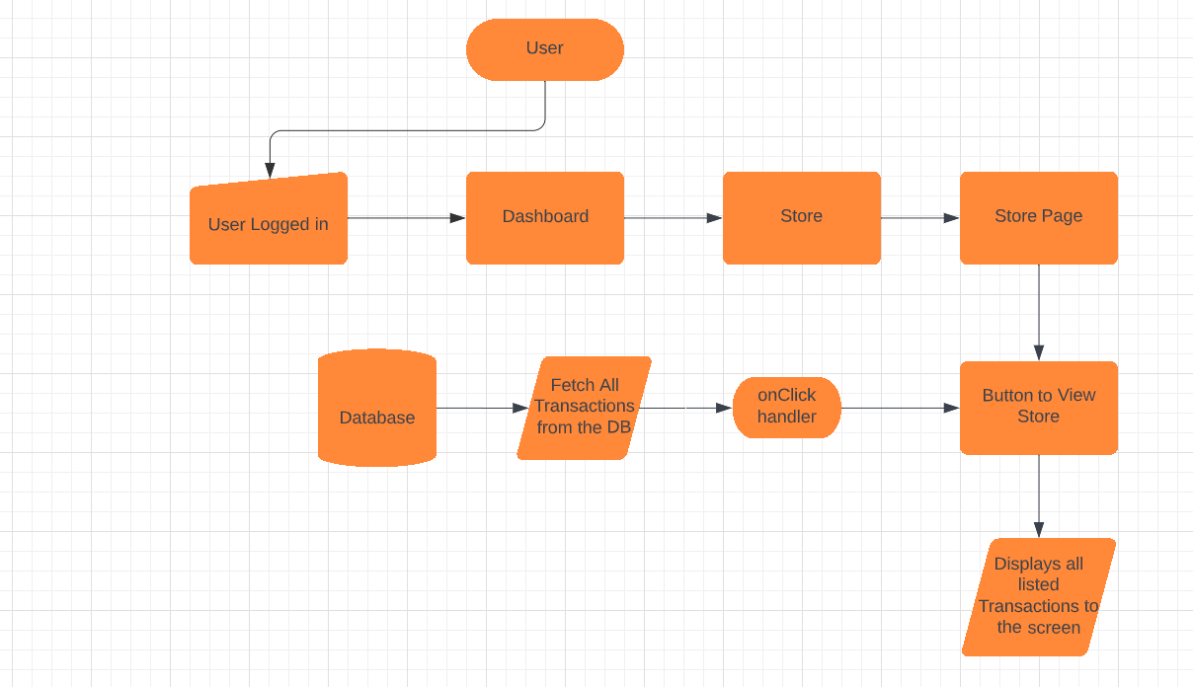
Store

Slide 9
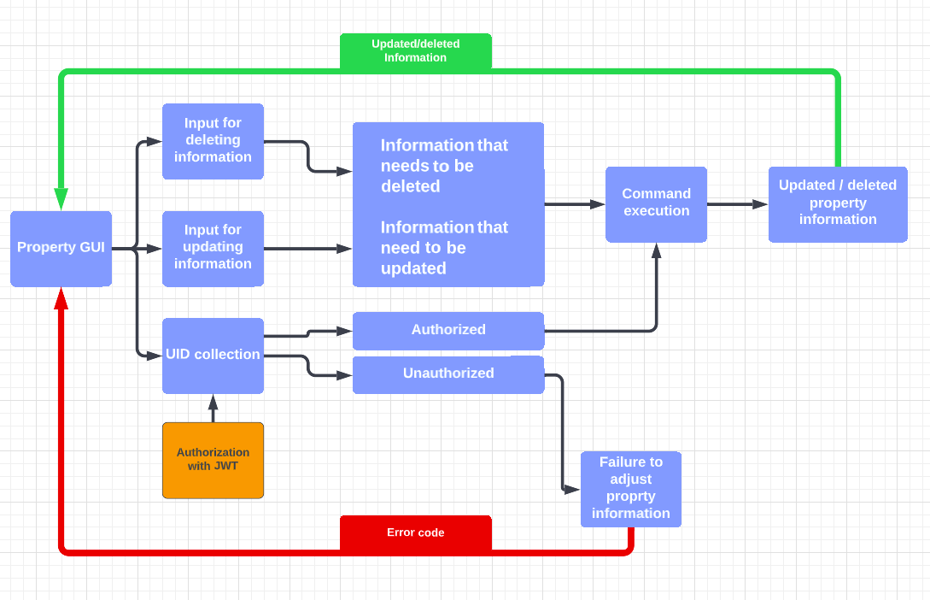
Update Property Information
Delete Property Information

Slide 10
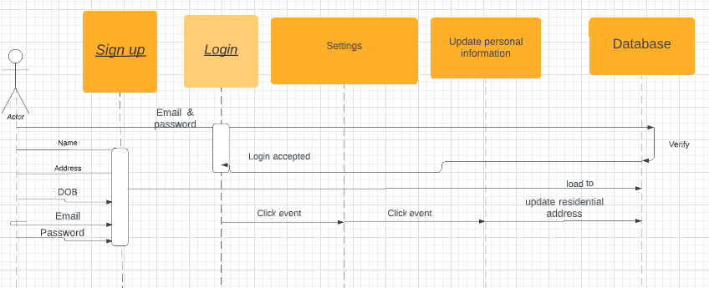
Confirm Personal Resident Information

Slide 11
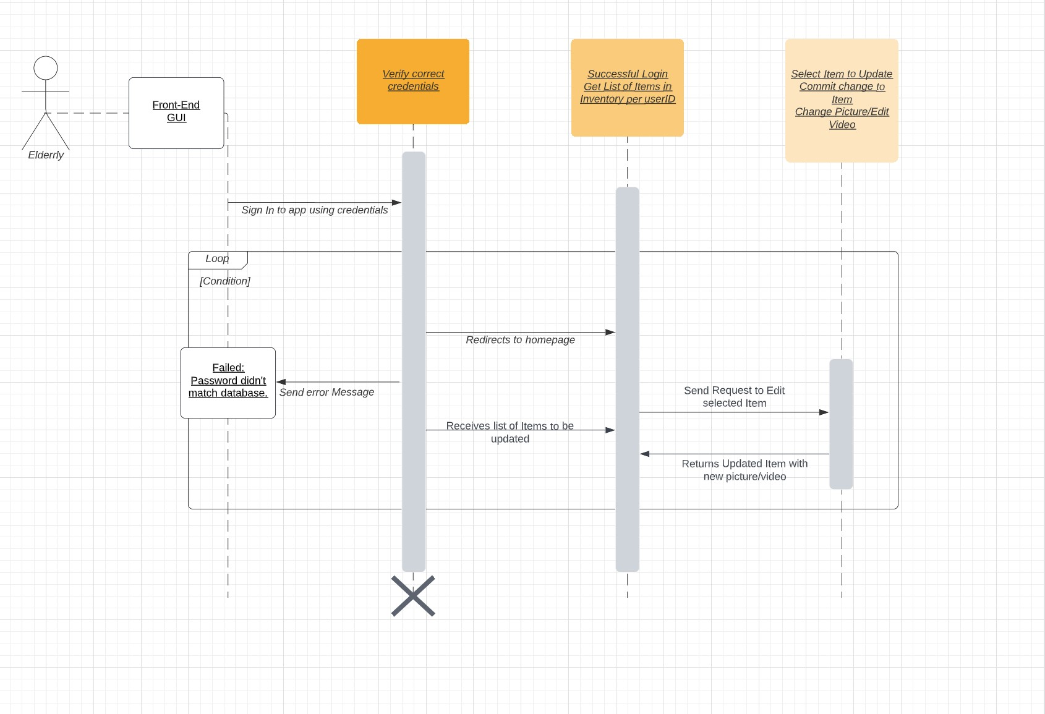
Upload Pictures and Videos into DB

Slide 12
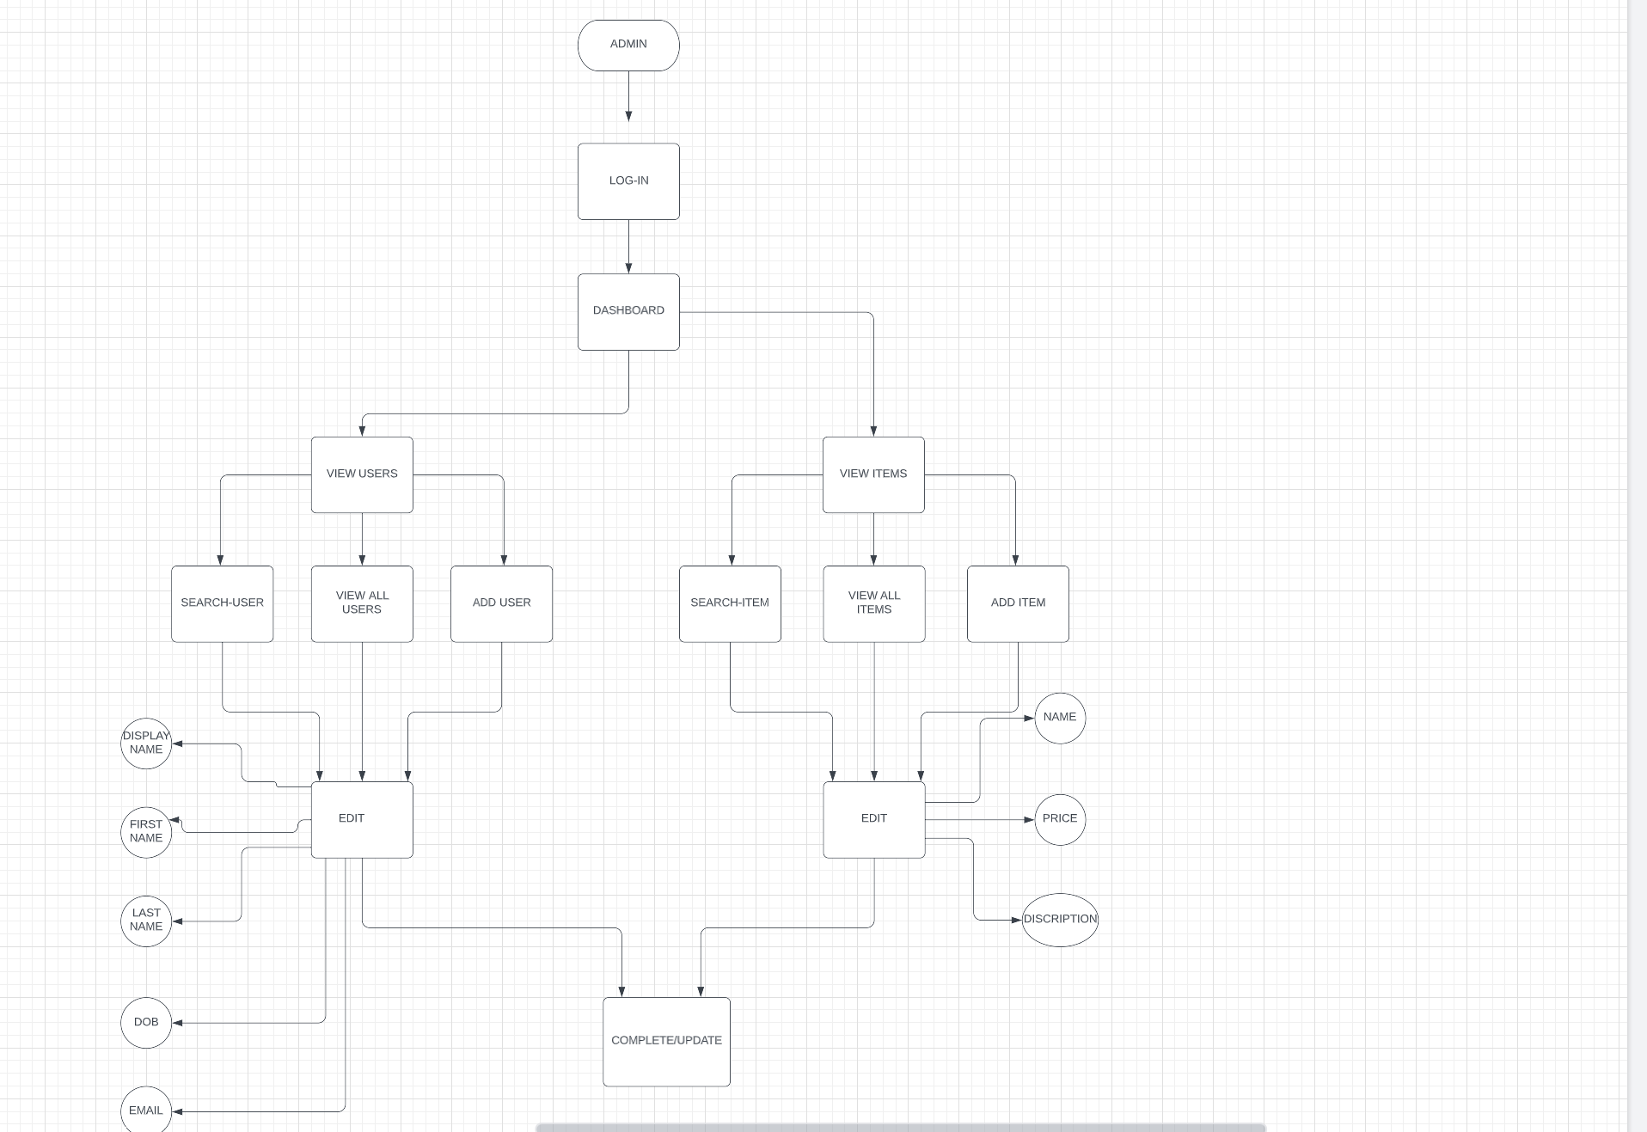
Admin Panel

