Slide 1
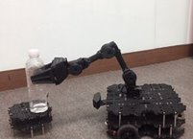
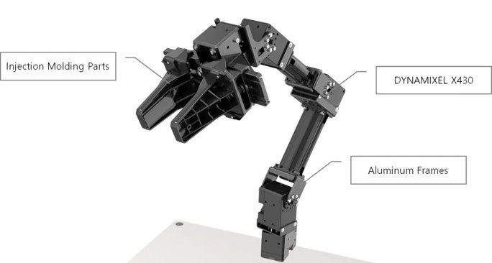
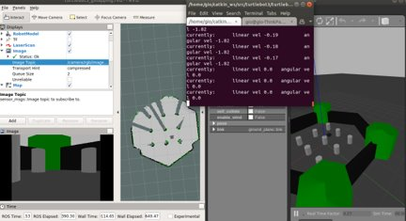
General Purpose Mobile Manipulator
ENG 4952C Engineering Design 2
Dept. of Electrical Engineering and Computer Science
PROBLEM SUMMARY
A lack of a US work force due to extended unemployment amid the Covid-19 pandemic. Small businesses suffer and more properties are becoming abandoned because of it. Since there is a shortage of an industrial labor force, a huge demand is needed for a cheaper, more affordable and more abundant workforce.
In an innovative world, we have been able to develop many things that people can do. Though people have not yet developed robots that can perform simple everyday tasks.
Since people are no longer working in manufacturing industries, this has caused those industries to suffer, and industries are looking for assistance .
TOOLS AND TECHNOLOGIES
Ubuntu, ROS (Robot Operating System), Python, Visual Studio Code, Gazebo, Rqt, SLAM (Simultaneous Localization and Mapping) , Raspberry Pi, OpenCR Microcontroller, MoveIt Group, Lidar, Text Editor, GitHub, TurtleBot3, Manipulator (Robot Arm)
SOLUTION
Create a mobile autonomous robot to do simple everyday industrial tasks. This will help employers upgrade their warehouse labor forces while reducing the cost of those forces, due to the lack of motivated and employable people in the US.
KEY FEATURES
<bullet list of features/capabilities of the solution>
Map a 2D environment using SLAM.
Pick up and grab objects using the manipulator.
Place object in different location
Avoid obstacles; prevent collisions of random objects that is in the way.
Autonomous navigation.
Easy to use and command
TEAM
Matthew Vohland (BSCS)
Khalid Nezami (BSEE)
Gabriel Gilman (BSEE)
Giovanni Michel (BSCE)
Kayla Miller (BSCE)
PROBLEM SPONSOR
Dr. Xiangnan Zhong
xzhong@fau.edu
FAU Department of Electrical Engineering and Computer Science
FACULTY CONTACT
Hari Kalva
hari.kalva@fau.edu

