Slide 1
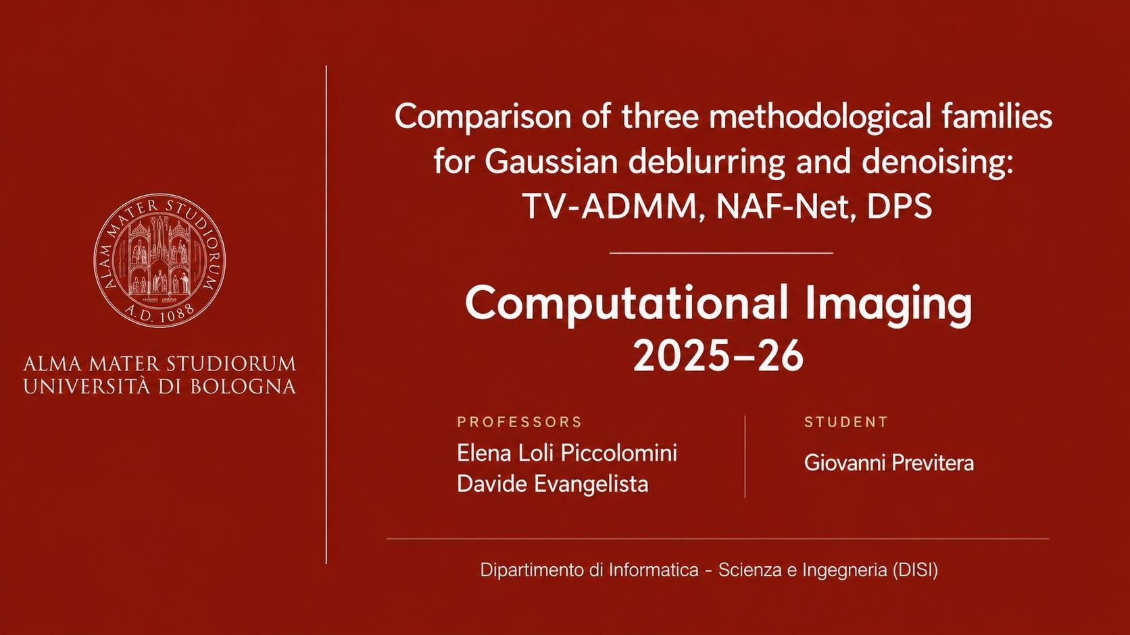

Slide 2

Description of the project
Title: Joint Image Deblurring and Denoising via TV-ADMM, NAF-Net, and DPS
Task: Deblur and Denoise on FFHQ 256×256
Forward model: y = A(x) + n where A = Gaussian blur (σ=2, kernel 9×9), n ~ N(0, σ²I)
Noise levels n: 0.005 · 0.01 · 0.05 · 0.1
Methods required: (1) Variational — TV regularization (2) End-to-end — NAF-Net (3) Generative — DPS
Metrics: PSNR and SSIM on test set
TV-ADMM
Variational
NAF-Net
End-to-End
DPS
Generative

Slide 3
Methodology — Problem Formulation
y = A(x) + n n ~ N(0, σ²I)
x ∈ [0,1]³ — clean RGB image (unknown)
A — Gaussian blur operator (σ_blur = 2, kernel 9×9)
n — additive Gaussian noise n ∈ {0.005, 0.01, 0.05, 0.1}
Goal: recover x* from y — ill-posed inverse problem
TV-ADMM
NAF-Net
DPS
min_x ½‖Ax−y‖² + λ·TV(x)
f_θ: y → x* (supervised)
p(x|y) ∝ p(y|x)·p(x)
Convex optimization
ADMM solver
Deep learning
Noise conditioned
Generative prior
Reverse diffusion

Slide 4
Methodology — TV-ADMM (Variational)
x* = argmin_x ½ ‖Ax − y‖² + λ · TV(x)
ADMM — 3 alternating steps per iteration:
1
x-update:
Solve (AᵀA + ρ DᵀD) x = rhs → gradient descent steps
2
z-update:
Soft-thresholding → proximal operator of (λ/ρ)‖·‖₂,₁
3
u-update:
Dual ascent → u ← u + DᵀD − z
Hyperparameter λ — tuned on validation set (grid search, max PSNR):
n | λ* | PSNR | SSIM
0.005 | 0.001 | 29.78 dB | 0.873
0.01 | 0.005 | 29.42 dB | 0.856
0.05 | 0.020 | 28.07 dB | 0.796
0.1 | 0.050 | 26.56 dB | 0.739

Slide 5
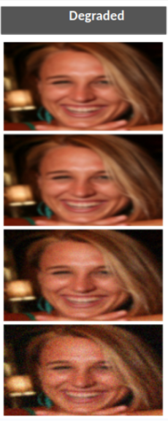
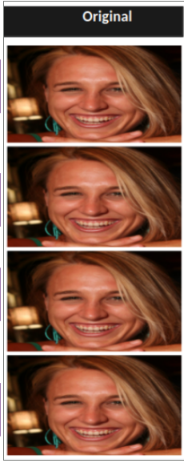
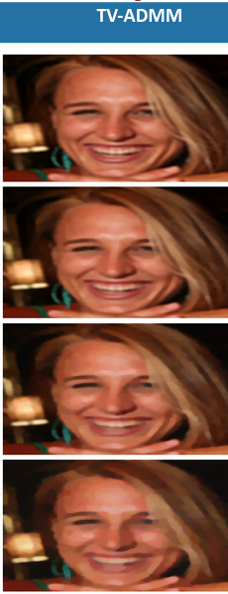
Visual Comparison (TV-ADMM)
Noise Level
n=0.005
n=0.005
n=0.01
n=0.1

Slide 6
Methodology — NAF-Net (End-to-End)
Architecture: U-Net + Simple Gate (replaces all GELU/ReLU)
Input
[RGB|σ] 4ch
Encoder
×3 stages
Bottleneck
NAF Block
Decoder
×3 stages
Output
RGB 3ch
← Skip connections →
NAF Block — Simple Gate
Training Setup
1. LayerNorm + depthwise conv
2. SimpleGate: SG(x) = x₁ · x₂ (no GELU)
3. Channel attention (sigmoid)
4. Feed-forward + learnable β, γ
Optimizer: Adam, lr=1e-3
Schedule: Cosine Annealing
Loss: L1 + 0.1×(1−SSIM)
Epochs / Batch: 30 / 4
Augmentation: H/V flip p=0.5
Noise conditioning: 4-channel input [RGB|σ]
★ Why NAF-Net? Designed for joint deblur+denoise. Outperforms UNet on GoPro & SIDD. ViT needs 10× more data.

Slide 7
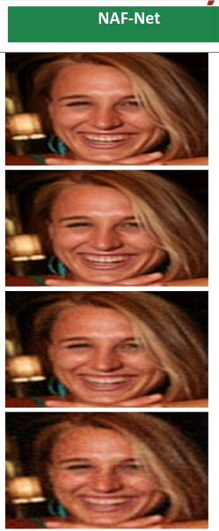
Visual Comparison (NAF-Net)
Noise Level
n=0.005
n=0.01
n=0.05
n=0.1

Slide 8
Methodology — DPS (Generative)
p(x | y) ∝ p(y | x) · p(x) = N(y ; A(x), σ²I) · p_diffusion(x)
DPS Reverse Diffusion Loop (Chung et al., ICLR 2023):
Predict x̂₀
x̂₀(xₜ,t) = (xₜ − √(1−αₜ)·εΘ(xₜ,t)) / √αₜ
Gradient
gₜ = ∇_{xₜ} (1/2σ²) ‖K·x̂₀(xₜ,t) − y‖²
Update
xₜ ≈ R_Θ(xₜ, t, s) − η·gₜ/‖gₜ‖ (guided DDIM step)
Parameter | Value | Notes
Pre-trained model | google/ddpm-celebahq-256 | HuggingFace — face domain
N steps (DDIM) | 200 | Quality/speed trade-off
ζ (guidance) | 1.0 | Uniform across all n
Post-processing | Gaussian blend α=0.10–0.15 | Only n ≥ 0.05 — reduce artefacts
Compute | Google Colab T4 GPU | ~60 sec/image

Slide 9
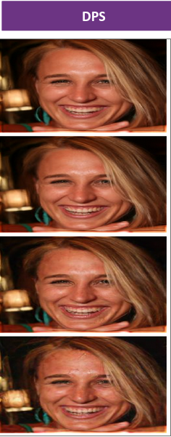
Visual Comparison (DPS)
Noise Level
n=0.005
n=0.005
DPS
n=0.01
n=0.1

Slide 10
Introduce the Experiments
Dataset — FFHQ 256×256
Degradation Pipeline
• 70,000 high-quality face images (Karras et al. 2019)
• 2,000 selected with seed=42
• Split: 70% train / 15% val / 15% test
• Normalization: [0,1] float32
• 100 test images per σ (TV/NAF) · 5 images (DPS)
• y = A(x) + n (identical for all methods)
• A = Gaussian blur: σ=2, kernel 9×9
• n ~ N(0, σ²I) with fixed random seed
• Pre-generated and saved to disk
• n ∈ {0.005, 0.01, 0.05, 0.1}
Gaussian PSF (σ=2, 9×9)
Noise levels n:
0.005
0.01
0.05
0.1
Very low
Low
Medium
High
⚠ All methods use identical pre-saved degraded images — guaranteeing a perfectly fair comparison.
← peak at center →

Slide 11
Presentation of Numerical Results — PSNR & SSIM
PSNR (dB) ↑ — higher is better
Method | n=0.005 | n=0.01 | n=0.05 | n=0.1
TV-ADMM | 29.78 | 29.42 | 28.07 | 26.56
NAF-Net | 29.46 | 29.37 | 28.07 | 26.64
DPS | 25.56 | 24.63 | 24.63 | 24.80
SSIM ↑ — higher is better
Method | n=0.005 | n=0.01 | n=0.05 | n=0.1
TV-ADMM | 0.873 | 0.856 | 0.796 | 0.739
NAF-Net | 0.867 | 0.863 | 0.797 | 0.720
DPS | 0.790 | 0.810 | 0.737 | 0.690
Key insight — PSNR–Perception Trade-off (Blau & Michaeli 2018):
TV-ADMM and NAF-Net maximize pixel accuracy (PSNR) → slight blur. DPS maximizes perceptual realism → sharper detail but lower PSNR. Both behaviors are correct — they optimize different objectives.

Slide 12
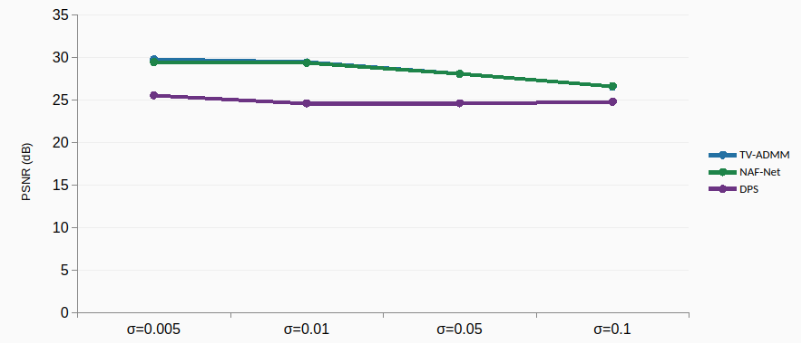
Presentation of Numerical Results — PSNR vs n
TV-ADMM and NAF-Net nearly overlap across all σ. DPS is ~4 dB lower by design — it optimizes perceptual quality, not MSE.

Slide 13
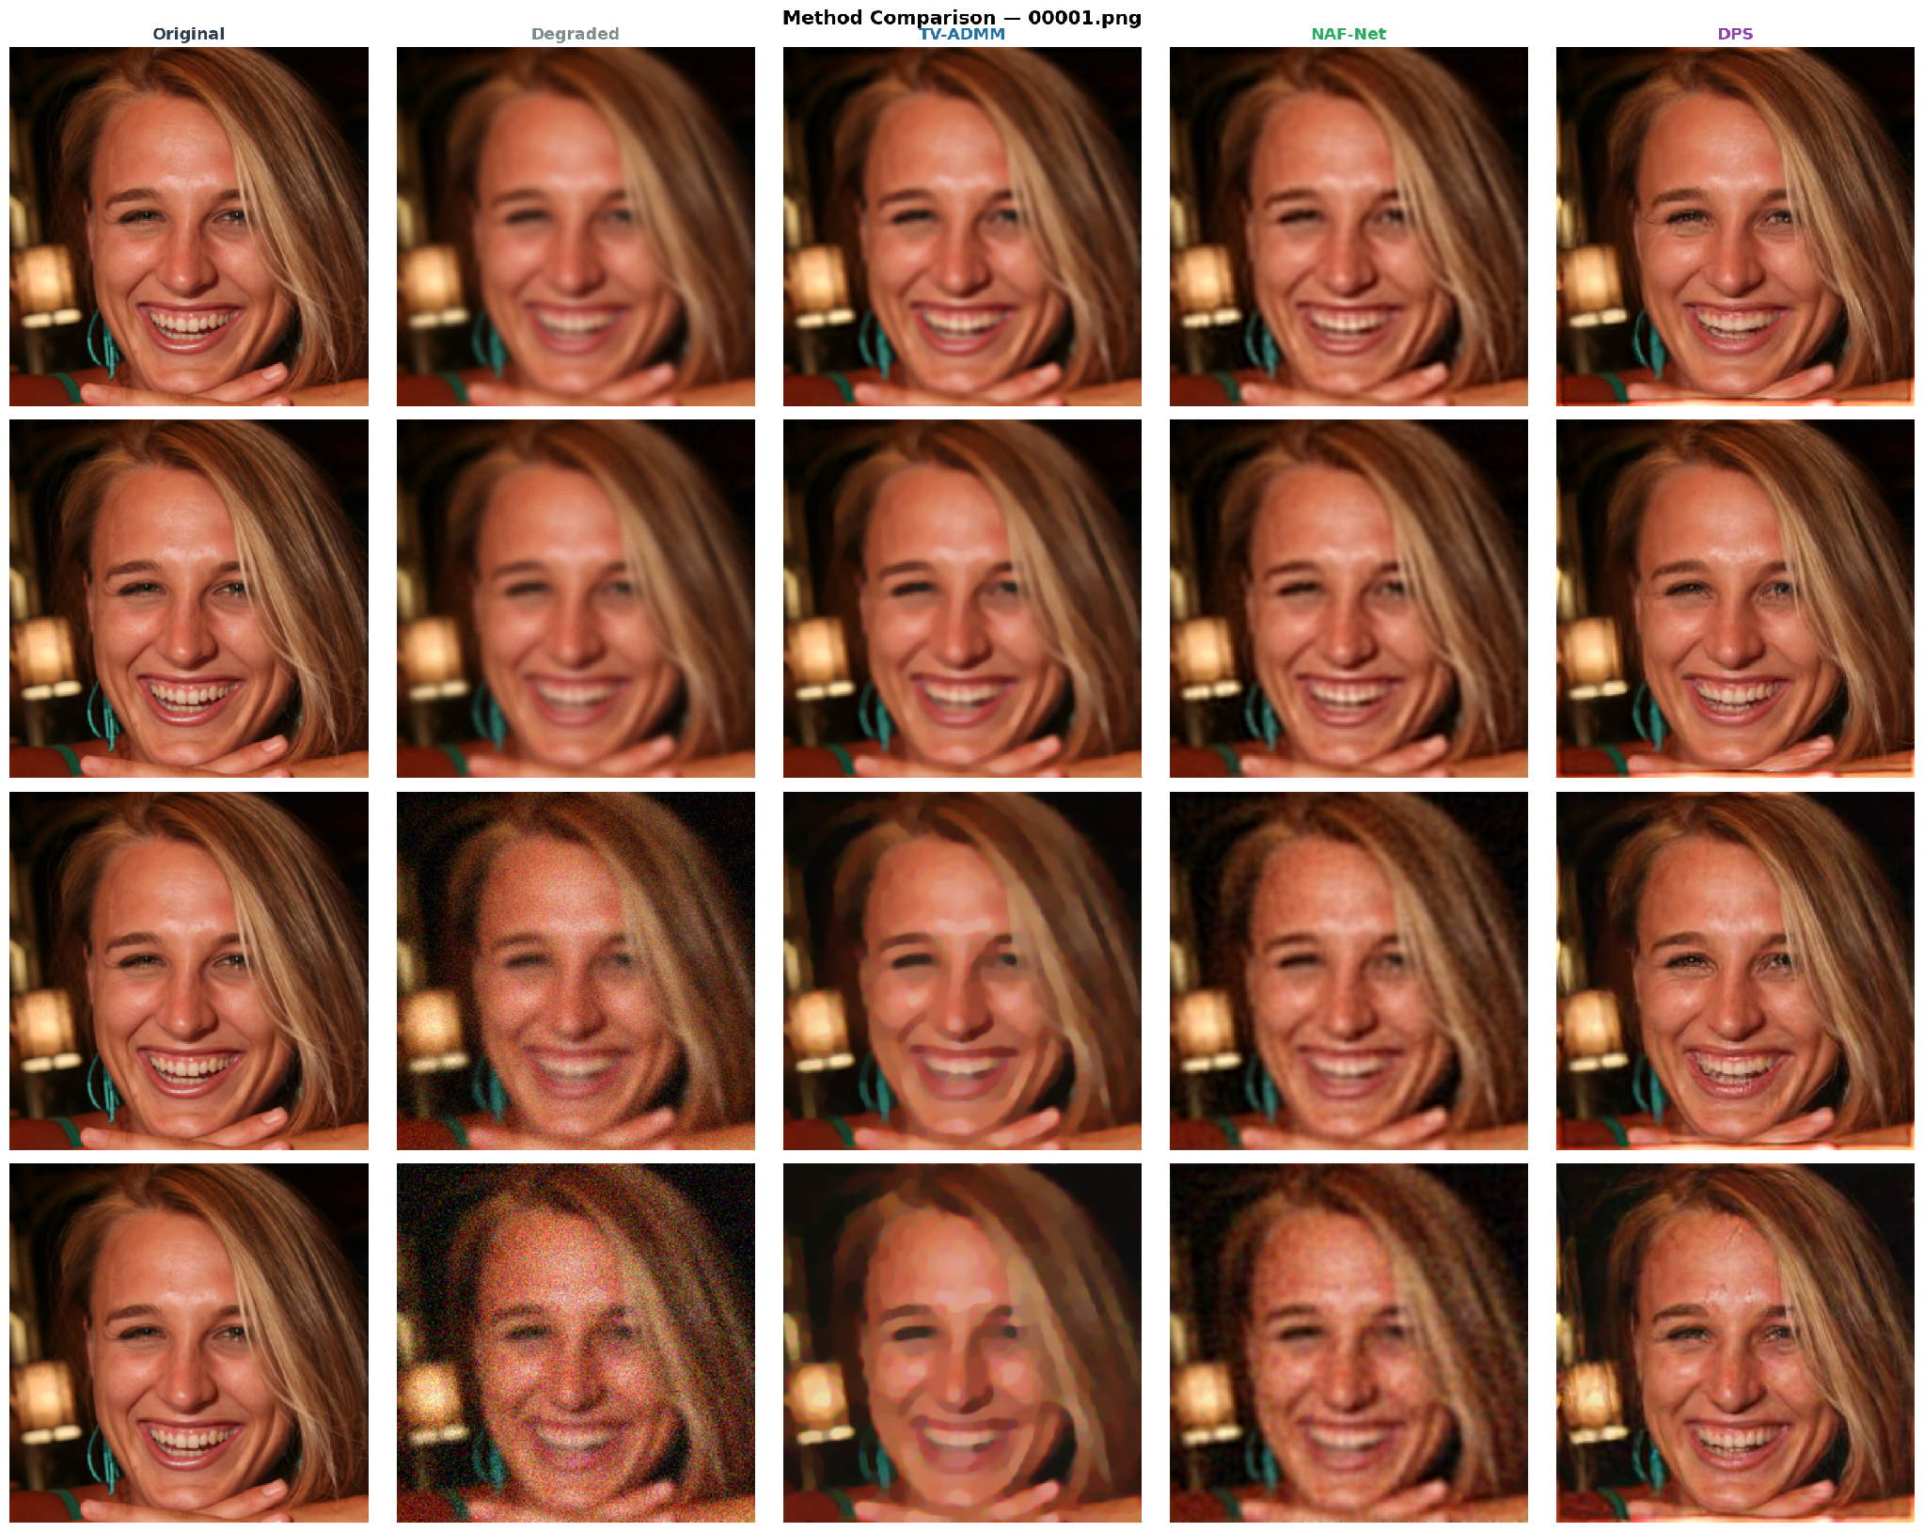
Presentation of Numerical Results — Visual Comparison (All noise level)
Original
Degraded
TV-ADMM
NAF-Net
DPS
Insert image
from
results/images/
Insert image
from
results//
Image 1
Insert image
from
results/images/
Insert image
from
results/images/
Insert image
from
results/images/
Insert image
from
results/images/
Image 2
Insert image
from
results/images/
Insert image
from
results/images/
Insert image
from
results/images/
Image 3

Slide 14
Conclusions
1
TV-ADMM
Achieves best PSNR at low noise (29.78 dB at n=0.005). Training-free, physically interpretable. Piecewise-constant prior causes texture loss at high n.
2
NAF-Net
Matches TV-ADMM quantitatively (29.46 dB) with sub-millisecond inference and superior visual quality. Noise conditioning enables a single model across all n.
3
DPS
Lower PSNR (25.56 dB) but superior perceptual quality — sharper, more realistic textures. Zero-shot generalization. High compute cost requires GPU.
★
Key Lesson
No single method dominates. PSNR ≠ perceptual quality (Blau & Michaeli 2018). The optimal method depends on accuracy, compute, and whether distortion or perception matters most.

Slide 15
Bibliography
[1] Rudin, L., Osher, S., & Fatemi, E. (1992). Nonlinear total variation based noise removal algorithms. Physica D, 60, 259–268.
[2] Boyd, S. et al. (2011). Distributed optimization and statistical learning via ADMM. Foundations and Trends in ML, 3(1), 1–122.
[3] Chen, L., Chu, X., Zhang, X., & Sun, J. (2022). Simple Baselines for Image Restoration (NAF-Net). ECCV 2022.
[4] Chung, H. et al. (2022). Diffusion Posterior Sampling for General Noisy Inverse Problems. ICLR 2023.
[5] Blau, Y. & Michaeli, T. (2018). The Perception-Distortion Tradeoff. CVPR 2018.
[6] Ho, J. et al. (2020). Denoising Diffusion Probabilistic Models. NeurIPS 2020.
[7] Karras, T. et al. (2019). A Style-Based Generator Architecture for GANs (FFHQ). CVPR 2019.
[8] Dhariwal, P. & Nichol, A. (2021). Diffusion Models Beat GANs on Image Synthesis. NeurIPS 2021.
GitHub: github.com/Giovanniprevitera01/computational-imaging-deblur

