Slide 1
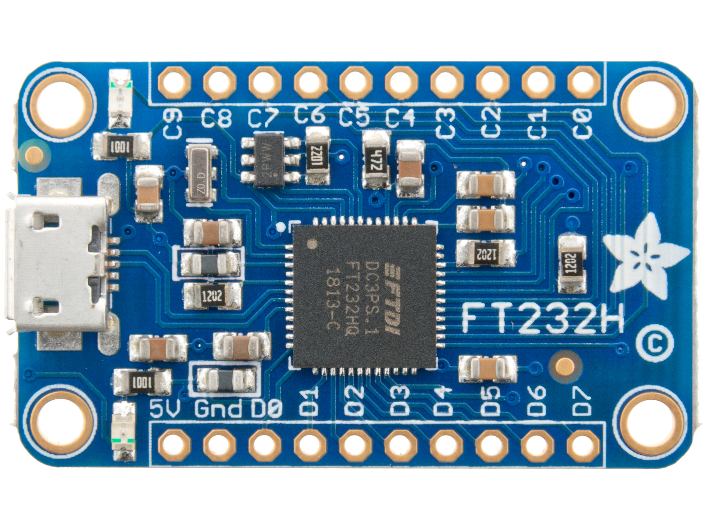
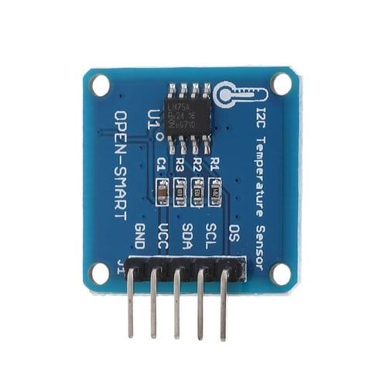
FT232H Breakout Board
LM75A Breakout Board
SCL
GPIO
SDA

