Slide 1
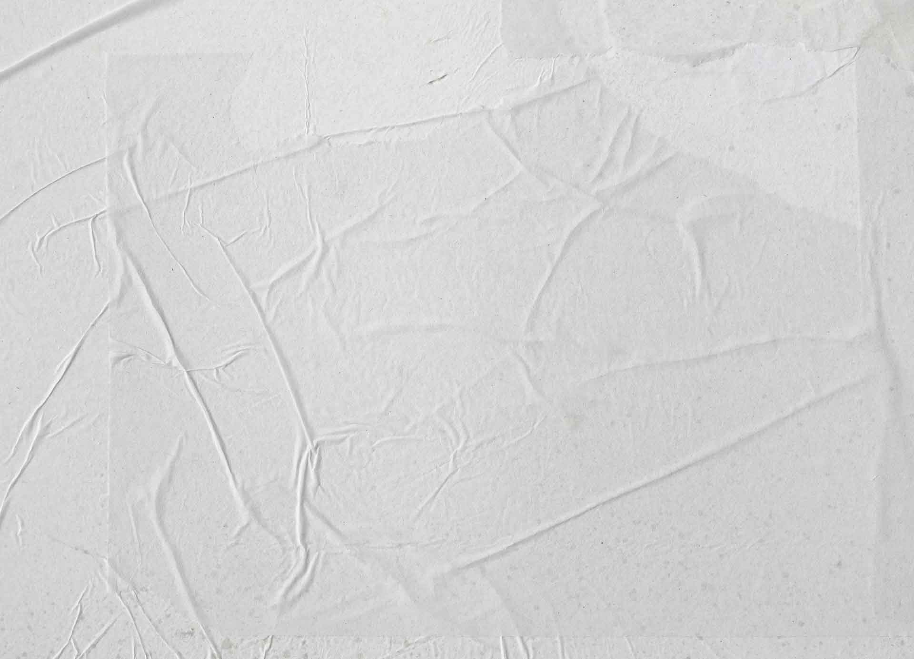
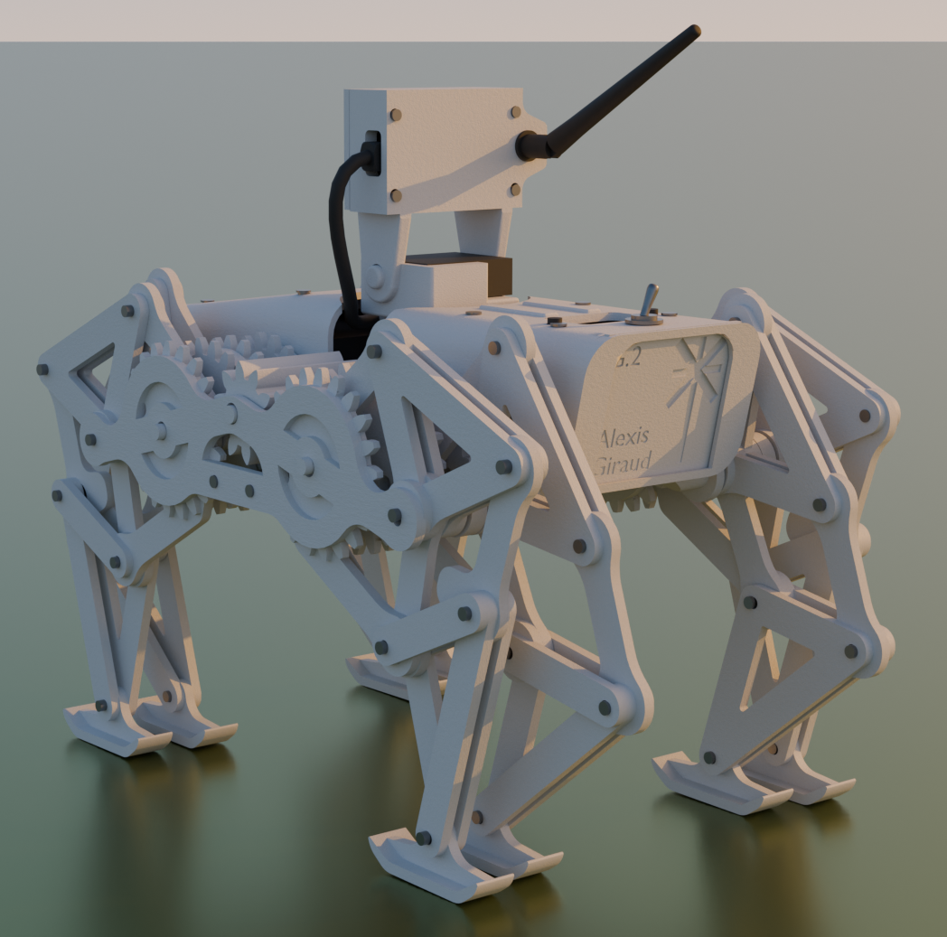
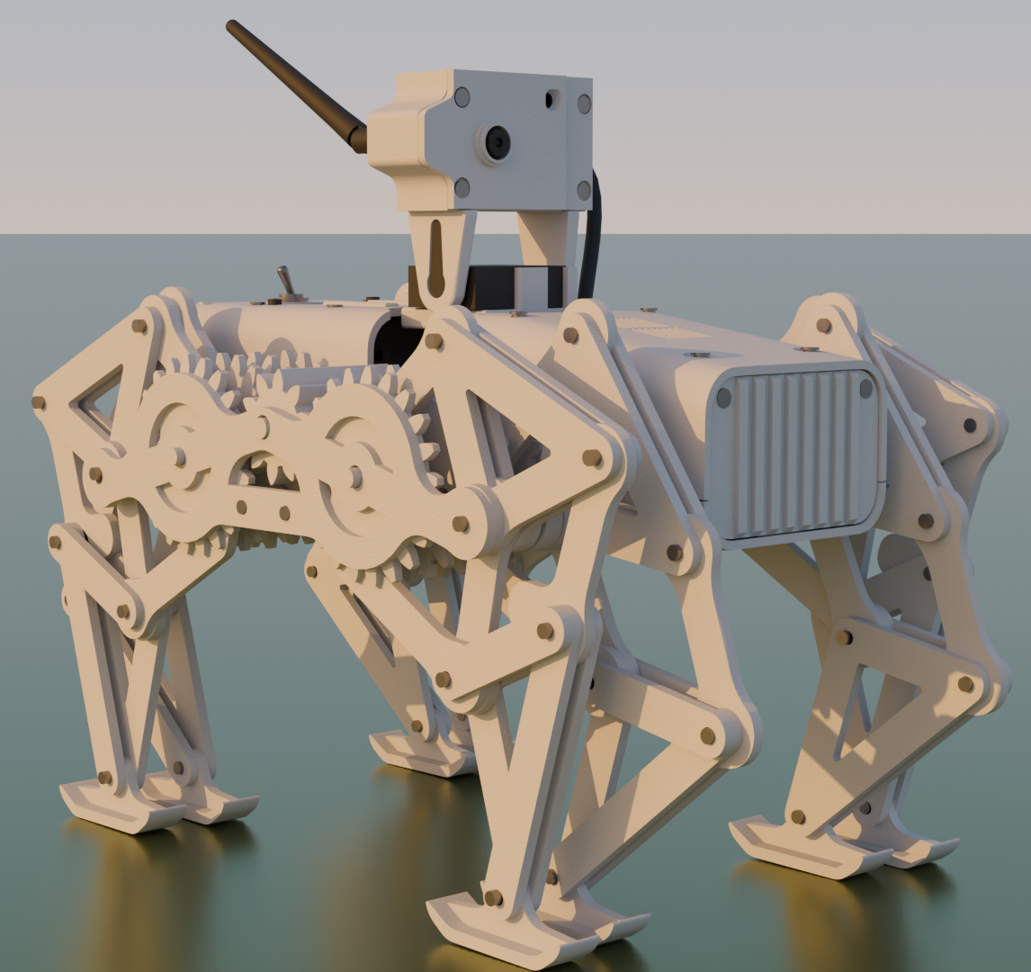
GUARDIAN .2
The Guardian .2 is a versatile robotic platform based around the Jansen mechanism; it is designed to perform a wide range of tasks. It enables users to remotely explore, inspect, and monitor environments ranging from warehouses to confined spaces such as drains or ducts. The Guardian can also operate alongside computer vision and artificial intelligence systems, allowing it to carry out more advanced functions such as automated inspection, anomaly detection, and data collection.

Slide 2
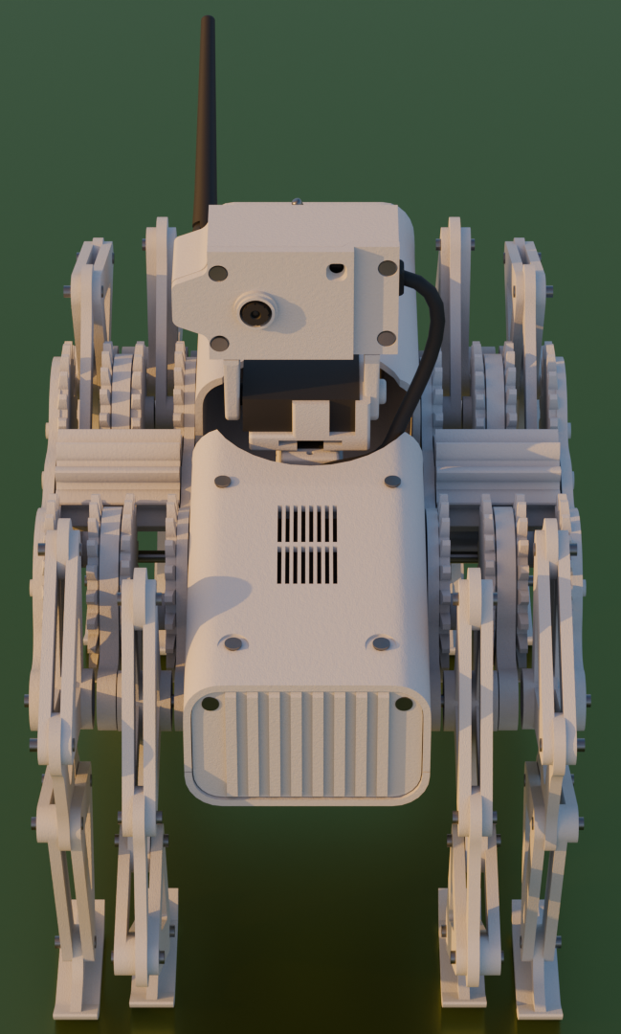
Features:
Real-time Wi-Fi video surveillance
Remote directional navigation system
Pan–tilt camera positioning
Onboard flashlight
Wireless audio transmission
PC-based control interface

Slide 3
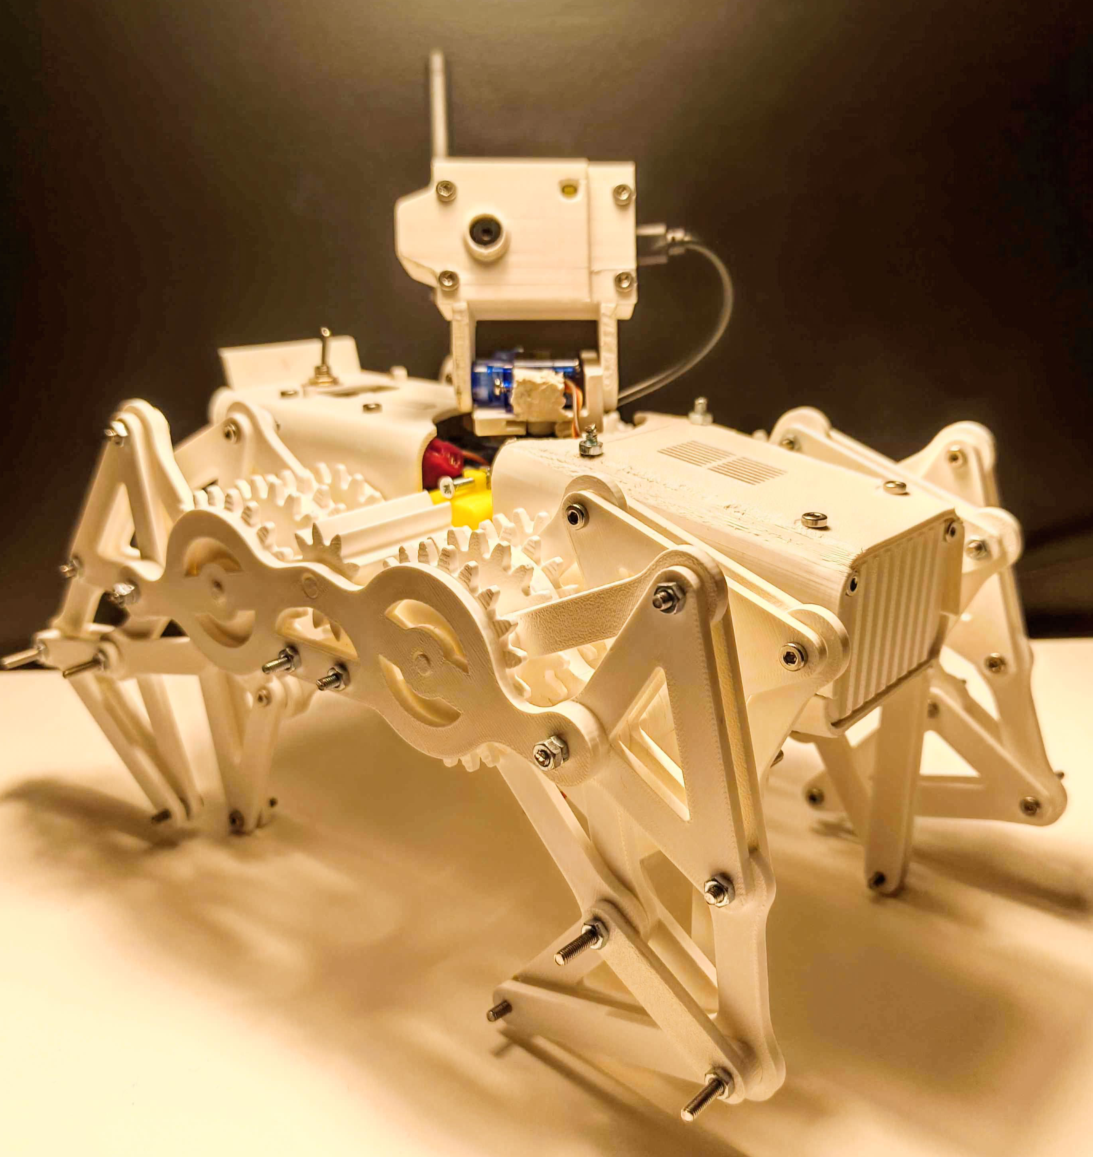
Results of the Jansen Mechanism:
Can walk on irregular surfaces
Can go over small obstacles
Requires low torque
Very stable
Tedious to integrate
Slower than wheels

