Slide 1
Bellabeat: Smart Device Usage Analysis
Google Data Analytics Capstone Case Study

Slide 2
Agenda
Project Overview & Goals
Data & Analysis
Recommendations
Actionable Next Steps

Slide 3
Purpose
Analyze Fitbit smart device usage data to identify consumer trends and develop high-level marketing recommendations for the Bellabeat app

Slide 4
Data Source & Scope
The data analyzed was the Fitbit Fitness Tracker Data published on Kaggle by Mobius, originating from the Furberg et al. dataset covering March – May 2016 across two exports.
Combined and cleaned Daily Activity from both exports: 1,373 participant-day records and 35 distinct participant IDs.
Combined and cleaned minute-level sleep data, reconstructed into 1,007 sleep sessions

Slide 5
Dataset Limitations
Data was collected in 2016 and may not reflect current behavior.
No demographic data, including age or gender, to establish relevance to Bellabeat customers.
Only 35 distinct IDs, with different participants contributing different amounts and types of records.
Cannot determine whether absent records reflect device capabilities, participant preferences, nonuse, or other factors.
Published description reports 30 eligible users, while our combined data contains 35 distinct IDs.

Slide 6
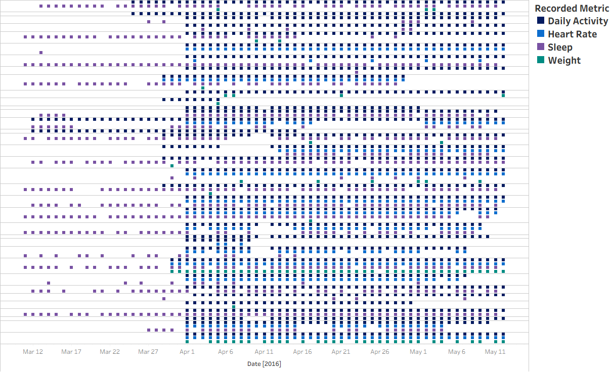
Participant Data Coverage
Horizontal groupings represent one participant
Colored marks indicate dates with recorded data
Gaps indicate dates without records

Slide 7
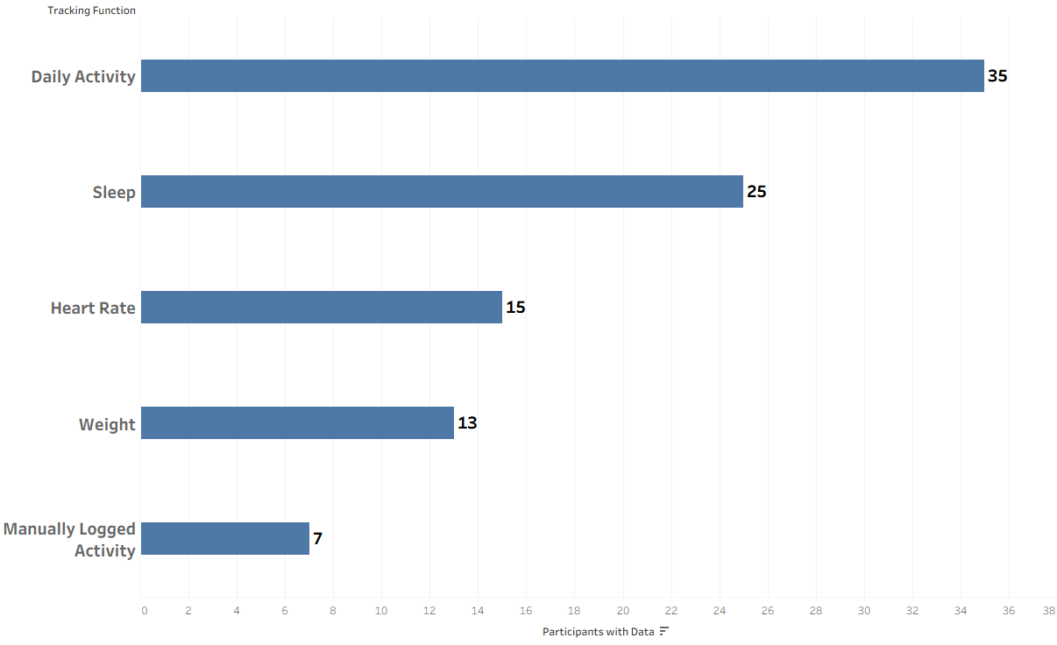
Participant Coverage by Data Type
Manually logged activity is identified within daily activity records

Slide 8
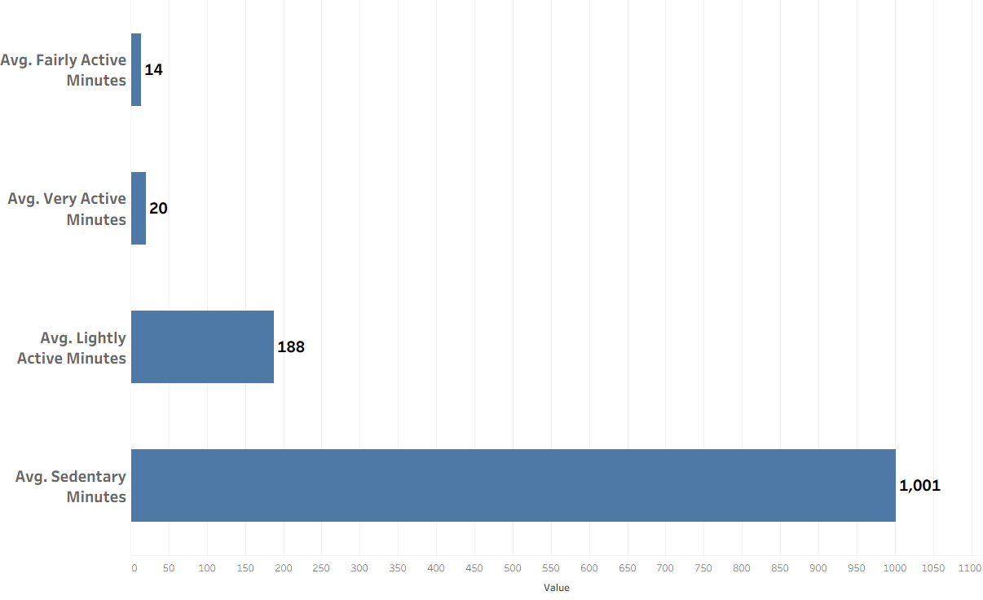
Average Daily Minutes by Activity Intensity

Slide 9
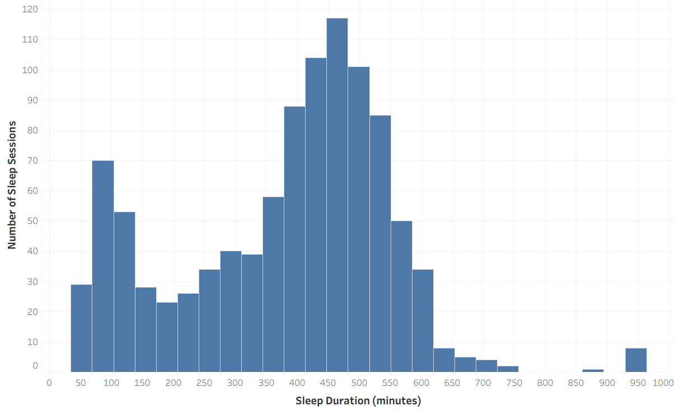
Sleep Duration Distribution

Slide 10
Marketing Recommendations for the Bellabeat App
Given the substantial amount of recorded sedentary time, Bellabeat could explore marketing messages that emphasize incorporating movement into everyday routines.
Explore sleep awareness messaging

Slide 11
Actionable Next Steps
Evaluate Bellabeat customer data to determine whether similar activity and sleep patterns are present
Assess customer interest in everyday movement and sleep awareness messaging
Test potential marketing messages before implementing a broader campaign

Slide 12
Data sources and supporting analysis
Data source: Fitbit Fitness Tracker Data—Kaggle
Tableau Exploratory Visualizations
Fitbit Sleep Data Analysis (Python/Jupyter Notebook)

Slide 13
Generative AI use disclosure
ChatGPT was used as a learning and technical support tool throughout this project, including Python tutoring, code development and debugging assistance, troubleshooting, project organization, and clarification of analytical concepts.
Analytical questions, methodological decisions, interpretation of results, and final conclusions were independently evaluated and determined by the author. AI-generated suggestions and code were reviewed and tested by the author.

