Slide 1
Ga for set covering problem

Slide 2
Work group
280117 Giuseppe Piombino https://github.com/Girasolo/computational_intelligence
291871 Alessia Leclercq https://github.com/AlessiaLeclercq/ComputationalIntelligence_S291871
302294 Leonardo Tredese https://github.com/LeonardoTredese/s302294-computational-intelligence-2022-2023
292113 Filippo Cardano https://github.com/Frititati/CI_2022_292113

Slide 3
Representation
Idea from the onemax problem:
each flag correspond to one of the lists generated by the well known function problem
Genome

Slide 4
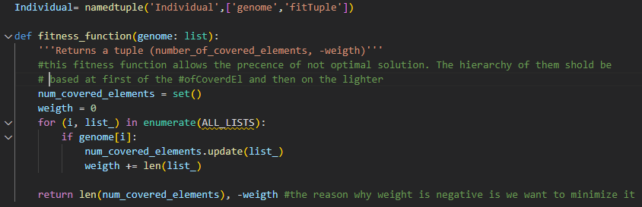
Representation
As in the onemax we have used a namedtuple
The fitness function returns a tuple (#coveredEl,-weight), which is assigned to the fitTuple

Slide 5
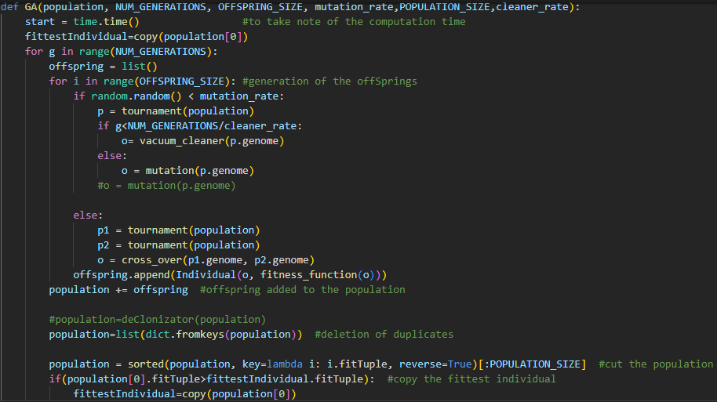
improvements

Slide 6
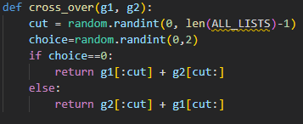
Cross_over

Slide 7
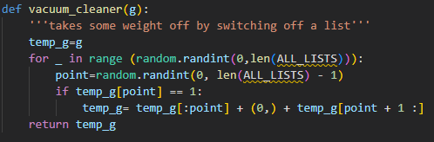
Vacuum cleaner

Slide 8
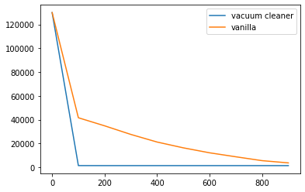
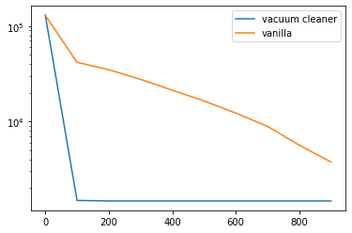
Vacuum Cleaner

Slide 9
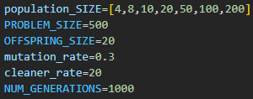
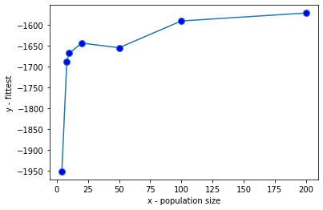
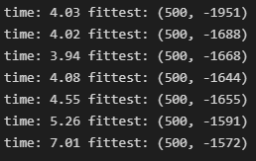
Parameter study:population size

Slide 10
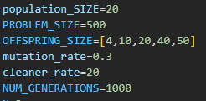
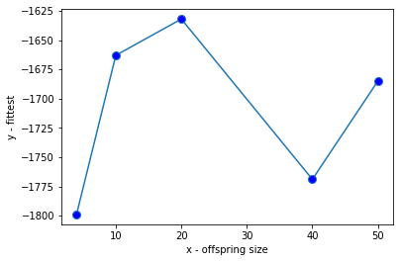
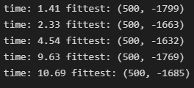
Parameter study: offspring size

Slide 11
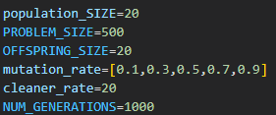
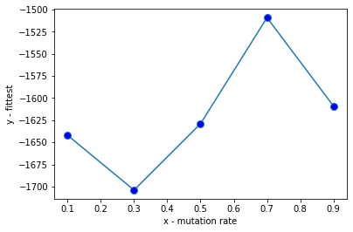
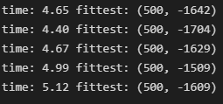
Parameter study: mutation rate

Slide 12
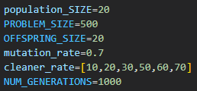
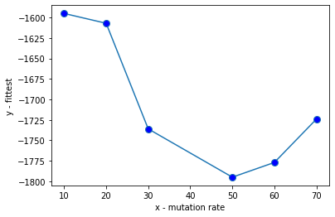
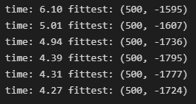
Parameter study: cleaner rate

Slide 13
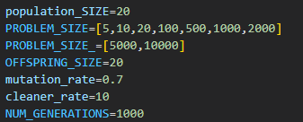
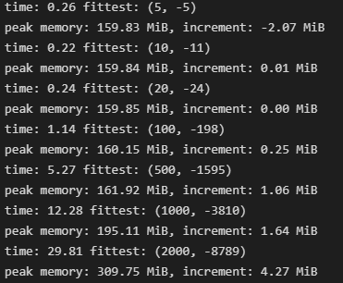

final trial

Slide 14
Further possible optimizations
Use of binary numbers instead of an array of ones and zeros
…

Slide 15
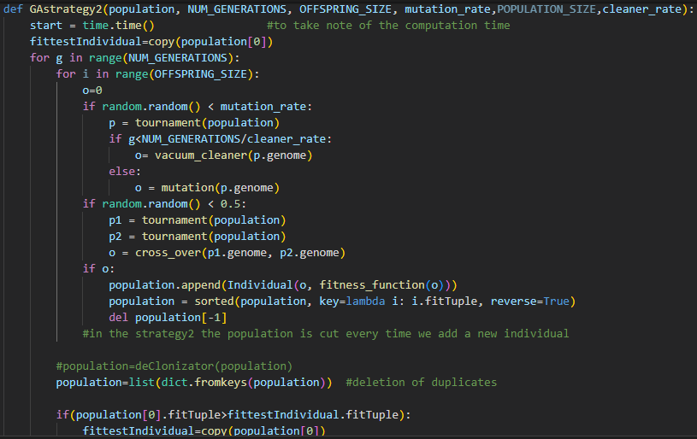
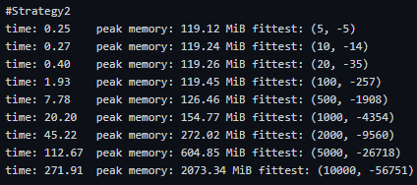
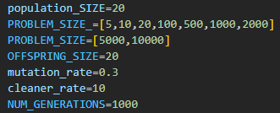
Alternative strategy: strategy 2

