Slide 1
Applications of CGHV60040D

Slide 2
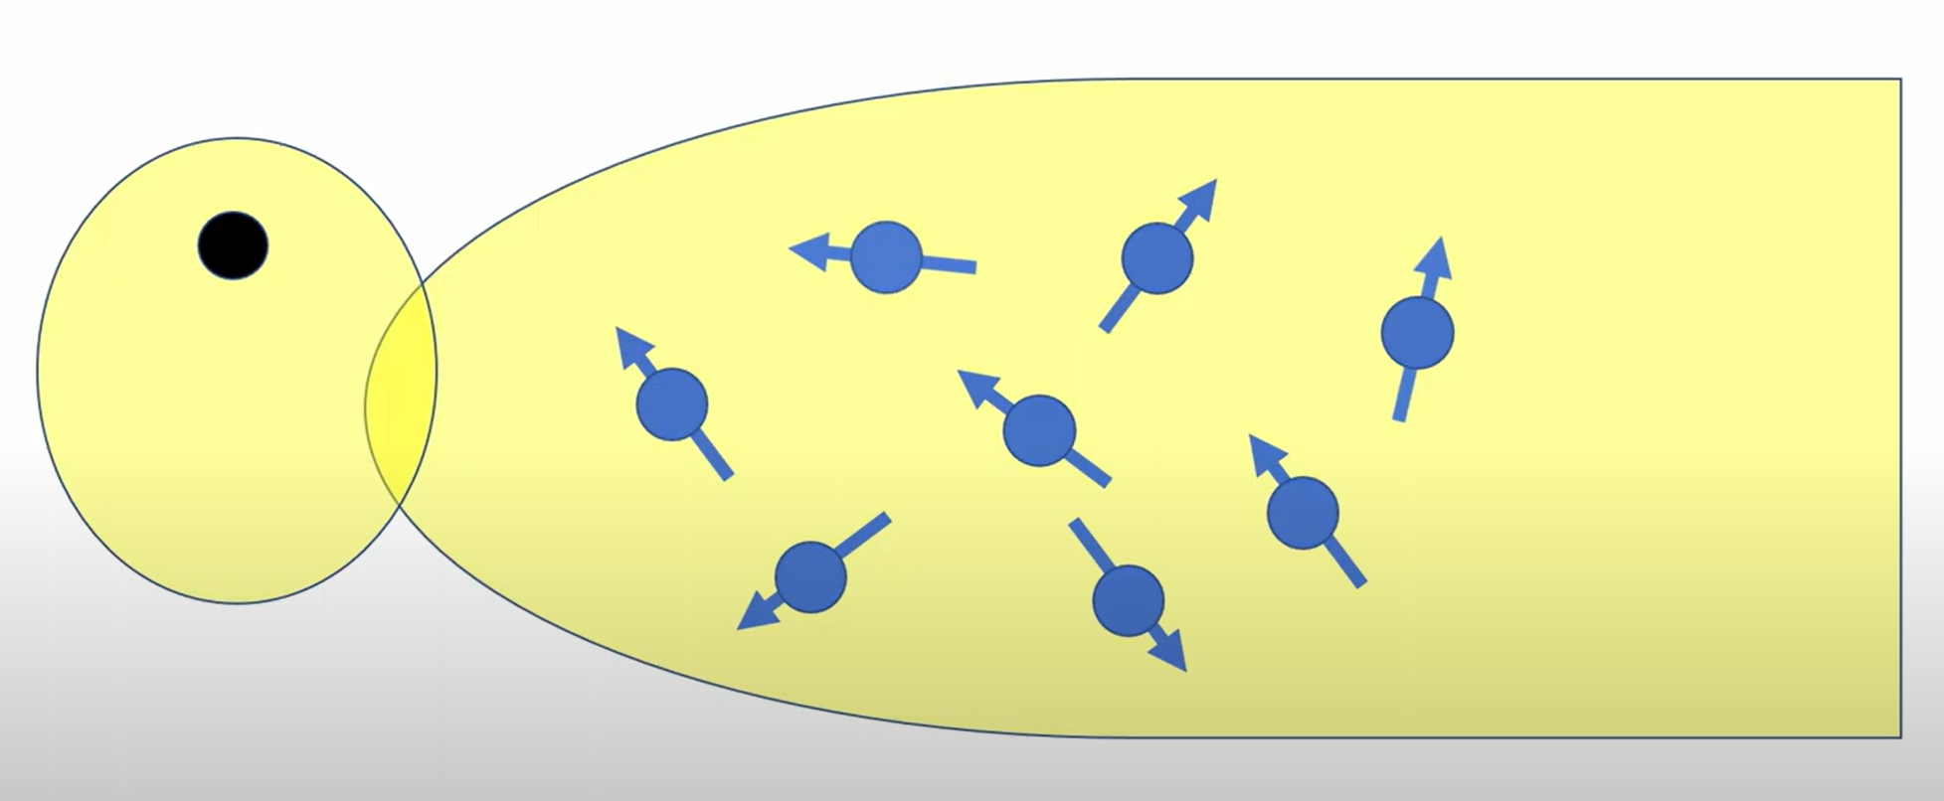
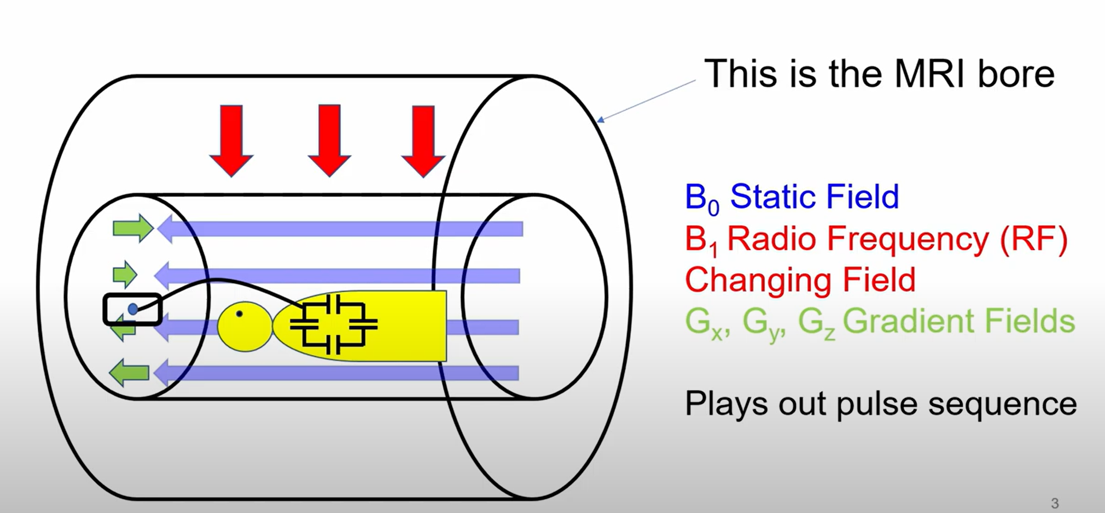
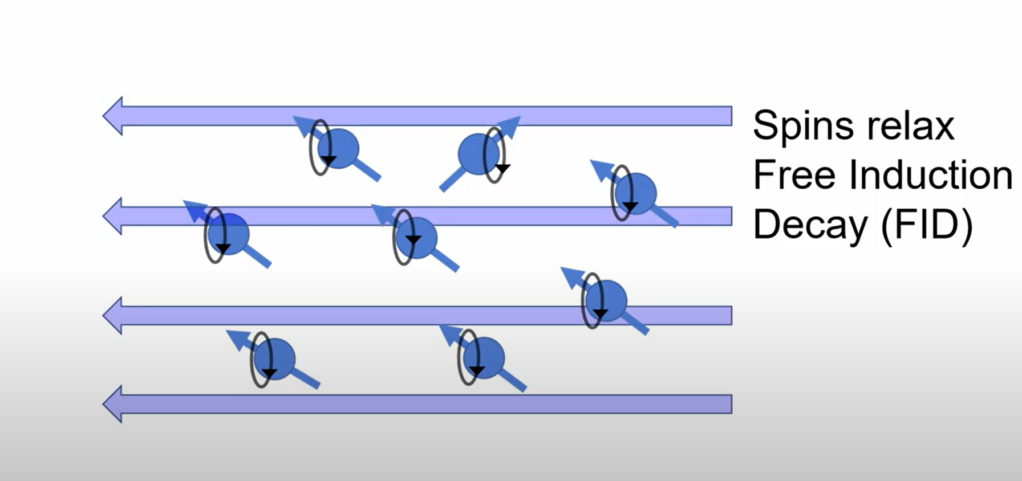
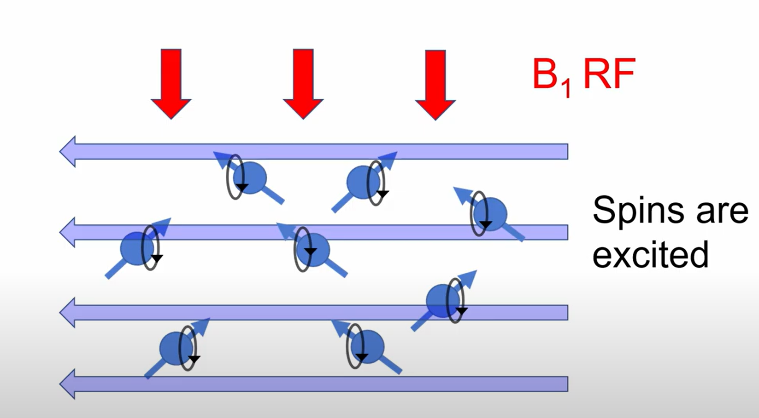
Q-Spoiling in MRI Scans
In an MRI Scan, an RF Magnetic Field (B1) is applied Perpendicular to the patient. (transmitter)
Human Body is 75% water, which has hydrogen protons.
These protons align themselves along this magnetic field, and precess (oscillate or rotate), about this applied field, at Larmor Frequency.
Once the B1 field is turned off, these protons, emit a signal.
This FID signal will be received by the receiver coil, and processed as MRI image. (when transmitter is off)

Slide 3
Q-Spoiling in MRI Scans
But if the receiver coil, receives signals when the transmitter is ON, it generates, high current, and heat, which is dangerous for the patient and instrument itself.
The PIN Diode is used here as a failsafe mechanism, to prevent the receiver coil, from receiving when the Transmitter is turned ON. This is called Q-Spoiling/Coil Decoupling
But the PIN Diode, requires some power, for this failsafe operation.
The author, utilizes the depletion mode, and Low off-state capacitance of the CGHV60040D to achieve low power Q-Spoiling technique.
Paper Link: 3.1
YouTube Video: Link
(The author himself explains his paper)

Slide 4
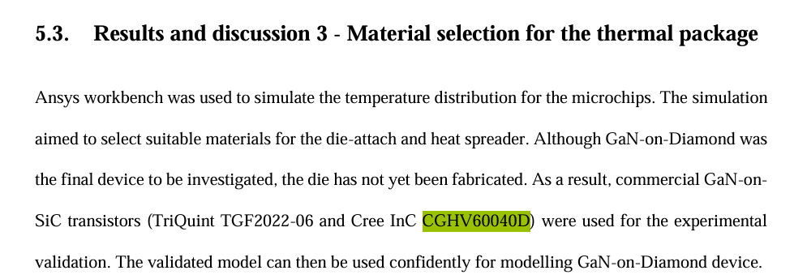
Thermal Management
Bare die mounted onto test platforms (copper or diamond carriers)
Served as a realistic heat source with high power density (up to 5 W/mm)
A simulation model was also made for the die.
Theses : 1.1

Slide 5
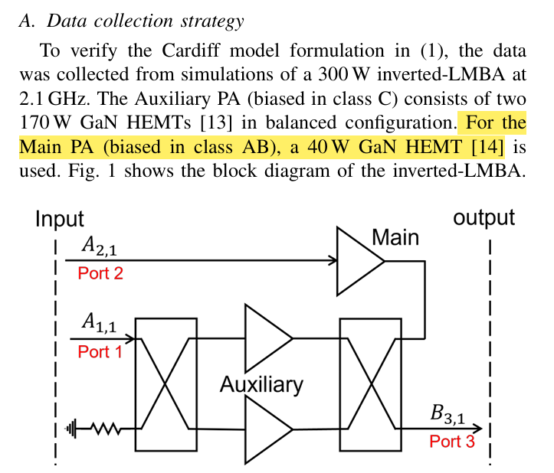
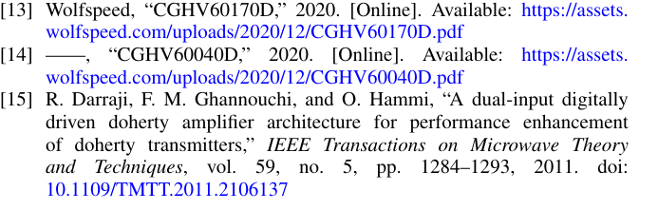
Class AB Power Amplifiers
This paper explores the use of the Cardiff non linear behavioral model to characterize the response of multiple input power amplifiers. In particular, a case study is presented on a 300W load modulated balanced amplifier operating at 2.1 GHz. The model mathematical formulation is presented, and the comparison between original data and model shows an error below 3%. More importantly, it is shown that the model can accurately interpolate between characterization points allowing a reduction of up to 96% of the points needed to accurately predict the model behavior. This significantly reduces the simulation and measurement time for multiple-input PA’s whilst attempting to determine the optimal driving conditions.
This paper uses CGHV60040D as a class AB Power Amplifier, denoted as “Main”, in the diagram.
Paper Link: 3.2

