Slide 1
CGHV60040D Die
DC Measurements
Id-Vg & Id-Vd

Slide 2
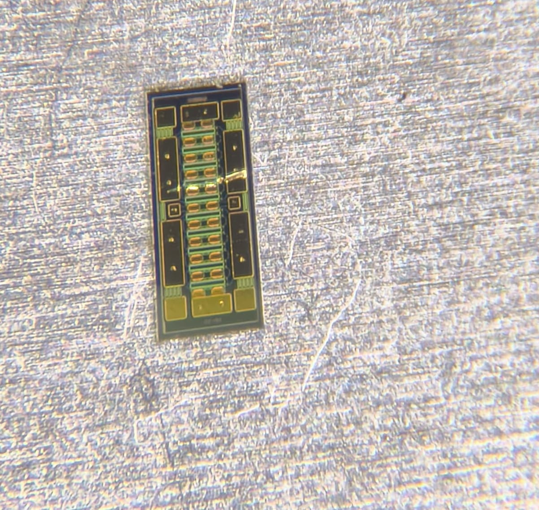
Die Placement
The Die was first placed on the Stainless Steel Carrier with 250um hole size.
The Chuck could not hold the die, as the vacuum hole diameter is 2mm.
DC Probe Station Datasheet: 2.1

Slide 3
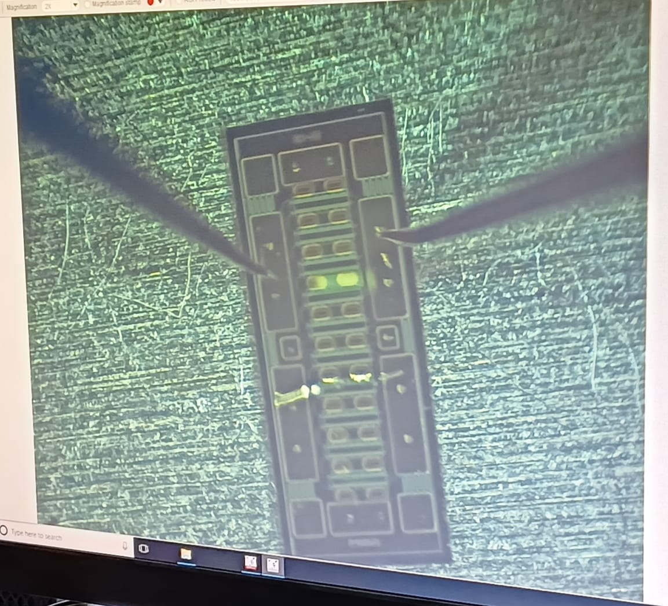
Die Probing
The Probes were made in contact with one of the Gate & Drain Pads.
The Chuck was used as the Source Contact (Ground).

Slide 4
Transfer Characteristics
The Probes were made in contact with one of the Gate & Drain Pads.
The Chuck was used as the Source Contact (Ground).

Slide 5
Output Characteristics
The Probes were made in contact with one of the Gate & Drain Pads.
The Chuck was used as the Source Contact (Ground).

