Slide 1
CGHV60040D Die
DC Measurements
Id-Vg & Id-Vd

Slide 2
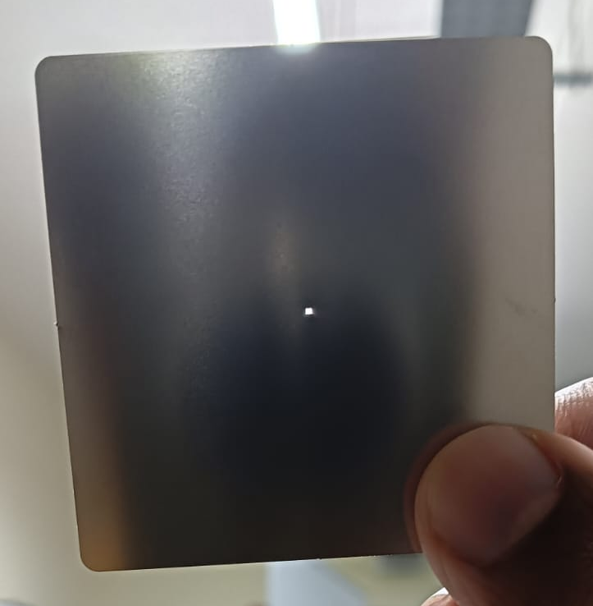
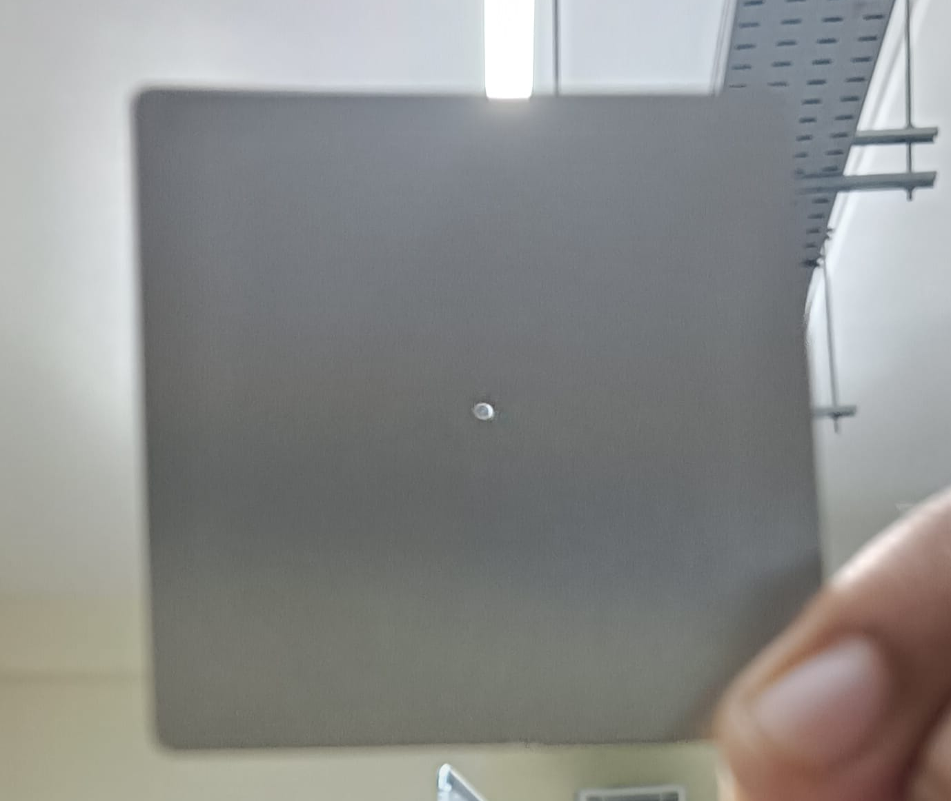
Used Approach
Get a Stainless Steel Mask, made from PCBPower.
Let the dimension of the hole be 250um, & 500um.
This provides an electric ground to the source, and also holds the chip under vacuum of the chuck.
Reference (Gerber Files): Link

Slide 3
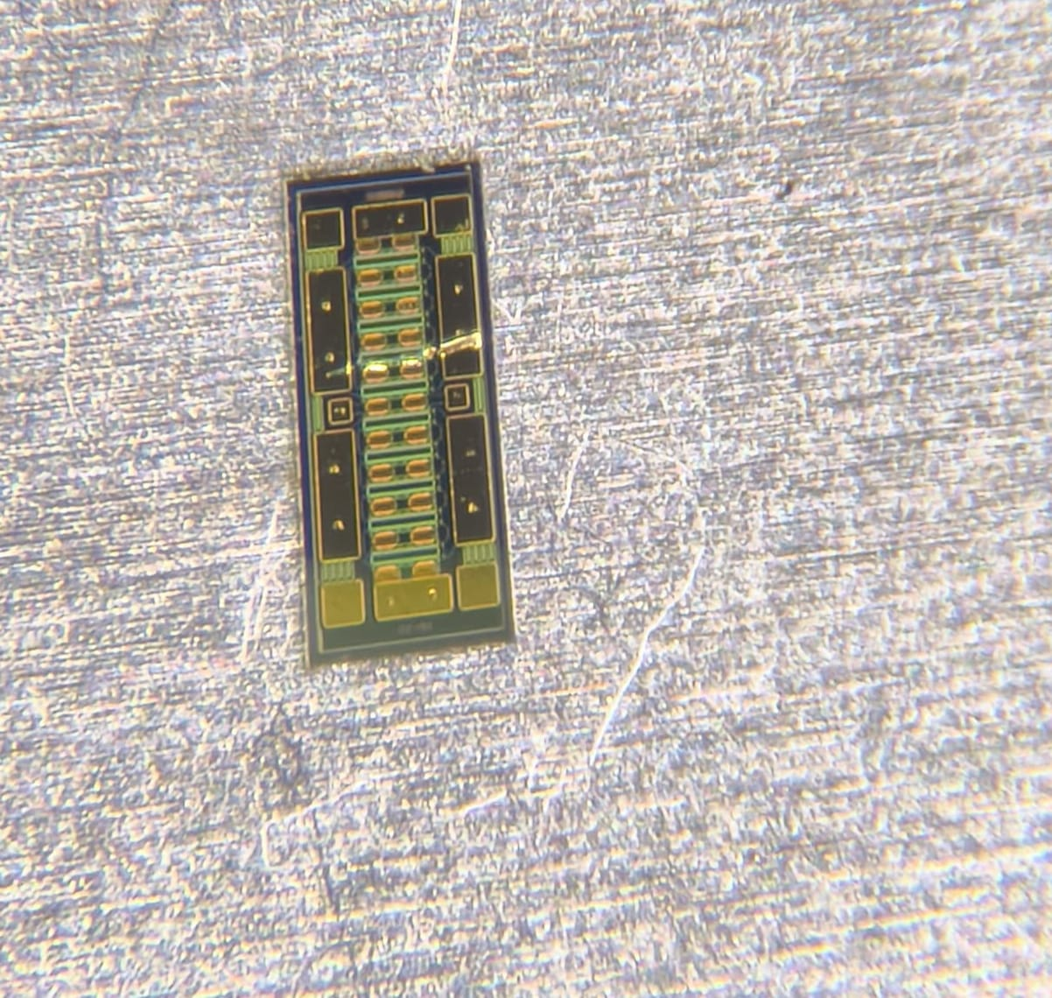
Die Placement
The Die was first placed on the Stainless Steel Carrier with 250um hole size.
The Vacuum chuck could not hold the die, as the allowable dimension of die is 2mm and above.
DC Probe Station Datasheet: 2.1

Slide 4
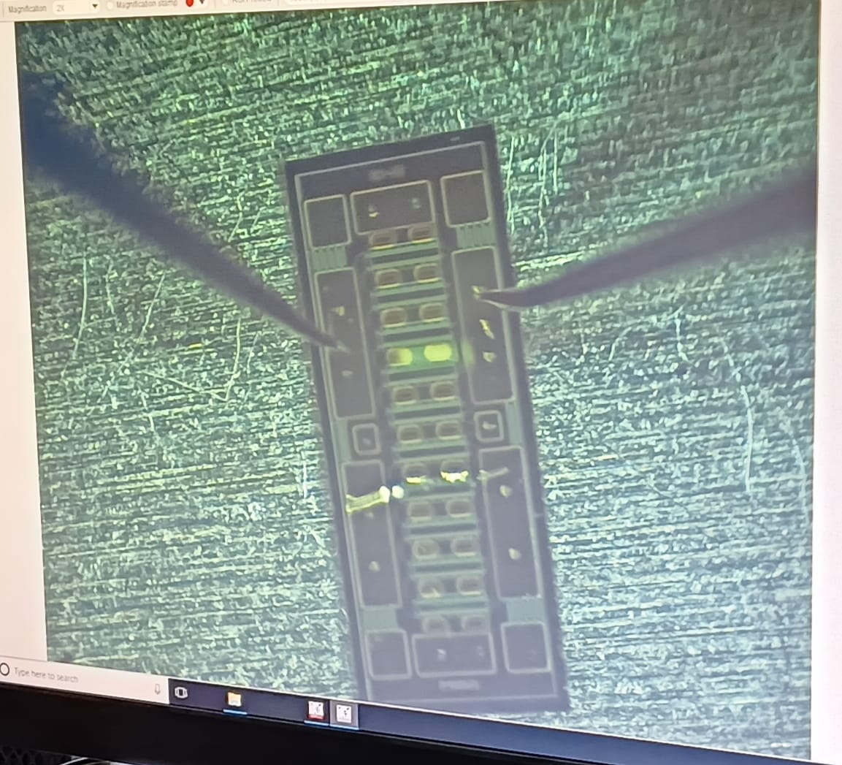
Die Probing
The Probes were made in contact with one of the Gate & Drain Pads.
The Chuck was used as the Source Contact (Ground).

Slide 5
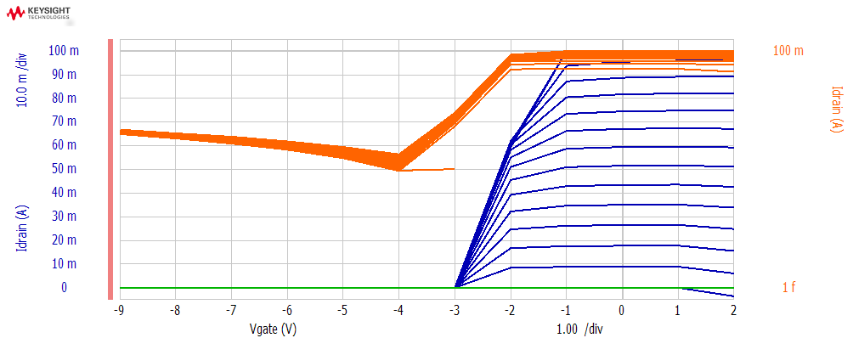
Transfer Characteristics
Gate Ramp (primary): -9V to 2V, step=1V
Drain Ramp (secondary): 0V to 1.5V, step=0.1V

Slide 6
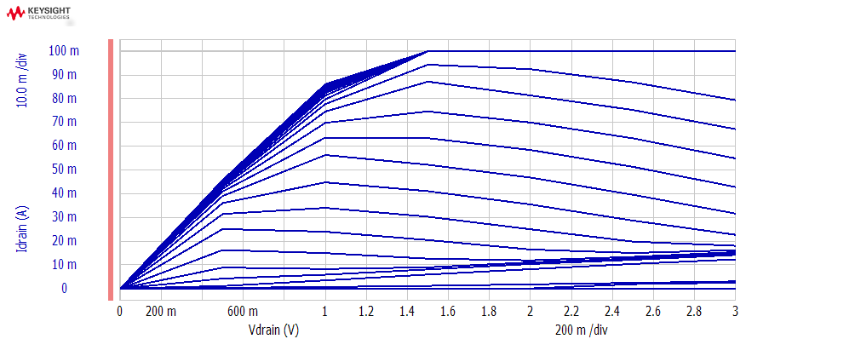
Output Characteristics
Drain Ramp (primary): 0V to 3V, step=0.5V
Gate Ramp (secondary): -4V to 0.2V, step=0.1V

