Slide 1
Maury 2640D Slide Screw Tuner
Ansys HFSS Simulation Dimensions

Slide 2
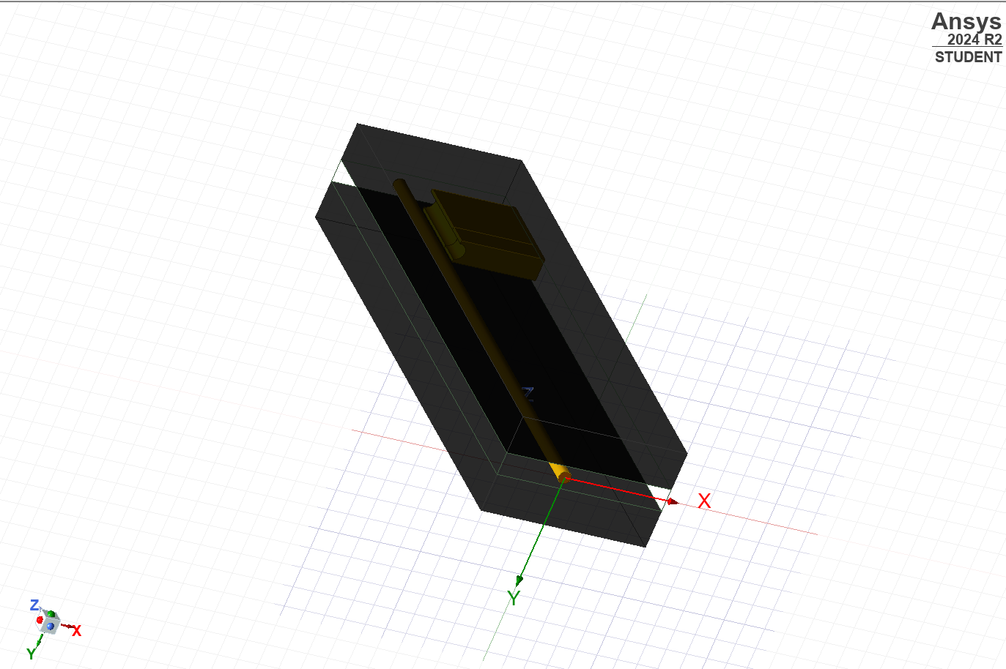
The Simulation includes three parameters.
D1 -> Depth of Tuner Probe 1
D2 -> Depth of Tuner Probe 2
Lateral -> Lateral Movement Length (Common for Both Probes).
Datasheet: 1.2

Slide 3
Aluminium Slabs
9.3 mm
(height)
127.35 mm
(length)
40.6 mm
(width)

Slide 4
Top View
14 mm
23.55 mm
9 mm
Inner Conductor
127.35 mm
Aluminium Slab
Slab Holder
40.6 mm

Slide 5
Side View
9.3 mm
1.275 mm
5.6 mm
24.2 mm
1.275 mm
Inner Conductor
Air Dielectric

Slide 6
Inner Conductor
Gold
There is no explicit mentioning of the material of the inner conductor in the Datasheet of the tuner.
But the tuner mentions a connector type of 7mm.
It is explicitly mentioned in the datasheet of the 7mm connector, that the inner conductor is of BeCu with Gold plating.
The same has been used in the simulation also.
Link: 1.1
3.05 mm
0.05 mm
BeCu

Slide 7
Tuner Probe 1
The Tuner probe material is also assumed to BeCu, as the purpose of the tuner is to affect the EM waves in the inner conductor.
Top View
5.5 mm
Side View
2 mm
20.6 mm
20.6 mm
16.6 mm

Slide 8
Tuner Probe 2
The Tuner probe material is also assumed to BeCu, as the purpose of the tuner is to affect the EM waves in the inner conductor.
Top View
5.5 mm
Left Side View
2 mm
12.7 mm
20.6 mm
20.6 mm
5.9 mm
6 mm
10.6 mm

Slide 9
Probe Lateral Movement
9.3 mm
TP1
TP2
TP1
TP2
7 mm
7 mm
Total Length of Aluminium Slab = 127.35mm
Movement Restriction on both sides= 14 mm (7 on each side)
Effective Movement Length = 113.35 mm

Slide 10
Probe Depth Movement
1.15 mm
6.1 mm
Minimum Depth
Maximum Depth
Note: This movement parameters are applicable for both Tuner Probe 1 & Tuner Probe 2

