Slide 1
CGHV60040D Die
Cross Sectional View Dimensions

Slide 2
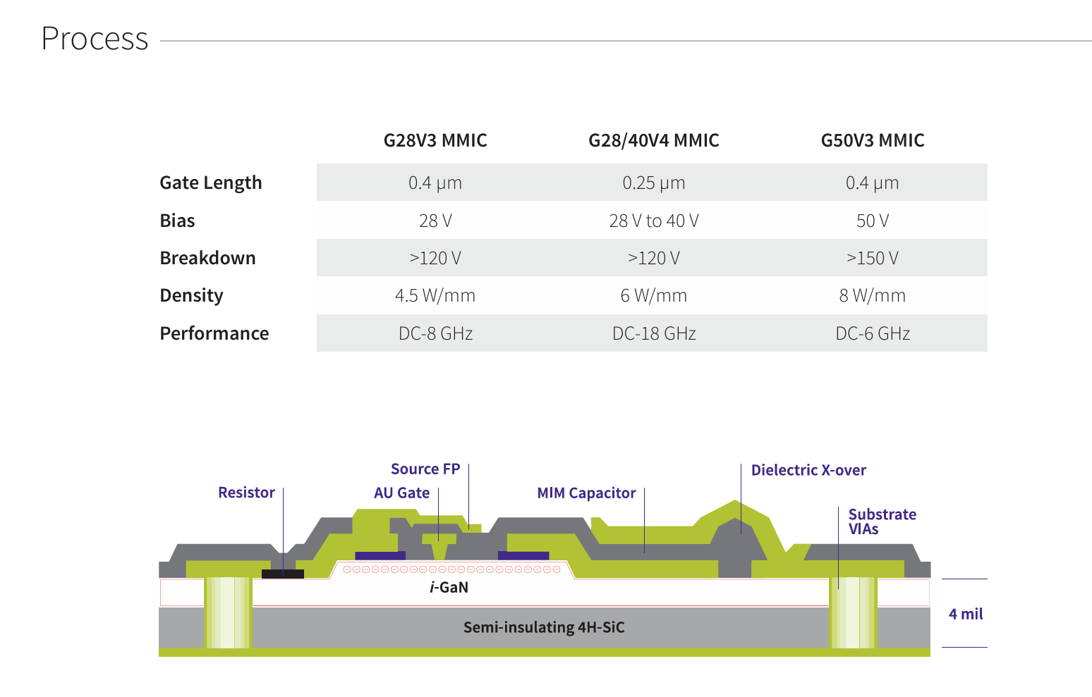
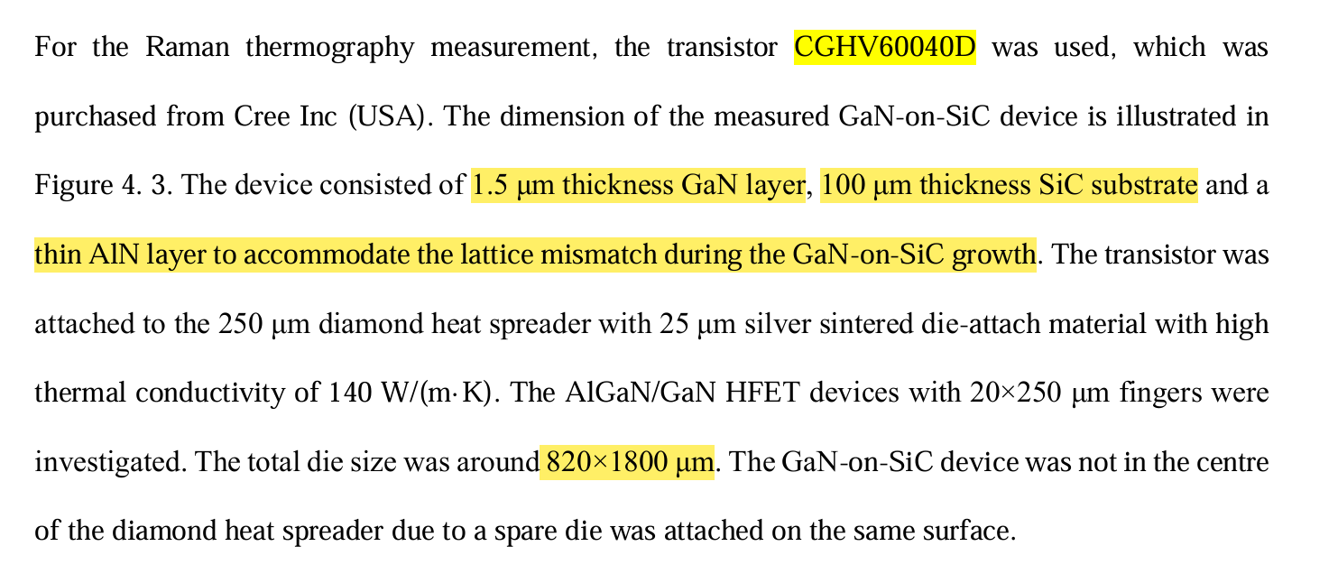
SiC Substrate
Thickness of SiC: 100um
Crystal Orientation: 4H-SiC
Links: Theses
Process

Slide 3
AlN Nucleation Interface
Reduce Lattice Mismatch between SiC & GaN
Thickness of AlN: ~1-2nm
Links: Theses
Process

Slide 4
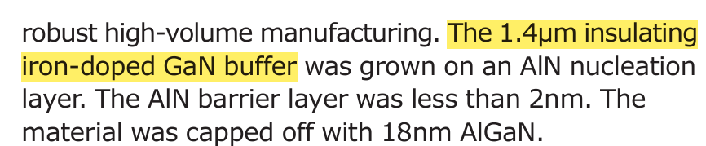
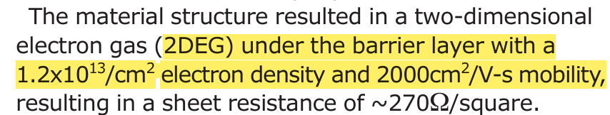
GaN Buffer
Thickness of GaN: ~1.5um
Channel Density: 1.2x1013/cm2 (0.25 um gate length)
eMobility: 2000cm2 /Vs (0.25 um gate length)
Proposed Dopant: Fe
Links: Theses
Semiconductor Today

Slide 5
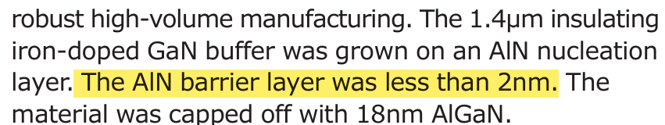
AlN Barrier between GaN & AlGaN
Increase 2DEG Density
Utilized in 0.25um technology. Good Possibility to be used in 0.4um also.
Thickness of AlN: ~1-2nm
Links: Semiconductor Today

Slide 6
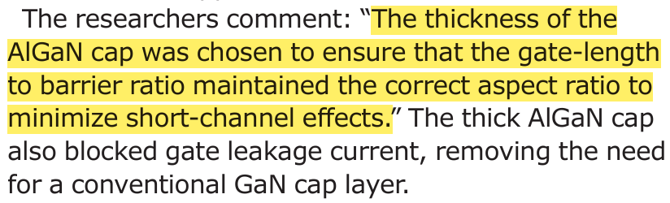
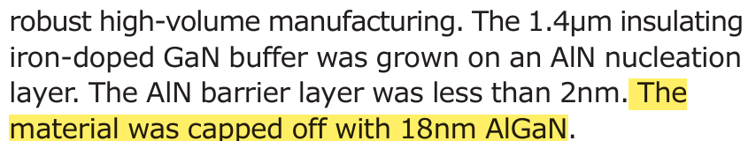
AlGaN Barrier
Thickness of AlGaN: ~30nm (18 nm for 0.25um tech, calculated for 0.4um, using the same ratio)
Al Mole Fraction: ~0.2-0.3 (0.22 used for G28V3 Technology)
Links: Process
Semiconductor Today

Slide 7
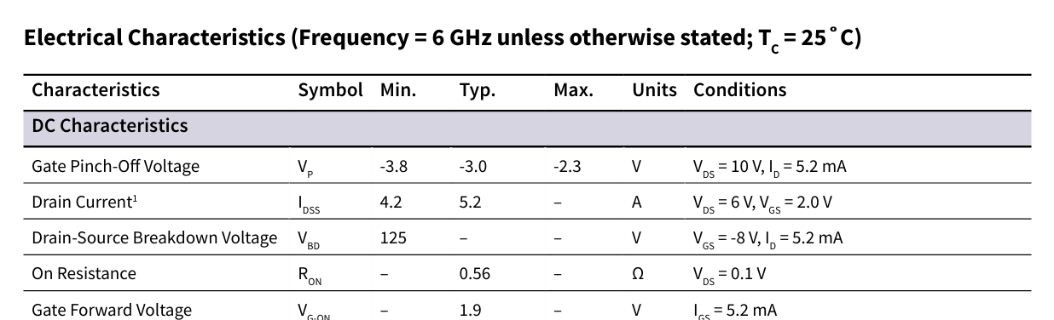
Overall Device Dimensions
Lg=0.4um
Lgd (Gate to Drain Distance): ~3.79 um (Calculated using Drain-Source Breakdown Voltage give in Datasheet)
Lgs (Gate to Source Distance): ~0.24 um (Calculated with the above-mentioned parameters)
The 0.25um technology, says that the Gate is not in the center, so this is correct.
Links: Process
Semiconductor Today
Datasheet: Datasheet

Slide 8
Si3N4 Passivation Layer
Thickness of AlGaN: ~30nm (18 nm for 0.25um tech, calculated for 0.4um, using the same ratio)
Al Mole Fraction: ~0.2-0.3 (0.22 used for G28V3 Technology)
Links: Semiconductor Today

