Slide 1

“Final Review of Mini Project” for E-3 2017 Admitted Batch CH.G.N.D Prasad – S170172 G. Bhargavi - S170033 B. DhanaLakshmi – S170389 Under the supervision of Asst.Prof.V.Pavani
Department of Computer Science and Engineering
Rajiv Gandhi University of Knowledge and Technologies
Srikakulam – 532402

Slide 2
Password Management Tool

Slide 3
Introduction
The main aim of our project, “Password Management tool” is to solve the issues that were arise in our daily life. Passwords are fundamental for information security. Most of us now have a multiple passwords we need to somehow keep track and remember.
There are two main problems then
First is how to create strong passwords for online accounts
secondly how to manage these account passwords securely
So one can use “Password management Tool” to maintain the passwords for each application. It is a system that allows users to store and access passwords securely when required.

Slide 4
Abstract
The main aim of our project is to build secured Password Management, as technology is growing day by day we have to remember many passwords. It is common to forgot any one of the password. In order to solve this problem , we came up with the idea of an “PASSWORD MANAGEMENT TOOL” which maintains the passwords for each application with strong encryption before storing the user’s personal data to hard drive or any where. It is easier to manage passwords for different websites/ applications/ accounts with high security and user can remember only one master password. The application is scalable and maintainable.
Technologies: Jdbc, Jsp,Junit, Maven, MySQL, Spring boot, Spring Security

Slide 5
Motivation of Project Work
The idea to implement this software came up from our regular experience. As technology is growing day by day we have to remember many passwords. Passwords are fundamental for information security. They are used as a first-line defence in securing almost all our electronic information, networks, servers, devices, accounts, databases, files, and more. It is common to forgot any one of the password.
In order to solve this problem , we proposed our idea i.e., “PASSWORD MANAGEMENT TOOL” which can solve these issues up to some extent.

Slide 6
Scope of Project
Our software application can be used by all the people who wants to store their passwords in most secured way. It is easier to manage passwords for different applications/ websites /accounts with high security. The user can
Remember one master password
View saved passwords securely and group the password accounts.
view all the different accounts he/she hold in a list view and also all the details related to the account like the user name, password etc .
save any number of account information using this tool.
Perform basic CRUD (create, Read, Update, Delete) Operations.

Slide 7
Analysis of Existing Methods/Models/Algorithms
Existing Method:
A design and implementation of Passwords Management System (PMS), by which you can manage your usernames and passwords details in an encrypted format in the database. It was made based on Blowfish Algorithm, which is a symmetric block cipher. The user has to login to the system. It checks for the validity of the user. The user shall be able to add account. The user can add any number of accounts using this application.

Slide 8
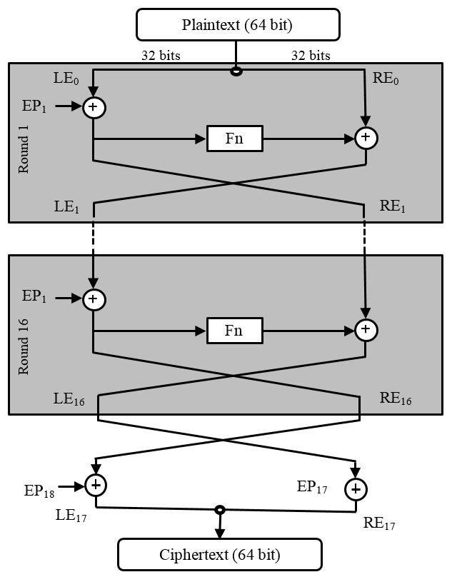
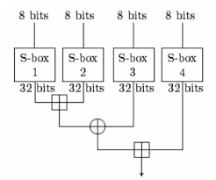
Blowfish Algorithm
Flow of Encryption Process
Flow diagram of function Fn

Slide 9
Proposed System:
Building a secured password management tool , this application is scalable and maintainable.
We are using technologies like maven, spring boot, spring security, junit, MySQL, jsp, hibernate.
Providing high security to the system by spring security framework. Spring Security provides an module for securing passwords.
The passwords are also encoded in database in most secured way.

Slide 10
Features of Spring Security
Protection against attacks like session fixation, bruteforce attacks.
JAAS(Java Authentication Authorization Servide) module.
Support java configuration
HTTP authentication
Password Storage
Web form authentication
Basic access authentication

Slide 11
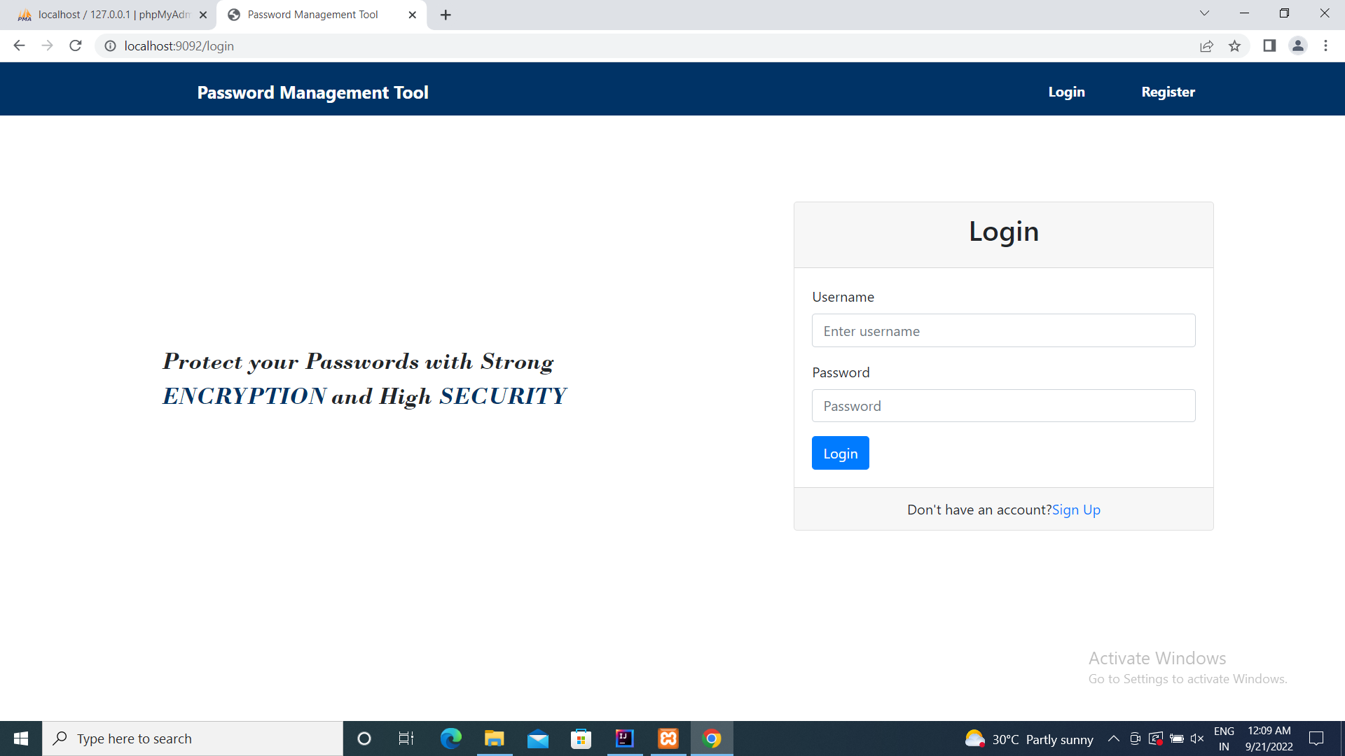
Results & Analysis

Slide 12
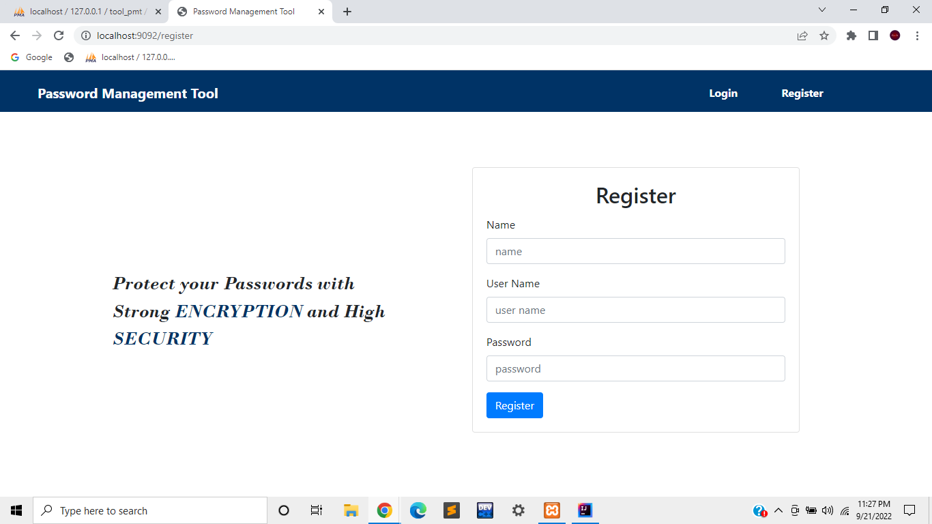
Register page.jsp

Slide 13
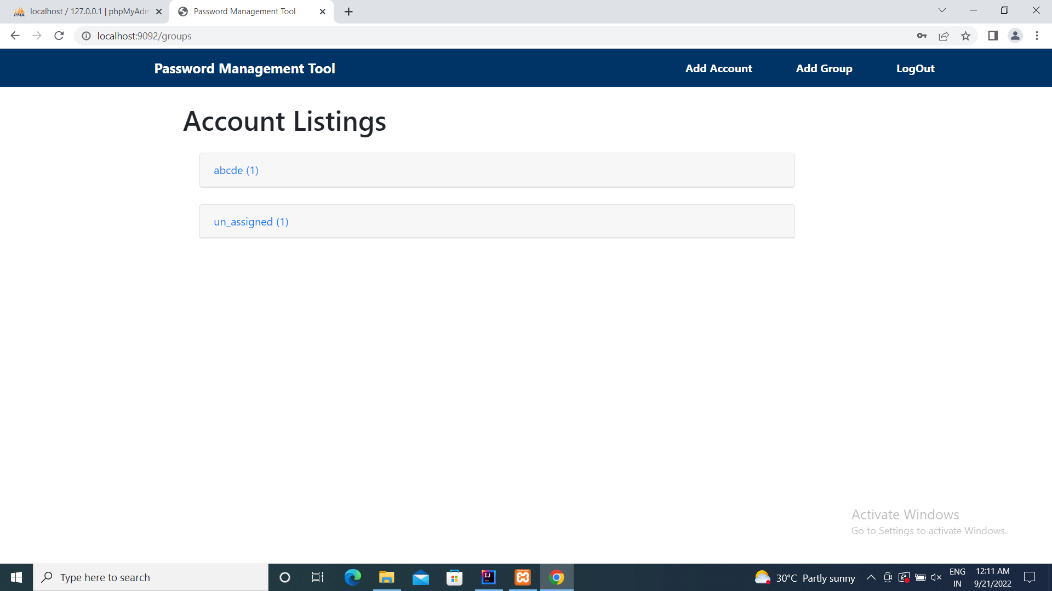
Home page - dashboard

Slide 14
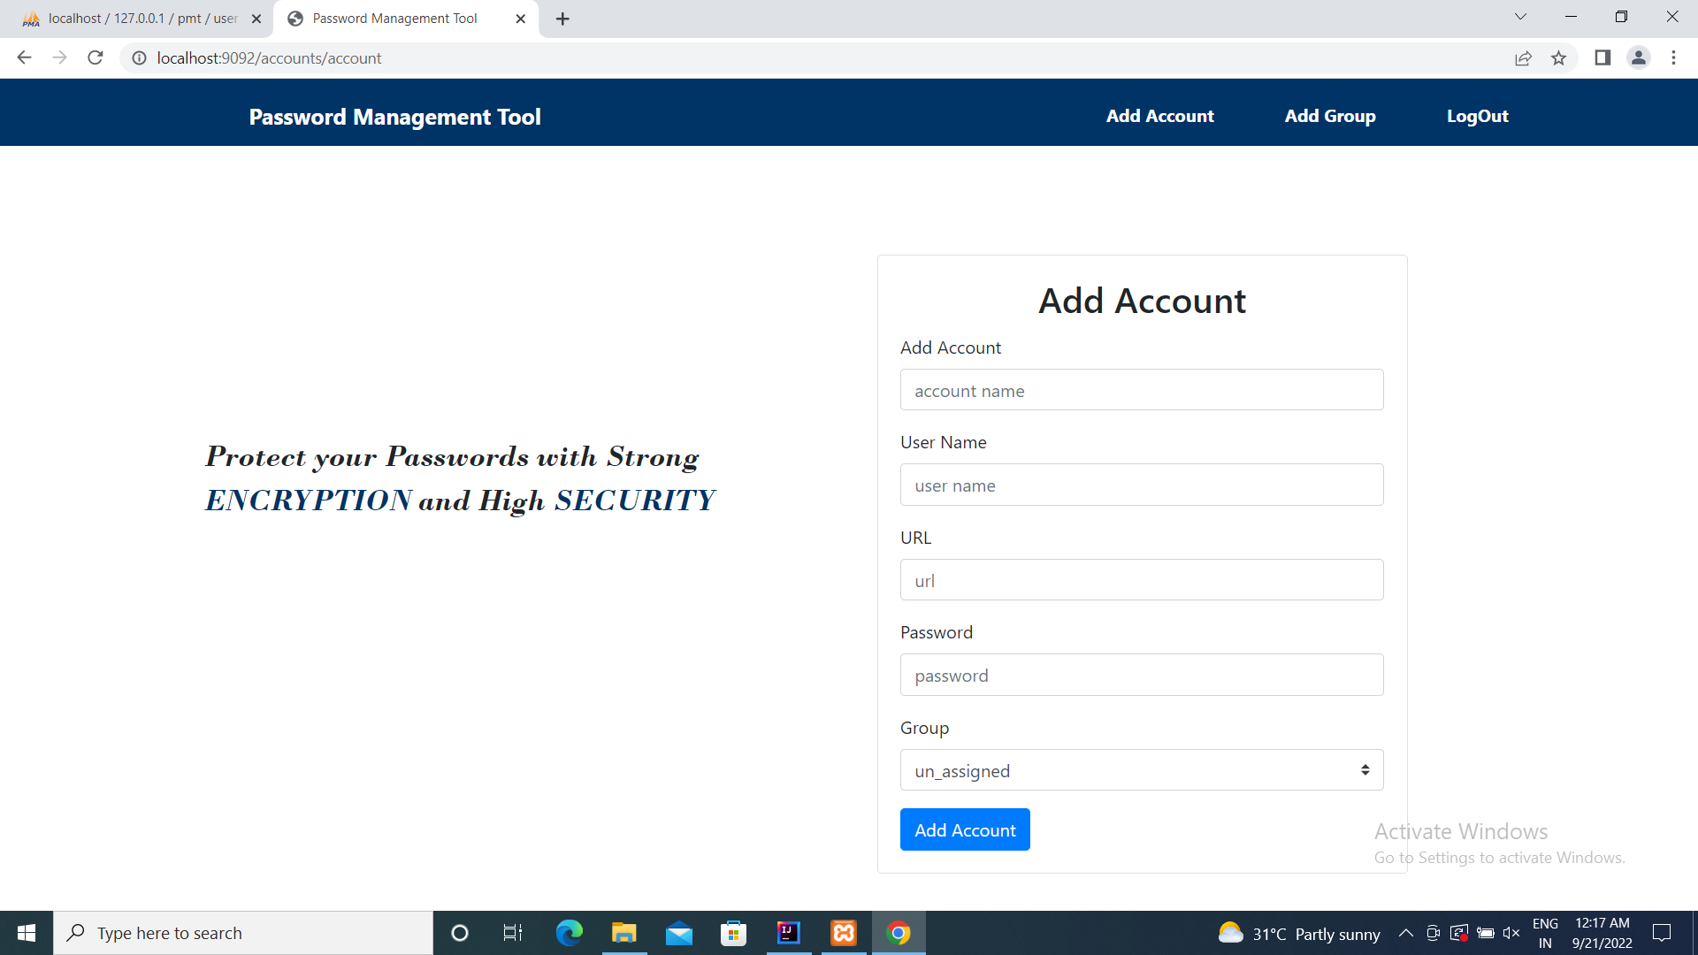
Addaccount.jsp

Slide 15
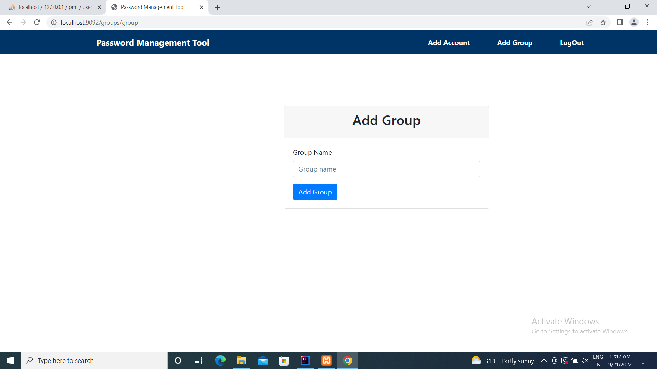
Add group.jsp page

Slide 16
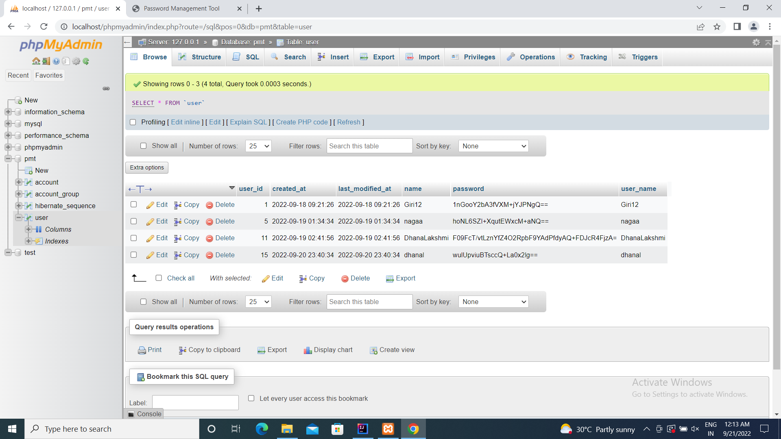

Slide 17
Conclusion
This project Password Management Tool was successfully executed by our team to check the end results using a database and it is found that our proposed system provides efficient and effective result when compared to existing system. It is a web application to store our passwords securely and it is implemented through jsp, spring boot and spring security. It also provides best user experience and user interface. This software is purely for solving the problems related to the security.

Slide 18
References
Author & Year | Title of the Reference Paper | Publisher | Analysis
Mingyan Wang | The Design and Implementation of Passwords Management System Based on Blowfish Cryptographic Algorithm | IEEE | A design and implementation of Passwords Management System (PMS), by which you can manage passwords.It was made based on Blowfish Algorithm.
Design and Implementation of password Management System
https://ieeexplore.ieee.org/document/5385014
Spring Boot Tutorial
https://www.youtube.com/watch?v=msXL2oDexqw
https://www.youtube.com/c/JavaBrainsChannel

Slide 19
Thank you

