Slide 1
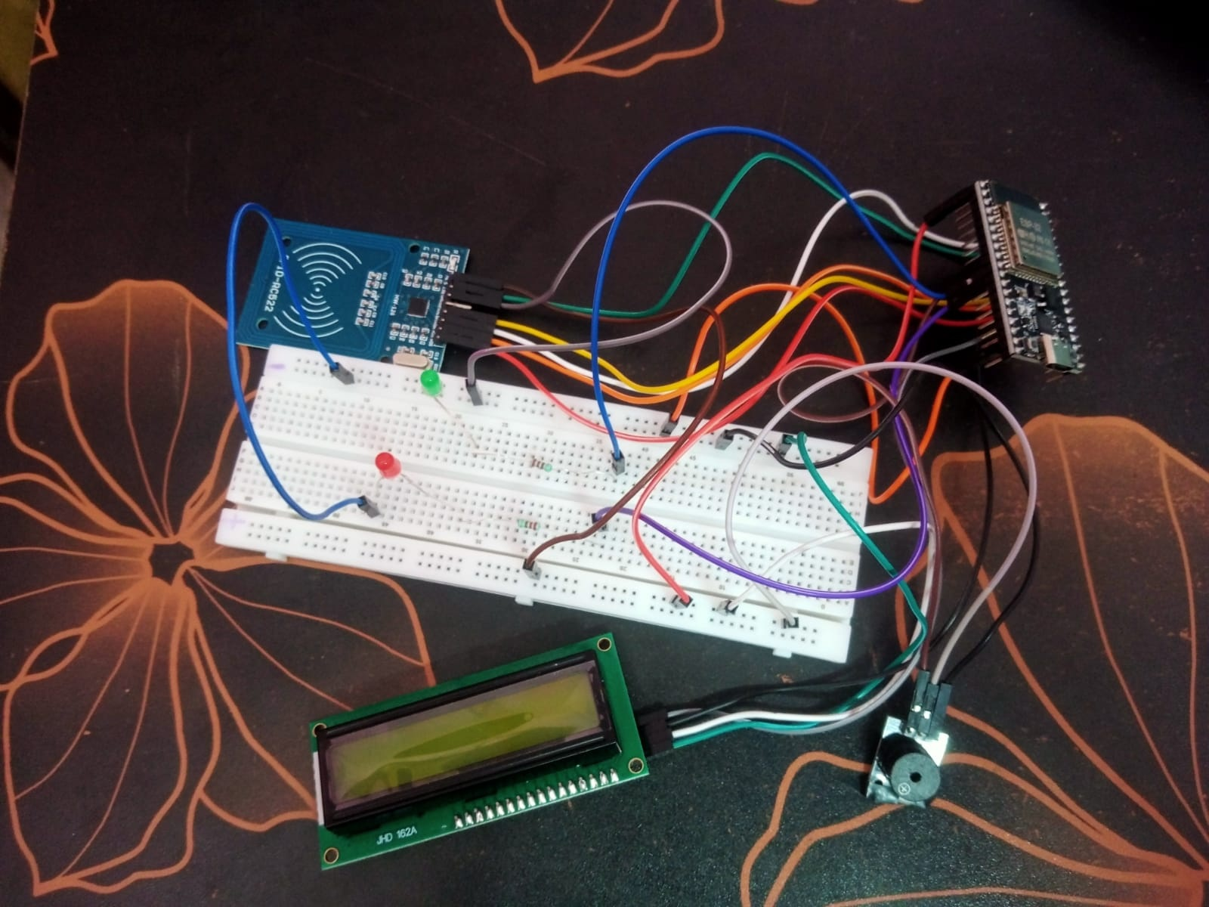
IOT & ROBOTICS | MAJOR PROJECT
SMART ATTENDANCE
SYSTEM USING RFID
ESP32 • RC522 RFID • 16x2 I2C LCD
LED and buzzer feedback
PROJECT DOCUMENTATION
Source code, circuit and test results
Prototype photograph supplied by project team

Slide 2
Problem Statement & Aim
Why an RFID-based approach is useful
Problem
Project aim
Manual attendance can take time and can lead to recording errors. Maintaining consistent and easily retrievable attendance records can be difficult with purely manual methods.
Build a small prototype that reads an RFID card, checks whether its UID is registered, and provides immediate LCD, LED, buzzer, and Serial Monitor feedback.
RFID helps automate card identification; a card UID alone does not prove the cardholder's identity.
2

Slide 3
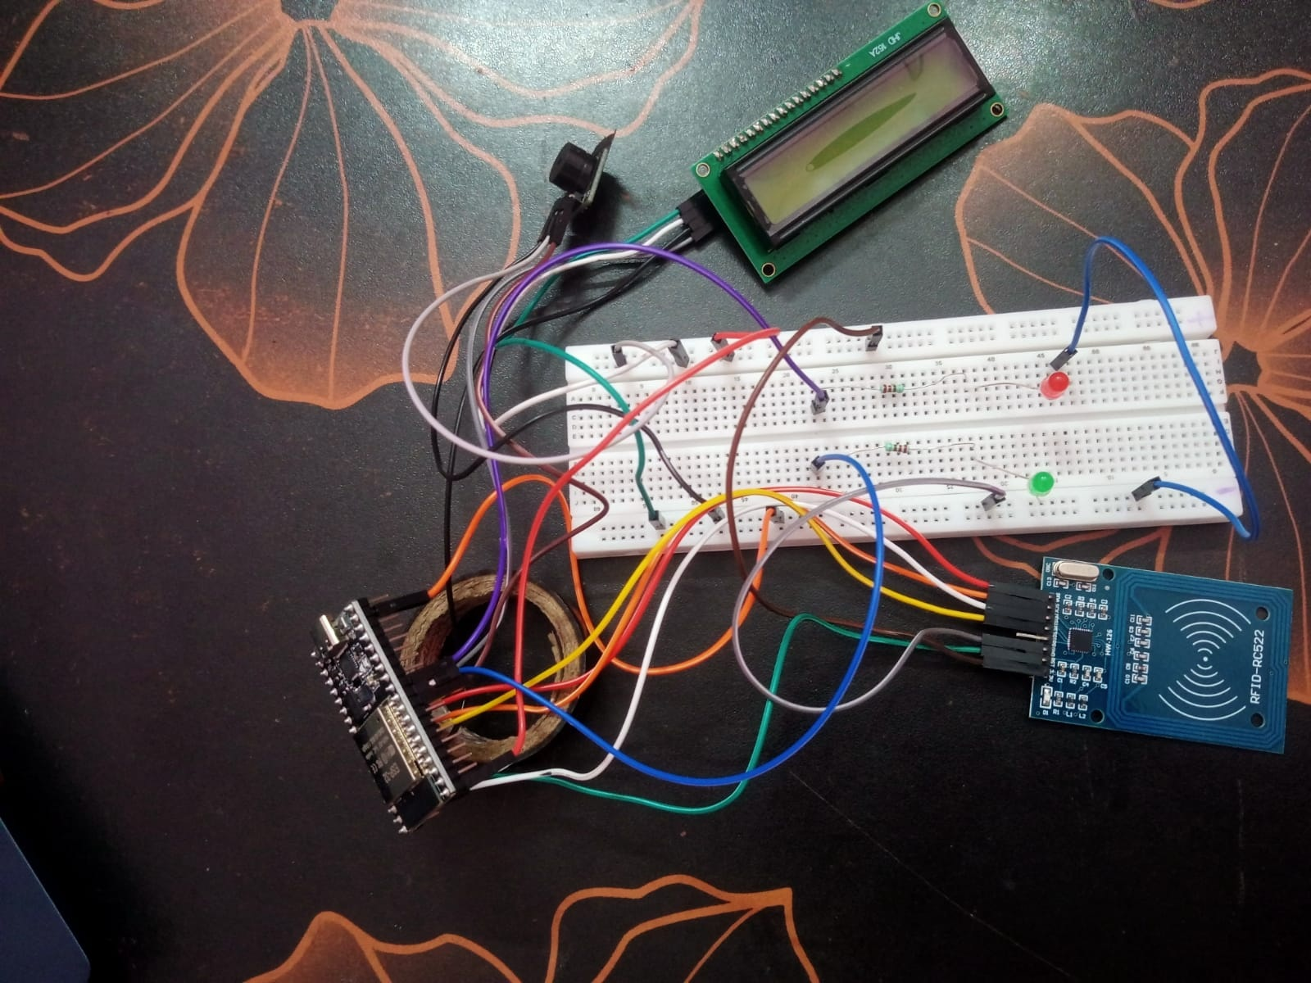
Objectives
Functions implemented in the supplied firmware
Read RC522 cards through SPI on the ESP32.
Map registered card UIDs to student names.
Store student registrations in ESP32 Preferences.
Show prompts and status messages on a 16x2 LCD.
Use red/green LEDs and a buzzer for feedback.
Prevent a second attendance mark for the same UID during the current power session.
Physical assembly documented in the supplied photo.
3

Slide 4
Hardware Components
Components used in the completed and tested prototype
ESP32
RC522 RFID
16x2 I2C LCD
Controller and program storage.
Reads a compatible card/tag UID.
Local prompts and result messages.
Green + red LEDs
Buzzer module
Breadboard + wires
Visual feedback through 220 Ω resistors.
Provides audible feedback for scan results.
Prototyping interconnections.
4

Slide 5
System Architecture
Data and control flow
RFID Card
RC522
ESP32
Outputs
Serial Monitor
UID presented
Reads card UID
Checks registration
and duplicate state
LCD + LEDs + buzzer
Status / event log
Persistent data
Session data
Registered UID/name mappings stored using ESP32 Preferences.
Attendance de-duplication is in RAM and resets after power cycle.
5

Slide 6
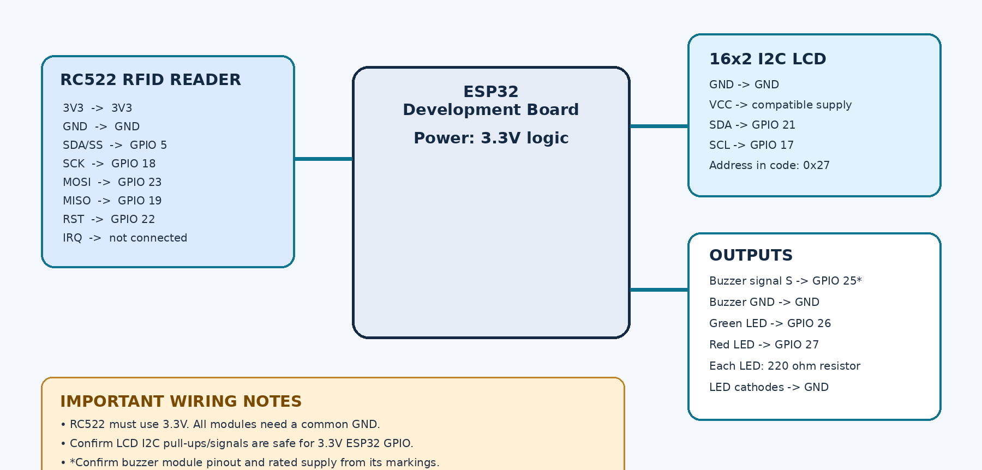
Circuit Design & Pin Mapping
Pin mapping used in the tested prototype
Safety: RC522 uses 3.3V; ensure LCD I2C signals are 3.3V-safe; confirm buzzer pinout.
6

Slide 7
Working Principle
Card scan decision flow
1. Startup
2. Load records
Initialize Serial, GPIO, LCD, SPI and RC522.
Read registered student UID/name pairs from Preferences.
3. Scan card
4. Check UID
Read and normalize the RFID UID.
Unknown UID -> red LED and not-registered message.
5. Check duplicate
6. Mark attendance
Already marked this session -> already-marked message.
Registered, not yet marked -> green LED, name message and success beep.
7

Slide 8
Software Features & Serial Commands
Open Serial Monitor at 115200 baud; select Newline as line ending
Command | Purpose
HELP | Shows command list and usage.
LIST | Lists registered cards/names.
ADD <UID> <Name> | Registers or updates a card UID/name.
Example format
ADD 04:A1:B2:C3 Student One
Replace the example UID with the exact UID printed after a real card scan.
Time limitation
The code logs elapsed uptime (millis), not a calendar date/time. An RTC or synchronized time source would be needed for real timestamps.
8

Slide 9
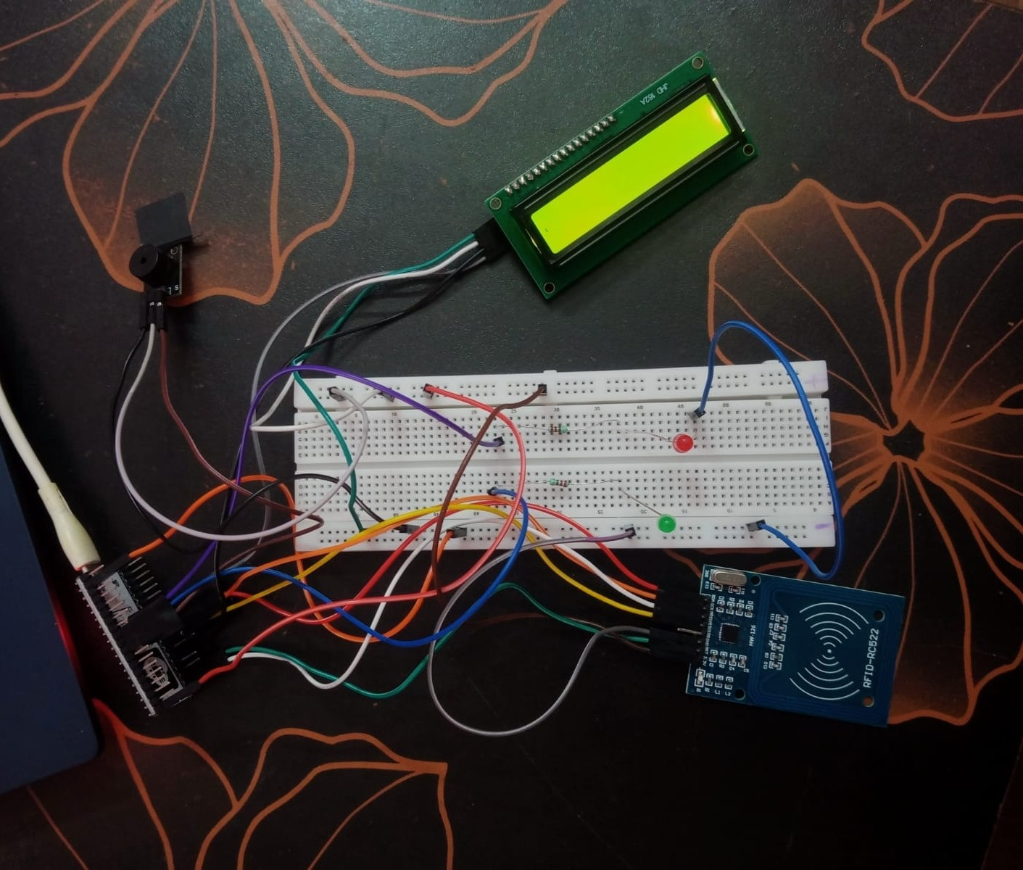
Prototype Photos
The pictures document the physical assembly
View 1
Alternate views
9

Slide 10
Testing & Results
All functional tests completed successfully on the assembled prototype
Assembly
Compilation & upload
LCD display
Completed prototype assembled and documented in photographs.
Firmware compiled and uploaded to the ESP32 successfully.
Startup message and “Scan your card” prompt displayed correctly.
RFID card tests passed
Indicators & Serial output
Registered card: attendance marked and student name displayed. Unregistered card: “Not registered”. Repeat scan: “Already marked”; no duplicate attendance during the current session.
Green LED and success beep confirmed accepted cards; red LED and error beeps flagged unregistered cards. Serial Monitor displayed card UIDs and attendance events.
10

Slide 11
CONCLUSION
The RFID attendance workflow was implemented and tested successfully.
The source code supports UID registration, student-name lookup, LCD status messages, LED/buzzer feedback, session duplicate checking, and serial logging.
Result: all functional tests in the implemented project scope passed successfully.
Smart Attendance System Using RFID | Major Project

