Slide 1
Scrap a Job Portal to Predict Salary

Slide 2



Our team
Mohith Sai Ram Reddy
J G Sukumar
Sambangi Nikhileswar

Slide 3
Table of contents
01
Introduction
02
03
04
Problem Statement
Motivation
Objective
05
06
07
08
Innovation
Use Case
Class Diagram
Code

Slide 4
01
Introduction

Slide 5
Introduction:
Determining an appropriate salary for a job can be a challenging task for
both job seekers and employers. This project proposes a solution to predict the salary of
a job posting by scraping a job portal:
Job portals and career websites are a valuable source of information about the job market, providing data on job titles, locations, and salaries.
However, collecting and analyzing this data can be time-consuming and tedious if done manually for aspirant from multiple websites
By using web scraping tool we collect job-related data, locations, organizations and can gain insights into job market trends, demand and other useful information which can be stored in a database, and trained and tested to a machine learning models to predict salaries
In this Project, we will explore the process of scraping a job portal to predict salary, and helping employer or job seeker by providing relevant information

Slide 6
02
Problem Statement

Slide 7

Problem Statement:
To develop a model to predict salary for job listings on a job portal by scraping data.
The model will provide accurate salary estimates for job seekers and help employers offer competitive salaries.

Slide 8
03
Motivation

Slide 9
Motivation
The motivation for scraping a job portal to predict salary from a job seeker's perspective is to provide job seekers with accurate salary estimates based on relevant job-related data
Accurate salary estimates can help job seekers identify job opportunities that offer competitive salaries that match their skills, experience, and qualifications. This can help job seekers achieve their career objectives and maximize their earning potential
Especially for aspiring job seekers, it is necessary to spend time brushing up on abilities and preparing for interviews. Searching for a job on various platforms requires a significant amount of time and energy. They would need a lot of time to analyze expected salary for a certain position because they were new to their pitch. So, we decided to create a tool to assist.

Slide 10
04
Objective

Slide 11
Objectives
Collecting data on job postings: The primary objective of scraping a job portal is to collect data on job postings, including job titles, job descriptions, location, industry, and other relevant information.
Extracting salary data: The second objective is to extract salary data from the job postings. This may involve identifying salary information in the job description or extracting salary data from structured fields in the job listing.
Cleaning and organizing data: Once the data has been collected and extracted, it will need to be cleaned and organized for analysis. This may involve removing duplicates, standardizing job titles, and resolving inconsistencies in the data.
Training a machine learning model: The final objective is to use the cleaned and organized data to train a machine learning model that can predict salaries based on job title, industry, location, and other factors. The model should be validated using a test
User Interface: Making user friendly Ui such that anyone can easily understand and use our application

Slide 12
05
Innovation

Slide 13
Innovation
Today's job seekers must rely on a variety of platforms to get results relevant to their location and skill sets. We developed a platform that scrapes the job data from many platforms and gives users results based on data such as required skills, location etc... In order to prevent the position from being filled or expiring, we have also ensured that the posting is scraped is listed on or before 14 days. We also worked on a crucial topic related to pay negotiations. Many job seekers nowadays, especially recent graduates, are unaware of the salary range for the positions they are applying for. They are thereby missing the real potential payoff. The primary cause, they discovered, was that the job seeker was highly focused on his preparation and didn't have time to look at market trends or conduct salary research before accepting a position. The feature was created by us to assist numerous job seekers in identifying their possible payoff.

Slide 14
06
Use Case Diagram

Slide 15
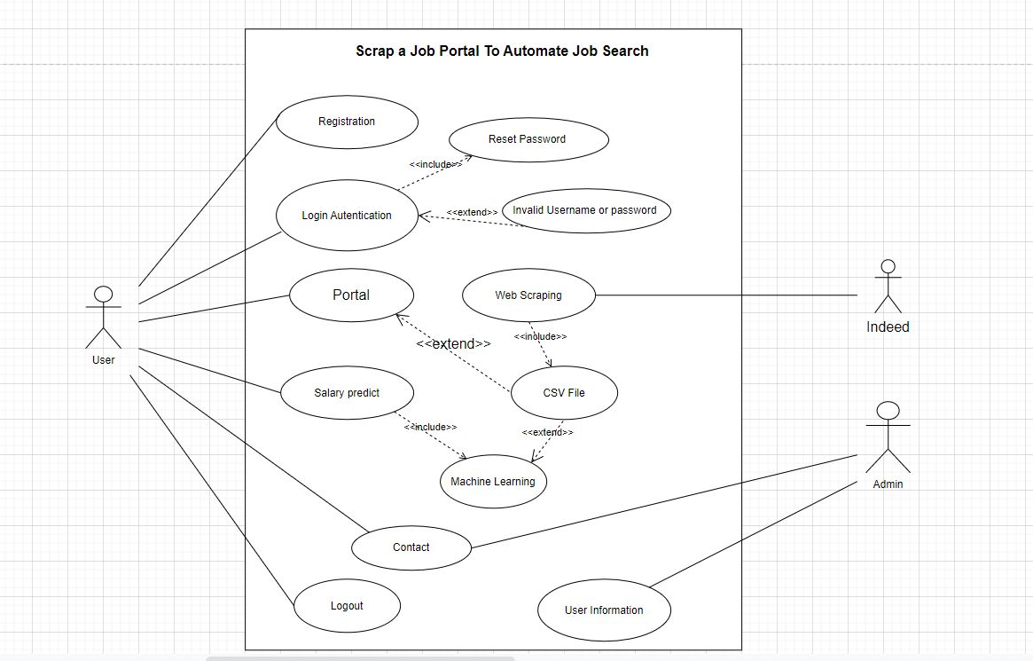

Slide 16
07
Class Diagram

Slide 17
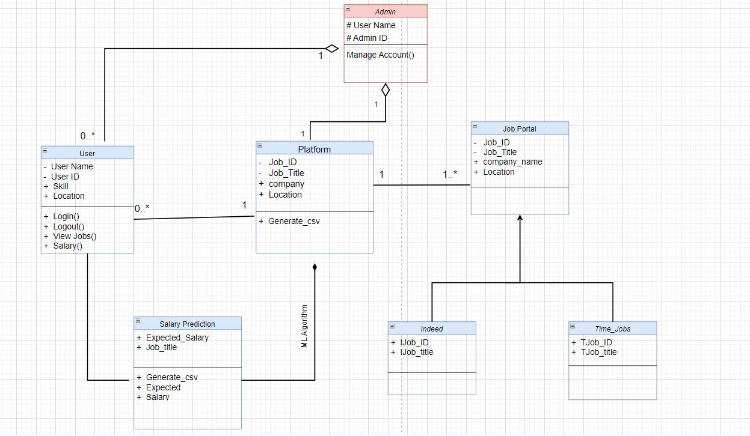

Slide 18
08
Code

Slide 19
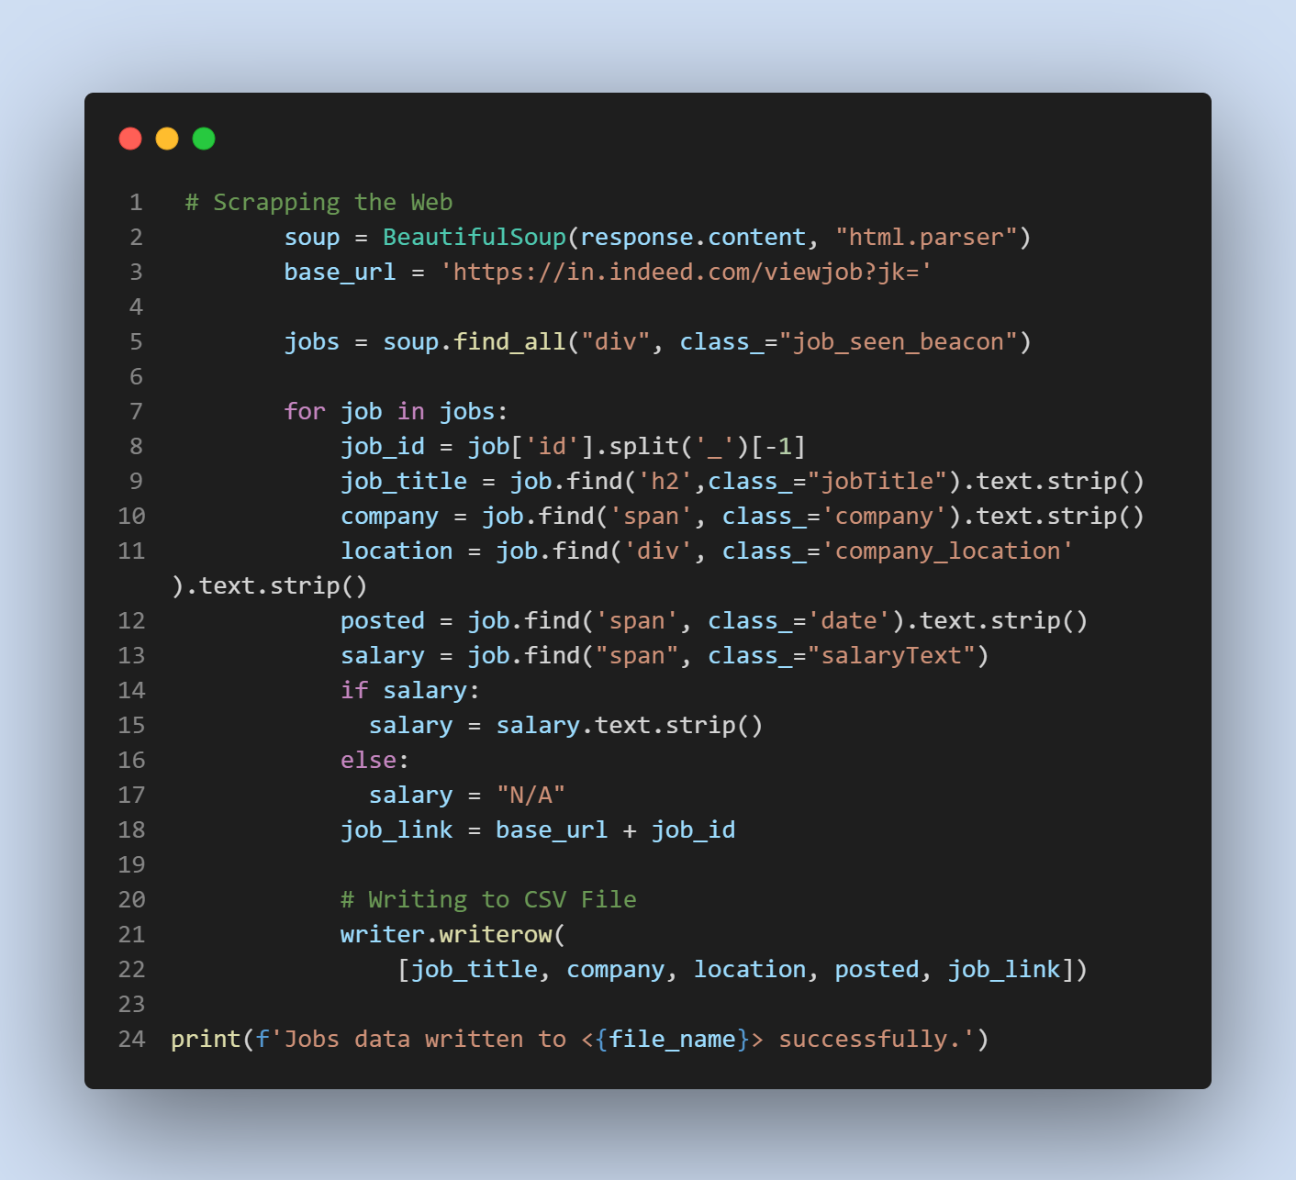
Web Scrapping
To Access Full Code click here

Slide 20
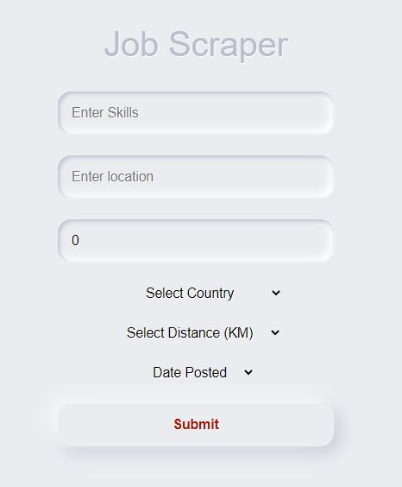
Job Search Portal

Slide 21
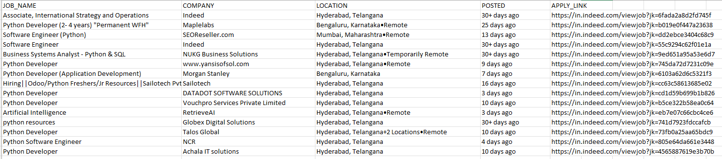
CSV Output:
Input:
Skill : Python
Location : Hyderabad

Slide 22


