Slide 1
🐾
PawPal+
A pet-care planner that decides what matters first — and shows its work.
My final project demo · built by Giridhar

Slide 2
THE PROBLEM — WHAT I SOLVED
Caring for a pet is a lot to track
• Owners juggle feeding, meds, walks, and grooming — every single day.
• The tasks that matter most for a pet's health are the easiest to forget.
• A plain to-do list doesn't tell you what to do first, or why.
• I wanted a planner that makes that call — and explains it.

Slide 3
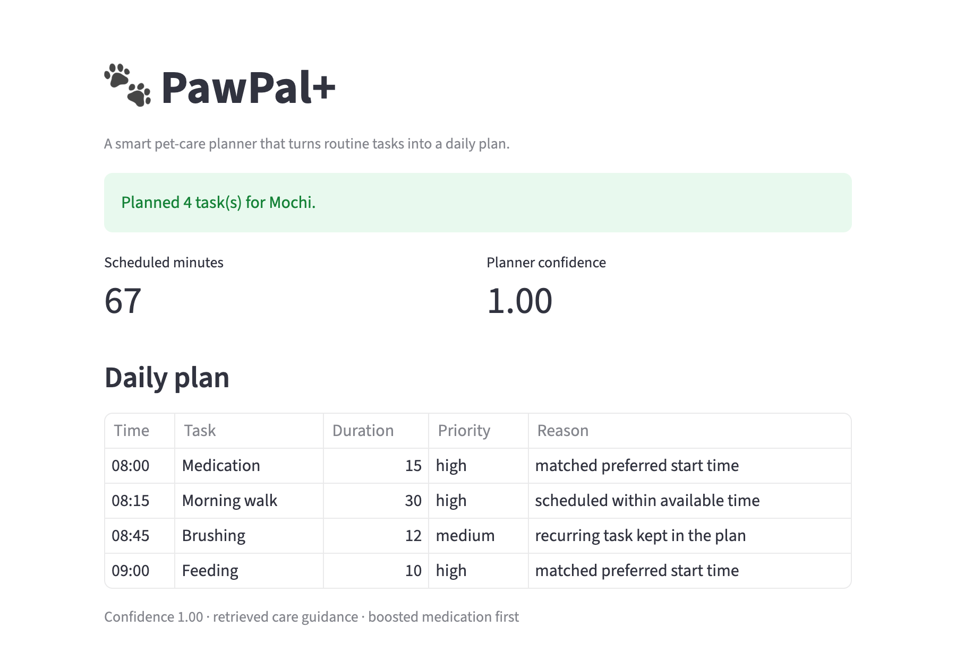
THE LOGIC — HOW THE AI THINKS
It looks things up, then plans in steps
An agentic loop: retrieve → prioritize → plan → check → fix.
THE LIVE APP
1
Look it up
Pulls care guidance for each task from a small knowledge base.
2
Prioritize
Boosts safety-first tasks: meds › feeding › walks › grooming.
3
Plan & check
Builds the day, then scans for time clashes and overlaps.
4
Fix & score
Resolves conflicts and reports a 0–1 confidence score.
Every step is logged to a trace — you can read why the plan came out this way.

Slide 4
THE RELIABILITY — HOW I KNOW IT WORKS
Tested, and honest when it's unsure
11/11
1.00
4
automated tests pass
confidence when the plan fits
cases I checked by hand
• Tests cover the boosts, the scheduling, conflict detection, and skips.
• Guardrails: empty names and no-task runs are caught, not crashed.
• When a task can't fit the day, it's skipped and the confidence drops — no pretending.

Slide 5
THE REFLECTION — WHAT SURPRISED ME
Small ideas, surprisingly big payoff
• A tiny knowledge base + simple boosts beat a plain scheduler — no big model needed.
• Just showing the reasoning trace made the tool feel far more trustworthy.
• The AI helped most with clean class design early on.
• It also steered me wrong once: it checked conflicts by exact start-time only, missing overlaps — I caught it and fixed it with proper slot checks.
Biggest lesson: a system you can see into is easier to trust than one that's just "smart."

Slide 6
Thanks — questions? 🐾
Happy to walk through the code or the planner trace.
github.com/Giridhar555/ai110-module2show-pawpal-starter

