Slide 1
AI-POWERED JOB RECOMMENDATION & CAREER INSIGHTS DASHBOARD
Team G: Giridhar Sriram Janga, Sai Bhargav Karnati, Jayanth Rachuri
GitHub: https://github.com/GiridharSriramJanga/Data_606_Team-G

Slide 2
CONTENTS
01. Introduction
Problem statement, motivation, and research questions driving our
Al solution.
02. Literature Review
Current industry practices, existing solutions, and identified gaps in job matching.
03. Dataset Overview
Glassdoor job postings, resume data, attributes, and growth projections.
04. Proposed Methods
NLP techniques, ML models, and dashboard implementation strategies.
05. EDA & Analysis
Visual insights on job trends, salary distributions, and skill demands.
06. Timeline & Next Steps
Development roadmap, modeling phases, and dashboard
deployment plans.

Slide 3
INTRODUCTION
Problem:
Job seekers struggle with filtering countless postings and understanding market trends. Our Al system addresses both challenges through personalized recommendations and real-time career insights.
Motivation:
Bridge the gap between job seekers and opportunities using data-driven insights for informed career decisions.
Research Question:
How can Al improve job matching accuracy?
What insights drive better career decisions for data professionals?

Slide 4
LITERATURE/INDUSTRY RESEARCH
Current Industry Solutions:
Major platforms like Linkedin and Indeed use basic keyword matching and collaborative filtering for job recommendations.
Netflix: Recommendation system responsible for ~80% of hours streamed (Gómez-Uribe & Hunt, 2015; Pajkovic et al., 2022).
Amazon: ~35% of total sales are generated from recommendation-driven features (PingAx, 2025; SuperAGI, 2025).
Amazon Personalization: Intent-aware recommendation modeling improved business metrics by ~10% (Zhou et al., 2023, arXiv).
Identified Gaps & Opportunities:
Existing systems lack real-time market insights and personalized career guidance.
Limited real-time salary and skill trend analysis
Many rely on keyword or collaborative filtering, limited adoption of semantic NLP embeddings for resume-job matching
Lack of career path and upskilling recommendations

Slide 5
DATASET OVERVIEW
1700+ INITIAL RECORDS
6000 MONTHLY GROWTH
20000 PROJECTED TOTAL
1500 WEEKLY NEW
PRIMARY DATASET: Glassdoor job postings scraped weekly with comprehensive job market data
• Job titles, companies, locations
• Salary estimates and company ratings
• Detailed job descriptions (unstructured text)
USER DATASET: Personal resumes and portfolios parsed for skill extraction and matching
• Skills, experiences, education data
• Used for personalized recommendations
• Real-time profile updates and matching
DATA STORAGE: AWS S3 with automated pipeline for continuous data collection
• Real-time updates and processing
• Scalable cloud infrastructure
• Trend analysis capability

Slide 6
PROPOSED METHODS
Data Pipeline & Storage
Automated scraper → AWS S3 → Cleaning & transformation → Historical records for trend analysis
NLP for Resume–Job Matching
Skill extraction (NER) + preprocessing
Semantic similarity via BERT embeddings + cosine similarity
Baseline: TF-IDF + Logistic Regression for comparison
ML Classification & Forecasting
Binary classification: Predict “good fit” vs. “not fit”
Forecast skill demand with ARIMA & Prophet → evaluate with RMSE / MAPE
Evaluation & Metrics
Matching: Precision@K, Recall@K, F1-score
Forecasting: RMSE, MAE, MAPE
Dashboard: interpretability & user feedback
Interactive Dashboard
Tableau/Power BI implementation
Real-time updates & personalized insights
Visuals: salary trends, skill demand, geographic distribution

Slide 7
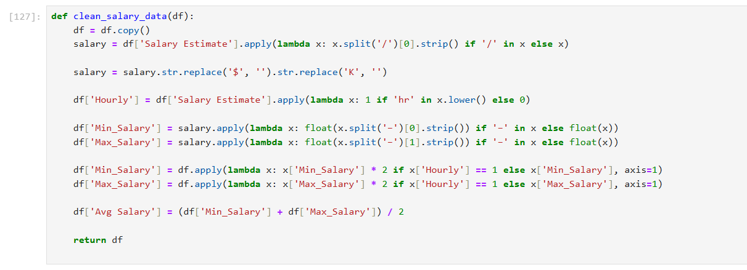
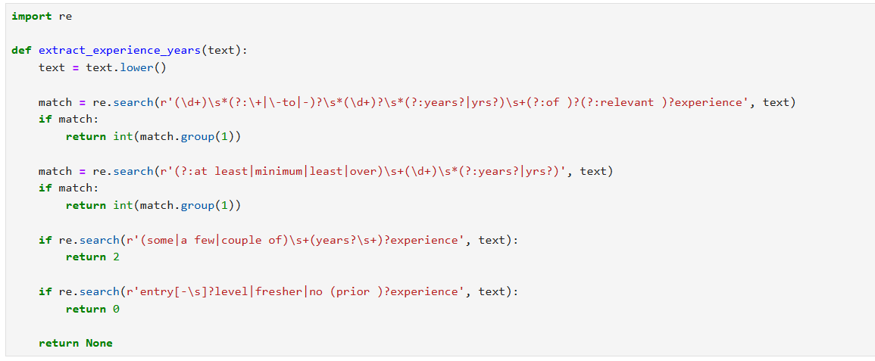
Data Cleaning and Transformation:
Job Title Cleaned
Salary data Cleaned
Extracted Skills, Experience etc.,.
Created new features for EDA

Slide 8
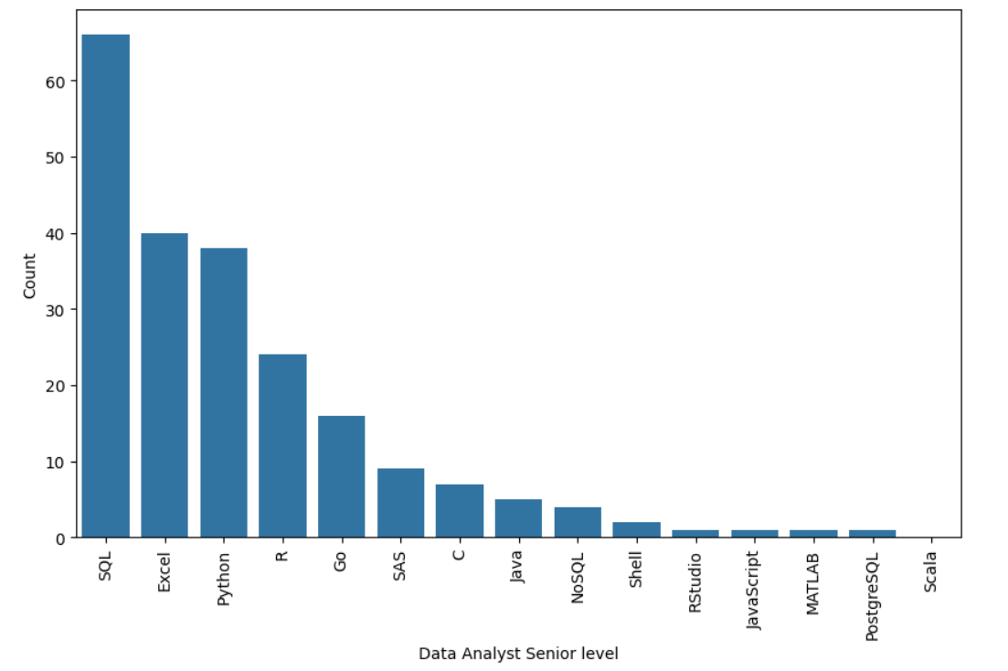
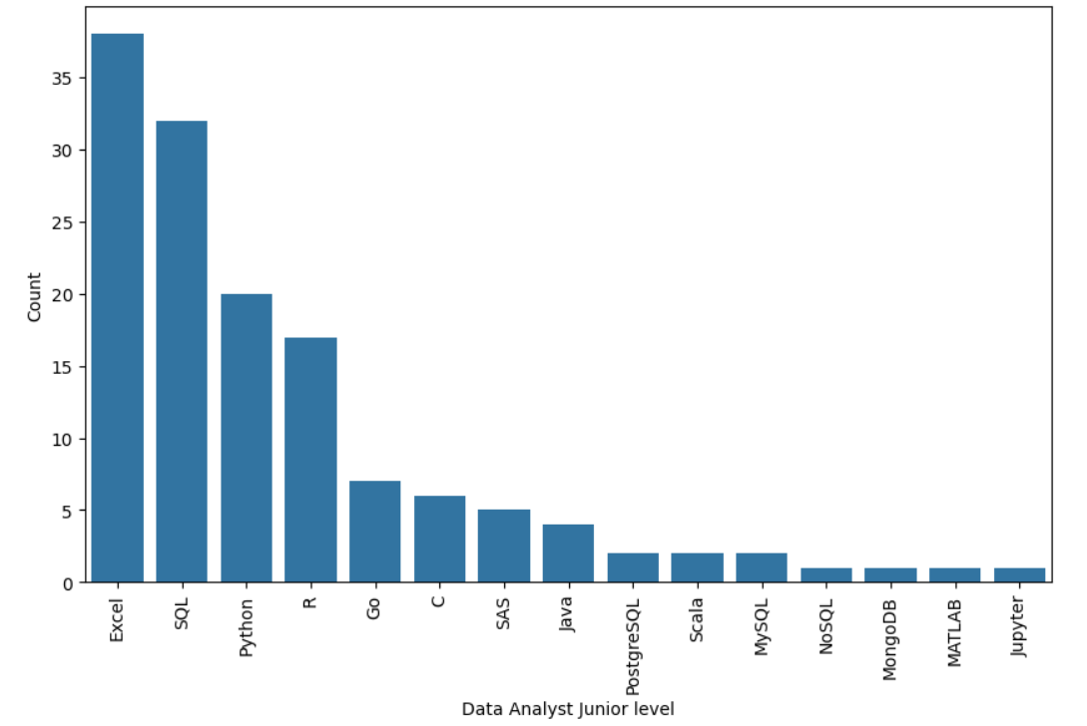
Exploratory Data Analysis: Skills By Seniority level
Entry-Level Analysts: Around 26% Excel, 22% SQL, and 14% Python
Senior-Level Analysts: Around 30% SQL, 18% Excel, and 17% Python

Slide 9
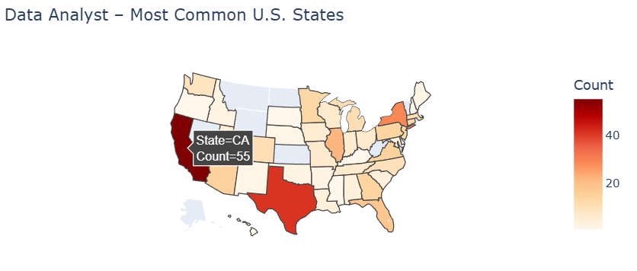
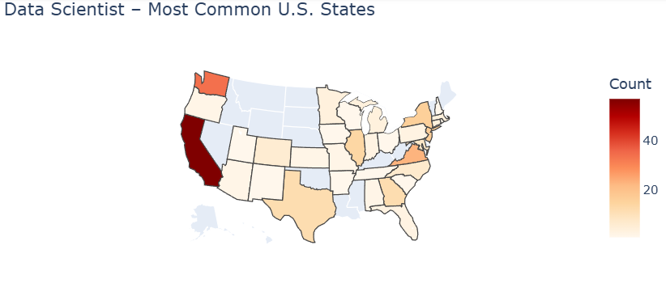
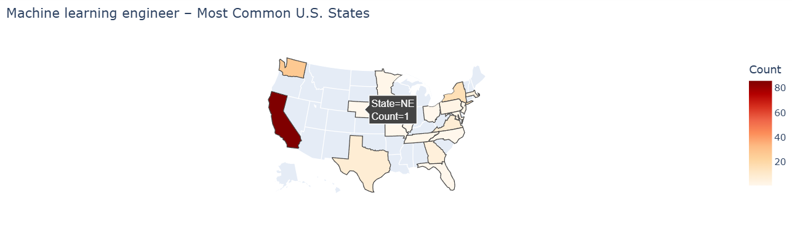
Exploratory Data Analysis: Location
Data Analysts show broader distribution, suggesting demand across industries (finance, healthcare, retail) nationwide.
Data Scientist and ML Engineer roles are concentrated in specific hubs like California, Washington and New York.
Advanced roles cluster in established firms, while analyst positions appear across more diverse organizations.

Slide 10
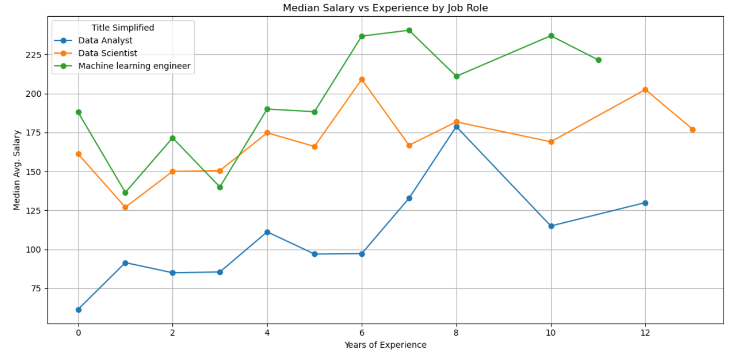
Exploratory Data Analysis: Salary Progression
Start small, grow big
Upskill for progress
Specialize to maximize

Slide 11
GITHUB PAGE
Link: https://github.com/GiridharSriramJanga/Data_606_Team-G

Slide 12
TIMELINE & NEXT STEPS
Week 5–6:
Finalize data pipeline, continue scraping.
Week 7–8:
Implement NLP models for skill extraction and job matching.
Week 9–10:
Build classification & forecasting models.
Week 11–12:
Develop an interactive dashboard in Tableau/Power BI.
Week 13+:
Testing, refinement, final report & presentation

Slide 13
REFERENCES
Gómez-Uribe, C. A., & Hunt, N. (2015). The Netflix Recommender System: Algorithms, Business Value, and Innovation. ACM Transactions on Management Information Systems. [DOI: 10.1145/2843948]Pajkovic, N., et al. (2022).
Exposing the Netflix Recommender System’s Operational Metrics. Convergence: The International Journal of Research into New Media Technologies. [SAGE Journals]
PingAx (2025).Case Study: Amazon’s Recommendation Engine. Retrieved from pingax.com - https://pingax.com/data-analytics/successful-projects/examples-of-impactful-projects/case-study-amazons-recommendation-engine/
SuperAGI (2025).Case Studies: How Top Brands Use AI Recommendation Engines to Boost Sales. Retrieved from superagi.com - https://superagi.com/case-studies-how-top-brands-are-using-ai-recommendation-engines-to-boost-sales-and-customer-satisfaction-in-2025/
Zhou, Y., et al. (2023). Learning to Personalize Recommendations Based on Customers’ Shopping Intents. arXiv preprint [arXiv:2305.05279]

