Slide 1

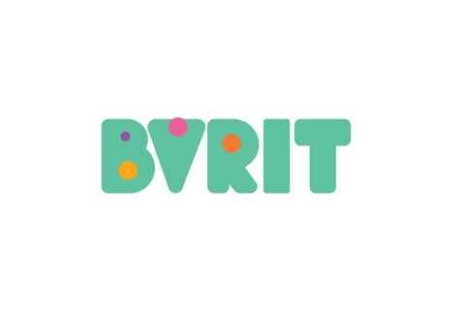
GUIDE TEAM Vijaya Katturi 23215A1205 Prathyusha [Assistant Professor] 23215A1201 Keerthana 22211A1255 Ruthish
AUTOMATED JOB APPLICATION AND
RESUME CUSTOMIZATION SYSTEM

Slide 2
CONTENT
01
04
02
05
03
06
07
ABSTRACT
EXISTING SYSTEM
PROBLEM STATEMENT
PROPOSED SYSTEM
SOFTWARE REQUIREMENTS
FLOWCHART
CONCLUSION

Slide 3
This project automates the job application process using AI and automation technologies to help users efficiently find job opportunities, customize resumes and submit applications with minimal effort. It scrapes job listings from platforms like LinkedIn and Glassdoor, matches them with the user’s skills and enhances resumes using NLP for better ATS compatibility. Refine resumes use AI suggestions. Finally, the system automates job applications by auto-filling forms and uploading tailored resumes, streamlining the process and increasing the chances of getting shortlisted.
ABSTRACT

Slide 4
Job seekers often struggle with manually searching for job opportunities, which takes a lot of time and effort. Tailoring resumes to match each job description and may miss important details applying to multiple jobs involves repetitive tasks that can be tedious and inefficient.
PROBLEM STATEMENT

Slide 5
SOFTWARE REQUIREMENTS
Frontend : React + vite ,Typescript, Tailwind CSS
Backend : Python –Recommended for NLPspacy, selenium, Gemini ,Jsearch
Database : Supabase

Slide 6
EXISTING SYSTEM
In the traditional job application process highly manual and inefficient, job seekers have to search for job openings manually across multiple platforms, which takes a lot of time . This repetitive process often leads to delays and missed opportunities, making job hunting less efficient.
Drawbacks/Limitations:
Manual job searching is time-consuming and overwhelming.
Manually checking job eligibility (skills, experience, location) is tedious.
Repetitive tasks in filling out applications lead to inefficiency.
Making resumes match different job descriptions takes a lot of time and effort.

Slide 7
PROPOSED SYSTEM
The proposed system automates the entire job application process using AI, NLP, and web automation.
Automated Job Search
AI-Powered Resume Customization
Web Automation for Applications

Slide 8
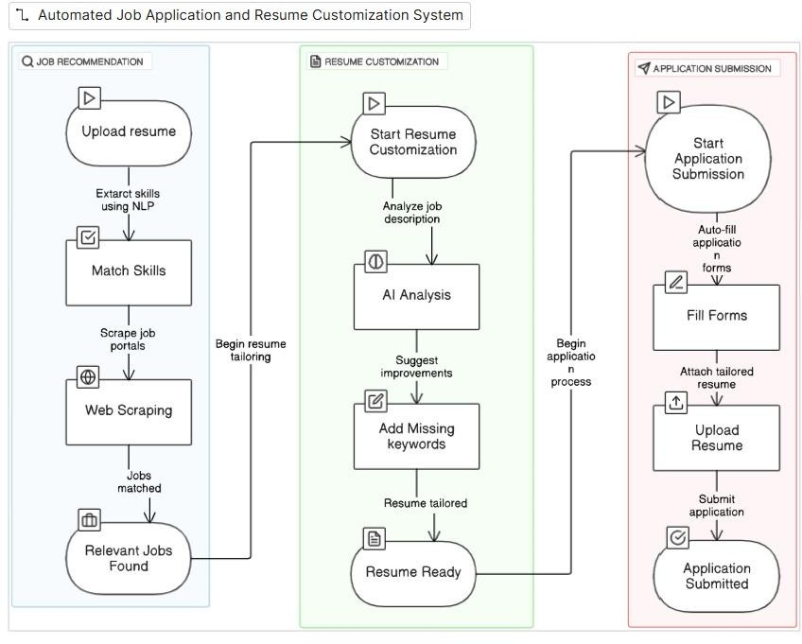
Flowchart:

Slide 9
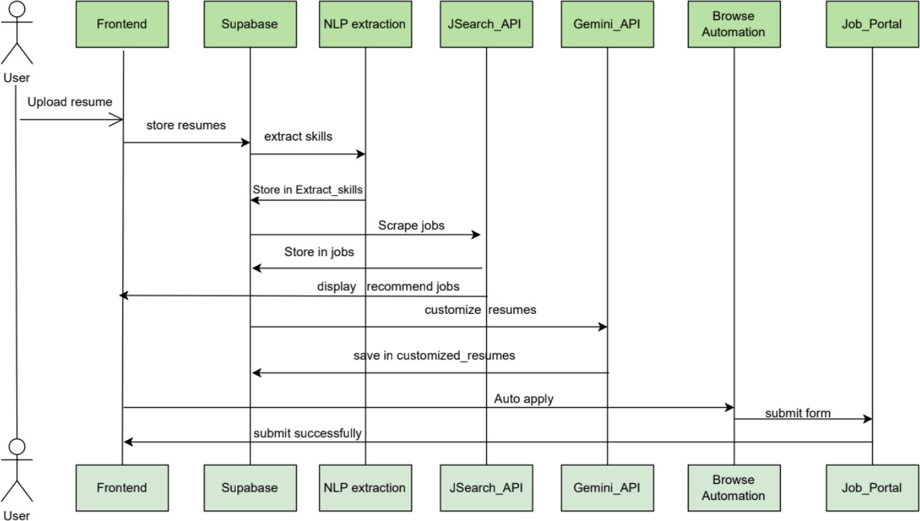
Dataflow Diagram:

Slide 10
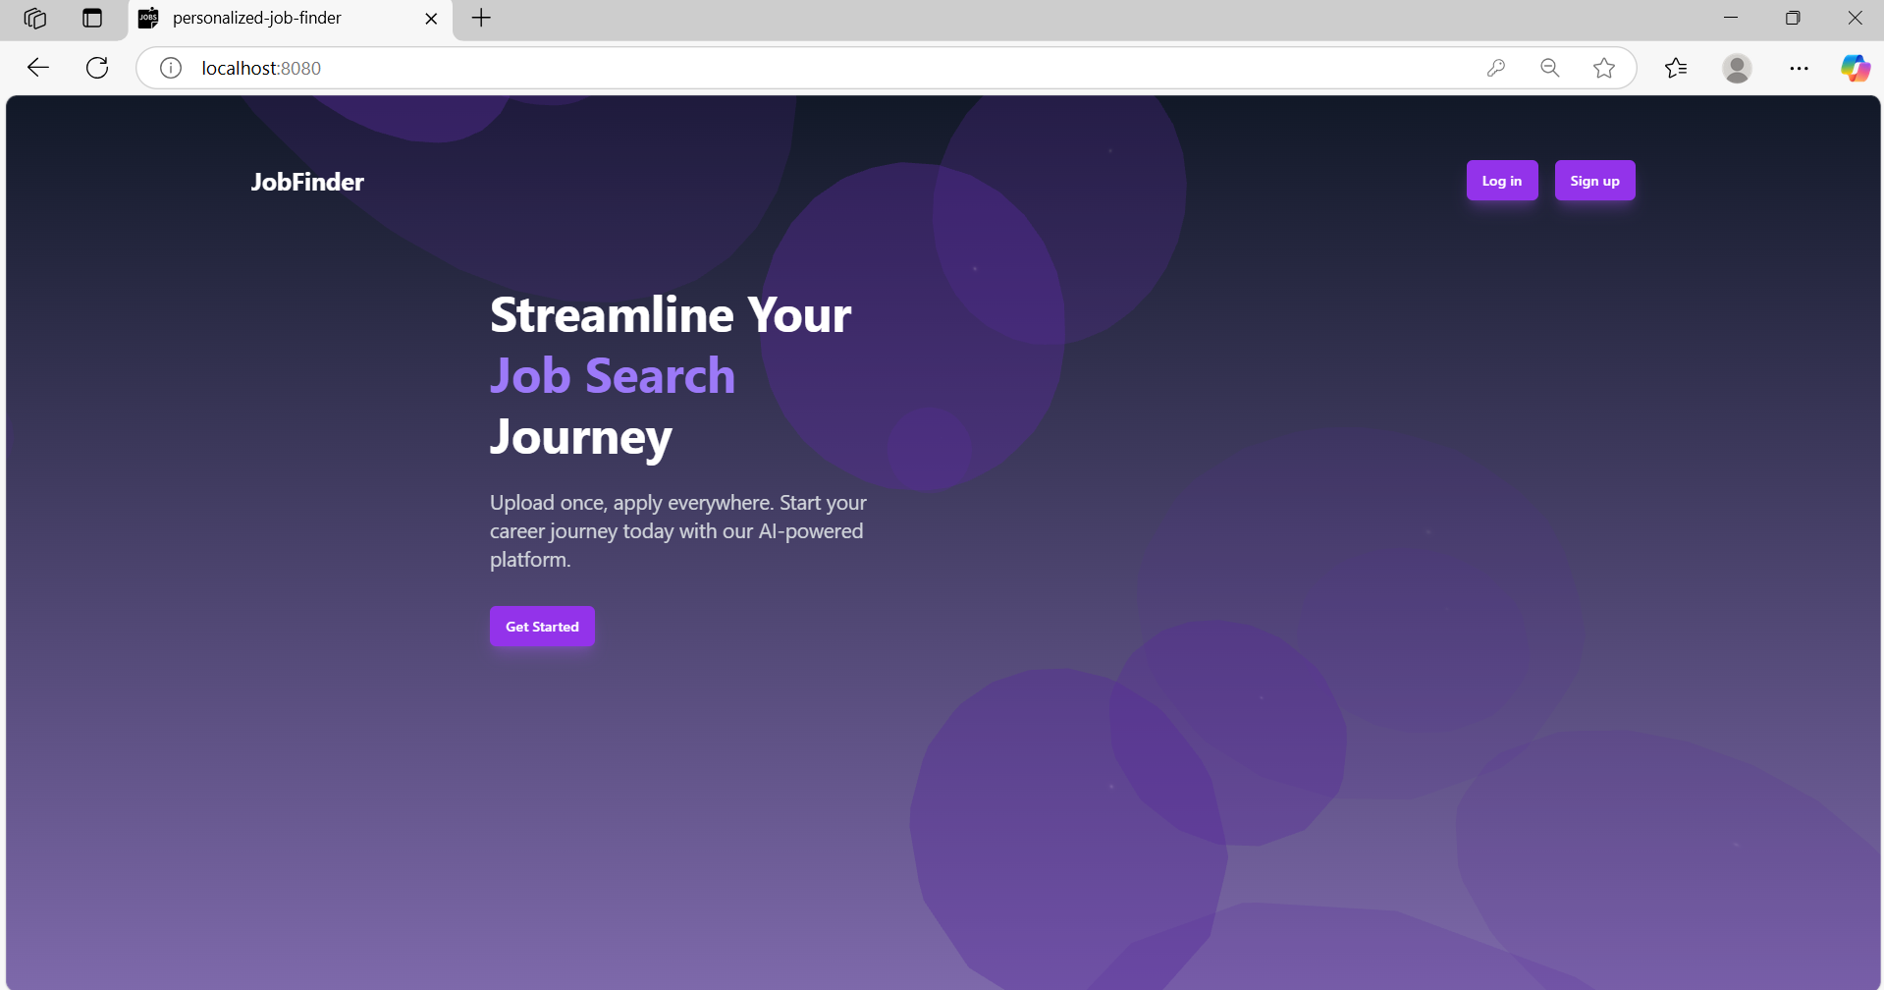
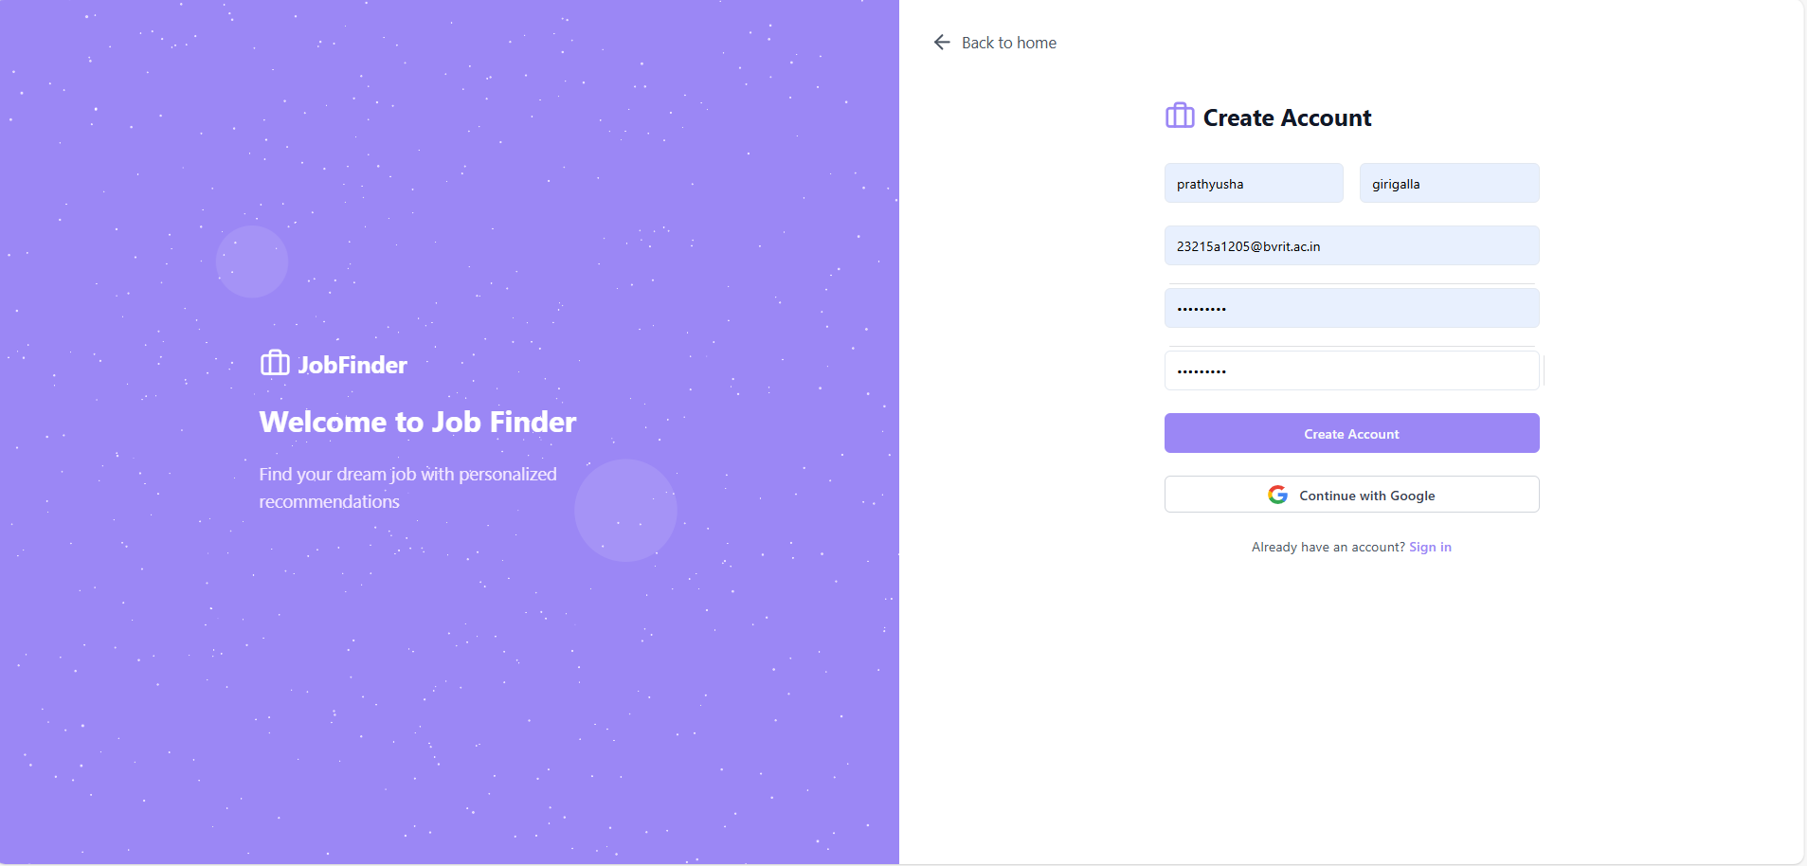
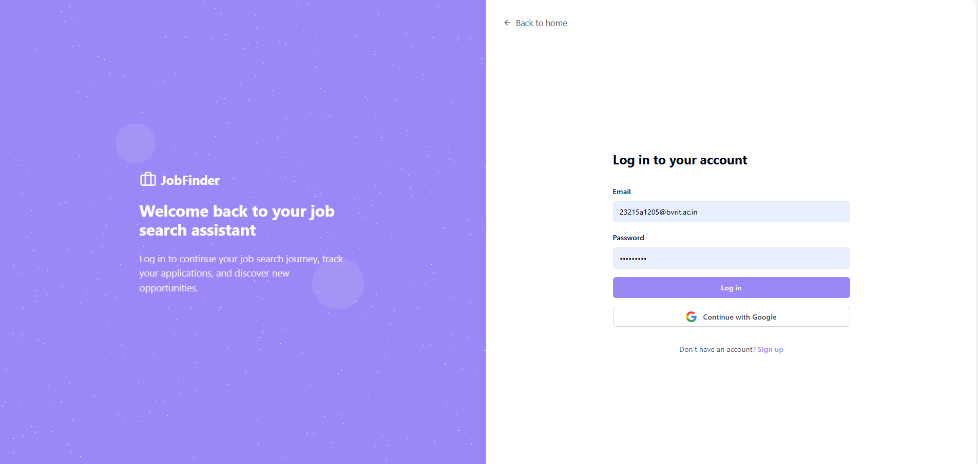
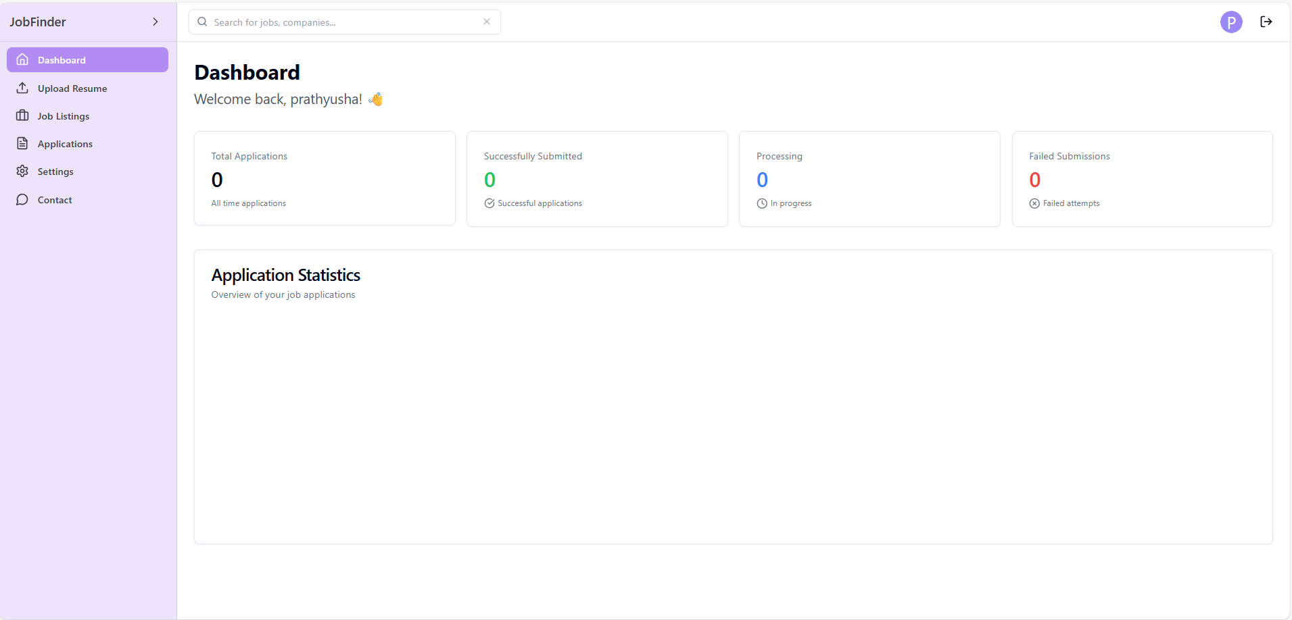
Screenshots:

Slide 11
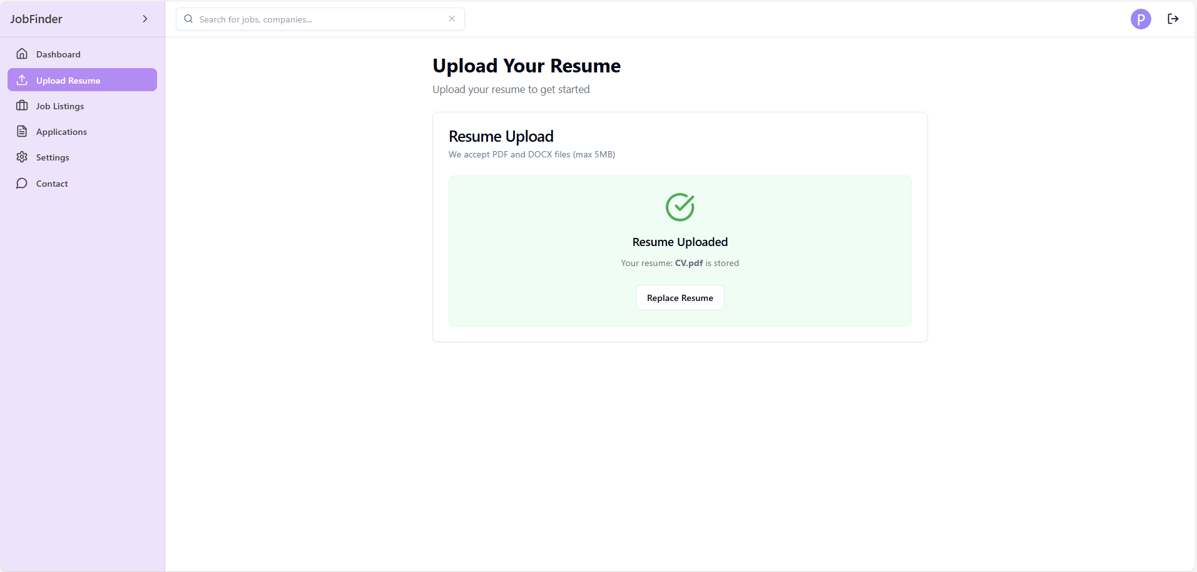
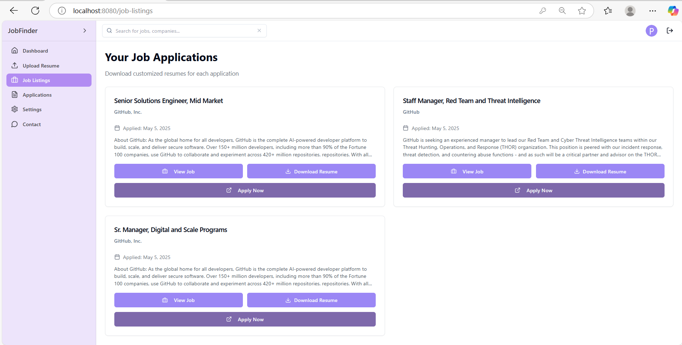
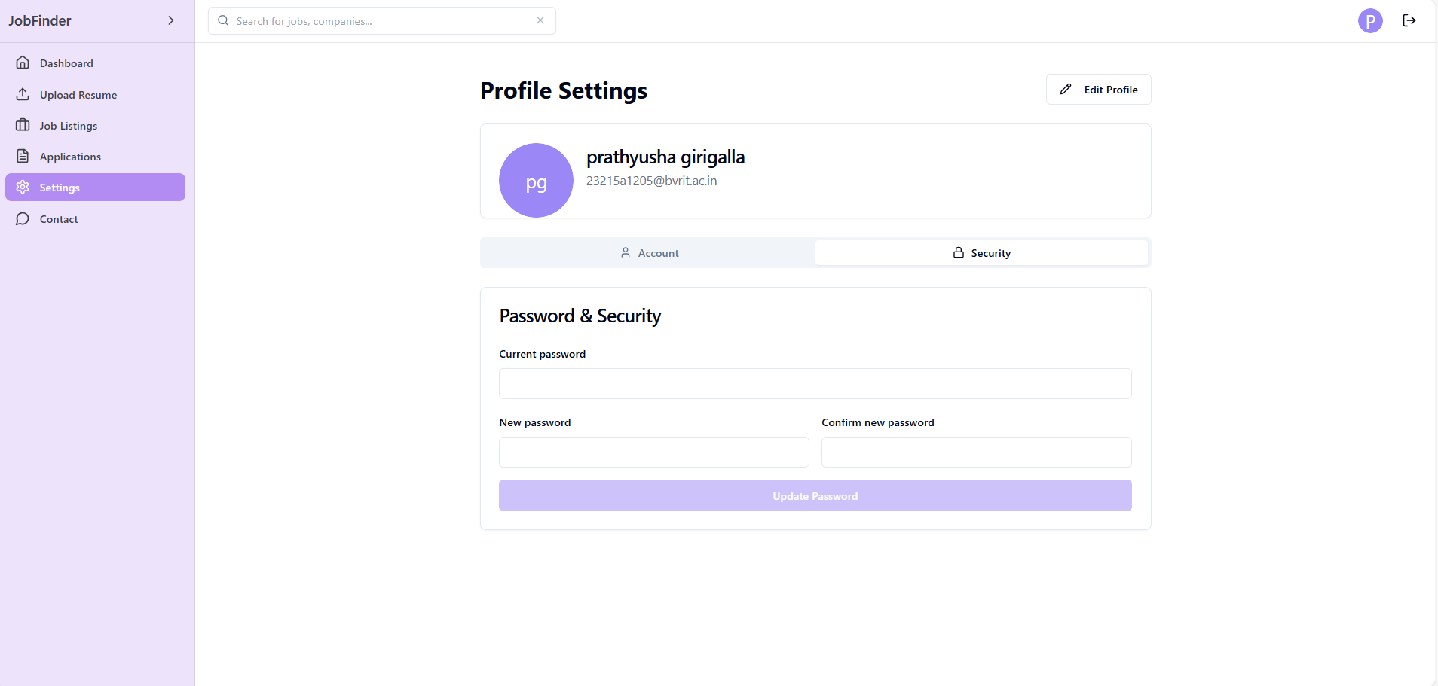
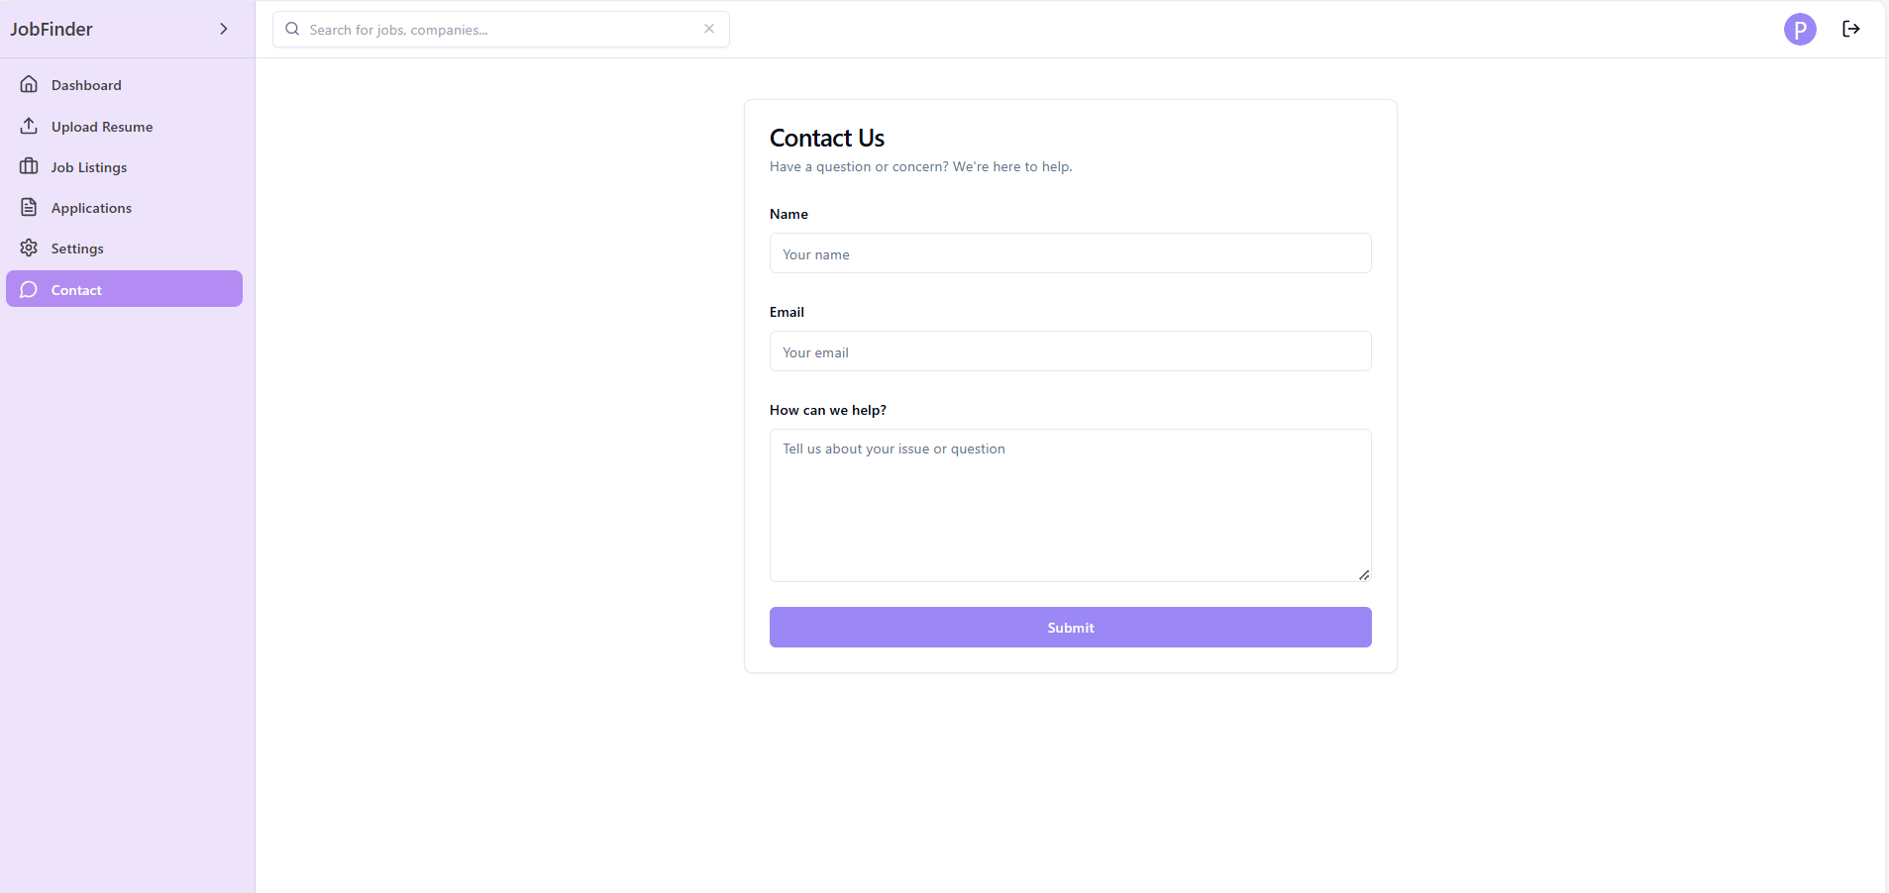

Slide 12
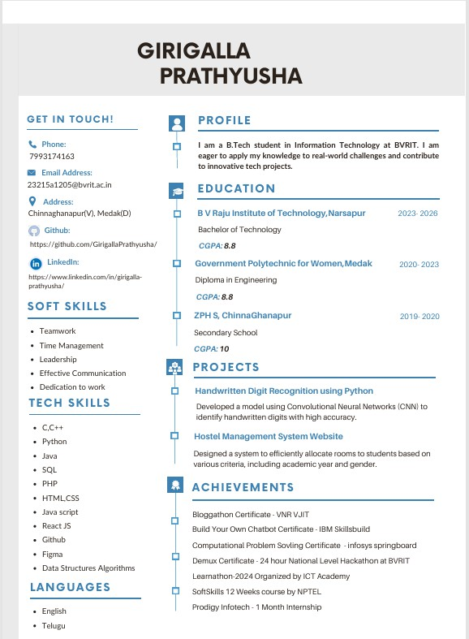
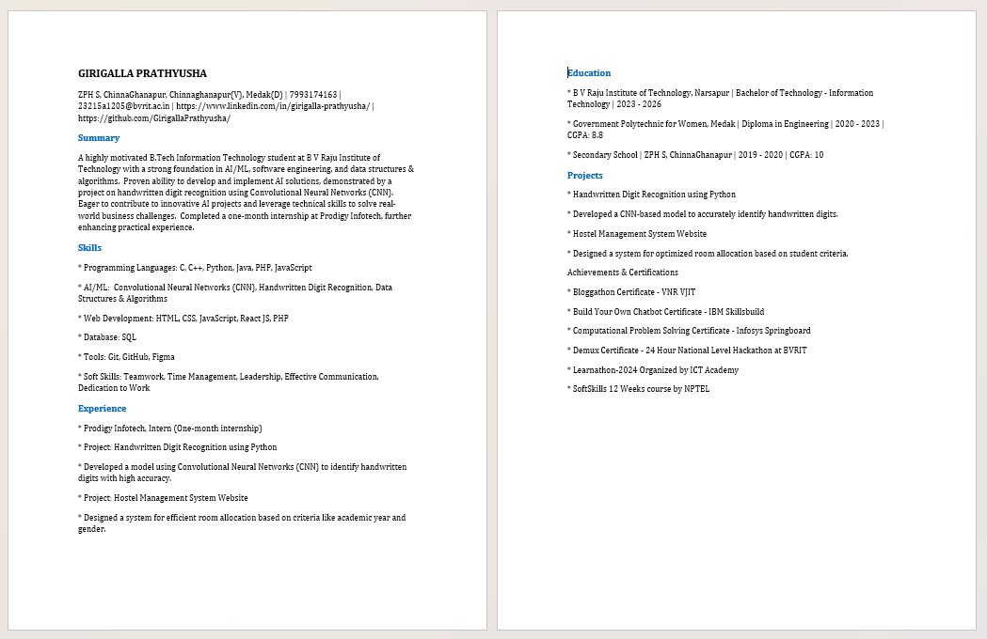
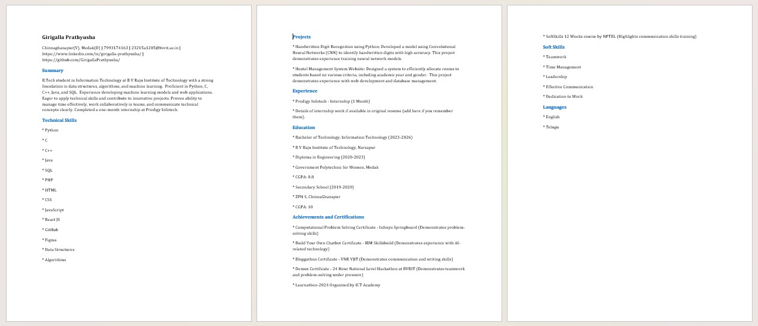
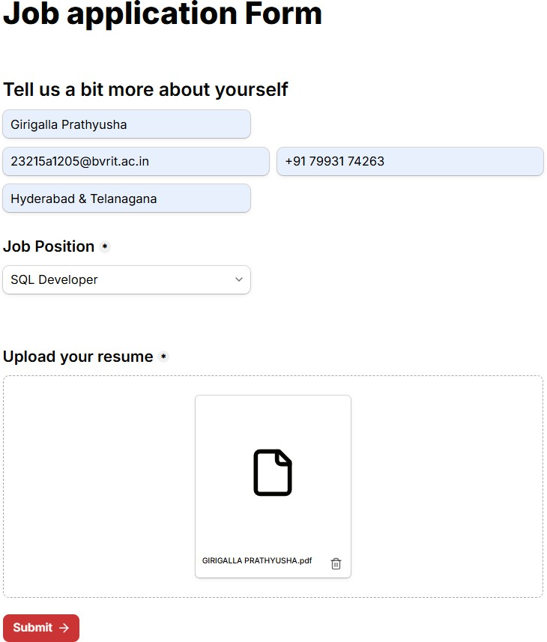

Slide 13
CONCLUSION
Our system automates the job search process by identifying relevant job opportunities
based on the user’s skills and preferences.
AI-powered resume customization ensures that resumes align with job descriptions by
highlighting missing keywords and improving content.
Web automation streamlines job applications by auto-filling forms
and submitting applications, reducing manual effort.
Enables users to apply to multiple jobs quickly, increasing their chances of getting shortlisted.

Slide 14
THANK YOU!

