Slide 1
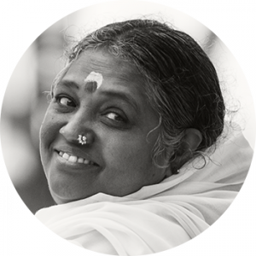

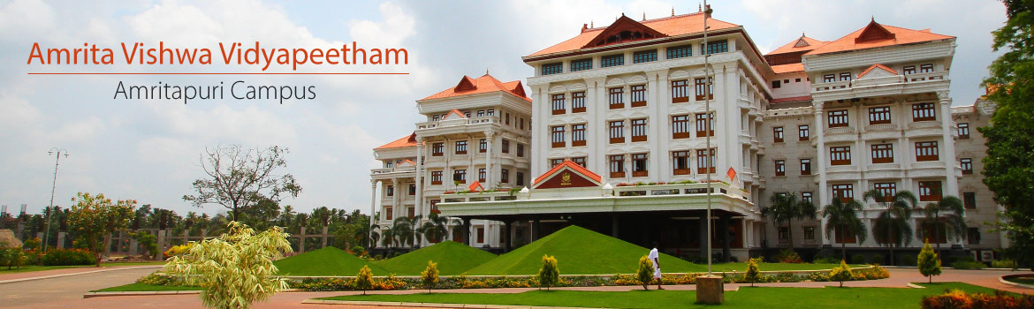
Model Free learning

Slide 2
Deep Reinforcement Learning
Deep Queue Network ( DQN)
Policy Gradient Methods
Policy Optimisation Methods
Actor Critic Method

Slide 3
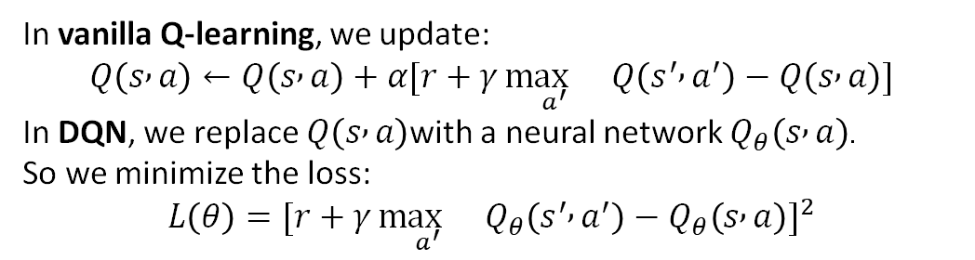
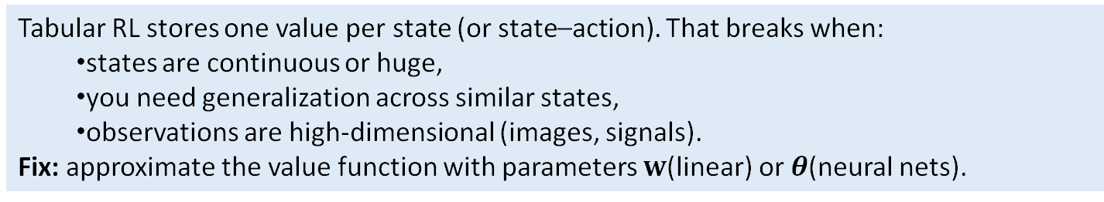
Function Approximation
In many real-world reinforcement learning problems, the state and action spaces are too large to be represented explicitly in tables.
Function approximation addresses this by using parameterized functions, such as neural networks, to represent the policy.
  Instead of storing a value for every state-action pair, a neural network takes the state as input and outputs the probability distribution over actions (or the parameters of a continuous action distribution).
  This enables the agent to generalize from limited experience to unseen states and actions, crucial for efficiency and robustness in high-dimensional environments.
In vanilla Q-learning, we update:
$$Q\left(s , a\right)←Q\left(s , a\right)+α[r+γ\underset{a^{′}}{\max{}}Q\left(s^{′} , a^{′}\right)−Q\left(s , a\right)]$$
In DQN, we replace $Q\left(s , a\right)$with a neural network $Q_{θ}\left(s , a\right)$.
So we minimize the loss:
$$L\left(θ\right)=[r+γ\underset{a^{′}}{\max{}}Q_{θ}\left(s^{′} , a^{′}\right)−Q_{θ}\left(s , a\right)]^{2}$$
Tabular RL stores one value per state (or state–action). That breaks when:
  states are continuous or huge,
  you need generalization across similar states,
  observations are high-dimensional (images, signals).
Fix: approximate the value function with parameters $w$(linear) or $θ$(neural nets).

Slide 4
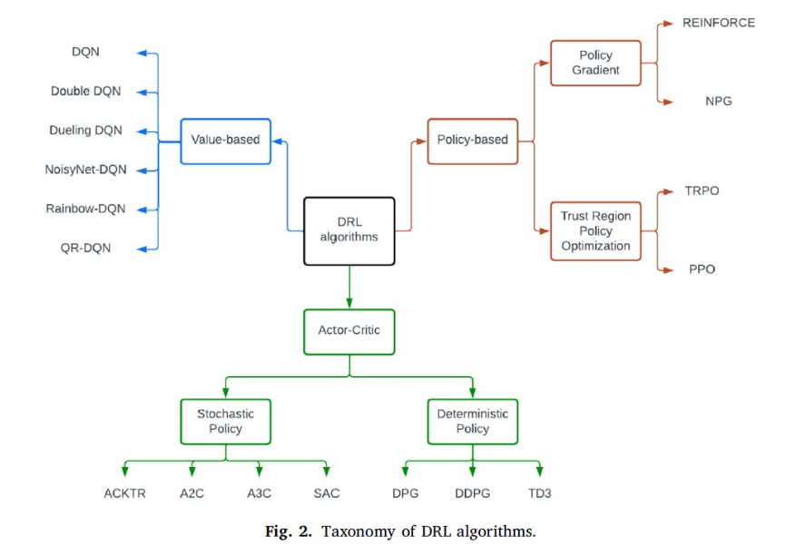

Slide 5
Deep Q Network(DQN)

Slide 6
Limitations of traditional Q-Learning
Scalability Issues: Traditional Q-Learning maintains a Q-table where each state-action pair is mapped to a Q-value. As the state space grows, especially in high-dimensional or continuous environments, the Q-table becomes impractically large, leading to memory inefficiency and slow learning processes.
Discrete State and Action Spaces: Q-Learning works well with environments where the states and actions are discrete and finite. However, many real-world problems involve continuous state and action spaces, which traditional Q-Learning cannot handle efficiently without discretizing these spaces, which can lead to a loss of information and suboptimal policies.

Slide 7
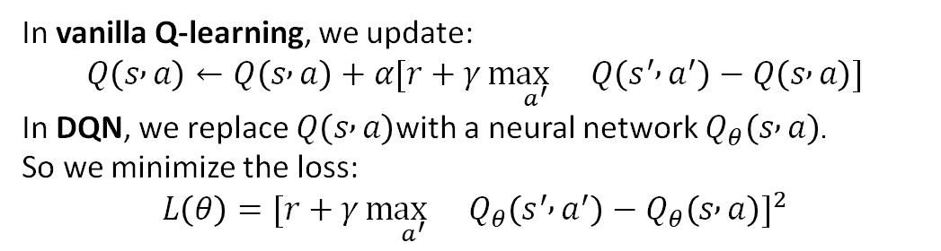
Traditional Q-learning has its challenges. It struggles with scalability as the state space grows and is less effective in environments with continuous state and action spaces. This is where Deep Q Networks (DQNs) come in. DQNs use neural networks to approximate the Q-values, enabling agents to handle larger and more complex environments effectively.
Deep Q-networks (DQNs) combine the principles of Q-Learning with the function approximation capabilities of neural networks. By doing so, they address the key limitations of traditional Q-learning.
In vanilla Q-learning, we update:
$$Q\left(s , a\right)←Q\left(s , a\right)+α[r+γ\underset{a^{′}}{\max{}}Q\left(s^{′} , a^{′}\right)−Q\left(s , a\right)]$$
In DQN, we replace $Q\left(s , a\right)$with a neural network $Q_{θ}\left(s , a\right)$.
So we minimize the loss:
$$L\left(θ\right)=[r+γ\underset{a^{′}}{\max{}}Q_{θ}\left(s^{′} , a^{′}\right)−Q_{θ}\left(s , a\right)]^{2}$$
Instead of storing Q-values in a table, DQNs use a neural network to approximate the Q-function. This network takes the state as input and outputs Q-values for all possible actions. By training the network with experiences from the environment, the agent learns to predict the expected rewards for each action, effectively generalizing across a large number of states and actions.

Slide 8
Deep Q-networks DQN
1.1: Components of a DQN
1.1.1: Neural Networks
1.1.2: Experience Replay
  1.1.2.1 Memory Buffer:
  1.1.2.2 Random Sampling
1.1.3: Target Network
2.1 DQN Algorithm
2.1.1 Forward Pass
2.1.2 Experience Replay
2.1.3 Backpropagation

Slide 9
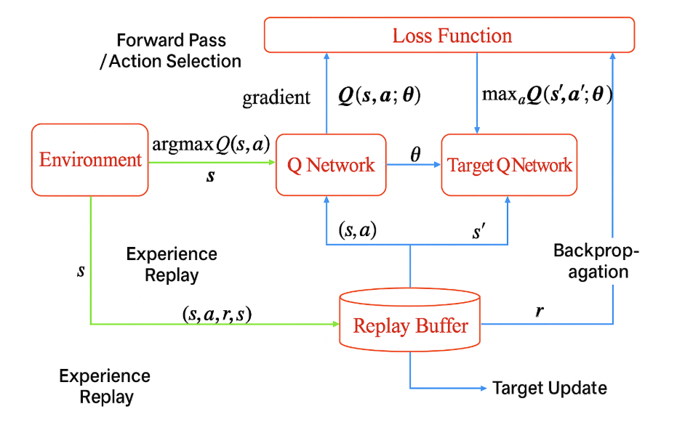

DQN
Environment → Q-Network: get state, predict Q-values.
Q-Network → Environment: choose action (ε-greedy).
Environment → Replay Buffer: store (s,a,r,s′).
Replay Buffer → Q-Network: sample batch for learning.
Target Network → Loss: compute stable target Q-values.
Loss → Q-Network: backpropagate to update weights.
Q-Network → Target Network: soft update weights.

Slide 10

1.1.1: Q-Neural Networks
A neural network acts as a function approximator for the Q-value function
$$Q\left(s , a\right)≈\text{expected} \text{future} \text{reward} \text{starting} \text{from} \text{state} s, \text{taking} \text{action} a.$$
Instead of keeping a table of Q-values for every (state, action) pair (impossible for high-dimensional states), the network learns to predict Q-values directly from the raw state input (like images or sensor data).
  Why
  Real-world states are continuous and complex (e.g., images in Atari, robot positions).
  Neural nets can generalize — learn Q-values for unseen states that look similar.
Analogy:
Think of it like replacing a giant lookup table with a smart function that can fill in the gaps between known points.

Slide 11
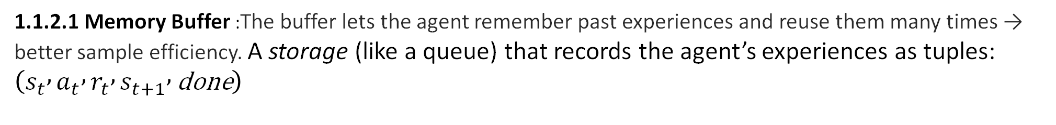
1.1.2 Experience Replay
This module gives DQN stability and data efficiency.
Agent’s "diary." It stores the agent’s experiences (state, action, reward, next state, done) over time, like how you might write down what happens to you each day.
1.1.2.1 Memory Buffer :The buffer lets the agent remember past experiences and reuse them many times → better sample efficiency. A storage (like a queue) that records the agent’s experiences as tuples: $\left(s_{t} , a_{t} , r_{t} , s_{t+1} , \text{done}\right)$
1.1.2.2 Random Sampling- During training, the agent flips through random pages of its diary to learn from past experiences. This breaks the sequence of events, helping the agent learn more robustly by preventing it from overfitting to the order of experiences.
1.1.3 Target Network
Target network is a separate neural network that is used to compute the target Q-values for training. It is identical in architecture to the main network but has frozen weights that are periodically updated to match the main network’s weights.
Think of this as a "stable guidebook" for the agent. While the main network is constantly learning and updating, the target network provides stable Q-values for training. It’s like having a reliable, periodically updated manual to refer to, which helps keep learning stable and consistent.

Slide 12
https://towardsdatascience.com/reinforcement-learning-from-scratch-deep-q-networks-0a8d33ce165b/

Slide 13
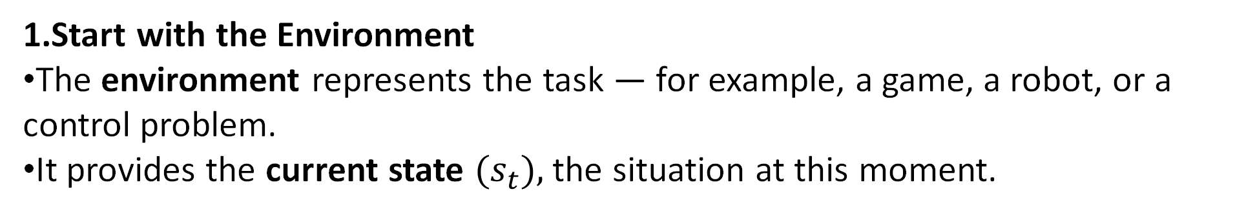
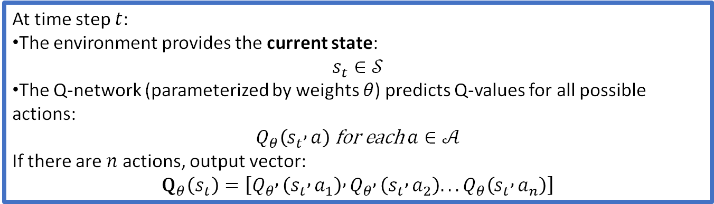
DQN Algorithm
Environment → Q-Network: get state, predict Q-values.
1.Start with the Environment
The environment represents the task — for example, a game, a robot, or a control problem.
It provides the current state ${(s}_{t}),$the situation at this moment.
At each time step, the environment gives the current state $s_{t}$. The agent feeds this state into the Q-Network.”
At time step $t$:
The environment provides the current state:
$$s_{t}∈𝒮$$
The Q-network (parameterized by weights $θ$) predicts Q-values for all possible actions:
$$Q_{θ}\left(s_{t} , a\right) \text{for} \text{each} a∈𝒜$$
If there are $n$ actions, output vector:
$$Q_{θ}\left(s_{t}\right)=\left[Q_{θ} , \left(s_{t} , a_{1}\right) , Q_{θ} , \left(s_{t} , a_{2}\right)...Q_{θ}\left(s_{t} , a_{n}\right)\right]$$

Slide 14

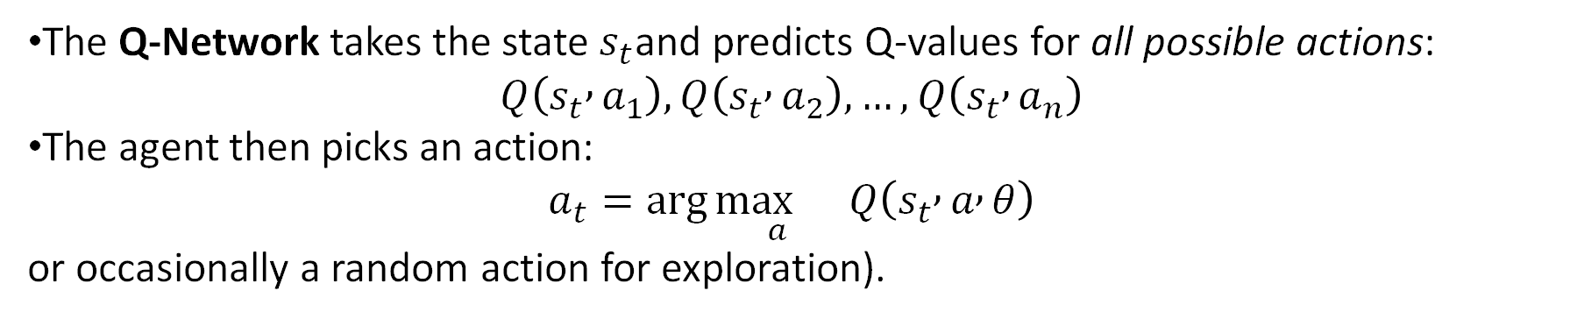
Q-Network → Environment: Choose action (ε-greedy policy)
DQN Algorithm
2.Q-Network (Forward Pass)
The Q-Network takes the state $s_{t}$and predicts Q-values for all possible actions:
$$Q\left(s_{t} , a_{1}\right),Q\left(s_{t} , a_{2}\right),…,Q\left(s_{t} , a_{n}\right)$$
The agent then picks an action:
$$a_{t}=\arg{\underset{a}{\max{}}}Q\left(s_{t} , a , θ\right)$$
or occasionally a random action for exploration).
“The network tells the agent how good each action might be. The agent picks the best one—or explores sometimes.”

Slide 15
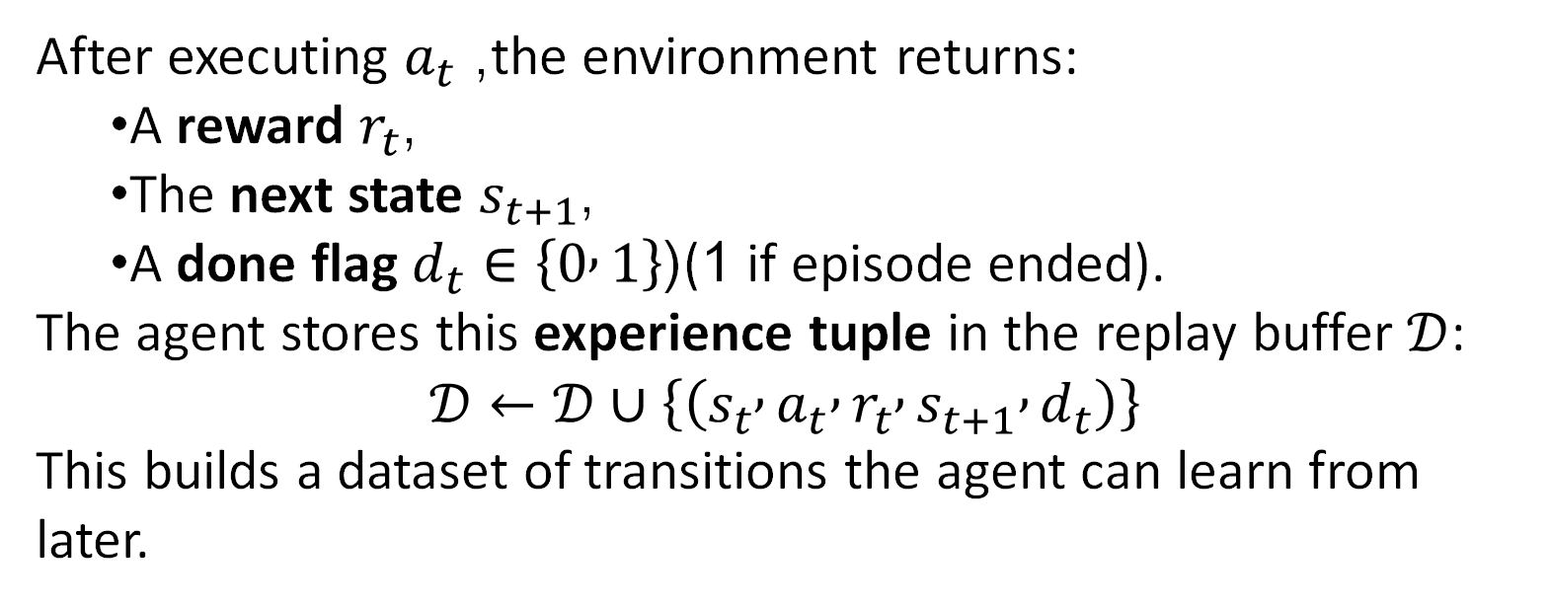
Environment → Replay Buffer: Store transition (s, a, r, s′)
DQN Algorithm
3.Environment Returns Reward and Next State
After executing $a_{t}$, the environment returns:
  A reward $r_{t}$,
  The next state $s_{t+1}$,
  A done flag $d_{t}∈\left\{0 , 1\right\}$((1 if episode ended).
The agent stores this experience tuple in the replay buffer $𝒟$:
$$𝒟←𝒟∪\left\{\left(s_{t} , a_{t} , r_{t} , s_{t+1} , d_{t}\right)\right\}$$
This builds a dataset of transitions the agent can learn from later.
The environment reacts, giving a reward and next state. We record this experience as one data sample.”

Slide 16
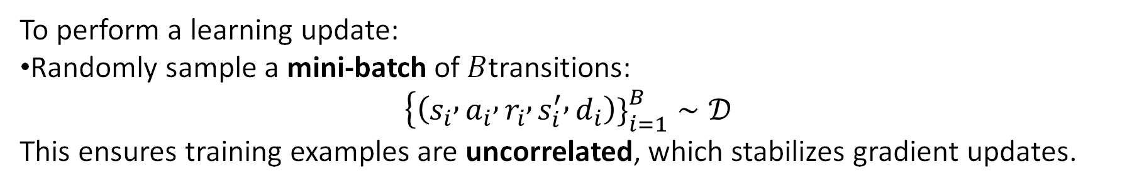
DQN Algorithm
Replay Buffer → Q-Network
4.Replay Buffer → Q-Network: Sample batch for learning
Store in Replay Buffer (Experience Replay)
  the agent will sample random mini-batches from this buffer to learn from multiple past experiences.
To perform a learning update:
Randomly sample a mini-batch of $B$transitions:
$$\left\{\left(s_{i} , a_{i} , r_{i} , s_{i}^{′} , d_{i}\right){\left.\}\right.}_{i=1}^{B}∼𝒟\right.$$
This ensures training examples are uncorrelated, which stabilizes gradient updates.
“The replay buffer is like the agent’s memory — it stores what just happened and keeps thousands of past experiences.”

Slide 17
Q -Network and Target Network
Target
The Q-network predicts the current action’s value.
The target network predicts the next state’s best possible value.
The agent learns by adjusting the Q-network until its current predictions match these stable target estimates.
Imagine you have:
  A student — trying to learn correct answers.
  A teacher — who already has some knowledge but isn’t perfect either.
A textbook of examples — this is the Replay Buffer, storing past experiences.
Now, the student and teacher both have copies of the same notes (the neural network parameters), but:
  The student updates their notes every day (fast learner),
  The teacher updates theirs only occasionally (slower, more stable).

Slide 18
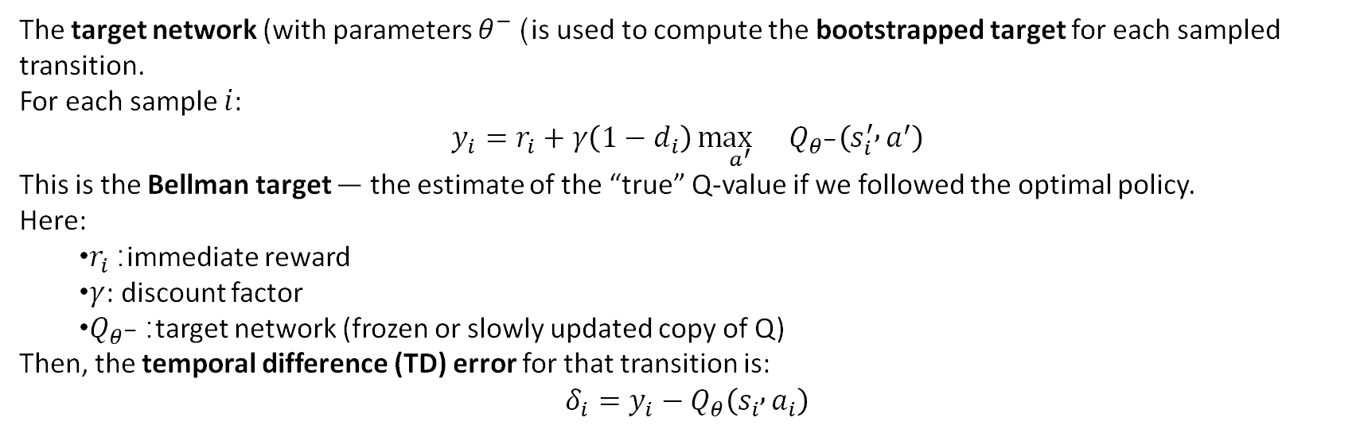
DQN Algorithm
Target Network → Loss
5.Target Network → Loss: Compute stable target Q-values
The target network (with parameters $θ^{−}$) is used to compute the bootstrapped target for each sampled transition.
For each sample $i$:
$$y_{i}=r_{i}+γ\left(1−d_{i}\right)\underset{a^{′}}{\max{}}Q_{θ^{−}}\left(s_{i}^{′} , a^{′}\right)$$
This is the Bellman target — the estimate of the “true” Q-value if we followed the optimal policy.
Here:
  $r_{i}$: immediate reward
  $γ$: discount factor
  $Q_{θ^{−}}$: target network (frozen or slowly updated copy of Q)
Then, the temporal difference (TD) error for that transition is:
$$δ_{i}=y_{i}−Q_{θ}\left(s_{i} , a_{i}\right)$$
If the episode ends → $d_{t}=1 else 0$
We don’t let the same network update both sides of the equation. The target network gives us a stable reference.”

Slide 19



DQN Algorithm
Loss → Q-Network
6.Loss → Q-Network: Backpropagate to update weights
The Q-network parameters $θ$are updated by minimizing the mean-squared TD error:
Gradient descent update:
Where $α$is the learning rate.
Backpropagation flows through the Q-network, adjusting weights to reduce the difference between predicted Q-values and the fixed target $y_{i}$.
The network corrects itself through gradient descent—learning which actions lead to higher long-term reward.”

Slide 20
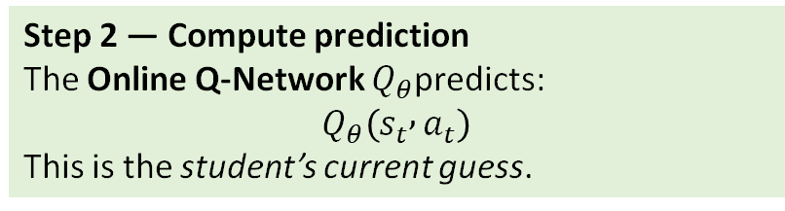
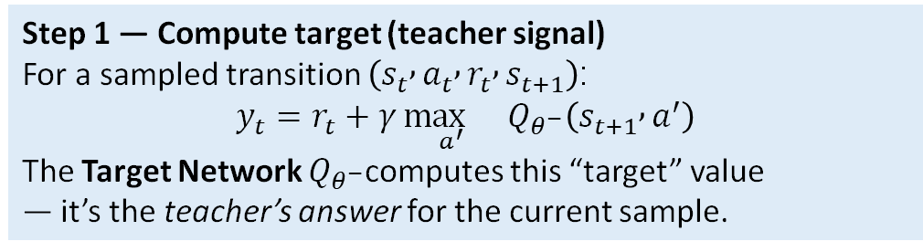

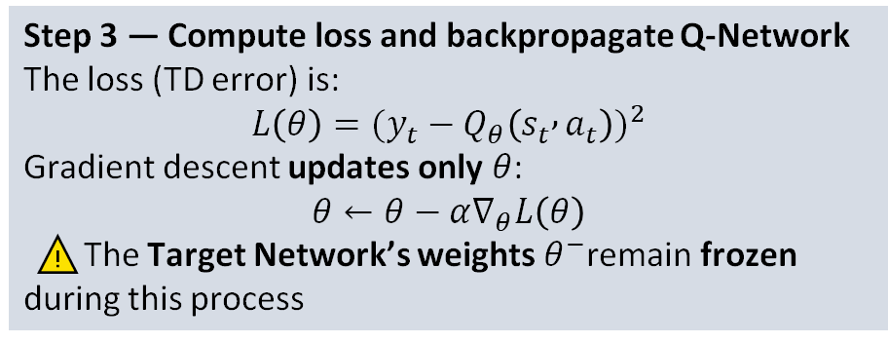
Target-Network- updations
Target Network → Loss
$$\left(θ\right)is Q −Network parameterθ^{−} is Target network parameter$$
Step 1 — Compute target (teacher signal)
For a sampled transition $\left(s_{t} , a_{t} , r_{t} , s_{t+1}\right)$:
$$y_{t}=r_{t}+γ\underset{a^{′}}{\max{}}Q_{θ^{−}}\left(s_{t+1} , a^{′}\right)$$
The Target Network $Q_{θ^{−}}$computes this “target” value
— it’s the teacher’s answer for the current sample.
Step 2 — Compute prediction
The Online Q-Network $Q_{θ}$predicts:
$$Q_{θ}\left(s_{t} , a_{t}\right)$$
This is the student’s current guess.
Step 4
How the Target Network does get updated
After some number of steps or episodes, we copy or softly blend weights from the online network:
Option 1 — Hard update (periodic copy)
Every $C$steps:
$$θ^{−}←θ$$
Option 2 — Soft update
Every step:
$$θ^{−}←τθ+\left(1−τ\right)θ^{−}$$
Step 3 — Compute loss and backpropagate Q-Network
The loss (TD error) is:
$$L\left(θ\right)=(y_{t}−Q_{θ}\left(s_{t} , a_{t}\right))^{2}$$
Gradient descent updates only $θ$:
$$θ←θ−α∇_{θ}L\left(θ\right)$$
⚠️ The Target Network’s weights $θ^{−}$remain frozen during this process

Slide 21
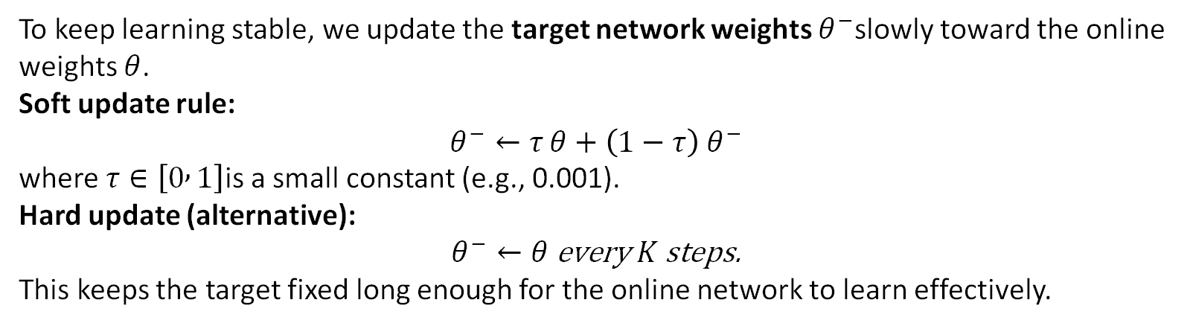
DQN Algorithm
Q-Network → Target Network
Q-Network → Target Network: Soft update of weights
To keep learning stable, we update the target network weights $θ^{−}$slowly toward the online weights $θ$.
Soft update rule:
$$θ^{−}←τ θ+\left(1−τ\right) θ^{−}$$
where $τ∈\left[0 , 1\right]$is a small constant (e.g., 0.001).
Hard update (alternative):
$$θ^{−}←θ \text{every} K \text{steps}\text{.}$$
This keeps the target fixed long enough for the online network to learn effectively.
“We compute how wrong our Q-network’s prediction was compared to the more accurate target.”

Slide 22
Repeat the Cycle
Continue interacting, storing, sampling, and updating until the Q-values converge and the policy becomes optimal.
This loop continues again and again — predict, act, store, replay, and learn — until the agent becomes good at the task.
Recap
  Environment → Q-Network: get state, predict Q-values.
  Q-Network → Environment: choose action (ε-greedy).
  Environment → Replay Buffer: store (s,a,r,s′).
  Replay Buffer → Q-Network: sample batch for learning.
  Target Network → Loss: compute stable target Q-values.
  Loss → Q-Network: backpropagate to update weights.
  Q-Network → Target Network: soft update weights

Slide 23
Why you need two networks- Q-Network and Target Network?
The problem if we use only one Q-network

Slide 24
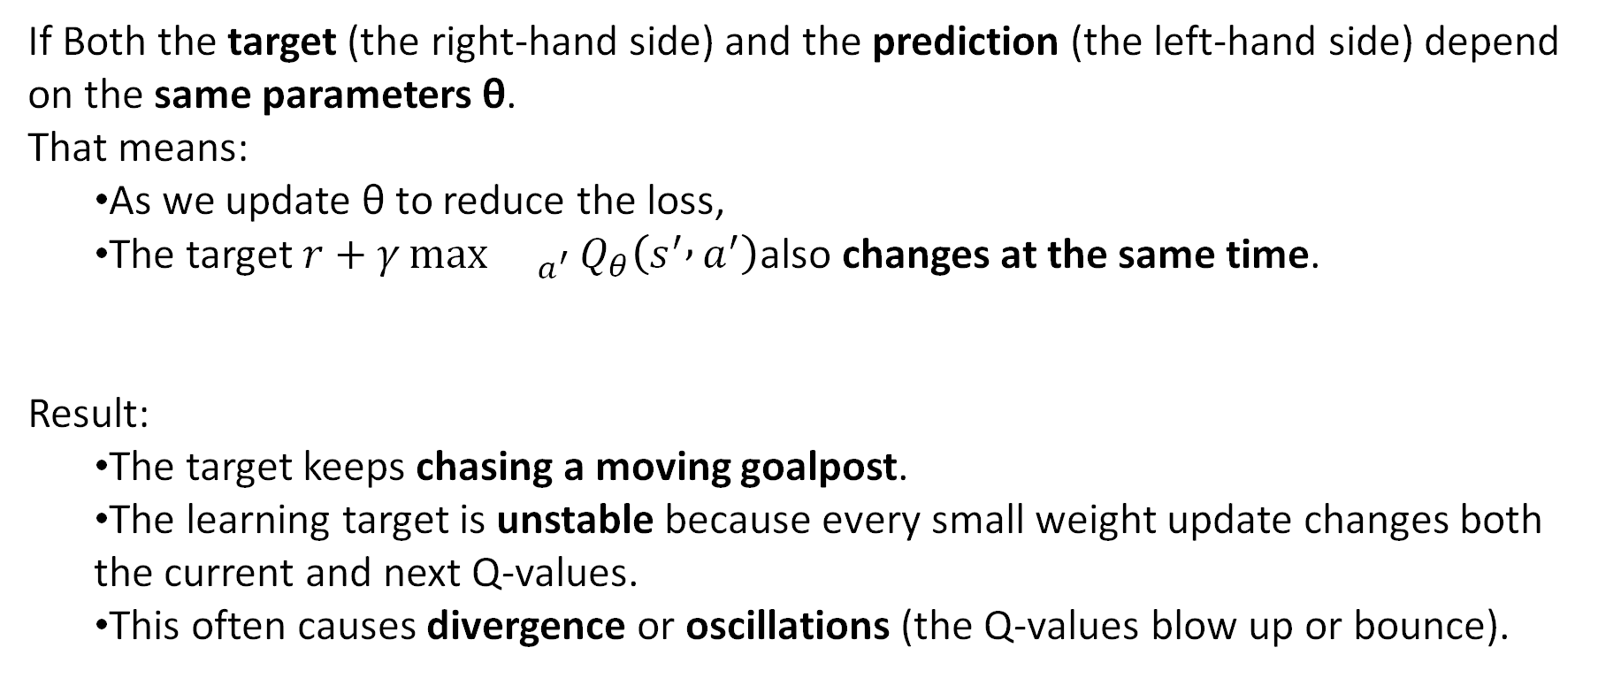
Why two networks- Q Network and Target Network?-The problem if we use only one Q-network
If Both the target (the right-hand side) and the prediction (the left-hand side) depend on the same parameters θ.
That means:
  As we update θ to reduce the loss,
  The target $r+γ{\max{}}_{a^{′}}Q_{θ}\left(s^{′} , a^{′}\right)$also changes at the same time.
Result:
  The target keeps chasing a moving goalpost.
  The learning target is unstable because every small weight update changes both the current and next Q-values.
  This often causes divergence or oscillations (the Q-values blow up or bounce).

Slide 25

Idea behind Target Network
The solution proposed by DeepMind in the original 2015 DQN paper was simple and brilliant:
Use a second network $Q_{θ^{−}}\left(s , a\right)$, a frozen copy of the main Q-network, to compute the target value.
So now the target becomes:
$$y_{t}=r_{t}+γ\underset{a^{′}}{\max{}}Q_{θ^{−}}\left(s_{t+1} , a^{′}\right)$$
and the loss is:
$$L\left(θ\right)=[y_{t}−Q_{θ}\left(s_{t} , a_{t}\right)]^{2}$$

Slide 26

Now what is different
Prediction: $Q_{θ}\left(s_{t} , a_{t}\right)$uses the online (current) network.
Target: $y_{t}=r+γ{\max{}}_{a^{′}}Q_{θ^{−}}\left(s^{′} , a^{′}\right)$uses a separate frozen target network.
  The target network’s parameters $θ^{−}$are updated only occasionally from $θ$:
  $$θ^{−}←θ \text{every} \text{K} \text{steps}$$
  or smoothly:
  $$θ^{−}←τθ+\left(1−τ\right)θ^{−}$$

Slide 27
Project topics
Implement RL for stock trading strategies.
Develop RL models for portfolio optimization.
RL applications in finance for decision-making and optimization
Use RL for personalized treatment recommendations.
Develop RL model for optimizing medication dosing.
Develop RL-based adaptive tutoring systems.
RL in education for personalized learning and intelligent assessment
Medical Image segmentation using RL
Medical image Classification using RL
Bias Mitigation Strategies with RL
Computer Games using RL, Snake Game etc

Slide 28
Deep RL Code

Slide 29
Lunar Landing Problem in Open AI Gym
The goal is to train an AI agent to autonomously land a lunar spacecraft safely and efficiently on a designated landing pad in a 2D simulated environment.
The lander starts at a random position above the surface of the moon and must control its descent using discrete thrusters.
This is formulated as a Reinforcement Learning (RL) problem where the agent must learn to take appropriate actions based on sensor readings, with the objective of maximizing total long-term reward.

Slide 30
Problem Statement (High-Level)
We want to train an autonomous lunar lander agent that can safely land a spacecraft on the surface of the moon using Deep Q-Learning (DQN).
The agent must learn how to control the spaceship using only:
  Numeric sensor readings from the lander (state variables)
  A reward signal from the environment
  Trial-and-error experience stored in a replay buffer
  It receives no human demonstrations and must learn the optimal landing strategy entirely through reinforcement learning.
The environment simulates a lander descending onto a landing pad between two flags.
It provides:
  A state vector (observations)
  A discrete action space (4 actions)
  A reward signal
  Episode termination when the lander crashes or lands safely
  The environment is from OpenAI Gym / Gymnasium.
https://gymnasium.farama.org/
https://gymnasium.farama.org/environments/box2d/lunar_lander/

Slide 31

  The agent’s objective is to maximize cumulative discounted reward.
Key Reward Components
  ✔ Shaping Reward
  Given every timestep to encourage good intermediate behavior:
    Moves closer to landing pad → positive reward
    Slows down velocity → positive reward
    Maintains upright angle → positive reward
    Moves away or tilts → negative reward
  ✔ Leg Contact Reward
    +10 for left leg touching safely
    +10 for right leg touching safely
  ✔ Fuel Penalty
    -0.03 per engine fire
    Discourages unnecessary fuel usage.
  ✔ Successful Landing Reward
    +100 to +140 depending on how soft and centered the landing is
    Greatly encourages good landing behavior.
  ✔ Crash Penalty
    -100 for crashing
    Makes catastrophic behavior highly undesirable.
  Total Reward
  $$r_{t}=r_{\text{shaping}}+r_{\text{leg} \text{contact}}−r_{\text{fuel} \text{cost}}+r_{\text{terminal}}$$

Slide 32
Problem: Train an AI agent to autonomously land a spacecraft using RL.
Input:States 8-dimensional continuous state vector.
  x Horizontal position
  y Vertical position
  vx Horizontal velocity
  vy Vertical velocity
  angle Tilt of the lander
  angular_velocity Tilt rate
  left_leg_contact 1 if left leg touches ground, else 0
  right_leg_contact 1 if right leg touches ground, else 0
Output:Actions: One of 4 discrete actions (fire engines).
  0 Do nothing
  1 Fire left orientation engine (push right)
  2 Fire main engine (push upward)
  3 Fire right orientation engine (push left)
Method: Deep Q-Network (DQN) with replay buffer + target network.
Learning Objective: Maximize total expected reward → perform safe, fuel-efficient landings.
Environment: OpenAI Gym – LunarLander-v2. Outcome: A model (neural network) that maps state → best action for stable landing.

Slide 33
Lets get to DQN code
Pls note OpenAI gym env takes care of states, actions rewards. To see the code of that refer to
https://gymnasium.farama.org/environments/box2d/lunar_lander/

Slide 34
OpenAI Gym’s LunarLander environment, which provides a challenging and interesting problem for our agent to solve.
import os
import pickle
import gym
import torch
import torch.nn as nn
import torch.optim as optim
from collections import deque
import random
import optuna
Here, we import the necessary libraries. gym is used for the environment, torch is for building and training our neural network, and collections, random, and optuna help with experience replay and hyperparameter optimization.

Slide 35
The environment internally contains:
  Physics engine (Box2D)
  Lander object (position, velocity, angle, legs)
  Reward logic
  Terminal conditions (crash or landing)
env = gym.make('LunarLander-v2', render_mode="rgb_array")
state_dim = env.observation_space.shape[0]
action_dim = env.action_space.n
Loads the OpenAI Gym environment named "LunarLander-v2"
Sets the rendering mode to "rgb_array" (so frames can be recorded as images)
We initialize the LunarLander environment and retrieve the dimensions of the state and action spaces. state_dim represents the number of features in the state, and action_dim represents the number of possible actions.
Ready to call
env.reset()
env.step(action)
env.render()

Slide 36
class DQN(nn.Module):
def __init__(self, state_dim, action_dim):
super(DQN, self).__init__()
self.fc1 = nn.Linear(state_dim, 128)
self.fc2 = nn.Linear(128, 128)
self.fc3 = nn.Linear(128, action_dim)
def forward(self, x):
x = torch.relu(self.fc1(x))
x = torch.relu(self.fc2(x))
return self.fc3(x)
For our deep-NN, we will create a class called DQN. This class defines a neural network with three fully connected layers. The input layer receives the state representation, the hidden layers process this information through linear transformations and ReLU activation functions, and the output layer produces the Q-values for each possible action.
Class initialisation
class DQN(nn.Module):
def __init__(self, state_dim, action_dim):
super(DQN, self).__init__()
self.fc1 = nn.Linear(state_dim, 128)
self.fc2 = nn.Linear(128, 128)
self.fc3 = nn.Linear(128, action_dim)

Slide 37
In the first layer, the input data x is passed through the first fully connected layer (self.fc1). The output is then transformed using the ReLU (Rectified Linear Unit) activation function:
def forward(self, x):
x = torch.relu(self.fc1(x))
x = torch.relu(self.fc2(x))
return self.fc3(x)
Forward Method The forward method defines how data flows through the network. This method is automatically invoked when you pass data through the network.

Slide 38
Implementing Experience Replay
The ReplayBuffer class provides a mechanism to store and sample experiences, which is essential for stabilizing and improving the learning process in DQNs
Therefore, it enables the agent to learn from a diverse set of past experiences, enhancing its ability to generalize and perform well in complex environments
class ReplayBuffer:
def __init__(self, capacity):
self.buffer = deque(maxlen=capacity)
def push(self, state, action, reward, next_state, done):
self.buffer.append((state, action, reward, next_state, done))
def sample(self, batch_size):
state, action, reward, next_state, done = zip(*random.sample(self.buffer, batch_size))
return state, action, reward, next_state, done
def __len__(self):
return len(self.buffer)
.. The __init__ method initializes a deque (double-ended queue) with a fixed capacity. The double-ended queue allows you to append and pop items from both ends efficiently. he push method adds a new experience to the buffer. Each experience is a tuple consisting of state, action, reward, next_state, and done:. random.sample(self.buffer, batch_size) randomly selects batch_size experiences from the buffer.

Slide 39
Implementing the Target Network
class DQNTrainer:
def __init__(self, env, main_network, target_network, optimizer, replay_buffer, model_path='model/model.pth', gamma=0.99, batch_size=64, target_update_frequency=1000):
def train(self, num_episodes, save=True):
class Optimizer:
def __init__(self, env, main_network, target_network, replay_buffer, model_path, params_path='params.pkl'):
def objective(self, trial, n_episodes=10):

Slide 40
_init in the DQNTrainer class
The __init__ method initializes various components needed for training:
env: The environment in which the agent operates.
main_network: The main neural network that is being trained.
target_network: The target neural network used for stabilizing Q-value estimates.
optimizer: The optimizer used for updating the weights of the main network.
replay_buffer: The buffer for storing and sampling experiences.
model_path: Path to save/load the trained model.
gamma: The discount factor for future rewards.
batch_size: The number of experiences sampled from the replay buffer for each training step.
target_update_frequency: The frequency at which the target network’s weights are updated to match the main network’s weights.
step_count: A counter to keep track of the number of steps taken during training.
def __init__(self, env, main_network, target_network, optimizer, replay_buffer, model_path='model/model.pth', gamma=0.99, batch_size=64, target_update_frequency=1000):
self.env = env
self.main_network = main_network
self.target_network = target_network
self.optimizer = optimizer
self.replay_buffer = replay_buffer
self.model_path = model_path
self.gamma = gamma
self.batch_size = batch_size
self.target_update_frequency = target_update_frequency
self.step_count = 0
# Load the model if it exists
if os.path.exists(os.path.dirname(self.model_path)):
if os.path.isfile(self.model_path):
self.main_network.load_state_dict(torch.load(self.model_path))
self.target_network.load_state_dict(torch.load(self.model_path))
print("Loaded model from disk")
else:
os.makedirs(os.path.dirname(self.model_path))

Slide 41
_init in the DQNTrainer class
def __init__(self, env, main_network, target_network, optimizer, replay_buffer, model_path='model/model.pth', gamma=0.99, batch_size=64, target_update_frequency=1000):
self.env = env
self.main_network = main_network
self.target_network = target_network
self.optimizer = optimizer
self.replay_buffer = replay_buffer
self.model_path = model_path
self.gamma = gamma
self.batch_size = batch_size
self.target_update_frequency = target_update_frequency
self.step_count = 0
# Load the model if it exists
if os.path.exists(os.path.dirname(self.model_path)):
if os.path.isfile(self.model_path):
self.main_network.load_state_dict(torch.load(self.model_path))
self.target_network.load_state_dict(torch.load(self.model_path))
print("Loaded model from disk")
else:
os.makedirs(os.path.dirname(self.model_path))
We check if the directory for the model path exists using os.path.exists(os.path.dirname(self.model_path)). If a saved model exists, it is loaded to continue training from where it left off:
torch.load loads the saved model weights into the main and target networks using load_state_dict. If the model directory does not exist, it is created using os.makedirs.

Slide 42
def train(self, num_episodes, save=True):
total_rewards = []
for episode in range(num_episodes):
state, _ = self.env.reset()
done = False
total_reward = 0
while not done:
self.env.render() # Add this line to render the environment
action = self.main_network(torch.FloatTensor(state).unsqueeze(0)).argmax(dim=1).item()
next_state, reward, done, _, _ = self.env.step(action)
self.replay_buffer.push(state, action, reward, next_state, done)
state = next_state
total_reward += reward
if len(self.replay_buffer) >= self.batch_size:
self.update_network()
total_rewards.append(total_reward)
print(f"Episode {episode}, Total Reward: {total_reward}")
if save:
torch.save(self.main_network.state_dict(), self.model_path)
print("Saved model to disk")
self.env.close()
return sum(total_rewards) / len(total_rewards)
This loop runs for the specified number of episodes. Each episode represents a complete interaction sequence with the environment.
self.env.reset() initializes the environment and returns the initial state.
done = False indicates that the episode is not finished.
total_reward = 0 initializes the total reward for the current episode.

Slide 43
def train(self, num_episodes, save=True):
total_rewards = []
for episode in range(num_episodes):
state, _ = self.env.reset()
done = False
total_reward = 0
while not done:
self.env.render() # Add this line to render the environment
action = self.main_network(torch.FloatTensor(state).unsqueeze(0)).argmax(dim=1).item()
next_state, reward, done, _, _ = self.env.step(action)
self.replay_buffer.push(state, action, reward, next_state, done)
state = next_state
total_reward += reward
if len(self.replay_buffer) >= self.batch_size:
self.update_network()
total_rewards.append(total_reward)
print(f"Episode {episode}, Total Reward: {total_reward}")
if save:
torch.save(self.main_network.state_dict(), self.model_path)
print("Saved model to disk")
self.env.close()
return sum(total_rewards) / len(total_rewards)
Action SelectionThe agent selects an action using the main network based on the current state.
selects the action with the highest Q-value predicted by the main network.

Slide 44
def train(self, num_episodes, save=True):
total_rewards = []
for episode in range(num_episodes):
state, _ = self.env.reset()
done = False
total_reward = 0
while not done:
self.env.render() # Add this line to render the environment
action = self.main_network(torch.FloatTensor(state).unsqueeze(0)).argmax(dim=1).item()
next_state, reward, done, _, _ = self.env.step(action)
self.replay_buffer.push(state, action, reward, next_state, done)
state = next_state
total_reward += reward
if len(self.replay_buffer) >= self.batch_size:
self.update_network()
total_rewards.append(total_reward)
print(f"Episode {episode}, Total Reward: {total_reward}")
if save:
torch.save(self.main_network.state_dict(), self.model_path)
print("Saved model to disk")
self.env.close()
return sum(total_rewards) / len(total_rewards)
next_state, reward, done, _, _ = self.env.step(action)
This line does ALL of these in one step:
Runs the physics engine
Updates lander position, speed, angle
Checks leg contact
Checks crash/landing
Computes SHAPING reward
Applies engine penalty
Applies crash/landing bonus or penalty
Returns reward to your DQN

Slide 45
def train(self, num_episodes, save=True):
total_rewards = []
for episode in range(num_episodes):
state, _ = self.env.reset()
done = False
total_reward = 0
while not done:
self.env.render() # Add this line to render the environment
action = self.main_network(torch.FloatTensor(state).unsqueeze(0)).argmax(dim=1).item()
next_state, reward, done, _, _ = self.env.step(action)
self.replay_buffer.push(state, action, reward, next_state, done)
state = next_state
total_reward += reward
if len(self.replay_buffer) >= self.batch_size:
self.update_network()
total_rewards.append(total_reward)
print(f"Episode {episode}, Total Reward: {total_reward}")
if save:
torch.save(self.main_network.state_dict(), self.model_path)
print("Saved model to disk")
self.env.close()
return sum(total_rewards) / len(total_rewards)
self.env.step(action) performs the action and returns the next state, reward, and whether the episode is done.
self.replay_buffer.push(...) stores the experience in the replay buffer.
state = next_state updates the current state to the next state.
total_reward += reward accumulates the reward for the current episode.

Slide 46
def train(self, num_episodes, save=True):
total_rewards = []
for episode in range(num_episodes):
state, _ = self.env.reset()
done = False
total_reward = 0
while not done:
self.env.render() # Add this line to render the environment
action = self.main_network(torch.FloatTensor(state).unsqueeze(0)).argmax(dim=1).item()
next_state, reward, done, _, _ = self.env.step(action)
self.replay_buffer.push(state, action, reward, next_state, done)
state = next_state
total_reward += reward
if len(self.replay_buffer) >= self.batch_size:
self.update_network()
total_rewards.append(total_reward)
print(f"Episode {episode}, Total Reward: {total_reward}")
if save:
torch.save(self.main_network.state_dict(), self.model_path)
print("Saved model to disk")
self.env.close()
return sum(total_rewards) / len(total_rewards)
Update NetworkIf the replay buffer has enough experience, the network is updated.
if len(self.replay_buffer) >= self.batch_size checks if the replay buffer has at least batch_size experiences.
self.update_network() updates the network using a batch of experiences from the replay buffer.
Function: update_network()
Periodically copy weights from main network → target network

Slide 47
def train(self, num_episodes, save=True):
total_rewards = []
for episode in range(num_episodes):
state, _ = self.env.reset()
done = False
total_reward = 0
while not done:
self.env.render() # Add this line to render the environment
action = self.main_network(torch.FloatTensor(state).unsqueeze(0)).argmax(dim=1).item()
next_state, reward, done, _, _ = self.env.step(action)
self.replay_buffer.push(state, action, reward, next_state, done)
state = next_state
total_reward += reward
if len(self.replay_buffer) >= self.batch_size:
self.update_network()
total_rewards.append(total_reward)
print(f"Episode {episode}, Total Reward: {total_reward}")
if save:
torch.save(self.main_network.state_dict(), self.model_path)
print("Saved model to disk")
self.env.close()
return sum(total_rewards) / len(total_rewards)
total_rewards.append(total_reward) adds the total reward for the current episode to the list of total rewards.
print(f"Episode {episode}, Total Reward: {total_reward}") prints the episode number and total reward.
torch.save(self.main_network.state_dict(), self.model_path) saves the state dictionary of the main network to the specified file path.
self.env.close() closes the environment.
return sum(total_rewards) / len(total_rewards) calculates and returns the average reward.

