Slide 1
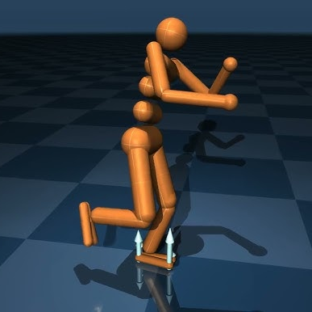
Reinforcement Learning for Humanoid stability and safety using Mujoco
Girija Jyothi Golla
2023-2024

Slide 2
Introduction to stability and safety
For the system to be stable, a condition that should be satisfied given positive V is that, for the trajectory of the closed-loop system
Negative Lie derivative indicates that V varies in the decreasing way. The “closer” here implies that at each step, the system is far more stable, with V expected to reduce in value.
On the other hand, if V increases, it implies that the system is going away from the stability, and hence hinting at potential instability.

Slide 3

Safety control and barrier functions
Safety is one of the key elements of control system design. Control barrier functions have as their primary task to hold the system within a certain safety zone, so that it does not reach any harmful or undesirable states.
Penality for Dangerous States: When the system approached this boundary the value of the barrier function shoots up. This forms a “barrier” that the system cannot go through and enter unsafe regions. In case the system tries to bypass this limit, the control law enforcement agent will have a penalty that pushes it back towards safe conditions.

Slide 4

Neural Controller Class (NeuralController):
This network possesses three fully connected layers which take the position of the robot as a comment sense input and output the action that needs to be taken.
This controller is aimed at training the actions needed for the robot to be upright.

Slide 5

Lyapunov Function (lyapunov_function):
The purpose is to measure the stability of the system. This function system sums up the values of the squares of the position and velocity of the robot.
Lower values of this function, therefore, imply that the system is only a few negative steps away from obtaining a stable non-collapsing position.
def lyapunov_function(state):
position = state[:model.nq] # Position
velocity = state[model.nq:] # Velocity
return torch.sum(position**2) + torch.sum(velocity**2)

Slide 6
Lyapunov Derivative (lyapunov_derivative):
Purpose: The Lyapunov derivative shall calculate a rate of change of the Lyapunov function between two successive states w.r.t time.
Interpretation: If the derivative is nonpositive, more precisely less than a threshold, the system is taken as stable.
def lyapunov_derivative(state, next_state):
V = lyapunov_function(state)
V_next = lyapunov_function(next_state)
return V_next - V

Slide 7

Barrier Function (barrier_function):
Purpose: It ensures safety by keeping state values within prescribed bounds. If the states deviate considerably, the function penalizes the control action.
Interpretation: The higher the value of barrier function, the robot's state is in safer more acceptable region. Lower values indicate approach towards unsafe state.
def barrier_function(state):
return torch.sum(1.0 / (state**2 + 1e-5))

Slide 8
Action Selection:
An action is generated by the neural controller based on the current state.
An exploration noise (Gaussian noise) is added to the action for allowing exploration.

Slide 9
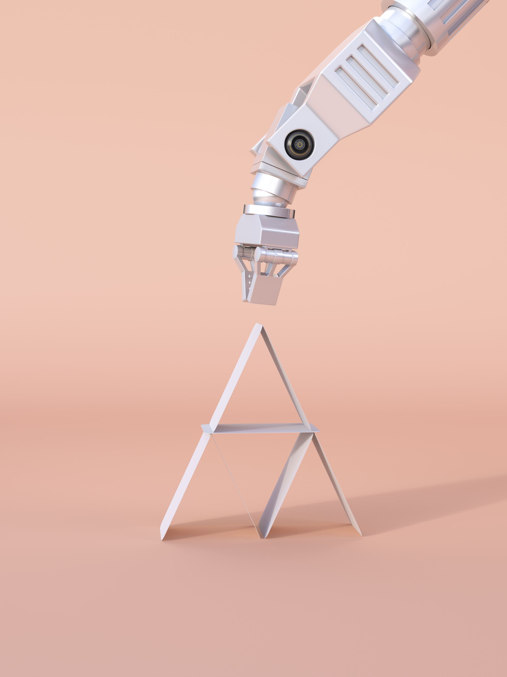
Reward Components:
Stability Reward: Based on the Lyapunov derivative (lyapunov_derivative). If this derivative is within the stability_threshold, it means the robot is moving toward stability and is rewarded positively.
Forward Reward: The reward for moving forward to continue further with the robot's advancement in moving forward.
Action Smoothness Penalty: A penalty for large abrupt changes in action that incentivizes smoother control.
Safety Penalty: In case of the violation of a certain threshold that provides an unsafe state by the barrier function barrier_function, this penalty is incurred. These components now put together for reward accumulation in a form guiding the neural controller for stability, safety, smooth motion, and forward progress:.

Slide 10

Training the controller
Then, after calculating the reward, the negative reward is back-propagated to update the parameters of the controller. In this way, the neural controller could learn such an action that maximizes the reward by balancing the robot.

