Slide 1


PREDICTIVE PARSER GENERATOR
PRESENTED BY:
GIRIJA B [192311044]
CSA1428-COMPILER DESIGN WITH LEXICAL ANALYSIS
MARCH-2025

Slide 2
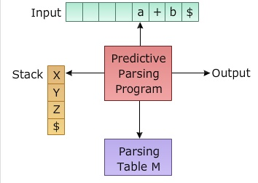
Introduction
This presentation explores the development of a tool for generating predictive parsers from context-free grammars. We'll delve into the concept of CFGs, examine the process of predictive parsing, and highlight the challenges associated with manual parser construction. We'll then showcase our innovative solution: a powerful tool that automates this process, streamlining development and enhancing efficiency.

Slide 3
Objectives
Define Clear Goals
The primary goal of this project is to develop an interactive tool that generates LL(1) Predictive Parsers from context-free grammars. The tool should: *Provide a user-friendly GUI using Tkinter. *Allow users to input grammars in a structured format. *Automatically compute First and Follow sets. *Generate an LL(1) parsing table *Simulate the parsing process step-by-step *Highlight errors in input strings
Problem statement
Parsing is a crucial step in compiler design and is essential for processing programming languages. However, manually computing First and Follow sets, constructing LL(1) parsing tables, and executing the parsing process can be complex and error-prone.
Expected Outcomes
A user-friendly GUI that takes a grammar as input, displays First/Follow sets, generates parsing tables, and parses input strings with detailed steps, ensuring clarity in predictive parsing.

Slide 4
Literature Review / Background
Summary of Existing Research
Existing research on LL(1) parsing is covered in classic texts like the Dragon Book (Aho, Ullman, Sethi) and Hopcroft & Ullman’s Automata Theory. These works define First & Follow sets, LL(1) parsing tables, and stack-based parsing. However, most of tools lack interactive step-by-step visualization.
Theoretical Foundation
Predictive parsing relies on: *Context-Free Grammars (CFGs) – Defines syntax rules. * First & Follow Sets – Determines parsing table entries. * LL(1) Parsing Table – Enables one-token lookahead parsing. * Stack-based Algorithm – Simulates top-down derivation.
Research Gap
Most existing solutions require manual computation of First & Follow sets and lack interactive GUI tools for learning. This project bridges the gap by offering an automated, step-by-step LL(1) parser generator with a user-friendly GUI.

Slide 5
Methodology
Tools & Frameworks Used
*Python – Main programming language for implementation. *Tkinter – GUI framework for interactive user input and output display. *Collections Library – Used for managing First & Follow sets efficiently.
Development Approach
-Grammar Input – User enters CFG. -Compute First & Follow – Determines parsing table entries. -Generate LL(1) Table – Uses First & Follow sets. -Parsing Simulation – Step-by-step stack-based tracing. -Error Handling – Displays syntax errors and parsing success/failure.
Data Collection (If Applicable)
Since this is a parser generation tool, no external dataset is required. However, sample grammars and test cases will be used for validation and debugging.

Slide 6
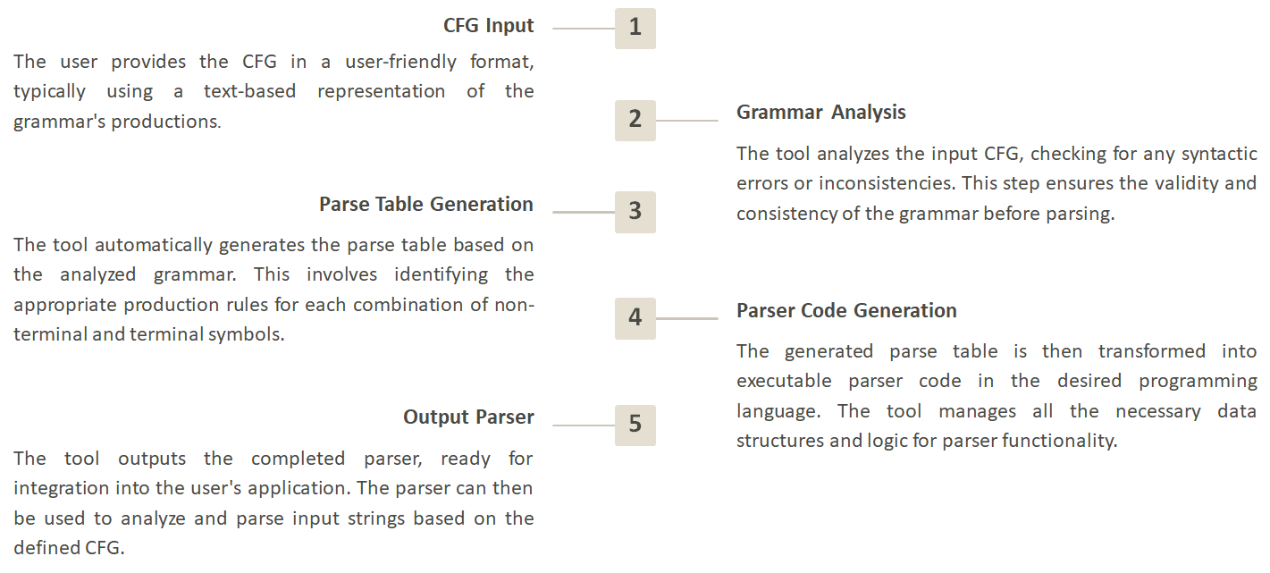
System Design / Architecture
Flowcharts & Block Diagrams
Technology Stack Used
-Python – Core programming language. -Tkinter – GUI framework for user interaction. -Collections Library – Efficient storage of grammar rules. -Algorithmic Implementation – First & Follow computation, LL(1) parsing.
System Architecture
The architecture follows a modular approach:
Input Layer – Takes CFG and user input string. Processing Layer – Computes First & Follow sets, generates parsing table, and processes input. Output Layer – Displays results, including parsing steps and error handling.

Slide 7
Implementation
Key Features & Functionalities
-Grammar Input: Users enter a context-free grammar (CFG) through a Tkinter GUI. -First & Follow Set Computation: Automatically calculates First and Follow sets for non-terminals. -LL(1) Parsing Table Generation: Constructs a table-driven parsing table based on First & Follow sets. -Parsing Simulation: Uses a stack-based approach to parse input strings step-by-step. -Error Handling: Displays syntax errors, missing table entries, and invalid grammar warnings.

Slide 8
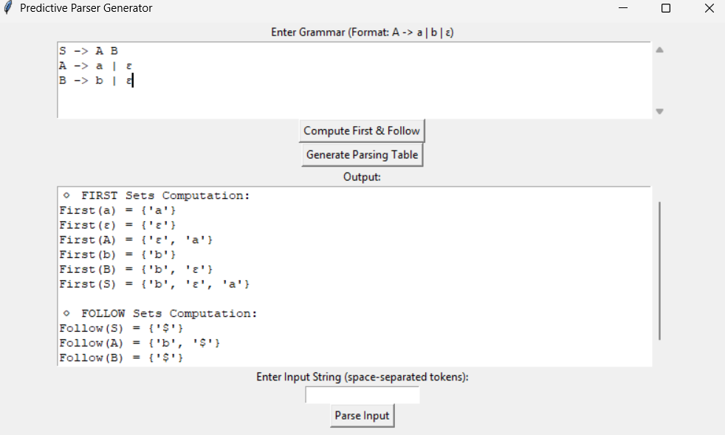
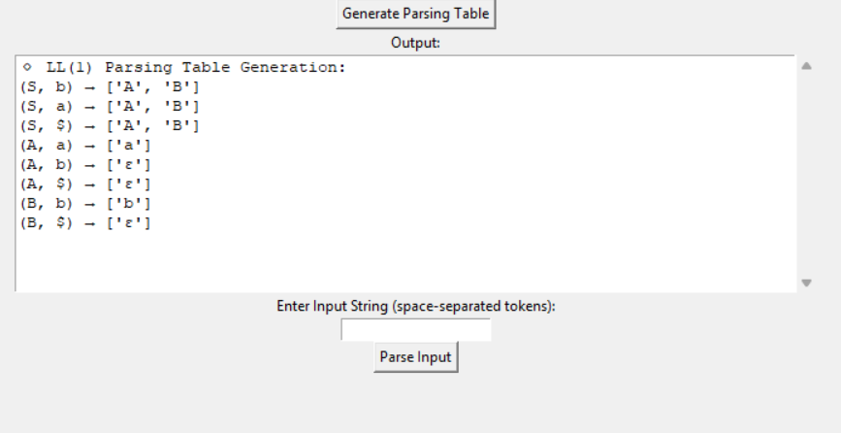
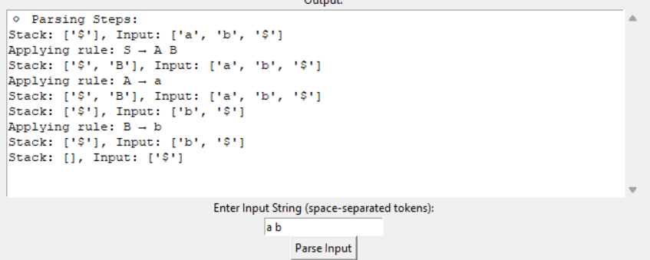
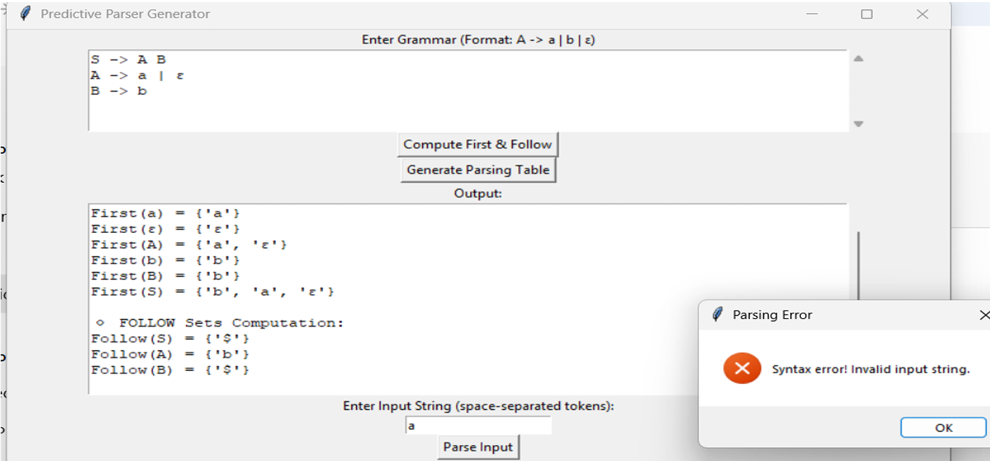
Implementation
Screenshots

Slide 9
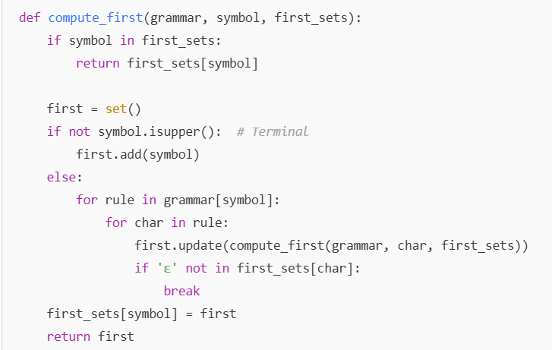
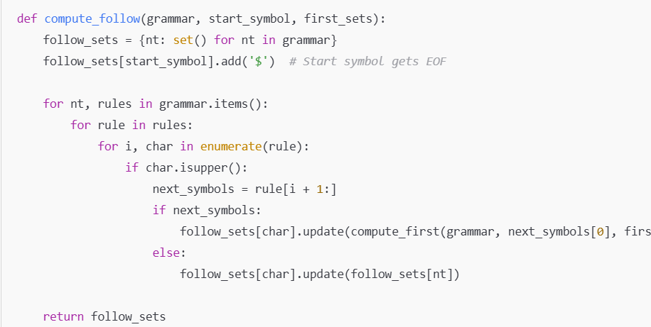
Implementation
Code Snippets
Compute First Set
Compute Follow Set

Slide 10
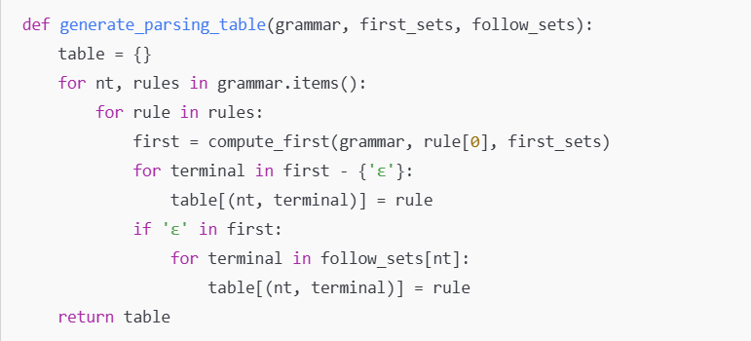
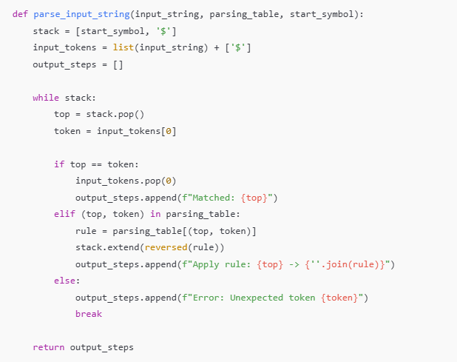
Implementation
Code Snippets
LL(1) Table Generation
Parsing Simulation

Slide 11
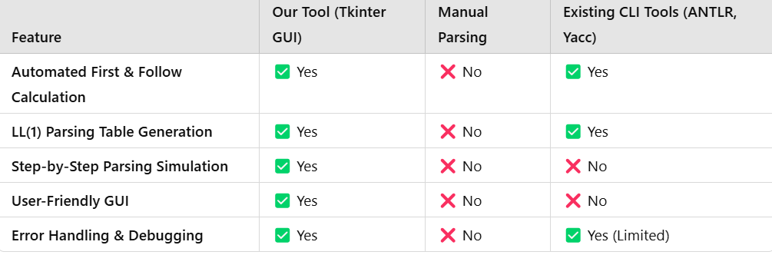
Results & Discussion
Comparison with Existing Solutions
Outcomes of the Project
-Automated LL(1) Parser Generator: Successfully computes First & Follow sets, generates LL(1) parsing tables, and simulates parsing steps using a Tkinter-based GUI. -Error Handling & Debugging: Detects grammar errors, ambiguous rules, and parsing failures for better debugging. -Step-by-Step Visualization: Users can see each step of parsing, making it easier to understand LL(1) parsing concepts.

Slide 12
Challenges & Limitations
Issues Faced During Development
-Handling Left Recursion: LL(1) parsers do not support left-recursive grammars, so manual transformation was needed. -Ambiguity in Grammar: Some CFGs are not LL(1) compatible, requiring checks and modifications. -Stack-Based Simulation Bugs: Ensuring correct push/pop operations in the parsing stack was tricky. -GUI Implementation Complexity: Displaying step-by-step parsing in Tkinter while keeping it user-friendly required multiple iterations.
Possible Constraints
-Limited to LL(1) Grammars: The tool works only for LL(1) parsers, so it cannot handle more complex grammars like LR(1) or ambiguous CFGs. -No Automatic Grammar Correction: Users must manually modify left-recursive and ambiguous rules before using the tool. -Scalability Issues: The Tkinter GUI may not be optimal for large grammars, as too many steps can clutter the output.

Slide 13
Future Scope
Enhancements & Improvements
Support for LL(k) Parsing: Extend the tool to handle LL(k) grammars for better flexibility.
Automatic Grammar Correction: Implement left-recursion elimination and ambiguity resolution to make it more user-friendly.
Performance Optimization: Improve parsing efficiency for large grammars using optimized data structures.
How This Project Can Be Extended
Web-Based Version: Develop an interactive web app using Flask/Django for wider accessibility.
Integration with Compiler Tools: Connect with ANTLR/Yacc for generating real-world parsers.
Visualization Enhancements: Add graphical parse trees and step-by-step animation for better understanding.

Slide 14
Conclusion
This project successfully developed an LL(1) Predictive Parser Generator with an interactive Tkinter-based GUI. The tool automates First & Follow set computation, LL(1) parsing table generation, and stack-based parsing simulation, providing users with a step-by-step visualization of the parsing process. Unlike traditional manual methods or CLI-based tools, this project enhances user-friendliness, debugging capabilities, and educational value.
The key takeaways include the importance of handling left recursion, the role of First & Follow sets in parsing decisions, and the challenges of ambiguity in grammar processing. While limited to LL(1) grammars, future improvements could include LL(k) support, automatic grammar correction, and a web-based version. Overall, this project serves as a valuable learning tool for students and professionals in compiler design and parsing algorithms.

Slide 15
References
Aho, A. V., Sethi, R., & Ullman, J. D. (1986). Compilers: Principles, Techniques, and Tools. Addison-Wesley. (The Dragon Book – a fundamental resource for parsing techniques)
Hopcroft, J. E., Motwani, R., & Ullman, J. D. (2006). Introduction to Automata Theory, Languages, and Computation. Pearson. (Covers context-free grammars and parsing algorithms in-depth)
Grune, D., & Jacobs, C. J. H. (2008). Parsing Techniques: A Practical Guide. Springer. (Explains LL(1) parsing and related algorithms with practical examples)
Knuth, D. E. (1965). On the Translation of Languages from Left to Right. Information and Control, 8(6), 607-639. (Foundational paper introducing parsing methods)

Slide 16
Thank You!

