Slide 1


K.RAMAKRISHNAN COLLEGE OF TECHNOLOGY
(AUTONOMOUS), TRICHY.
CHAT APPLICATION
PRESENTED BY
GIRIJESH R
2303811710421046
SUPERVISOR
Mr. M. Saravanan, M.E.,
AP/CSE.

Slide 2
PRESENTATION OVERVIEW
Objective
Project Introduction
Problem Statement
Methodologies (Programming concepts relevant to problem statement)
Architecture of the proposed system
List of Modules
Merits
Results and Discussion
Queries

Slide 3
OBJECTIVE
Implements a basic client-server chat application in Java using socket programming.
Provides a GUI using Java AWT for real-time message exchange between two endpoints.
Demonstrates networking, multithreading, and event-handling concepts.

Slide 4
PROJECT INTRODUCTION
The application facilitates real-time text communication between a client and a server.
Built to demonstrate fundamental networking and GUI design principles.
Enables users to exchange messages interactively through a simple user interface.

Slide 5
PROBLEM STATEMENT
The objective of the provided code is to create a simple chat application with a graphical user interface (GUI) that facilitates real-time communication between a client and a server using Java sockets. The application demonstrates basic networking concepts and GUI design, allowing message exchange via a text area, input field, and send button.The application employs a multi- threaded approach, enabling simultaneous message handling and GUI responsiveness. The server waits for incoming connections and manages multiple clients, ensuring seamless message broadcasting. Additionally, the client's user interface updates dynamically to display received messages and supports user input through an intuitive GUI design

Slide 6
METHODOLOGIES
Socket Programming: For establishing and maintaining network communication using Socket and ServerSocket.
Multithreading: Ensures non-blocking message exchange and GUI responsiveness.
AWT GUI Components: Includes TextField, TextArea, and Button for interaction, with ActionListener for event handling.

Slide 7
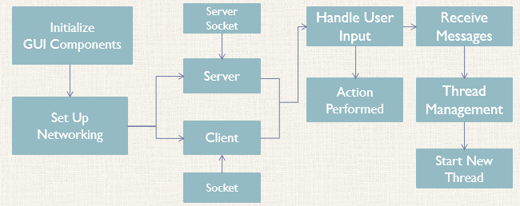
ARCHITECTURE OF THE PROPOSED SYSTEM

Slide 8
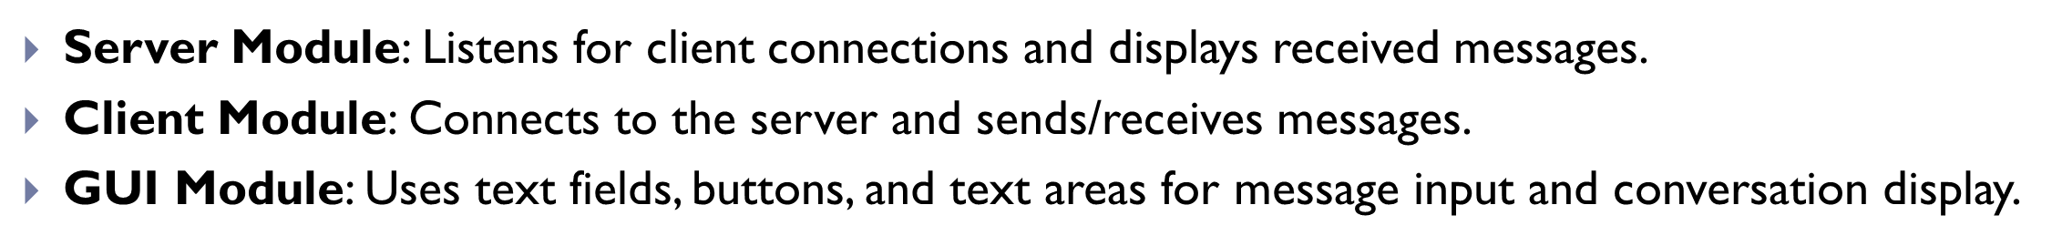
LIST OF MODULES
MODULE DESCRIPTON

Slide 9
MERITS
Demonstrates Java networking, GUI development, and multithreading concepts.
Serves as a foundation for building advanced chat systems with enhanced features.
Future work could include encryption, support for multiple clients, and a modernized GUI.

Slide 10
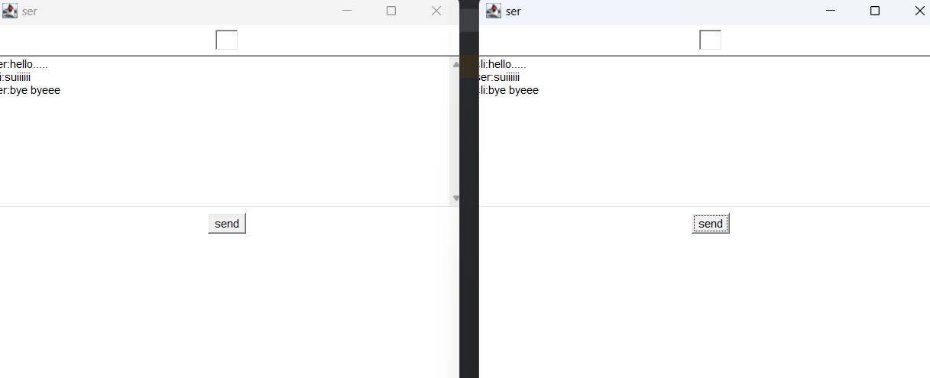
RESULTS AND DISCUSSION
Successfully exchanges real-time messages between the server and client.
The GUI dynamically updates to display sent and received messages.
Challenges include handling exceptions like disconnects and maintaining responsiveness.

Slide 11
QUERIES ?

