Slide 1
Privacy-Preserving Traffic Flow Prediction using Federated Learning: A Simplified Implementation of FedGRU Algorithm
Girik Khullar
CS21B2003
CS5005 - IIoT and Cloud Computing Assignment

Slide 2
Table of Contents
Introduction
Aim of the Project
Hardware/ Software Required
Problem Statement
Methodology
Results
Conclusion/ Future Work

Slide 3
Introduction
Traffic Flow Prediction (TFP) plays a crucial role in urban management, aiding in congestion alleviation, traffic light optimization, and overall transportation efficiency.
Traditional centralized machine learning (ML) methods utilize sensor data for TFP but raise privacy concerns due to data sharing.
Federated Learning (FL) enables collaborative model training across distributed organizations without sharing raw data.
FL addresses privacy concerns by aggregating model updates locally, ensuring data privacy while maintaining predictive accuracy.
Implemented a simplified implementation of the FedGRU algorithm for privacy-preserving TFP. FedGRU combines FL with Gated Recurrent Unit (GRU) neural networks for TFP.

Slide 4
Aim of the Project
Replicate and implement the FedGRU algorithm for privacy-preserving traffic flow prediction using federated learning.
Follow the methodology outlined in the paper to combine federated learning with the GRU neural network.
Demonstrate the feasibility and effectiveness of the approach through implementation.
Ensure data privacy by enabling organizations to train a global model collaboratively without sharing raw data.
Validate the accuracy of traffic flow prediction while maintaining privacy within the federated learning framework.
Reproduce the findings of the paper and validate the effectiveness of the FedGRU algorithm.
Provide a practical implementation of FedGRU for predicting traffic flow accurately in urban areas while safeguarding sensitive information.

Slide 5
Hardware/Software Required
List of Hardware
Computer with a decent CPU (i7-10750H in this case used)
Optionally a GPU for training (GTX 1650Ti used)
List of Software
Python to implement the algorithm
IDE (VSCode, Jupyter Notebooks used)
ML Libraries (Pytorch, Numpy, Pandas
Internet, Google Slides for PPT

Slide 6
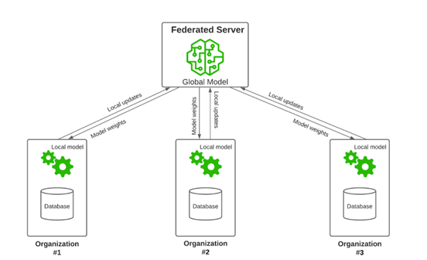
Problem Definition
The relevance of this problem lies in its impact on various stakeholders, including urban residents, taxi drivers, businesses, and government agencies.
Accurate traffic flow prediction enables more efficient traffic management, reduces congestion, and improves overall transportation system performance.
Additionally, it enhances the effectiveness of intelligent transportation systems (ITS) subsystems, such as advanced traveler information, online car-hailing services, and traffic management systems.
By preserving data privacy while predicting traffic flow, our project contributes to the development of safer, more efficient, and privacy-aware urban transportation systems.

Slide 7
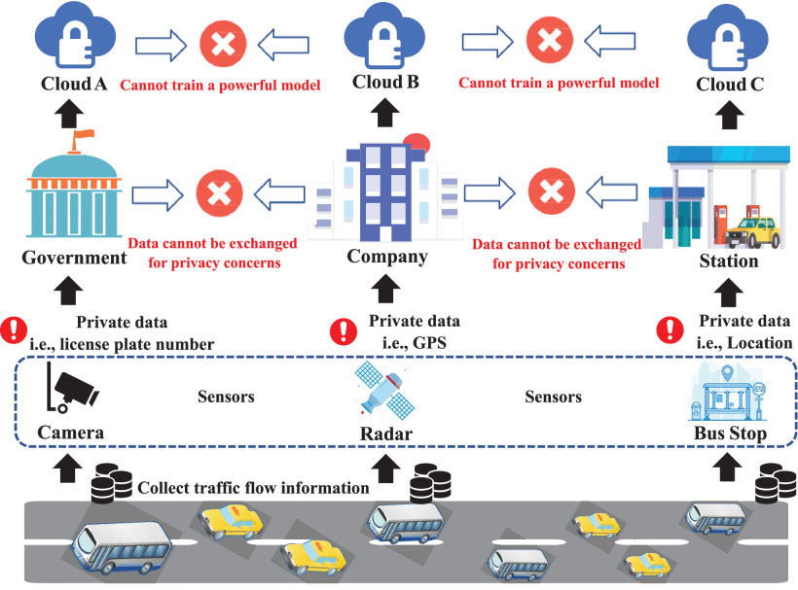
Problem Definition
Our project solves the challenge of accurately predicting traffic flow while preserving data privacy in urban areas.
Traditional centralized learning methods face obstacles in sharing sensitive information, especially in scenarios like traffic prediction where privacy concerns are paramount.
The project implements the FedGRU algorithm,
combining federated learning with the gated
recurrent unit (GRU) neural network.
This approach allows organizations to
collaboratively train a global model without
sharing raw data, thus maintaining privacy.

Slide 8
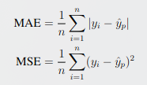
Methodology
Main contribution is that we have implemented the proposed algorithm from the paper and verified it successfully.
We also demonstrate that it is possible to get SOTA models even while maintaining the privacy and security of the data.
Federated Learning and Gated Recurrent Unit (GRU)
Privacy-Preserving Traffic Flow Prediction Algorithm (FedGRU)
implementing and fine-tuning the FedGRU algorithm to meet the specific requirements of traffic flow prediction in urban areas.

Slide 9
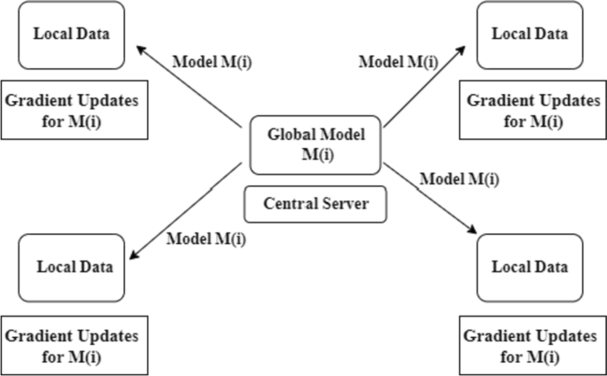
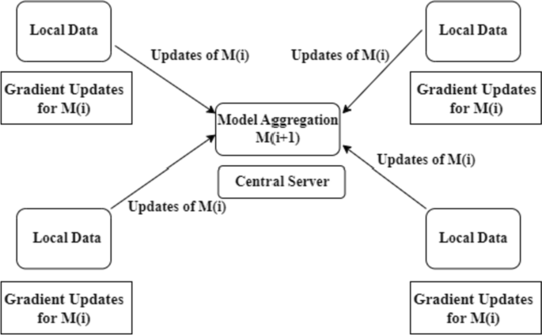
Methodology
We first initialize the global model weights randomly. Then, these weights are transferred to all the clients who then create their own models with the weights sent by the central global server.
Once the clients get the models, they train their individual models on their individual datasets without communicating with each other in any manner possible.
Once the local models are trained, each client sends the weights of its model to the global model in cloud which then uses the FedAVG algorithm

Slide 10
Analysis/ Results
FedGRU algorithm is applied to the real-world data collected from the Caltrans Performance Measurement System (PeMS) database for performance demonstration.
Testing is done on a 5 min interval and we use MSE and MAE as our metrics.
We find that randomly choosing clients in each global epoch leads to some variance in the performance while training.
Both GRU and FedGRU have nearly the same performance on the test set.
Thus, there is no reason not to use the FedGRU algorithm if data privacy is a concern as there is no loss of performance.

Slide 11
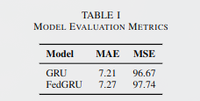
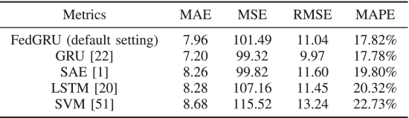
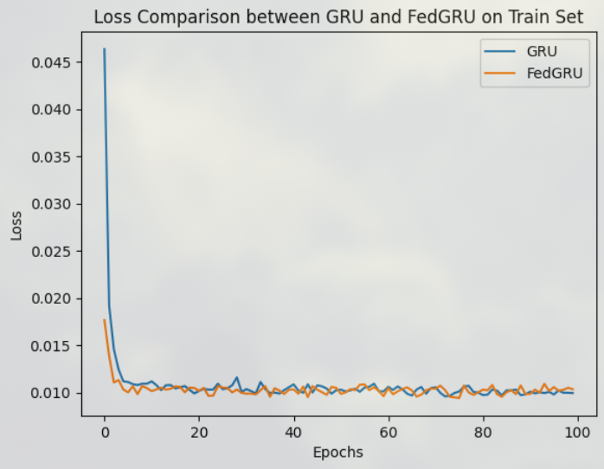
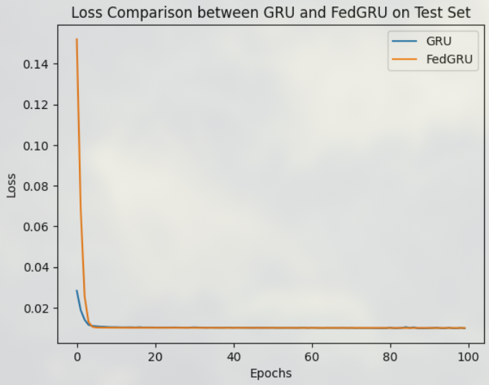
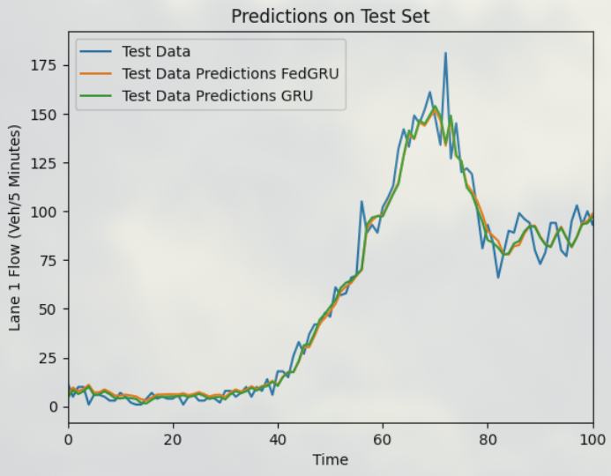
Analysis/ Results

Slide 12
Conclusion
FedGRU for TFP was implemented successfully with a high accuracy demonstrating the feasibility of the algorithm.
We demonstrated that it is possible to train models on traffic flow detection sensors without sharing data to the cloud, thus maintaining privacy, and still achieve comparable results to the SOTA.
Loss curves signify that no additional time is required to get comparable results to the global, centralized model.
We did not implement ensemble clustering based FedGRU for TFP and would like to do so in future. Also, we want to try our hands on Graph Convolutional Networks as well.

Slide 13
References
Y. Liu, J. J. Q. Yu, J. Kang, D. Niyato and S. Zhang, "Privacy-Preserving Traffic Flow Prediction: A Federated Learning Approach," in IEEE Internet of Things Journal, vol. 7, no. 8, pp. 7751-7763, Aug. 2020, doi: 10.1109/JIOT.2020.2991401. https://ieeexplore.ieee.org/document/9082655
https://paperswithcode.com/paper/privacy-preserving-traffic-flow-prediction-a
G. Nidhi and J, “Federated learning analysis for vehicular traffic flow prediction: evaluation of learning algorithms and aggregation approaches,” Cluster Computing, 2024

Slide 14
Thank You Any Questions?

