Slide 1
MOBILE TELECOMMUNICATIONS
A look at telecommunication technology

Slide 2
INTRODUCTION
It is the use of technology that allows us to communicate with people in different locations, without the use of physical connection (wires or cables)
In 1986, the first wireless telegraph system was developed and in the first year the first ever wireless communication took place.
The early mobile system used single high power transmitters that gave coverage upto about 80kms.
In 1973, the first modern era mobile phone was invented by Martin Cooper, he placed the first cellular mobile call to his rival at BELL labs, Joel Engel.
In wireless communication the data is transported using electronic waves that would normally travel the wires.
This is used in: radio broadcast, networking, internet and many more.

Slide 3
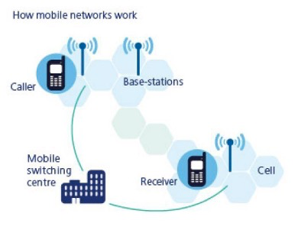
How Wireless Communication Works?
It all begins with a transmitter which produces a periodic wave. This signal propagates to the antenna.
The antenna radiates the alternating current as an electronegative wave.
The receiver detects the wave and decodes the data.
The output waves have different frequencies.
These frequencies can be used for different purposes. Some uses of these frequencies can be: broadcasting, mobile communication, radio navigation etc.

Slide 4
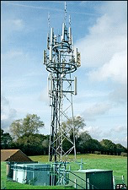
How does Wireless Communication works in Our Phones Work?
When we speak into a cell-phone, the microphone converts the sound of our voice into a up and down pattern of electrical signals that are packed into a radio wave which is beamed out the phone’s antenna
A mast – a tall structure used to send and receive signals - receives these signals and passes them to the base station. From the base station, the calls are routed to the base station nearest to the destination phone and then finally to that phone.

Slide 5
WHAT ARE THE RECENT TELECOMMUNICATIONS?
1G
2G
The acronym for first generation, was introduced in 1970’s .
The acronym for second generation, developed in the late 1980s.
3G
4G
The acronym for third generation, propelled in the year 2000.
The acronym for fourth generation, developed in the decade of 2010.

Slide 6
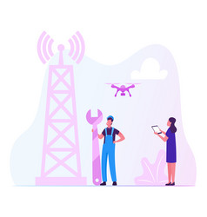
FIRST GENERATION
In the 1970’s, privately owned businesses began building up their own particular correspondence frameworks to advance existing frameworks further.
Those private frameworks were Analogue mobile phone systems (AMPS) utilized in parts of America and the United Kingdom.
Total Access Communications Systems (TACS) and Nordic Mobile Telephone (NMT) were also used in parts of Europe.
These created frameworks are now what is known as the First Generation of mobile communication creativity.

Slide 7

SECOND GENERATION
2G alludes to the second era in the light of GSM and was developed in the late 1980s.
It utilises computerised signals for voice transition. The principal focal point of this innovation was on advanced flags and gives individuals the ability to convey content and picture message at low speed.
The GSM innovation was ceaselly enhanced to give better administrations which prompted improvement of cutting-edge Technology in the vicinity of 2g and the 3g mobile networks.

Slide 8
THIRD GENERATION
This generation in light of GSM and was propelled in the year 2000. The point of this innovation was to offer rapid information across the world.
The first innovation was enhanced to permit information upto 14 Mbps and all the more utilising bundle exchanging. Utilising Wide Band Wireless Networks with which clearness is expanded.
It likewise offers information administrations, access to TV/Video, Data, Text, etc, as well as new administrations like Global Roaming is now possible. It works at a scope of 2100MHz and has data transmission of 15-10MHz utilized for High-Speed network and video visiting.
The 3G mobile framework was called a UMTS (Universal Mobile Telecommunication System) in Europe, while CDMA2000 is the name of American 3G variation.

Slide 9
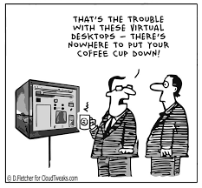
FOURTH GENERATION
4G offers a much improved downloading rate upto 100Mbps. It gives the same element advantages as 3G but also includes administrations like Multi-Media, Newspapers, watching TV programs online using services such as Netflix with a lot more clarity due to the send/receive speeds of data now being significantly quicker than past ages.
It introduced us to the Mobile Social Media and Mobile App world used it how it is today.
LTE (Long Term Evolution) is considered to be a 4G evolution.

Slide 10
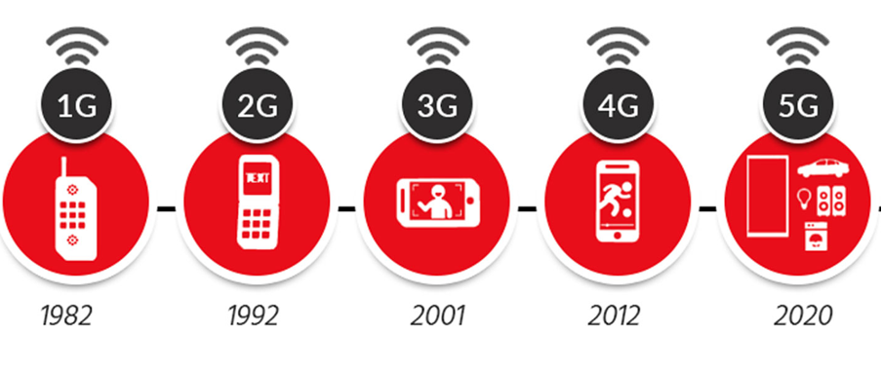
WHAT’S COMING NEXT?
5G i.e., fifth generation mobile network- it is the new global wireless standard after 1G, 2G, 3G and 4G networks.
It enables a new kind of network that is designed to connect virtually everyone and everything together including machines, objects and devices.
This technology is meant to deliver higher multi-Gaps peak data speeds, ultra low latency, more reliability, massive network capacity, increased availability, and a more uniform user experience to more users. Higher performance and improved efficiency empower new user experiences and connects new industries,.

Slide 11
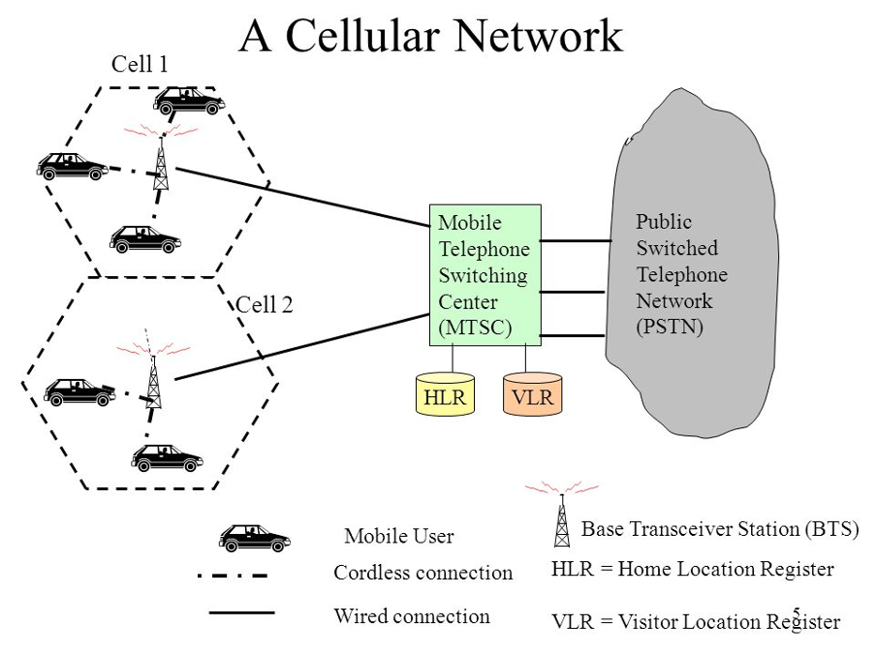
WHY IS 5G BETTER THAN 46?
5G is significantly faster than 4G.
5G has more capacity than 4G.
5G has signified lower latency than 4G.
5G is a unified platform that is more capable than 4G
5G uses spectrum better than 4G.
It is a unified platform.
It uses better spectrum.
Faster than 4G
5G has more capacity then 4G
It has lower latency than 4G

Slide 12
WHERE IS 5G USED?
Broadly speaking, 5G is used across three main types of connected services, including enhanced mobile broadband, mission critical communication, and the massive IoT.
I. Enhanced Mobile Broadband: In addition to making our smartphones better, the technology can usher in new immersive experiences such as VR and AR with faster, more uniform data rates, lower latency, and lower cost-per-bit.
II. Mission-Critical Communication: This can transform industries with ultra-reliable, available, low latency links like remote control of critical infrastructure, vehicles and medical procedure.
III. Massive IoT: It is meant to seamlessly connect a massive number of sensors virtually everything through the ability to scale down in data rates, power and mobility- providing extremely lean and low-cost connectivity rates.

Slide 13
THANKS!
Hope you enjoyed the presentation

