Slide 1
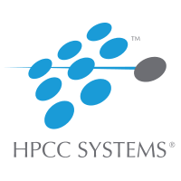
Investigate Third Party Environments Working with the HPCC Systems – Power BI and GitPod
Girikratna Sharma
Trainee Software Engineer
LexisNexis Risk Solutions - Mumbai

Slide 2
Content Covered in this Presentation:
Bare Metal HPCC Deployment
Overall Architecture
Integration of Power BI with Local HPCC Cluster
Integration of Power BI with Sample HPCC Data
Integration of Ratings Data without change in Script
Basic Analytics using Larger Data from HPCC in Power BI
Use Case of GitPod: Explanation on Progress and overall Validity
Case Study of GitPod

Slide 3
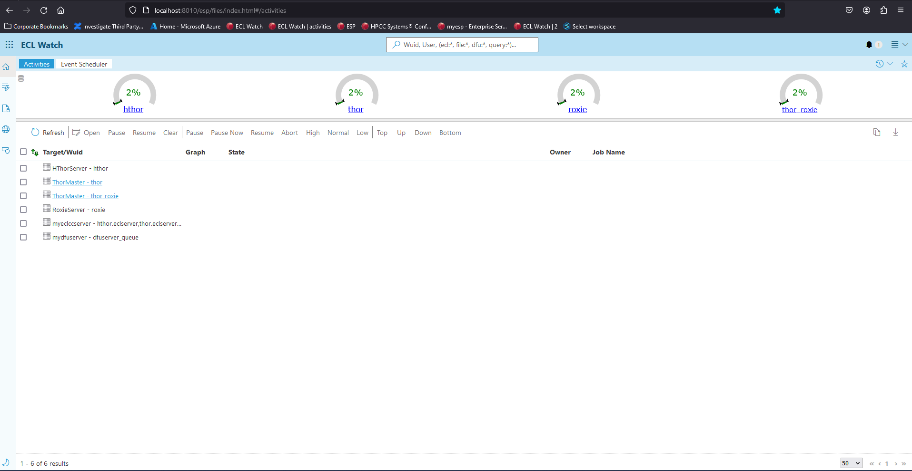
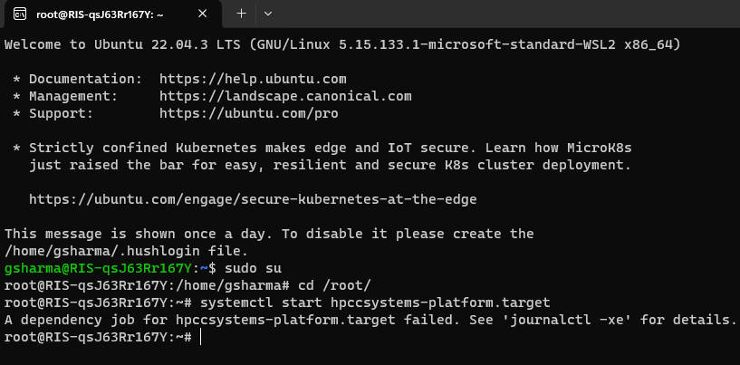
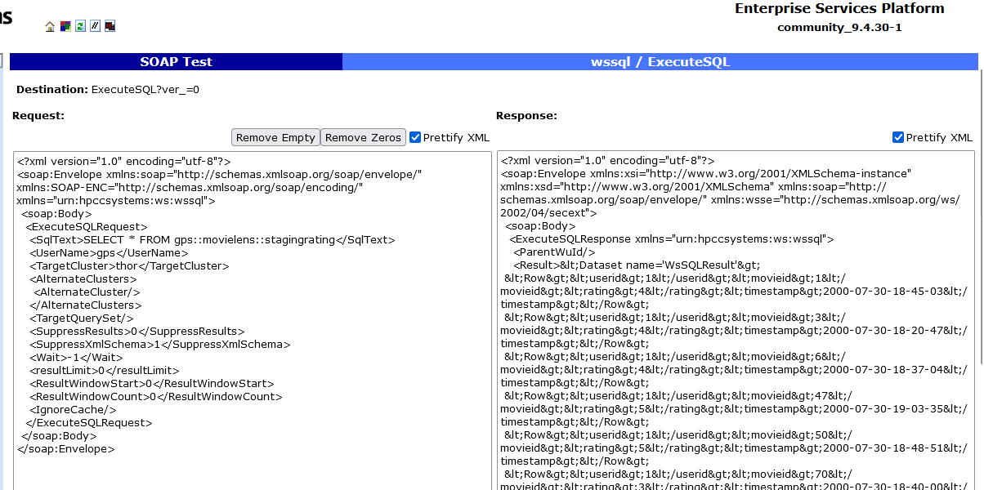
Bare Metal HPCC Deployment:
Deployed HPCC on WSL Ubuntu and configured WsSQL:
ESP Port: 8002
ECL Watch Port : 8010
WsSQL Port: 8510

Slide 4
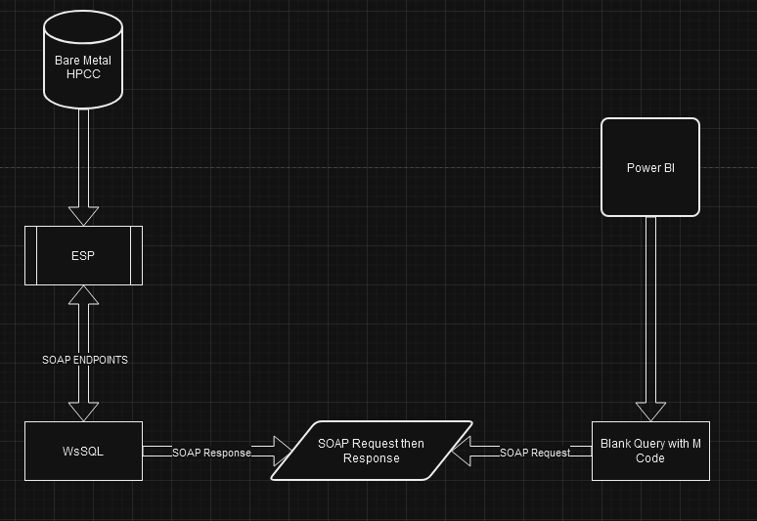
Overall Architecture:
Worked on Decoding the SOAP Response from XML into data useful for Analytics on Power BI
Worked on the Power Query ‘M’ Code based on the Request generated by WsSQL in ExecuteSQL

Slide 5
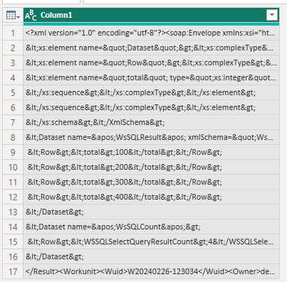
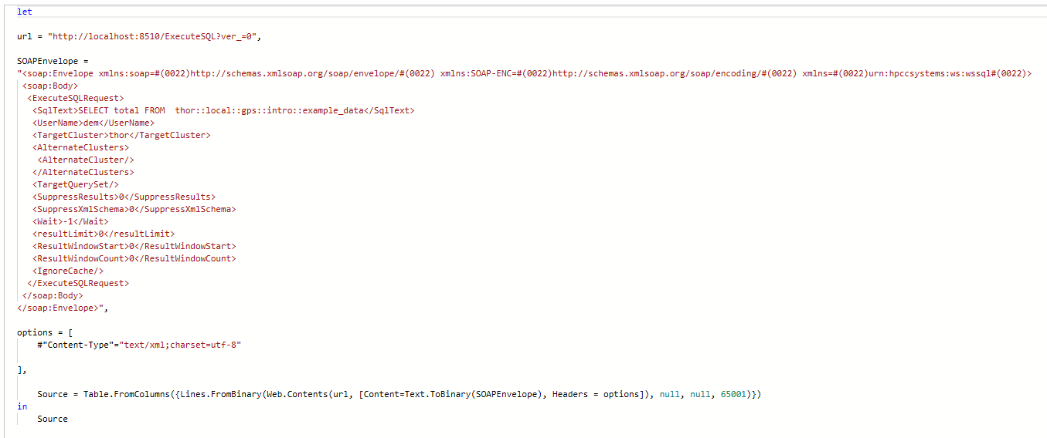
Integration of Power BI with Local HPCC Cluster:
A SOAP API connection established from “Blank Query” in Power BI, wherein M Code is written in “Advance Editor” of the SOAP Request generated in “ExecuteSQL” in WsSQL.

Slide 6
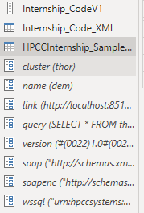
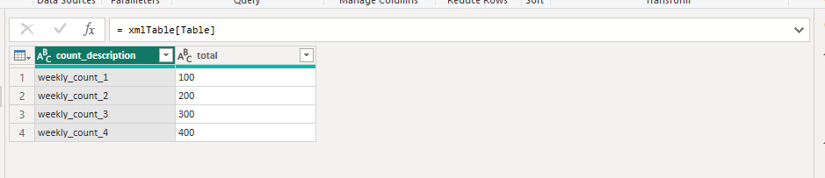
Integration of Power BI with sample HPCC Data :
Integration of sample In-line data from HPCC (Local Bare Metal Deployment) with Power BI and Parameterized all WsSQL components in Power Query

Slide 7
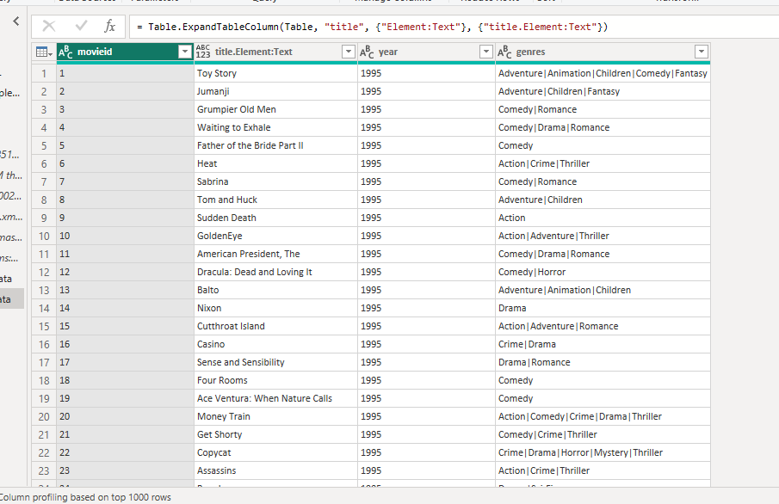
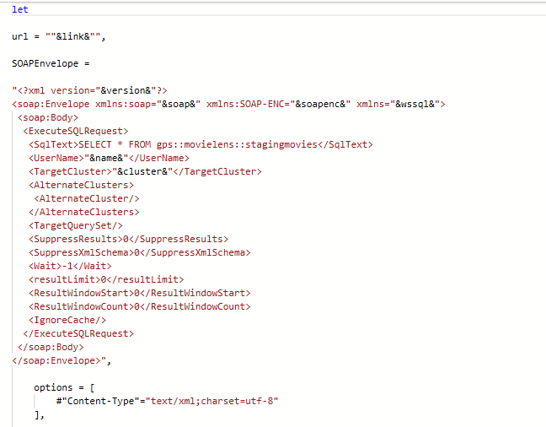
Integration of Larger Data without change in Script:
A sample data of Movies with the columns as “Movie ID” , “Title” , “Year” and “Genres”

Slide 8
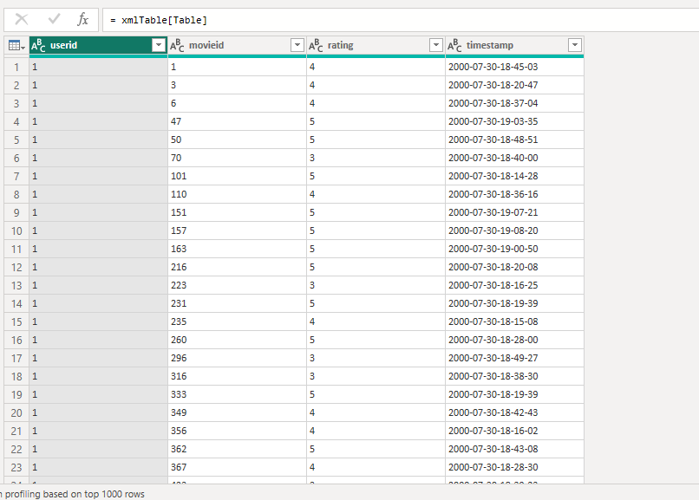
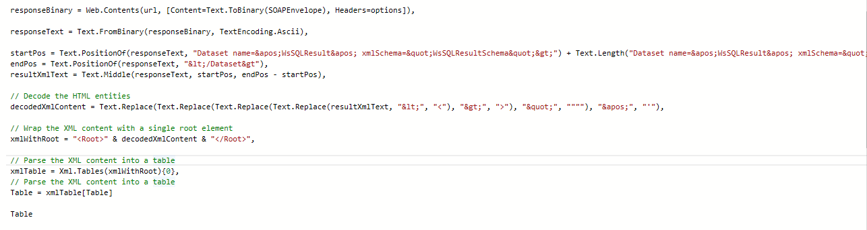
Integration of Ratings Data without change in Script:
A sample data of Ratings with the columns as “User ID” , “Movie ID” , “Rating” and “Timestamp”

Slide 9
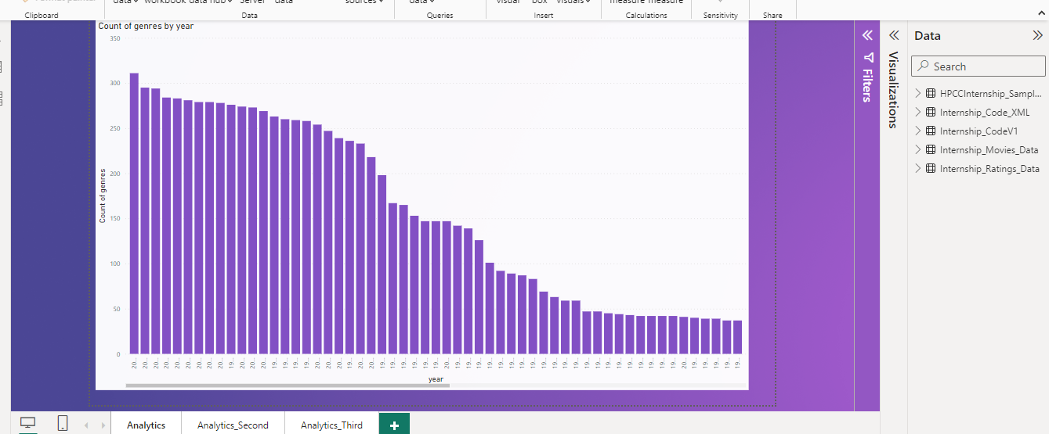
Basic Analytics using Larger Data from HPCC in Power BI:
Basic Analytics in Power BI based on the data, to create Dashboards and Stories, to complete the cycle of Data Analytics

Slide 10
Use Case of GitPod: Explanation on Progress and overall Validity
GitPod has a major benefit mainly for the HPCC Platform’s Open-Source GitHub Repository, where any new contributor or developer can directly push commits and browse through the code and test changes without the need to install and setup HPCC on their Local Machine (Either via WSL or Docker).
Another point is ease of use, no need to setup any development platform since it can all be configured by the GitPod’s yaml configuration file. Even in the case of Trainee’s or New Hire’s, they can directly get exposure to the code and can skip or delay the need to configure.
The GitPod yaml file must be modified based on the dependencies of the HPCC Platform once that is done, the HPCC Platform Forked in my Repository can work on GitPod under my GitHub ID’s Workspace which can be access by the GitPod homepage.

Slide 11
Case Study of GitPod with HPCC Platform Deployment:
One of the biggest issues which we face while working with GitPod is the constant return to state which we need to perform, an example can be, say we want to run an installation of a dependency, that install needs to be mentioned in the yml file (It executes every time the VM is executed) or else we will have to manually run it.
The configuration of Cmake proves to be challenging as most of the dependencies which are called have direct contact with the OS of the VM which we are running, trying to reconfigure based on a new Fork of the Platform on Github still faces the same issue.
Whereas the use of a tool to automate the execute of a Platform during Production is valid, but due to the dependency on GitPod itself, this method will not pose a major advantage, when compared to the Docker Image build for testing a feature in Production.

Slide 12
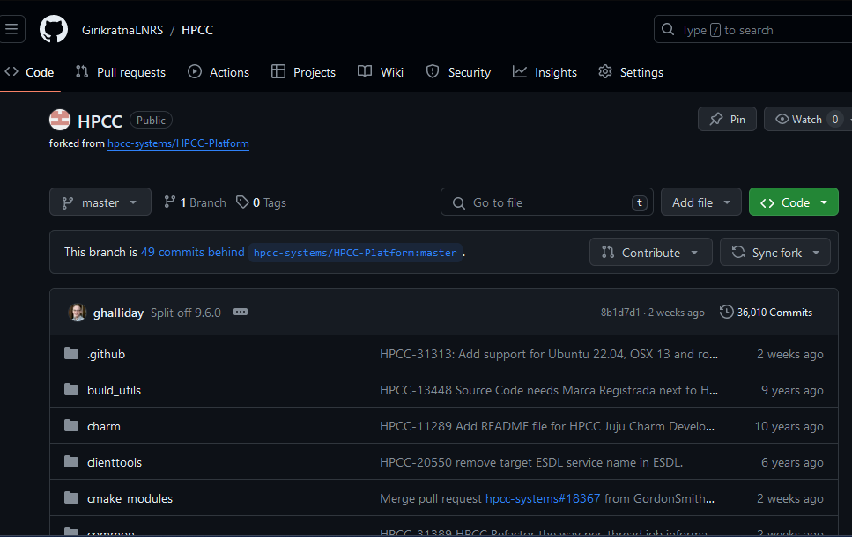
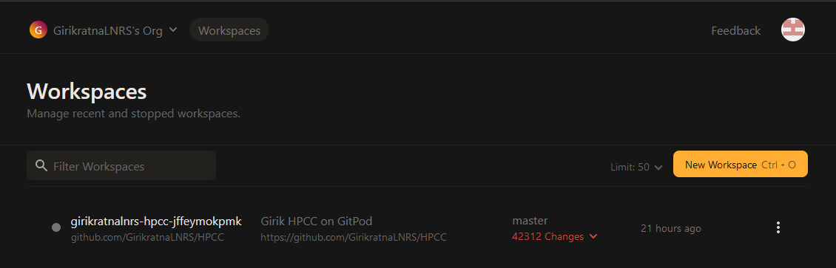
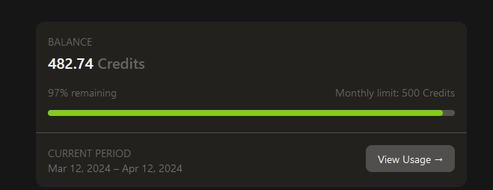
Progress on GitPod Integration:

Slide 13


Slide 14
Special Thanks to the Team:
Community Manager: Hugo Watanuki
Local Mentor: Srinivasan Kothandam Aryaman Gautam
International Mentor:
Xiaoming Wang
Managers: Rahul Jain Neeraj Pandey

Slide 15
Thank You

