Slide 1



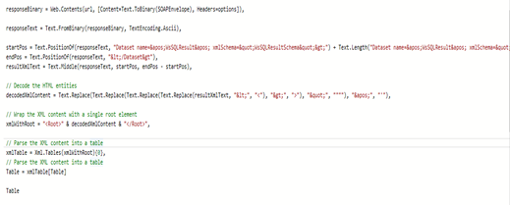
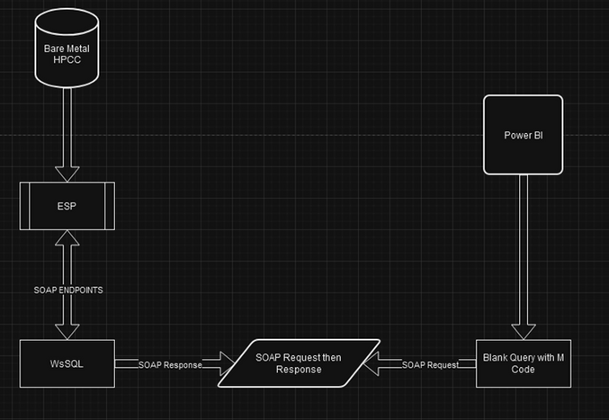
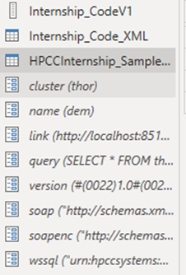
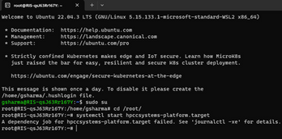
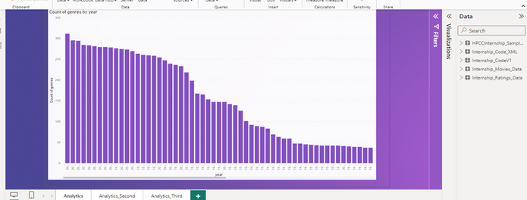
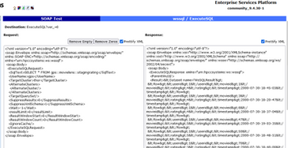
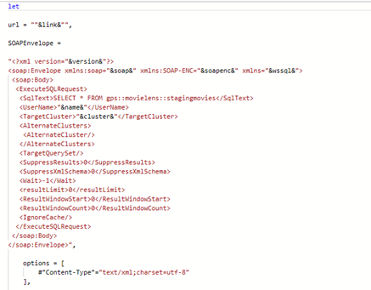
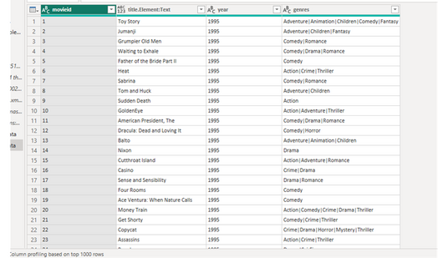
Integration of Power BI with HPCC Platform
Girikratna Sharma
Prerequisites:
Bare Metal HPCC Installation
WsSQL Web Service part of ESP
Power BI Installed
Connection Architecture
Decoding SOAP Response
The 2 code snippets are part of the Power Query Code used to send the SOAP Request as the SOAP Envelope and then decode the SOAP Response into Table format which is useful for analytics
Sample Analytics
We can the Parameterize the SOAP Envelope which we will send from Power BI, to ensure we just need to modify this, and nothing else as the code remains constant irrespective of size of data.
The Connection is between 2 HTTP Endpoints, which are WsSQL and Power Query Code inside Power BI, from which we can send a SOAP Request and recieve a SOAP Response.
SOAP Envelope
Sample Data Output from Code
References:
WsSQL ESP Web Service Guide
Installation and Running the HPCC Platform

