Slide 1
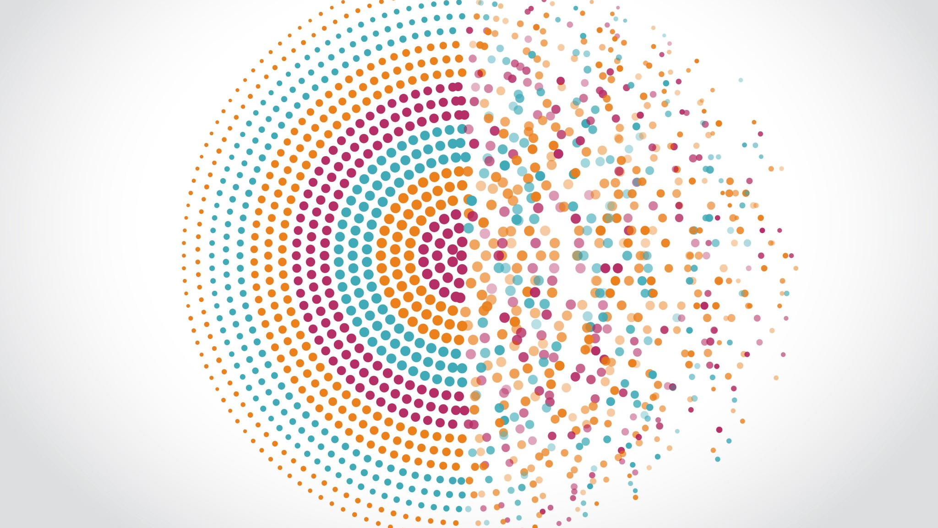
Visual Object Detection Using Yolo8
An overview of YOLOv8's architecture and implementation

Slide 2
Abstract
This project explores the use of YOLOv8, a state-of-the-art object detection model, for visual object detection in indoor environments using the MIT Indoor Scenes dataset. YOLOv8 improves accuracy and efficiency compared to previous YOLO versions and frameworks like Detectron2 by offering a streamlined architecture and faster inference. The dataset comprises images from 67 distinct indoor categories, such as kitchens, bedrooms, and offices, making it ideal for evaluating the model's performance in diverse real-world scenes. The project implements YOLOv8 to detect objects across these indoor environments, analyzing performance metrics, confidence levels, and challenges such as cluttered spaces and varying object scales. The results showcase YOLOv8’s superior detection capabilities, making it a strong candidate for real-time object detection tasks.

Slide 3
YOLOv8 Architecture
The YOLO architecture consists of 3 essential blocks in the algorithm and everything will occur in these blocks, which are: Backbone, Neck and Head.
Backbone:
The backbone, also known as the feature extractor, is responsible for extracting meaningful features from the input.
Activities:
- Captures simple patterns in the initial layers, such as edges and textures.
- Can have multiple scales of representation as you go, capturing features from different levels of abstraction.
Will provide a rich, hierarchical representation of the input.

Slide 4
Neck:
The neck acts as a bridge between the backbone and the head, performing feature fusion operations and integrating contextual information. Basically the Neck assembles feature pyramids by aggregating feature maps obtained by the Backbone, in other words, the neck collects feature maps from different stages of the backbone.
Activities: - Perform concatenation or fusion of features of different scales to ensure that the network can detect objects of different sizes. - Integrates contextual information to improve detection accuracy by considering the broader context of the scene. - Reduces the spatial resolution and dimensionality of resources to facilitate computation, a fact that increases speed but can also reduce the quality of the model.
Head:
Function: The head is the final part of the network and is responsible for generating the network’s outputs, such as bounding boxes and confidence scores for object detection. Activities: - Generates bounding boxes associated with possible objects in the image. - Assigns confidence scores to each bounding box to indicate how likely an object is present. - Sorts the objects in the bounding boxes according to their categories.

Slide 5
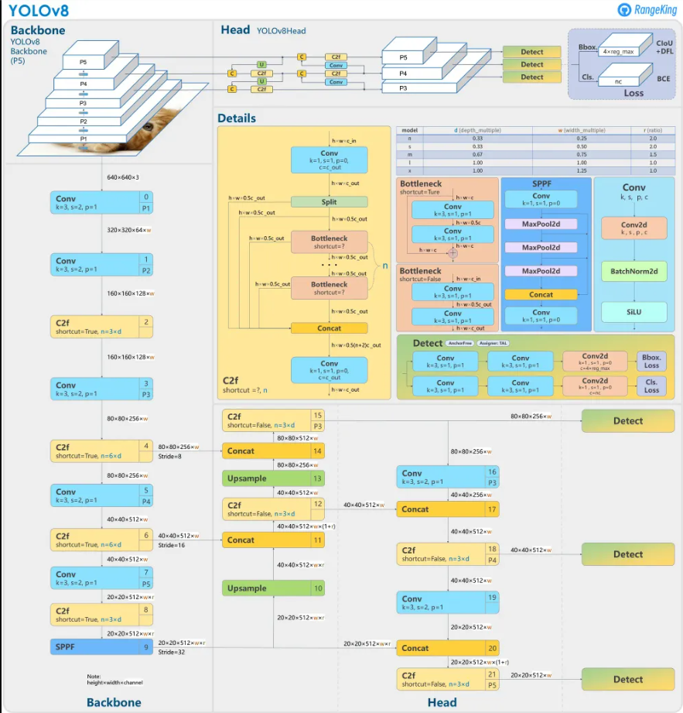

Slide 6
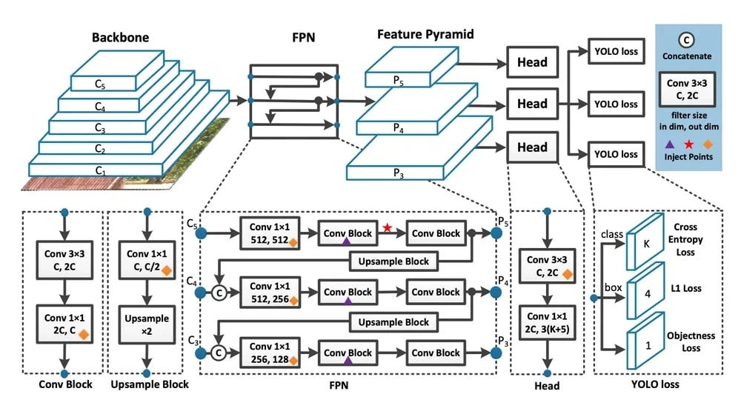

Slide 7
Dataset
Dataset used for the object detection is MIT Indoor Scenes
The Indoor Scenes CVPR 2019 dataset has 15,620 images of 67 different indoor places, like bedrooms, bathrooms, kitchens, and offices. It is mainly used to classify scenes (recognizing the type of place in an image) but can also be used for tasks like finding objects in images or dividing images into parts. The images are organized neatly into folders by category, making it easy to use for training deep learning models like ResNet or YOLO. This dataset is great for tasks like recognizing scenes, detecting objects, and reusing models for similar problems.
Dataset Link: https://www.kaggle.com/datasets/itsahmad/indoor-scenes-cvpr-2019/data

Slide 8

Code
This code imports os module gets the current working directory using os.getcwd() stores it in variable HOME, and prints the directory path.

Slide 9

Code
%pip install ultralytics supervision roboflow:
Installs three Python packages:
Ultralytics: A package for working with YOLO models and other computer vision tools.
Supervision: A library for supervision tasks, like labeling and dataset creation.
Roboflow: A platform for managing and preparing datasets for computer vision projects.
import ultralytics:
Imports the ultralytics package to make its functions available for use in the script.
ultralytics.checks():
Runs a check to verify the environment setup for the ultralytics package
Ensuring that all dependencies and configurations are correctly set up for running models like YOLO
.

Slide 10
Code
!yolo: This is a shell command (indicated by the !) that runs the YOLO (You Only Look Once) object detection model from the Ultralytics library, which is used in a Jupyter notebook or Google Colab.
task=detect: Specifies the task to perform, which in this case is detection (identifying and classifying objects in images).
mode=predict: Sets the mode to predict, meaning it will use a pre-trained model to make predictions (not training the model).
model=yolov8x.pt: Specifies the pre-trained YOLOv8 model file to use for detection. The yolov8x.pt file is a PyTorch model file.
conf=0.25: Sets the confidence threshold to 0.25. This means the model will only consider detections with a confidence score greater than or equal to 25%.
source='/content/Bathroom/008.jpg’: Defines the input image to process. In this case, it is an image file located at /content/Bathroom/008.jpg.
save=True: Tells YOLO to save the resulting output image(s) with detected objects (bounding boxes and labels) drawn on them.

Slide 11
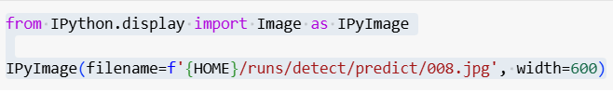
Code
from IPython.display import Image as IPyImage:
Imports the Image class from the IPython. display module, and aliases it as IPyImage. This is used to display images in Jupyter notebooks or Google Colab.
IPyImage(filename=f'{HOME}/runs/detect/predict/008.jpg', width=600):
Displays the image located at the path f'{HOME}/runs/detect/predict/008.jpg' (where HOME is the current working directory).The width=600 argument sets the displayed image's width to 600 pixels in the notebook.
This code displays the processed image (with detections) from the YOLOv8 model in the notebook, using the image saved in the previous step.

Slide 12
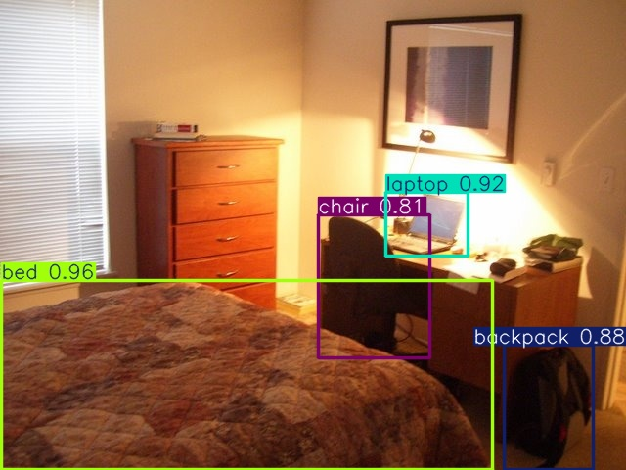
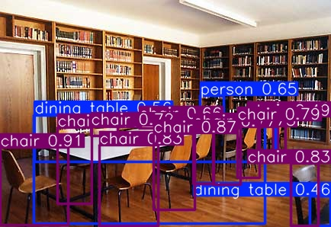
Results:
Bedroom Library

Slide 13
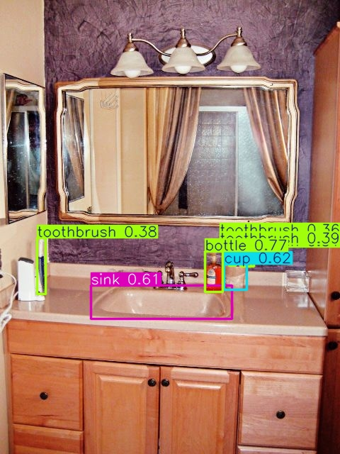
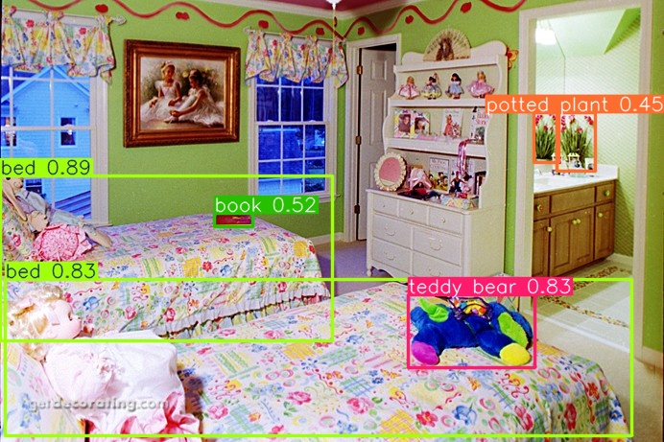
Results:
Bathroom Children Room

Slide 14
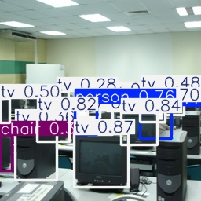
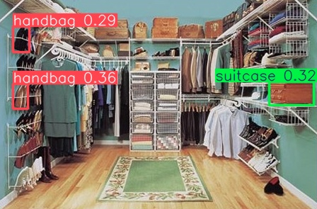
Results:
Closet Computer Room

Slide 15
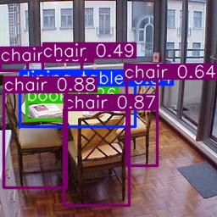
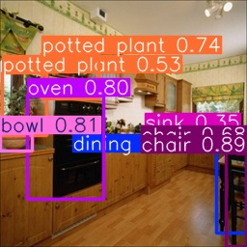
Results:
Dining Room Kitchen

Slide 16
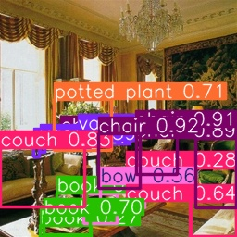
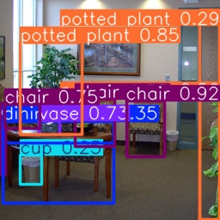
Results:
Living Room Waiting Room

Slide 17
Summary of YOLOv8 Object Detection Probabilities Across Rooms
Bedroom:
Frequently detected objects: Bed, Chair, Book.
Probability range: High confidence scores (up to 95%)
Bathroom:
Likely detected objects: Toilet, Sink, Mirror.
Confidence: Predicted probabilities vary, with certain objects consistently exceeding 90%.
Children’s Room:
Detected objects: Toys, Beds, Books.
Observation: High confidence for colorful or unique shapes commonly associated with toys (88%-95%).

Slide 18
Summary of YOLOv8 Object Detection Probabilities Across Rooms
Closet:
Detected objects: Clothes, Shoes, Hangers.
Confidence trends: Moderate to high, reflecting clear visibility of closet items (85%-93%).
Computer Room:
Focused objects: Laptop, Chair, Desk.
Accuracy: High confidence scores for technology-related items (90%-96%).
Dining Room:
Common objects: Dining Table, Chairs, Plates.
Confidence scores: Strong for static, well-lit objects (89%-94%).

Slide 19
Summary of YOLOv8 Object Detection Probabilities Across Rooms
Kitchen:
Frequently detected: Appliances (e.g., Oven, Microwave), Tableware.
Probabilities: Slightly variable due to clutter, but certain items consistently above 85%.
Library:
Key detections: Bookshelves, Books, Chairs.
Confidence: Strong for structured objects like books (91%-96%).
Living Room:
Predicted objects: Sofa, TV, Coffee Table.
High probability: Objects in open spaces often detected with high confidence (92%-97%).
Staircase:
Detected features: Steps, Railings.
Confidence: Moderate to high (80%-90%), influenced by lighting and visibility.
Waiting Room:
Common objects: Chairs, Table, Decorative Items.
Trends: Consistently high confidence for seating-related objects (88%-93%).

Slide 20
Advantages of YOLOv8 for the MIT Indoor Scenes Dataset Compared to YOLOv5, YOLOv11, and Detectron2
Over YOLOv5
Improved Accuracy:
YOLOv8 features better feature extraction and anchor-free detection, resulting in higher precision and recall compared to YOLOv5.
Handles more challenging detection tasks, such as small or occluded objects, more effectively.
Lighter and Faster:
YOLOv8 is more efficient in terms of inference speed and model size, making it suitable for real-time applications.
Benefits from optimized computational layers and streamlined architecture compared to YOLOv5.
Native Support for Tasks:
Unlike YOLOv5, YOLOv8 natively supports classification, object detection, and segmentation tasks in a single pipeline, which is highly versatile for diverse datasets like MIT Indoor Scenes.
Better Training Mechanisms:
Incorporates improved loss functions (e.g., CIoU/DIoU), leading to more accurate bounding boxes.
Enhanced augmentation strategies, such as mosaic and mix-up, improve generalization on indoor scenes.

Slide 21
Advantages of YOLOv8 for the MIT Indoor Scenes Dataset Compared to YOLOv5, YOLOv11, and Detectron2
Over YOLOv11
Mature Framework:
YOLOv8 benefits from broader community support, optimized implementations, and extensive benchmarking compared to YOLOv11, which is still evolving.
More stable and reliable for production-level tasks.
Streamlined Architecture:
YOLOv8 integrates advanced innovations from prior YOLO models into a compact design, avoiding the over-engineering seen in YOLOv11.
Easier to train and deploy without requiring complex tuning.
Compatibility with Diverse Hardware:
YOLOv8’s optimizations make it more portable across edge devices and GPUs, ensuring better scalability for indoor detection tasks.

Slide 22
Advantages of YOLOv8 for the MIT Indoor Scenes Dataset Compared to YOLOv5, YOLOv11, and Detectron2
Over Detectron2
Speed and Efficiency:
YOLOv8 is significantly faster than Detectron2 for inference, making it ideal for real-time applications.
Lightweight architecture enables quick processing even on low-resource devices.
Ease of Deployment:
YOLOv8 is easier to deploy and integrate into production pipelines.
Fewer dependencies compared to the more complex frameworks required for Detectron2.
Simplicity in Training and Fine-Tuning:
YOLOv8 has straightforward training processes, making it accessible to users with less experience in deep learning.
Detectron2 requires more expertise in tuning hyperparameters for optimal performance.
Adaptability for Object Detection:
YOLOv8 focuses purely on object detection and segmentation, while Detectron2 may require additional configuration to focus on specific tasks like indoor object detection.

Slide 23
Conclusion
YOLOv8 is a strong choice for real-time object detection in the MIT Indoor Scenes Dataset. It offers high accuracy, fast inference, and easy deployment, making it ideal for applications that require efficient and reliable detection across diverse indoor environments. While it excels in handling large objects and cluttered scenes, its performance may drop with very small objects or complex segmentation tasks. For advanced segmentation needs, models like Detectron2 can be considered.

