Slide 1
News Summarizer
Team Name: News Summarizer
Team Members:
Y. Varun
Y. Nanda Sankar
Y. Siddarthha
Y. Mukesh Kumar Reddy
Y. Yuvanarendra
T. Girisaran
V. Mohith
T Srikanth Reddy
T Hemanth Kumar

Slide 2
OBJECTIVES:
Automate News Aggregation – Collect news from various sources using web scraping.
Categorize Articles – Classify news into categories: India, World, Business, Technology, and Sports.
Summarize News – Use NLP techniques (BART model) to generate short, meaningful summaries.
Enhance Accessibility – Convert text summaries into speech using Google Text-to-Speech (gTTS).
Build a User-Friendly Interface – Use Streamlit to display summarized news with images, links, and audio options.
Improve Information Consumption – Reduce reading time while keeping users informed with key details.

Slide 3
BACKGROUND AND MOTIVATION:
Information Overload – With thousands of news articles published daily, users struggle to find relevant information quickly.
Time-Consuming News Reading – Reading full articles takes time; a quick summarization helps users grasp key points efficiently.
AI-Powered Summarization – NLP techniques (BART model) generate concise summaries, making news easier to consume.
Enhanced Accessibility – Text-to-Speech (TTS) converts summaries into audio, helping visually impaired users and those who prefer listening.
User-Friendly Experience – Categorized news (India, World, Business, Tech, Sports) and a simple web interface (Streamlit) improve usability

Slide 4
LITERATURE REVIEW:
TITLE | AUTHORS | YEAR | SUMMARY | SOURCE
NLP Based Text Summarization Techniques for News Articles: Approaches and Challenges | Sara Tarannum, Piyush Sonar, Aashi Agrawal, Krishnai Khairnar | 2021 | Explores extractive and abstractive summarization methods, challenges in preserving key information while summarizing news article | IRJET
News Summarization and Evaluation in the Era of GPT-3 | Tanya Goyal, Junyi Jessy Li, Greg Durrett | 2022 | Analyzes how large language models (GPT-3) perform in news summarization compared to traditional NLP models and evaluates summarization quality | arXiv
Summarization for News Articles Using Unsupervised Learning Approach | S. S. S. Manikandan, S. S. S. Karthik | 2024 | Proposes an unsupervised learning-based summarization method using NLP and transformer models to extract key points from news articles | springer

Slide 5
Hardware and Software Tools :
Python – Core programming language
NLP (BART model) – Used for text summarization
Web Scraping – Beautiful Soup, Newspaper3k to fetch news
Text-to-Speech – Converts summaries into speech
Streamlit – Creates a simple and interactive web interface

Slide 6
APPROACH METHODOLOGY:
Data Collection (Web Scraping)
Data Preprocessing
News Categorization (Bag of Words Approach)
Summarization (NLP Model - BART Transformer)
Text-to-Speech (TTS) Conversion
User Interface (Streamlit Web App)

Slide 7
SUMMARY:
This project was designed to make news consumption quicker and easier by automatically summarizing articles using AI. We built a system that scrapes news from various sources, categorizes it into India, World, Business, Technology, and Sports, and generates short, meaningful summaries using the BART Transformer model. To make it even more accessible, we added a Text-to-Speech (TTS) feature, allowing users to listen to summaries instead of reading them. The entire project is wrapped in a simple, user-friendly web app built with Streamlit, making it easy for anyone to browse, read, or listen to news effortlessly. This project not only saves time but also enhances accessibility.

Slide 8
Conclusion:
The News Article Summarizer is a useful tool for quick and efficient news consumption.
It categorizes, summarizes, and converts news into audio for better accessibility.
The project can be enhanced with more features like real-time updates and mobile support.
AI-powered summarization makes news consumption smarter and easier.

Slide 9
Future Enhancements:
Improve AI Model – Fine-tune the summarization for better accuracy.
More Languages – Add multilingual support for global users.
Custom News Selection – Let users choose topics of interest.
Mobile App – Expand to mobile for better accessibility.
Real-Time Updates – Fetch and summarize news continuously.

Slide 10
REFERENCES:
Abstractive Text Summarization Using Transformers – A deep dive into AI-based summarization techniques. 🔗 Medium Article
BART Model for Text Summarization – Understanding the BART Transformer model for NLP tasks. 🔗 ProjectPro
NLP Course by Hugging Face – Basics of Natural Language Processing (NLP) and deep learning models. 🔗 Hugging Face
Bag of Words (BoW) Model in NLP – Explanation of how BoW helps in text classification. 🔗 GeeksforGeeks
Text Summarization Techniques in NLP – A comparison of extractive and abstractive summarization methods. 🔗 Topcoder
Web Scraping with Python – Guide on using BeautifulSoup and Newspaper3k for extracting news articles. 🔗 Real Python
Text-to-Speech Conversion Using gTTS – How to convert text into speech using Google’s TTS library. 🔗 PyPI - gTTS

Slide 11
Features
Automatic Categorization – News grouped into India, World, Business, Tech, and Sports.
AI-Powered Summarization – Uses deep learning for concise summaries.
Text and Audio Options – Users can read or listen to news.
User-Friendly Interface – Simple, easy-to-use, and interactive.
Fast & Efficient – Saves time by removing unnecessary details.

Slide 12
How It Works
1. Collect news: Scrapes articles from multiple sources.
2. Process text: Cleans and categorizes articles.
3. Summarize: Uses AI (BART model) to generate short summaries.
4. Convert to audio: Uses Google TTS to create spoken versions.
5. User Interface: Displays categorized news with text & audio.

Slide 13

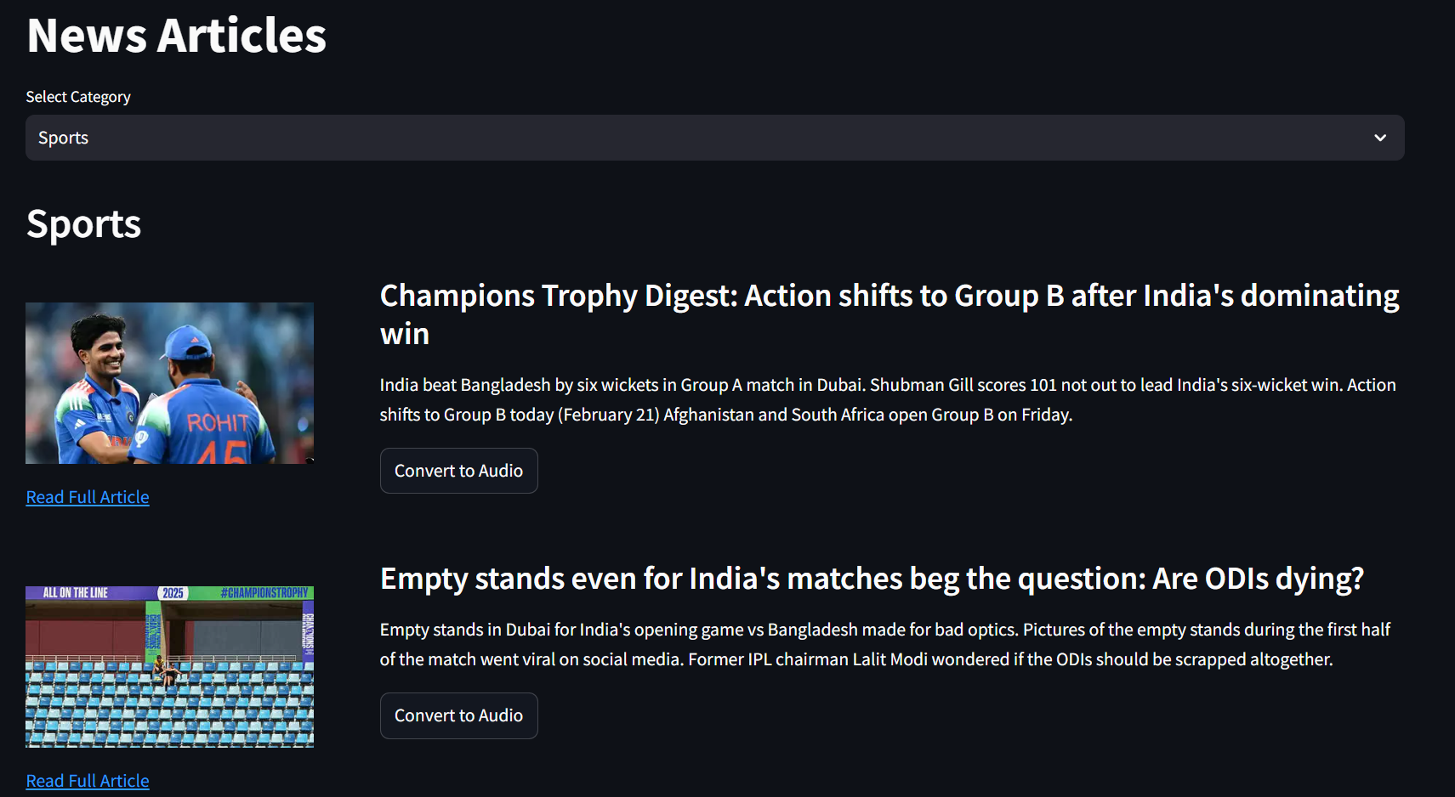

Slide 14


