Slide 1

SMART INDIA HACKATHON 2026
MODULAR AMR PLATFORM
• Problem Statement ID: SIH26112
• Problem Statement Title: Design and Develop a Modular Autonomous Mobile Robot (AMR) Platform for Smart Warehouse Automation
• Theme: Robotics & Drones
• PS Category: Hardware
• Team ID: AU/SIH/26-126
• Team Name: AMRX

Slide 2
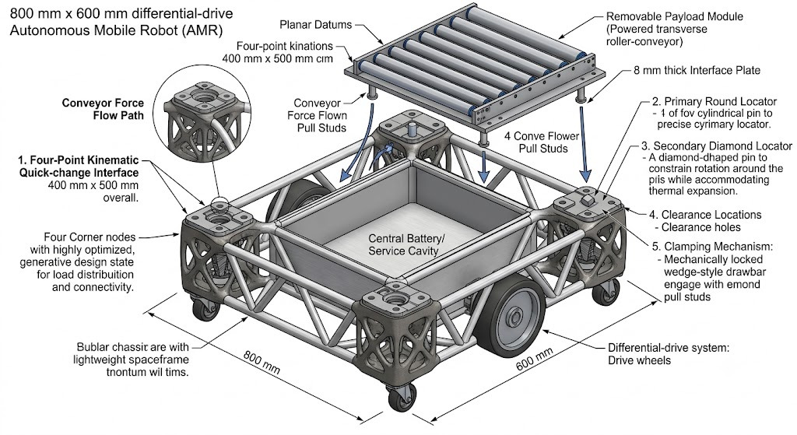
GENERATIVELY DESIGNED MODULAR AMR
AMRX
Part A — Universal Base Chassis ("Mothership"):
Core Hardware: Houses drive motors, battery, electronics, and navigation systems as a common mobile platform.
Generative Design: Engineered using Autodesk Fusion Generative Design & Topology Optimization to withstand real warehouse forces (payload weight, braking shear, cornering torque, vibration).
Additive Manufacturing: Features an organic, ultra-lightweight structure optimized exclusively for 3D printing (bypassing traditional CNC/sheet metal).
Part B — Interchangeable Task Module:
Functional Attachment: Specialized add-on (e.g., bin-handling lift) to perform specific warehouse tasks.
Tool-Less Quick Docking: Custom mechanical/electrical interface enabling rapid, bolt-free module swaps to instantly change robot roles.
Innovation - First to combine generative lightweighting + high-load tool-less docking - Load path engineered as one system, not bolted-together parts

Slide 3
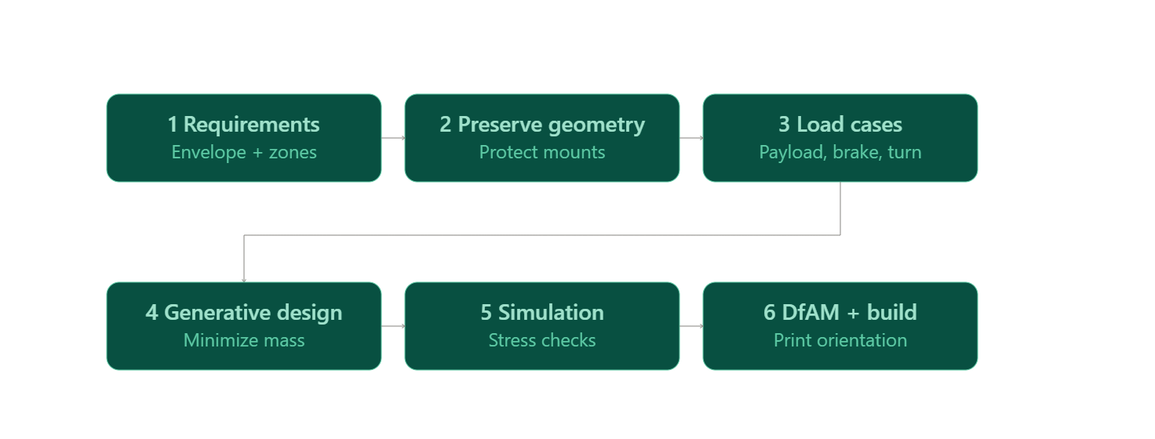
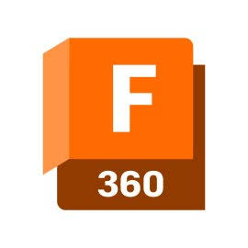
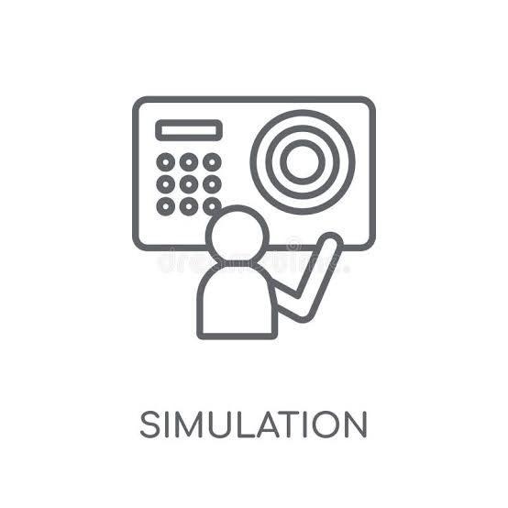
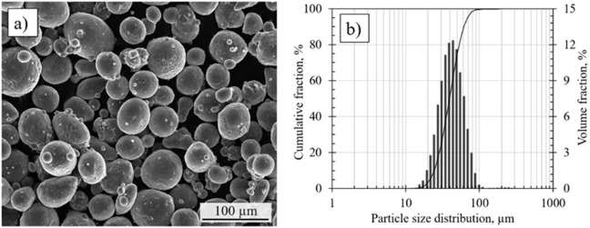
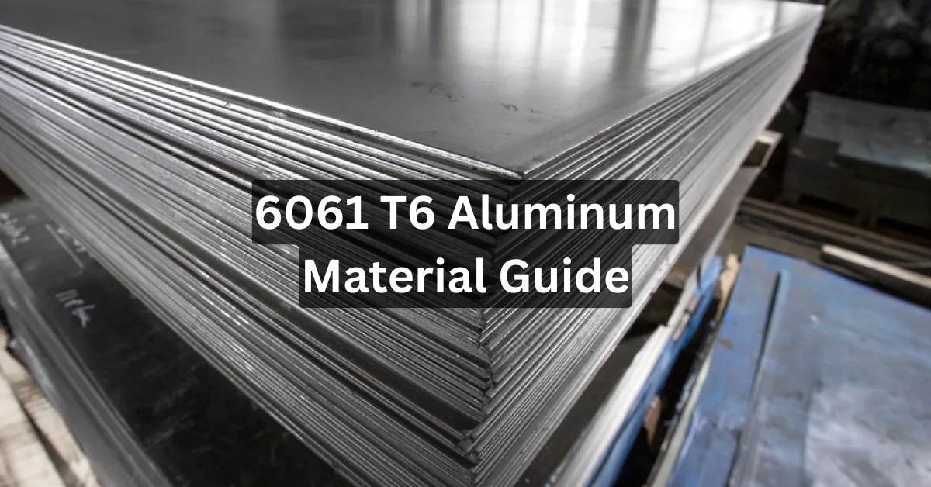
TECHNICAL APPROACH
AMRX
Technologies used :
Fusion, Generative Design, Topology Optimization, Simulation, Render
Materials: AlSi10Mg (LPBF) nodes and 6061-T6 conventional members
Prototyping: Slicer + desktop FDM/SLA print
4
6
2
1
3
AlSi10Mg Powder Characterization: SEM Morphology & Particle Size Distribution

Slide 4
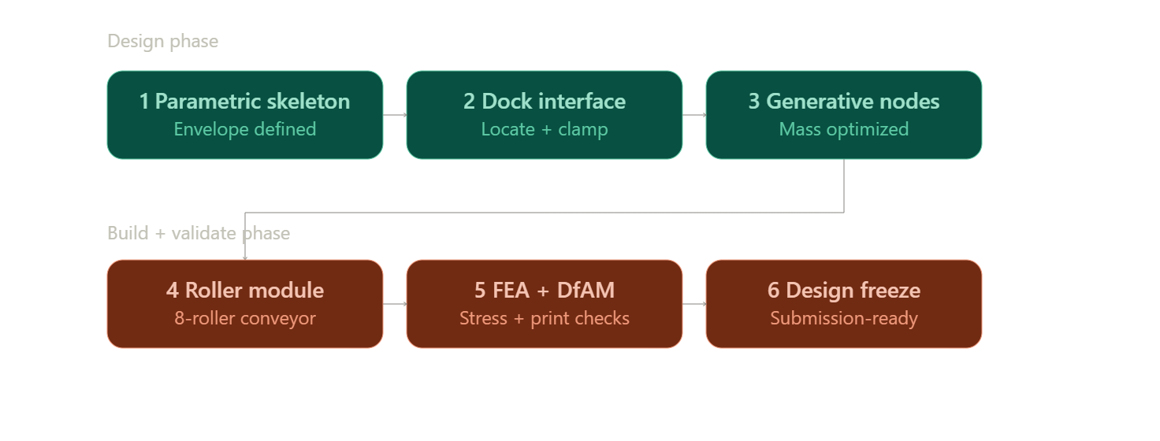
FEASIBILITY AND VIABILITY
AMRX
Q: Is this idea actually feasible to build?
A: Hybrid Architecture: Print only high-stress corner nodes; use standard conventional tubes/plates for the rest.
Cost & Volume Efficiency: Focuses additive manufacturing where needed, drastically reducing print costs and support volume
Zero Software Feasibility Gap: Full access to free student licenses for Autodesk Fusion (Generative Design, Topology Optimization, Simulation).
Q: What could go wrong?
Full printed chassis could become costly/support-heavy if over-applied
Docking interface risks slip, jamming, or over-constraint if locating/support/clamping aren't kept separate
Printed locators may wear or deform under repeated docking cycles
Open service cavity could weaken torsional stiffness if load paths aren't routed carefully
Q: How do we solve these problems?
A:
Print only load-concentrating nodes; conventional members elsewhere
Keep locating, vertical support, and clamp preload as separate geometric functions
Use post-machined datum faces with replaceable hardened wear inserts
Route load paths in triangulated patterns around the cavity perimeter

Slide 5
IMPACT AND BENEFITS
AMRX
Feature / Metric | Commercial Benchmark Platforms (MiR250, OTTO 100, OTTO 1500) | Proposed Hybrid Generative AMR Chassis
Frame Architecture | Heavy-gauge steel weldments with flat bolted top plates | Hybrid LPBF AlSi10Mg generative nodes combined with standard 6061-T6 structural profiles.
Top Module Interface | Non-modular or semi-permanent bolting requiring manual re-tooling | Exact-constraint, tool-less quick-dock interface for instant task swapping
Self-Weight & Efficiency | High dead weight (~78–94 kg for MiR250) leading to higher energy draw per cycle | High strength-to-weight ratio; optimized material distribution lowers battery consumption
Fleet Utilization | Low flexibility; requires separate vehicle fleets for distinct tasks | High flexibility; one base platform dynamically switches between conveyor, lift, and robotic arm tasks
Warehouse Operators: A single base platform with hot-swappable task modules reduces total fleet CapEx by ~28–40% by eliminating the need for dedicated single-purpose vehicles.
Maintenance & Serviceability: Designed with an open-access central service bay and field-replaceable hardened wear inserts at primary precision datums to minimize downtime.
Engineering Value: Topology-optimized load paths handle explicit multi-axis stresses (braking, turning torque, payload shear) with maximum mass-to-stiffness efficiency.
Manufacturing & Environment: Support-free node geometry minimizes raw LPBF print volume, while the lighter overall frame lowers energy draw per duty cycle.
Proposed Hybrid generative AMR v/s Exisiting commercial options
Business Case & Commercial Strategy
Market Gap: Current market solutions force logistics operators to purchase separate, dedicated AMRs for every unique workflow. Our solution fills this gap by offering a single universal base platform paired with task-specific modules.
Profitability & Revenue Model:
  Hardware Sales: 40–50% gross margins on base units by using hybrid LPBF node printing rather than full-frame additive manufacturing.
  Module Ecosystem: Recurring revenue from high-margin quick-dock task attachments (conveyors, lifters, robotic arm mounts).

Slide 6
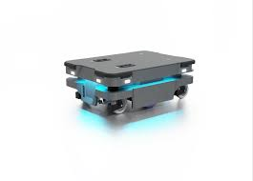
Existing solutions
AMRX
MiR250 Benchmark Specs & Cost
Payload Capacity: 250 kg
Footprint & Weight: 800 × 580 × 300 mm | 83–94 kg
Max Speed: 2.0 m/s (7.2 km/h)
Battery & Runtime: Up to 17.5 hrs | 0–80% fast charge in 1 hr
Navigation & Safety: ±3 mm docking accuracy | 360° SICK LiDAR + 3D Cameras
Base Price: ~$55,000–$65,000 USD (₹45–55 Lakhs INR)
USP
Cheaper than other alternatives
Customizable according to the user
One AMR base, multiple warehouse jobs
Same common interface for conveyor, rack, towing or lifting modules
Payload: 250 kg total top load
Footprint: 800 × 600 × 500 mm
Chassis: Hybrid generative frame,
Drive: 2 × 750 W, 48 V geared BLDC/servo motors; commercial AGV drive units in this class support heavy-duty loads.
Max Speed: 1.8 m/s (6.5 km/h);
Battery: 48 V 60 Ah LFP — 2.88 kWh, roughly ₹52K at current Indian retail.
Compute: Jetson Orin Nano Super — 67 TOPS, 8 GB LPDDR5.
Modular Interface: 4-point 3-2-1 zero-point coupling
Upper Module: Heavy-duty powered roller conveyor,
Estimated Prototype BOM: ₹5-6lakh
Target Audience:
Automated 3PL warehouses
e-commerce fulfillment centers
automotive assembly plants
flexible manufacturing SMEs.

Slide 7
RESEARCH AND REFERENCES
AMRX
Autodesk Fusion — Generative Design: Manufacturing Method
https://help.autodesk.com/view/fusion360/ENU/?contextId=GD-SPECIFY-MFG-METHOD
https://help.autodesk.com/view/fusion360/ENU/?contextId=GD-SPECIFY-MFG-METHOD
Laser powder bed fusion of AlSi10Mg
https://www.sciencedirect.com/science/article/pii/S2588840425000617#fig1
https://pmc.ncbi.nlm.nih.gov/articles/PMC9415272/
Reviews of the existing solutions In the market
https://antonrobots.com/mir250-review/
https://ottomotors.com/resources/videos/automate-your-cart-workflows-with-otto-100/

