Slide 1



Alliance One – MathX Ideation
Field | Details
Problem Statement ID | SIH26073
Problem Statement Name | AI/ML-Based Intelligent Anomaly Detection for Automatic Weather Stations
Team Leader | Girish N
Team Members | Vinit R
School Name | ASAC
Contact Details | ngirishBTECH25@stu.alliance.edu.in , 9743737568
The Mathematics Ideathon
Demo presentation · 30 October 2026, 10 AM Venue: LT 702, LC-2
Infinity Club, Department of Pure and Applied Mathematics

Slide 2




Problem Definition
The Challenge
Rain gauges jam, sensors drift and glitch outdoors. Weather is non-stationary, so static 3σ rules miss subtle faults or delete real cloudbursts.
Intended Users
KSNDMC and IMD network operators, BBMP flood and underpass alert teams, and engineers curating clean climate records.
Operational Context
Bengaluru, z ≈ 920 m: 6,505 rain gauges and 935 weather stations report T, H, P, R, W every 15 min. Storms form in under an hour.
Specific Problem
For each reading, decide: sensor fault or genuine (even extreme) weather. Flag 4 fault types with a reason code at FPR ≤ 1%.

Slide 3
Why Static Rules Fail
!
ADC spike: one sample
Mean and σ have a 0% breakdown point. One spike inflates σ, the ±3σ band balloons and hides every fault for the next 24 h.
!
Real cloudburst
Rain > 6σ while T drops 6 °C. A univariate 3σ rule on rainfall deletes it, blinding the flood model.
!
Diurnal blindness
6,505
935
1,530
The 24 h heating cycle itself inflates σ on raw data, so the bands are too wide to catch subtle drift.
rain gauges (KSNDMC)
weather stations
defunct gauges in audit

Slide 4



Mathematical Formulation
Variables
xₜ = [T, H, P, R, W]ᵀ ∈ ℝ⁵ every Δt = 15 min → output ŷₜ ∈ {0,1} + reason code rₜ ∈ {0,1}⁴
OBJECTIVE FUNCTION
1
Inputs
Hourly/15-min AWS telemetry, diurnal profile, MAD scales, robust covariance Σ̂, satellite rain rate
2
Constraints
Physical bounds at 920 m: T ∈ [−5, 50] °C, H ∈ [0, 100]%, P ∈ [880, 940] hPa, R ≤ 150 mm/hr
3
Assumptions
Residual eₜ locally stationary after removing trend + 24 h cycle; < 50% of any window is faulty
Maximise detection quality while bounding the false-alarm rate (α max = 1%) and the detection delay.
4

Slide 5

Fault Taxonomy
Point spike · ADC surge, bit-flip
SIGNAL MODEL
1
Flatline · clogged gauge
2
μ trend S diurnal harmonics
η weather chaos ε noise
f sensor fault — healthy sensor ⇔ f = 0
Calibration drift · ageing
3
Physical inconsistency
4

Slide 6



Proposed Method
Algorithm / Model
Hybrid 3-tier pipeline:
① physics invariants + flatline test
② robust MAD, CUSUM, MCD
③ chaos, topology, conformal test
④ ISRO/NASA satellite check
Justification
50%-breakdown estimators cannot be masked by the faults they detect.
Every flag carries its equation, score and threshold.
Runs on a micro-controller: O(W + d²) per record.
Baseline Comparison
Static range + 3σ Shewhart limits.
Mean and σ break down at 0%: one spike widens the bands and hides later faults.
Same 720 h test set, 58 injected faults.

Slide 7
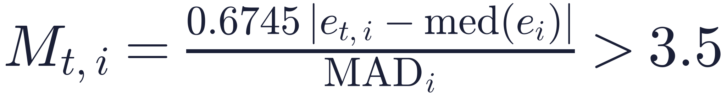
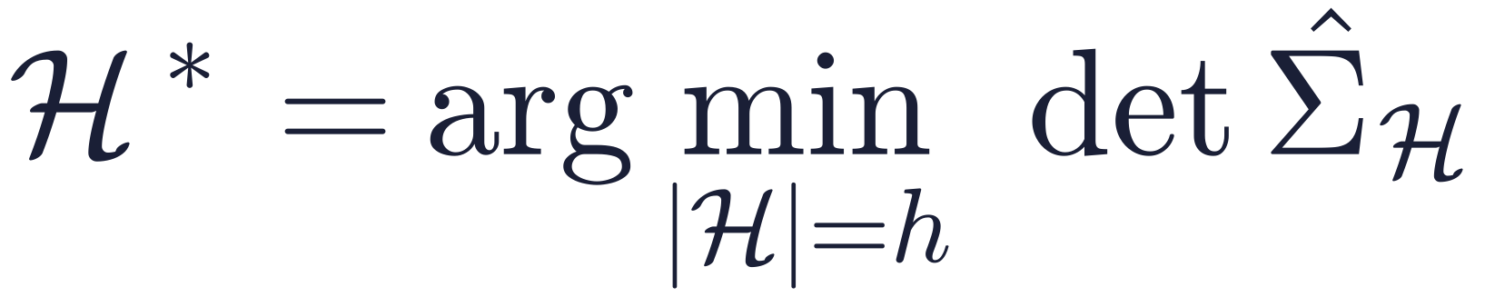
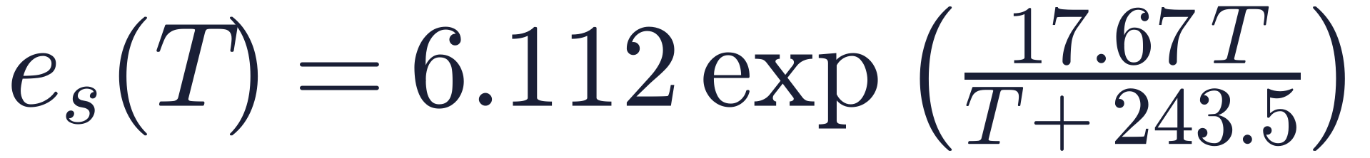
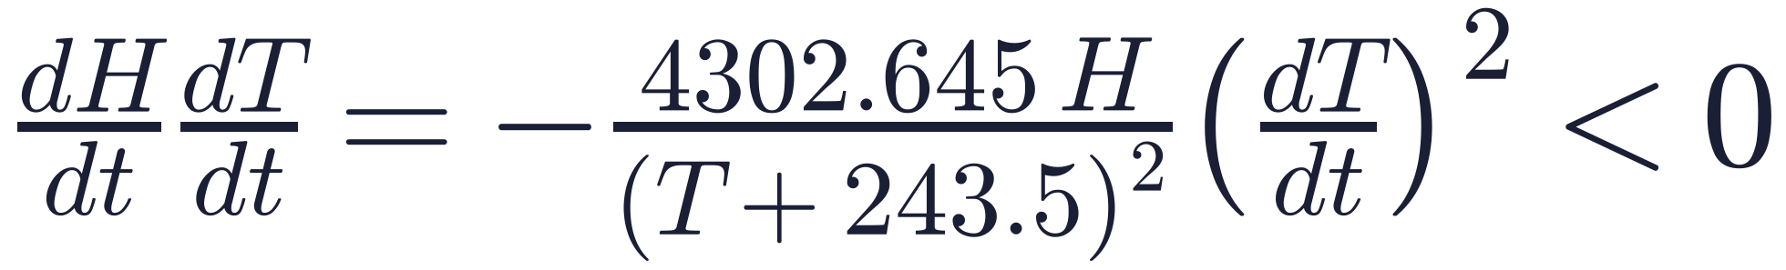
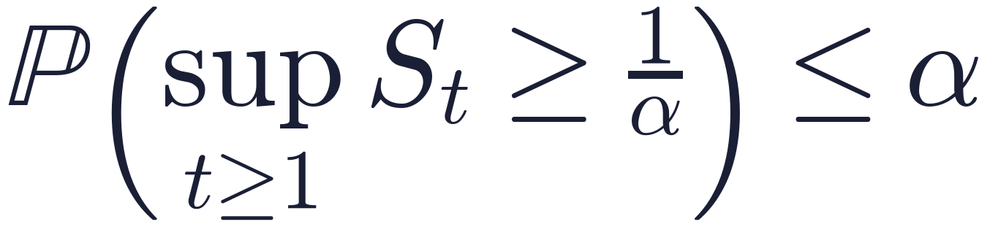
Core Mathematics of Detection
1
Robust residual control Tukey · Huber · Page
2
Minimum Covariance Determinant Rousseeuw
50% breakdown: spikes can’t hide spikes; CUSUM catches drift.
Catches cross-sensor faults, e.g. heavy rain reported in dry air.
3
Clausius–Clapeyron invariant Atmospheric physics
4
Conformal test martingale Vovk · Ville 1939
Zero training data: if dry air warms, humidity must fall.
Distribution-free guarantee on the false-alarm rate.

Slide 8
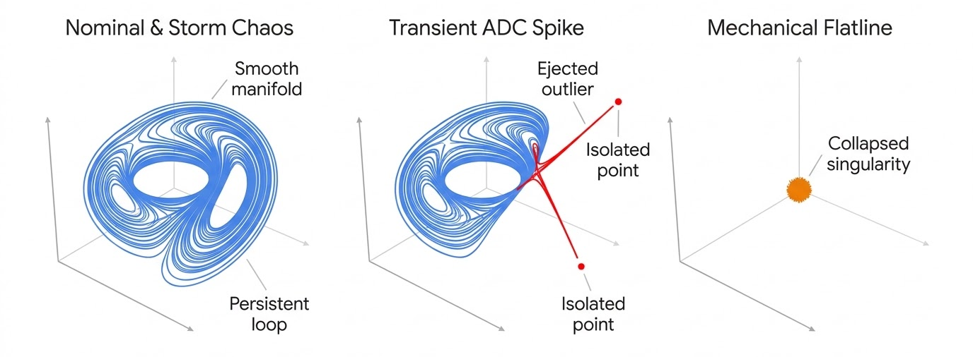
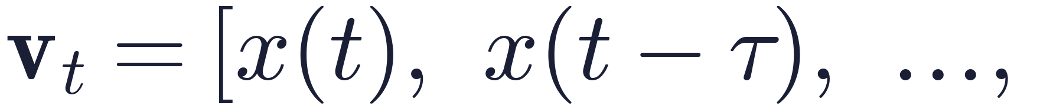
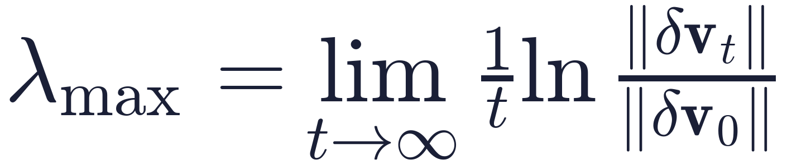
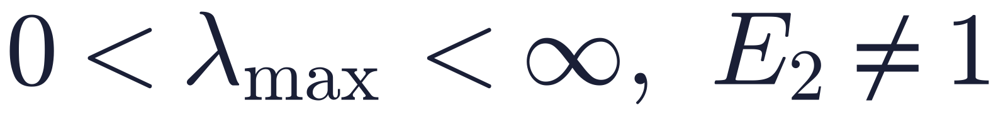
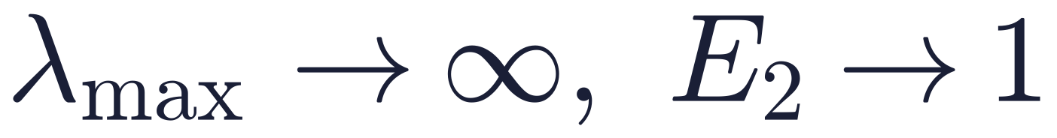
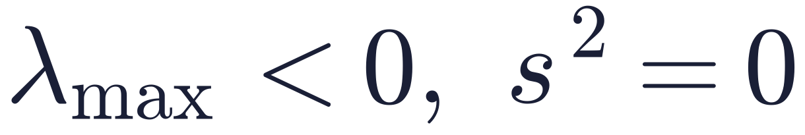
Chaos Is Not a Fault
Takens embedding 1981
Rebuilds the hidden weather attractor from one sensor if m ≥ 2d + 1.
Lyapunov exponent
Cao’s test noise or chaos?
KEEP · real weather
FLAG · spike
FLAG · flatline

Slide 9
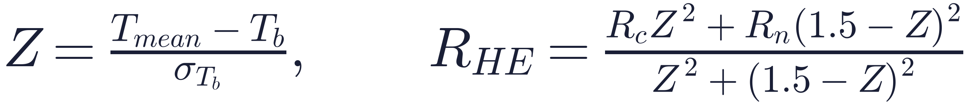
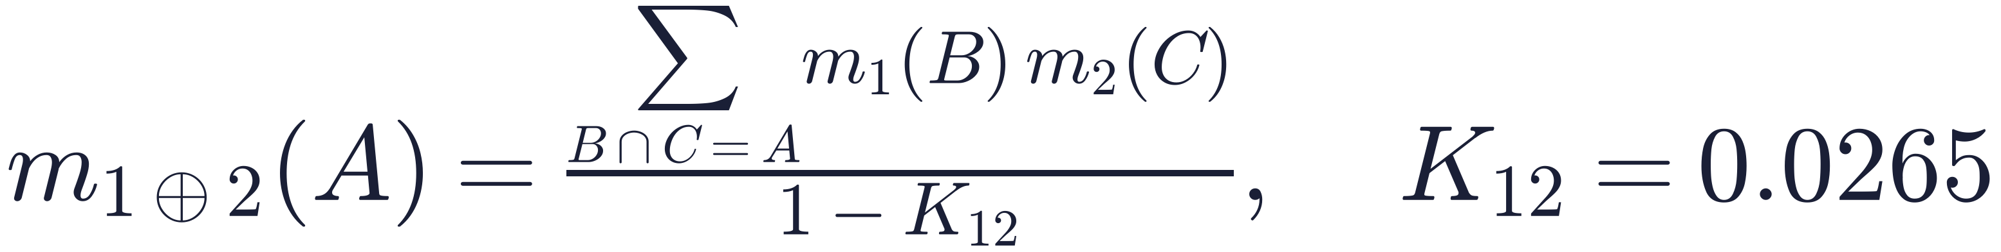
Satellite Oracle: ISRO + NASA
How we apply math to ISRO data
Is the rain gauge clogged? Dempster–Shafer
INSAT-3DR/3DS Imager · TIR-1 10.7 µm · WV 6.7 µm · 4×4 km pixels · 15-min scans (MOSDAC 3DIMG_L2B_HEM) + NASA/JAXA GPM IMERG microwave rain
Gauge 0 mm · cloud top 215 K · H-E 34 mm/hr · IMERG 28.5 mm/hr · ΔT −4.8 °C
1
Align 15-min staggered scan blocks to the AWS clock (equinox scan-lag corrected)
2
Pixel → point with elevation-covariate block-to-point co-kriging
3
Fuse ground + 2 satellites with Dempster–Shafer belief
Bel(stuck) = 0.916 > 0.90 Pl = 0.999 → RAIN_GAUGE_CLOGGED
CLOUDBURST
PROTECTION

Slide 10
Data Strategy
1
2
3
4
Data Sources
ERA5 (Open-Meteo), KSNDMC/IMD, INSAT-3DR, GPM IMERG
Preprocessing
Align to a strict 15-min grid; remove trend and 24 h cycle → residual eₜ
Missing Data
Gap ≤ 3 h: interpolate the residual, add the cycle back. > 3 h: COMM_LOSS
Dataset Split
Chronological, never shuffled: no future data leaks into the past
Chronological split · N = 720 h with 58 injected faults + 1 real storm
Calibrate 60% · diurnal profile, MAD, Σ̂
Tune 20%
Test 20%

Slide 11




Validation Plan
Evaluation Metrics
Precision, Recall, F₁, false-positive rate FP/(FP+TN), detection delay Δt from fault start to first flag, F₁ drop at 5–20% missing data
Benchmarks
Static range + 3σ Shewhart baseline and KNN-CAD on the same test set: 58 injected faults across all 4 classes + 1 real storm
Failure Cases
A brown-out biasing T, H, P along their natural correlation; a fault at the exact onset of a convective storm
Reproducibility
Seed = 42 fault placement; chronological split; deterministic pipeline with no external API at run time

Slide 12
Benchmark: Baseline vs Proposed
False-positive rate
0.45% from 1.51%
3.4× fewer false alarms
Mean detection delay
2.1 h from 14.5 h
flatlines & drift caught early
Timestamp | Observed | Score vs threshold | Certificate
Day 04 · 03:00 | T = 34.8 °C (expected 20.4) | M = 11.42 > 3.5 | TEMPORAL_SPIKE
Day 09 · 14:00 | T = 29.50 °C frozen for 6 h | s²(6) = 0 < 10⁻⁶ | FLATLINE_FAULT
Day 16 · 18:00 | T = 28.9 °C (expected 25.7) | C⁺ = 6.84 > 5.0 | CALIBRATION_DRIFT
Day 22 · 15:00 | R = 38 mm, H = 28% | D² = 34.8 > 20.52 | MULTIVARIATE_INCONSISTENCY
Day 26 · 16:00 | R = 42 mm, H = 96%, P −4.2 hPa | D² = 9.4 ≤ 20.52 | VALID_EXTREME_WEATHER · kept
Targets from our validation plan (N = 720 h, 58 injected faults, seed 42). The live prototype recomputes every number on real Open-Meteo data.

Slide 13
Prototype and Demo
Workflow · edge → cluster → satellite oracle
Sample Input
xₜ = T, H, P, R, W
Model
physics → robust → oracle
Output
ŷₜ + reason + score
Visualization
dashboard + audit log
Implementation roadmap
Phase 1 · Prototype (now)
Live single-station pipeline on real Bengaluru data, fault injection, diagnostic dashboard
Phase 2 · Edge (months 1–2)
Tier 1 on STM32/ESP32: < 5 ms, < 10 KB SRAM; 1-byte QC flag on MQTT packets
Phase 3 · City (months 3–6)
KSNDMC cluster tier + INSAT-3DR/GPM oracle; co-kriging across Bengaluru stations

Slide 14




Risks and Limitations
Data Limitations
Computational Cost
Uncertainty
Ethical Concerns
Real labelled faults are scarce; we inject physically modelled faults into real weather.
O(W + d²) per record, < 2 ms on a CPU; satellite tier runs only on escalation.
A fault at storm onset can hide in storm variance; Dempster–Shafer keeps doubt explicit.
Deleting a real cloudburst blinds flood alerts, so raw data is never deleted: only flagged.

