Slide 1
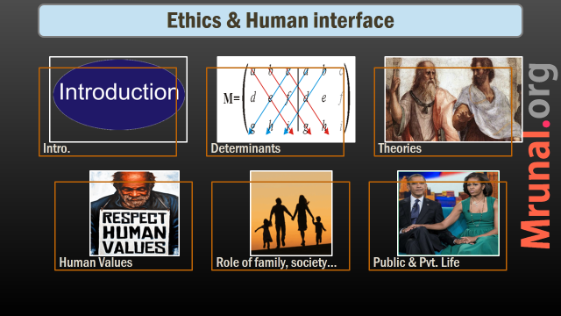
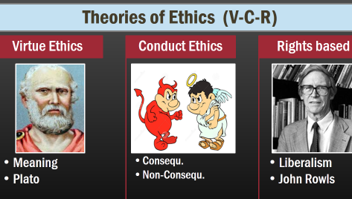
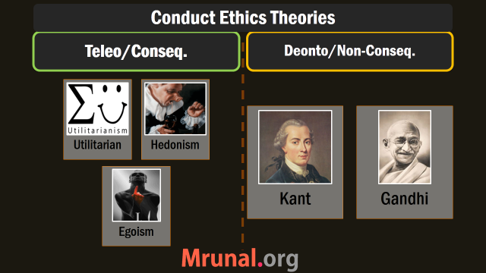
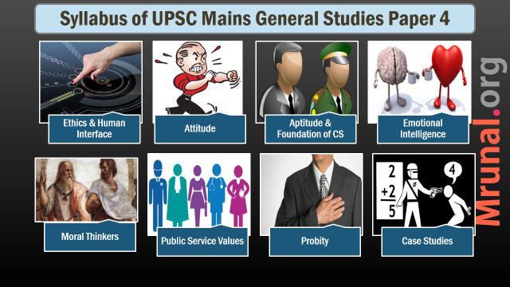

Slide 2
Syllabus of UPSC Mains General Studies Paper 4
Ethics & Human Interface
Emotional Intelligence
Case Studies
Attitude
Aptitude & Foundation of CS
Moral Thinkers
Public Service Values
Probity

Slide 3
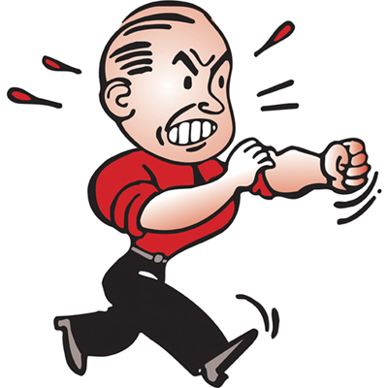
Attitude
Syllabus
content, structure, function;
its influence and relation with thought and behavior;
moral and political attitudes;
social influence and persuasion.

Slide 4
Attitude: Subtopics
Definition & Content
Structure & Function
Behavior prediction
Moral & Political Attitude
Social Influence
Attitude change

Slide 5
Attitude
1. Definition
Mental evaluation of an object
2. Content
Cognitive
State of Mind towards an object that contains ABC components
Affective
Behavioral
Characteristics
Separate but not independent

Slide 6
Attitude
Definition & Content
Structure & Function
Behavior prediction
Moral & Political Attitude
Social Influence
Attitude change

Slide 7
Attitude: 3. Structure
Unidirectional
Problem :- Neutral and ambivalence indistinguishable

Slide 8
Attitude: 3. Structure
Bidirectional
Cognitive Dissonance
ambivalence
-ve
Neutral
+ve

Slide 9
Attitude: 4. Function
Utilitarian
big property
don't like property tax hike
Knowledge
help organize new information.
“I believe good things happen to good people"
bad thing happened to him- so, he must be a bad person
Ego-defensive
denial, Repression, Projection, Rationalization
Social reform movement
Value expressive
to express one's central values
Gandhiji’s clothes

Slide 10
Attitude
Definition & Content
Structure & Function
Behavior prediction
Moral & Political Attitude
Social Influence
Attitude change

Slide 11
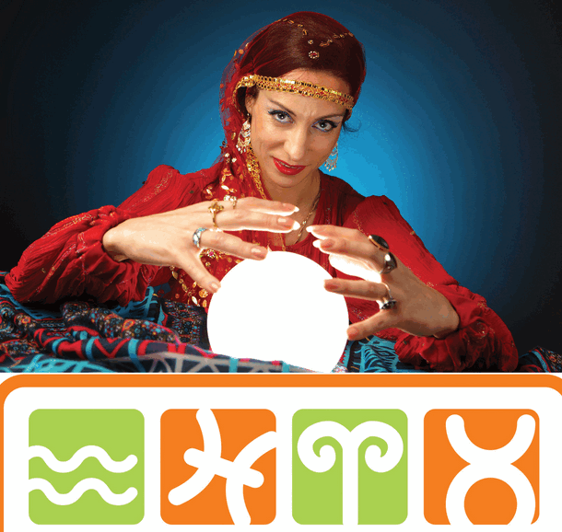
5. Behavior Prediction
Attitude
MODE: E.g Implicit prejudicial attitude
Theory of reasoned action: Intentions, and perceived/real control
Low latency attitude
Strong attitude

Slide 12
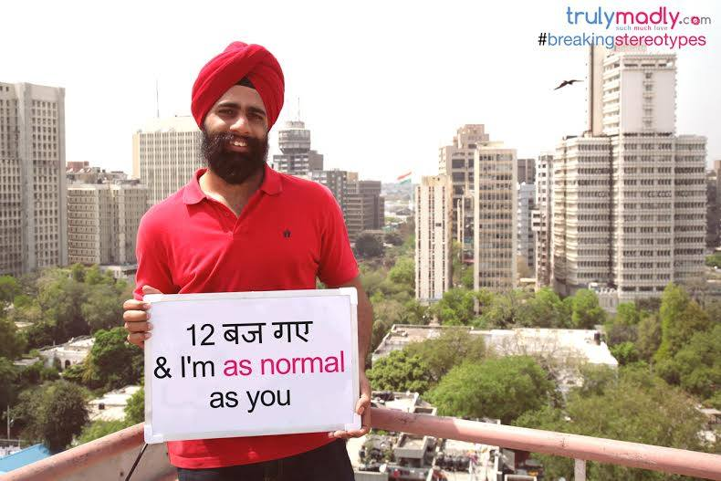
Prejudice and Discrimination
Ethics
Prejudice is based on negative stereotypes
Stereotypes can be good or bad
E.g. Jains are traders, Gujaratis are business minded, tamils are mathematics lover
E.g. Punjabis are alcoholic
Gender stereotypes, national stereotypes
In-group out-group mechanism experiment
Implicit prejudices

Slide 13
Attitude
Definition & Content
Structure & Function
Behavior prediction
Moral & Political Attitude
Social Influence
Attitude change

Slide 14
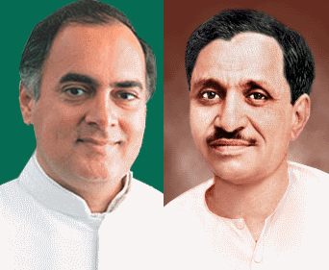
6. Moral and Political attitude
Moral Attitude
Moral beliefs with B, C components
Deeper conviction
Vegetarianism, non-violence, religious attitude

Slide 15
6. Moral and Political attitude
Political Attitude
Right / Left
Liberal
Democratic attitude
Radical
Moderate
Reactionary
Progressive
Conservative

Slide 16
6. Moral and Political attitude
Determinants of Political attitudes
Economic status
Age
Conception about human nature
Disposition

Slide 17
Attitude
Definition & Content
Structure & Function
Behavior prediction
Moral & Political Attitude
Social Influence
Attitude change

Slide 18

Social influence
Attitude
Change in behavior on real/perceived pressure from others
Conformity, Compliance, Obedience
Milgram’s experiment

Slide 19
Social influence
Attitude
Variations in milgram’s experiment
Obedience, conformity
Conscience
Accountability/responsibility
Explains Nuremberg

Slide 20
Attitude
Definition & Content
Structure & Function
Behavior prediction
Moral & Political Attitude
Social Influence
Attitude change

Slide 21
8. Attitude Change
Attitude Formation
Classical Conditionaing
Operant conditioning
Observational learning
Attitude change
Dissonance theory
Learning theory
ELM
Importance? (1) IEC in public awareness (2) Mass campaigns (3) Advertisement

Slide 22
Attitude: Subtopics
Definition & Content
Structure & Function
Behavior prediction
Moral & Political Attitude
Social Influence
Attitude change

Slide 23
