Slide 1
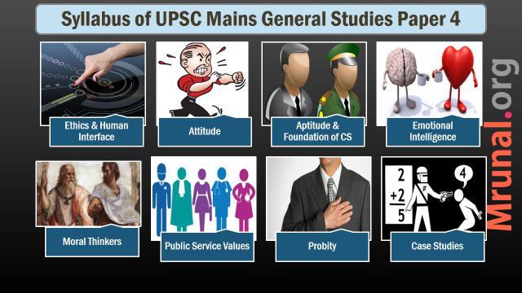

Slide 2

Aptitude & Foundation of CS
Syllabus
Integrity, impartiality and non-partisanship, objectivity,
dedication to public service, empathy,
tolerance and compassion towards the weaker sections

Slide 3
Aptitude
Aptitude (+training)→ ability(+practice) → skill
Aptitude – forward looking prescription – innate potential
A natural/inherent talent to acquire a certain skill or ability in the future through appropriate training. Aptitude can be both mental as well as physical.
Ability – Present: What can one do now

Slide 4
Civil Servant’s Aptitude
Intellectual aptitude
Moral aptitude
Emotional aptitude

Slide 5
for Civil services
Foundational Values
What are values?
Nolan committee values
2nd ARC values
Traditional/Other Values

Slide 6
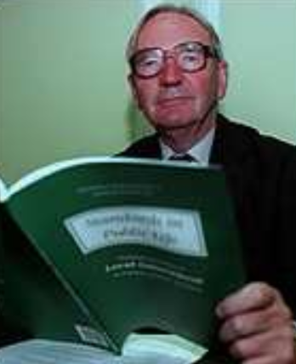
Standards of public life in UK ‘96
Nolan committee
Selflessness
Integrity
Objectivity
Accountability
Openness
Honesty
Leadership

Slide 7
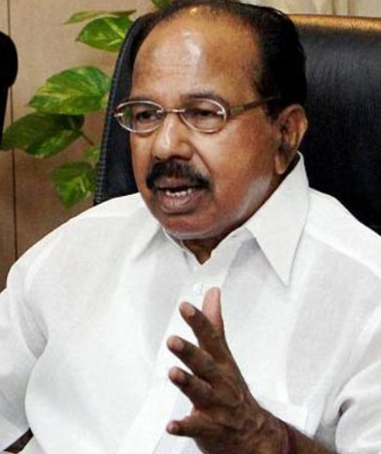
Foundational values of civil services
2nd ARC
Integrity
Objectivity
Dedication to public service
Empathy
Impartiality and Non-Partisanship
Compassion and tolerance towards weaker section

Slide 8
Traditional values & other values
Traditional values
Neutrality
Anonymity
Other values
Creativity
Humility

Slide 9
1. Integrity
Foundational Values
Integrity
Honesty
Probity

Slide 10
1. Integrity
Foundational Values
Meaning
Moral integrity
Value system = Conduct
Value system internally consistent
Value system rational
Intellectual integrity
Professional Integrity
Organizational Integrity

Slide 11
1. Integrity
Foundational Values
How to inculcate?
ARC recommendations
Code of ethics
Integrity testing
Institutional framework
First posting under honest supervisor

Slide 12
2. Objectivity
Foundational Values
Merit based decisions, rigorous analysis of evidence
Selection
Administrative decisions
Recommendation of awards

Slide 13
2. Objectivity
Foundational Values
How to inculcate?
Training
Critical thinking
Right to review decision
Right to be heard
Information management :- Business intelligence
Transparency

Slide 14
3. Dedication to public service
Foundational Values
Knowledge of public interest, Perseverance
Perseverance
Predictor of success
Optimism about the outcome
Overcoming political pressures, administration constraints

Slide 15
Empathy
Foundational Values
Empathy
Compassion
Sympathy
Altruism

Slide 16
4. Empathy
Foundational Values
Empathy vs compassion
Compassion vs altruism
Why needed?
Concept homo empathicus
Also important in EI
Basis of pro-social behavior
Caution:
Empathy vs Objectivity

Slide 17
4. Empathy
Foundational Values
Failure of Empathy
Bullying, ragging, stalking
Intolerance, lack of compassion
Worsened by ICT
Can it be cultivated? – it’s a skill

Slide 18
4. Empathy
Foundational Values
How to inculcate?
Art, Literature, Cinema
Practice of common holidays
Perspective taking, role playing
Six habits of highly empathic people
Higher empathy scenario

Slide 19
5. Compassion and Tolerance towards Weaker section
Foundational Values
Equality with positive discrimination
What is compassion?
How to Inculcate?
Measurement → Zurich Prosocial Game
Loving-kindness meditation
Buddhist teachings

Slide 20
6. Impartiality & Non-Partisanship
Foundational Values
Meaning
Why?
Social reality
Better resource allocation, policy formulation, implementation
Commerce ministry vs Foreign ministry in diplomacy, different services dragging each other
Casteism, communalism, regionalism, elitism

Slide 21
Neutrality
Traditional values
Similar to Impartiality → political impartiality
Why?
Public confidence
Confidence of political executive
Government stability
Career graph

Slide 22
Other Values
Neutrality
Optimism
Creativity
Responsiveness
Efficiency
Effectiveness

