Slide 1
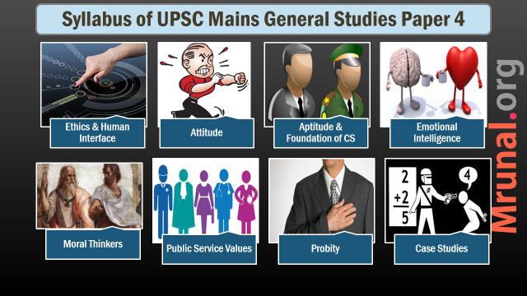

Slide 2

Emotional Intelligence
Syllabus
Emotional intelligence-concepts
Their utilities and application in administration and governance.

Slide 3

Emotional Intelligence: Meaning & components
Components
Model 1
Self-awareness
Self-management
Social awareness
Relationship management
Model 2
RULER Acronym

Slide 4
Self Awareness
EI
Emotional self awareness
Self-assessment
Self-confidence

Slide 5
Self-Management
EI
Adaptability
Emotional self control
Initiative
Trust-worthiness/integrity
Optimism

Slide 6
Social Awareness
EI
Empathy
Service Orientation
Organizational awareness

Slide 7
Relationship Management
EI
Inspirational
Developing others
Catalyst for change
Conflict management
Influence
Team work and colloborator

Slide 8
Emotional Intelligence: Meaning & components
Components
Model 1
Self-awareness
Self-management
Social awareness
Relationship management
Model 2
RULER Acronym

Slide 9
RULER
EI
R – Recognition of emotions
U – Understand Causes
L – Labelling
E – Express
R - Regulating

Slide 10
Emotional intelligence
Importance of
Why EI?
Emotions can’t be wished away
EQ is a consistent predictor of leaders/managers/success
Non-weberian/NPM bureaucracy

Slide 11
Emotional intelligence
Importance of
Why EI?
Dealing with multiple stakeholders
Unregulated emotions can be impediment to ethical conduct
Mental health
In digital age → flood of information, more connection, alienation from nature, urban life

Slide 12
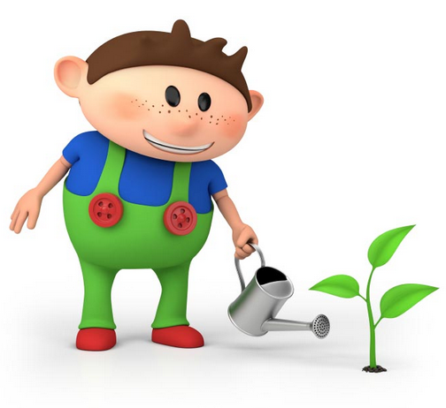
Emotional intelligence?
How to develop
Nature vs nurture
Yoga
Emotional literacy
Labelling emotions, expressions
Non-verbal communication

Slide 13
Emotional intelligence?
How to develop
Develop empathy
Cultivation of optimism
Introspection: Take responsibility of your own emotions

