Slide 1
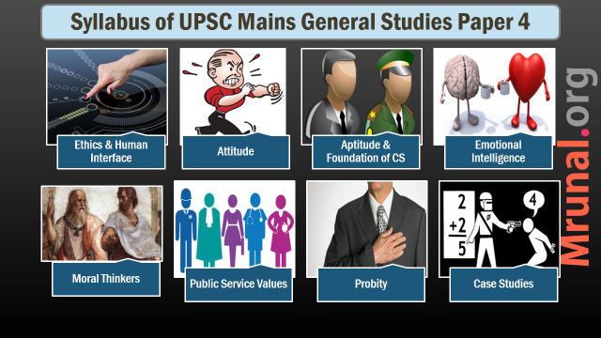

Slide 2

Public service values
Secondary values,
Public service Value universe

Slide 3
Value Frames
Political
administrative
Public org
Employees
Organization
Citizen-customers
Organization
Society at large

Slide 4
Change in the public service values
Bureaucratic
Organization centered
Process centered
Independent action
Centralized
Budget driven
Monopolistic
Post-Bureaucratic
Citizen centered
Outcome centered
Collective action
Decentralized
Revenue driven
competitive
Reasons? NPM, L-P-G, ICT

Slide 5
convergence
Value
Citizen-customer centricity in Public, CSR in private

Slide 6

conflicts
Value
Why?
Accountability to whom?
Privacy vs openness
HR vs security
Efficiency vs emp welfare
Equality vs liberty
Justice vs mercy
Individualism vs communitarianism

Slide 7
conflicts
Value
RTI vs Official secrets act
Morality vs Competence

Slide 8
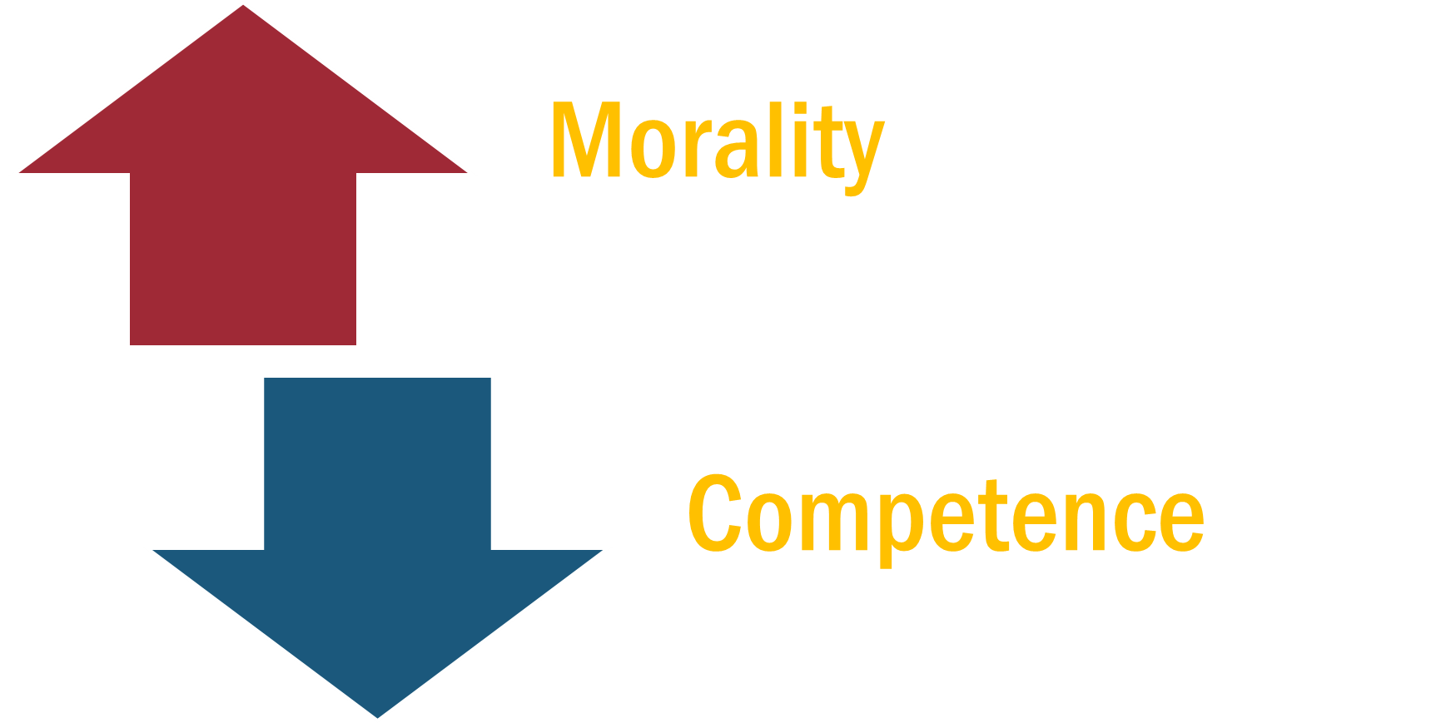

Value conflicts

Slide 9
Dilemna in public service
Conditions for dilemma
Multiple moral choices
Two/More choices are morally equal
Decision has to be made
How to resolve?
Find alternative that avoids dilemma
Gandhiji’s talisman
Foundational values
Conscience

Slide 10

Law
Sources of Ethical guidance
Within the person – conscience/intuition
Codes, Rules and Regulations, Laws
Laws
Common good
Compliance
When conscience is not enough
Creates conditions for morality in public life

Slide 11

Conscience
Sources of Ethical guidance
Meaning?
Types of conscience
Development/Expansion of conscience

Slide 12

Meaning
Accountability
What is accountability?
Answerability and enforceability
Ethics as self-Accountability
Vertical and horizontal
Vertical
Elections, RTI, Media, CC, CSO

Slide 13
Accountability Classification
Elections
Horizontal
Verticle
RTI, Media
CC, CSO
Accountability

Slide 14
Accountability Classification
Horizontal Accountability
Internal
External
Parliament
Judiciary
CAG
CVC
Superiors
CBI/Police
Internal Audit
Grievance redressal mechanisms
Verticle

Slide 15
How to strengthen Ethical governance?
Political structure
Statutory structure
Institutional structure
Social structure
International cooperation

Slide 16
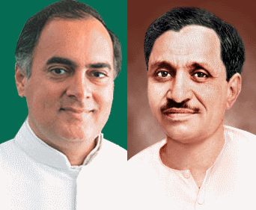
Political structure
3M → Money, Muscle, Media power

Slide 17

ARC Recommendation
Statutary structure
PCA amendments
Sanction requirement
Private bodies, NGO
Two types of corruption
Immediate forfeiture + burden of proof shift in disproportionate asset case

Slide 18
ARC Recommendation
Statutary structure
New serious economic offence act
Tax evasion, insider trading, Money laundering, counterfeiting
Integrity pacts
Rational regulation → no over regulation

Slide 19
ARC Recommendation
Institutional structure
Ethics management system or Ethics infrastructure
CVC, CBI, Lokpal etc

Slide 20

Social infrastructure
Civic education in school
Reward scheme
False claims act like USA
Social audit

Slide 21

Funding
Ethical issues in IR and Funding
Philosophical explanation
Humanitarian
Historical Burden
Export of capital/overseas demand
State actors vs non-state actors

Slide 22

Types of Aid
Ethical issues in IR and Funding
Military aid
Technical assistance
Capital grants
Loans

Slide 23
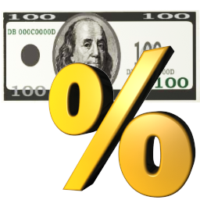
Ethical concerns
issues in IR and Funding
National interests vs values
Idealism →realism→internationalism
Terrorism, smuggling, climate change, poverty, disarmament, resource competition
What are the limit of sovereignty?
R2P initiative of UN
Global commons
Is internet a global common?

Slide 24
Ethical concerns
issues in IR and Funding
Just war theory
Justification → Defensive, uphold HR
Conduct of war → ethical conduct during war
Post war → reconstructions, reconciliation

Slide 25

Corporate governance
Definition → adds value to the company + beneficial to all ‘stakeholders’
Failure of corporate governance
Satyam, sahara, Ranbaxy, voxwagen

Slide 26
Corporate governance
Includes
Complying with all the laws of the land
Accountability towards all stake holders
Conducting business with integrity and transparency
Corporate culture

Slide 27
Corporate governance
Regulatory Regime
SEBI initially
Now MCA(Min of corp Aff), RBI, SEBI
Ethical issues
Dominant shareholders
Minority promoters
Independent directors

