Slide 1
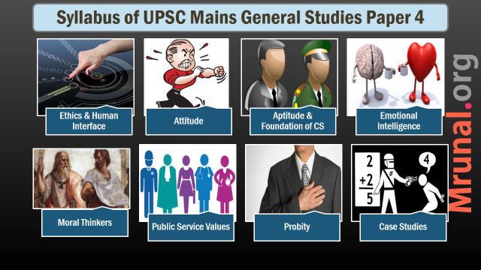

Slide 2

Philosophical bases
Public service
Public good vs Private good
Welfare state theory
Rights based state

Slide 3
Transparency/RTI
Probity
Principles of in promoting transparencey
Maximum disclosure
Obligation to publish
Promotion of open government
Limited scope of exceptions
Process to facilitate access
Costs
How many principles followed in RTI?

Slide 4
Good work culture
Work Culture
Paradigm by which people operate in an organization
Good work culture
employees are passionate about work
Satisfied with work
Opportunity to grow
Healthy competition
Ex. private org, google, facebook

Slide 5
How to improve?
Work Culture
How to improve?
cleanliness, ergonomics
Women concerns
Team work
Consultative decision making
Reducing layers in decision making
Recreational activities

Slide 6
Reform measures
Utilization of public funds
Improving collection
Outcome budgeting, zero-based budgeting
audit
Increase scrutiny/participation by
Legislature
Civil society

Slide 7
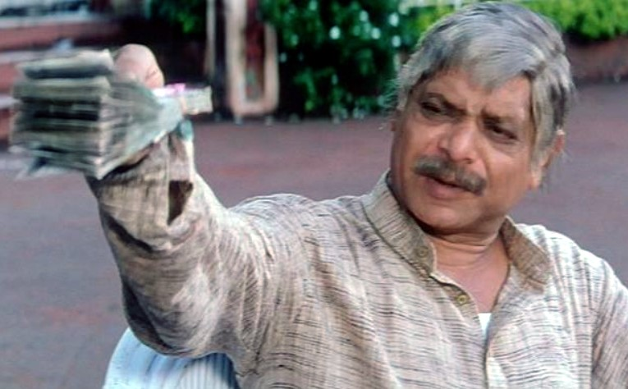
Forms of
corruption
Bribery
Extortion
Rent seeking
Nepotism
Clientelism
Embezzlement
Fraud

Slide 8
Cost of Corruption
Corruption
Corruption in developing countries
Resource diversion
Environmental degradation
Poverty
Moral fiber of the society

Slide 9
Cost of Corruption
Corruption
Quality of policy making
Economic growth
Flight of capital
Institutional capacity
Alienation of people from government

Slide 10

Types
Corruption
Corruption Types
Collusive
coersive

Slide 11

New/innovative ways to combat
Corruption
Right to review of decisions
Right to obtain reasons for decisions
Right to be heard

Slide 12
Ethics Management System
Ethics infrastructure
A law enumerates core principles and institutional structure to implement it
Every department designs its own CoC,CoE as per the guidelines of the act
Mechanisms for enforcement

Slide 13
What’s the difference?
Code of Ethics
Core values,
Code of Conduct
(Un)Acceptable behavior
Benchmarks
aspirational
Enforceable
Minimalist
Should this be made enforceable?

Slide 14
ARC recommends Code of Ethics for
Corruption
Civil Servants
Ministers
Legislators
Judiciary

