Slide 1
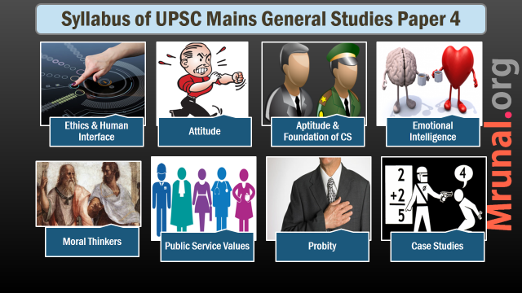

Slide 2

Aspects covered
Case studies
Identify stakeholders
Final answer should factor in all stakeholders
Use deontological, rights, utility, egoistic, virtue ethics perspectives
Address peripheral issues too
Value source:- CoE,CoC, Foundation values
What does you conscience say?
Ethical development more than institutional aspect

Slide 3
Aspects covered
Case studies
Ignore status quo
  Lack of courage of conviction, timidity, dereliction of duty
Creating options
  Divide your choice among many and then pick and choose
  Best, worst, escape, middle way
Persuasion, attitude change priority, cognitive dissonances etc

Slide 4
Aspects covered
Case studies
For attitude change/Persuasion
  Use SHGs/NGOs/Media etc.
Consultative decision better one wherever feasible

Slide 5
Bogus rape complaint(2014)
Case studies
You are a no-nonsense, honest officer. You have been transferred to a remote district to head a department that is notorious for its inefficiency and callousness. You find that the main cause of the poor state of affairs is the indiscipline of a section of employees. They do not work themselves and also disrupt the working of others. You first warned the troublemakers to mend their ways or else face disciplinary action. When the warning had little effect, you issued a show cause notice to the ringleaders. As a retaliatory measure, these troublemakers instigated a woman employee amongst them to file a complaint of sexual harassment against you with the Women’s Commission. The Commission promptly seeks your explanation. The matter is also publicized in the media to embarrass you further. Some of the options to handle this situation could be as follows :
Give your explanation to the Commission and go soft on the disciplinary action.
Ignore the Commission and proceed firmly with the disciplinary action.
Brief your higher-ups, seek directions from them and act accordingly.
Suggest any other possible option(s). Evaluate all of them and suggest the best course of action, giving your reasons for it.

Slide 6
Bogus rape complaint(2014)
Case studies
Analysis
Stakeholders
Only a section of employees are trouble makers
Media gaze
Women being used for vested interests

Slide 7
Bribe(2014)
Case studies
Suppose you are the CEO of a company that manufactures specialized electronic equipment used by a government department. You have submitted your bid for the supply of this equipment to the department. Both the quality and cost of your offer are better than those of the competitors. Yet the concerned officer is demanding a hefty bribe for approving the tender. Getting the order is important both for you and for your company. Not getting the order would mean closing a production line. It may also affect your own career. However, as a value-conscious person, you do not want to give bribe.
Valid arguments can be advanced both for giving the bribe and getting the order, and for refusing to pay the bribe and risking the loss of the order. What those arguments could be? Could there be any better way to get out of this dilemma? If so outline the main elements of this third way, pointing out its merits. 250 words.

Slide 8
Bribe(2014)
Case studies
Analysis
Stakeholders
Hint given:- value conscious CEO → mention of conscience
Giving bribe not giving bribe both involves substantial demerits → dilemma? → think of ways to avoid it.

Slide 9
Why villagers migrate?(2014)
Case studies
In our country, the migration of rural people to towns and cities is increasing drastically. This is causing serious problems both in the rural as well as in the urban areas. In fact, things are becoming really unmanageable. Can you analyze this problem in detail and indicate not only the socio-economic but also the emotional and attitudinal factors responsible for this problem? Also, distinctly bring out why—
Educated rural youth are trying to shift to urban areas;
Landless poor people are migrating to urban slums;
Even some farmers are selling off their land and trying to settle in urban areas taking up petty jobs.
What feasible steps can you suggest which will be effective in controlling this serious problem of our country?

Slide 10
Why villagers migrate?(2014)
Case studies
Analysis
3 part answer → why migration? Why in the 3 scenarios? What to do ?
Why migration?
Why these 3 instances?
What to do to control the migration?

