Slide 2
Customer Segmentation Analysis
Group : The Data Bees
Trupti Shailendra Gandhi (1002202261)
Girish Sunkadakatte Chandrappa (100221727)

Slide 3
Problem Statement
Current marketing strategy lacks a clear understanding of customer behavior and response patterns across different campaigns. Without effectively utilizing available data such as demographics, purchase history, and previous campaign acceptance the company struggles to optimize targeting and improve campaign outcomes.
Project Focus
This project aims to build a model to predict customer response to marketing campaigns, identify key influencing factors, and help the company enhance customer targeting, boost campaign performance, and reduce marketing costs.

Slide 4
Dataset Description
The dataset comprises 2240 observations and 29 features, including both categorical and numerical variables from various domains, aimed at understanding the factors influencing marketing campaign response analysis.
Category | Features
Demographic | ID, Year_Birth, Education, Marital, Kidhome, Teenhome, Income
Purchase Behaviour | MntFishProducts, MntMeatProducts, MntFruits, MntSweetProducts, MntWines, MntGoldProds
Purchase Channels | NumDealsPurchases, NumCatalogPurchases, NumStorePurchases, NumWebPurchases, NumWebVisitsMonth
Campaign Interaction | AcceptedCmp1, AcceptedCmp2, AcceptedCmp3, AcceptedCmp4, AcceptedCmp5, Response
Customer Interaction | Complain, DtCustomer
Recency & Engagement | Recency
Internal Cost Variables | Z_CostContact, Z_Revenue

Slide 5
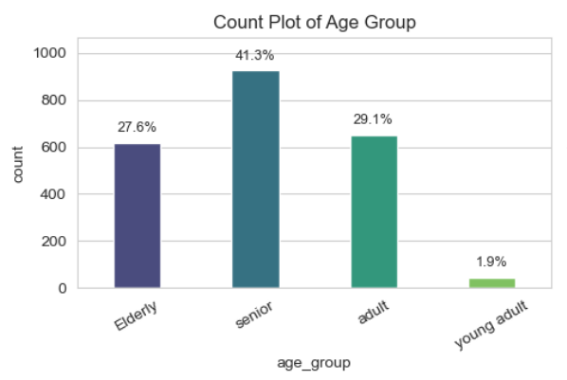
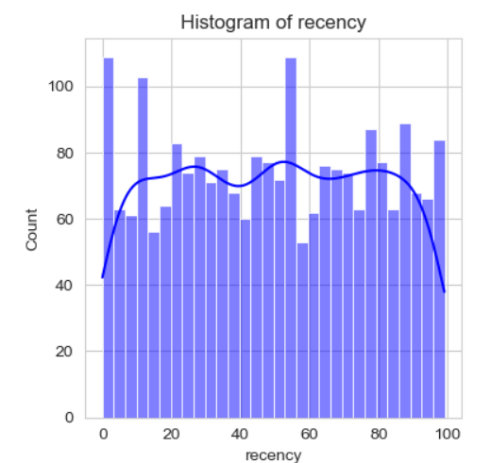
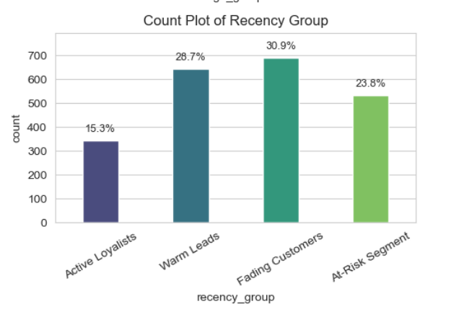
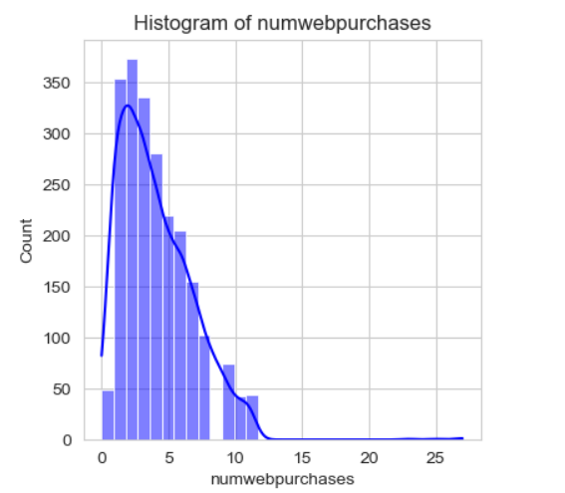
Exploratory Data Analysis
Majority of customers are seniors (41.3%) indicating that marketing efforts should be tailored to older age groups for maximum engagement.
Fading Customers are the largest segment with 30.9% who haven't interacted recently but were previously active.
Recency distribution is uniform which indicates a balanced mix of new and old engaged customers.
Web purchases are low for most customers which suggests an urgent need to improve digital and online engagement through better targeted online campaigns.

Slide 6
Exploratory Data Analysis
Majority of customers are seniors (41.3%) indicating that marketing efforts should be tailored to older age groups for maximum engagement.
Fading Customers are the largest segment with 30.9% who haven't interacted recently but were previously active.
Recency distribution is uniform which indicates a balanced mix of new and old engaged customers.
Web purchases are low for most customers which suggests an urgent need to improve digital and online engagement through better targeted online campaigns.

Slide 7
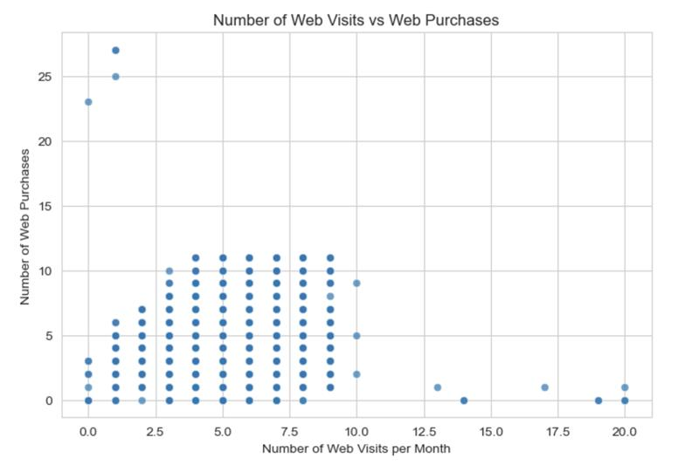
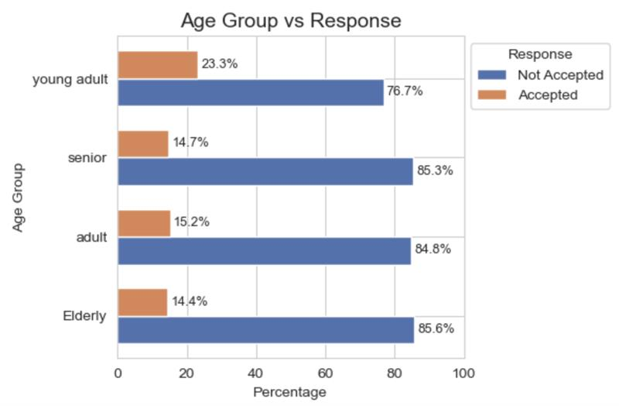
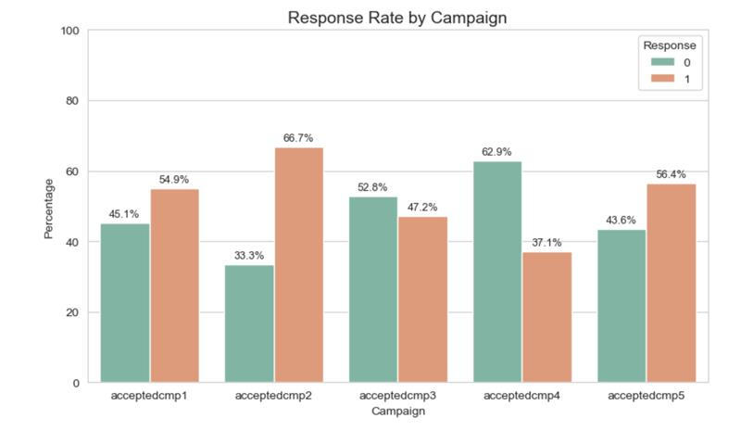
Exploratory Data Analysis
Campaign2 achieves the highest acceptance rate of 66.7% while campaign4 have the lowest acceptance rate with only 37.1%.
Campaign3 acceptance and non-acceptance rates are near which shows neutral performance.
Majority of the customers are having 0-10 web visits per month.
There is no strong correlation between web visits and web purchases, indicating higher traffic doesn’t guarantee making more purchases.
Young adults (23.3%) are the most responsive age group, while older age groups show very low engagement with campaigns.

Slide 8
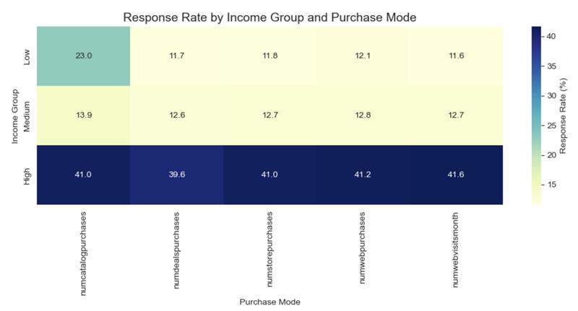
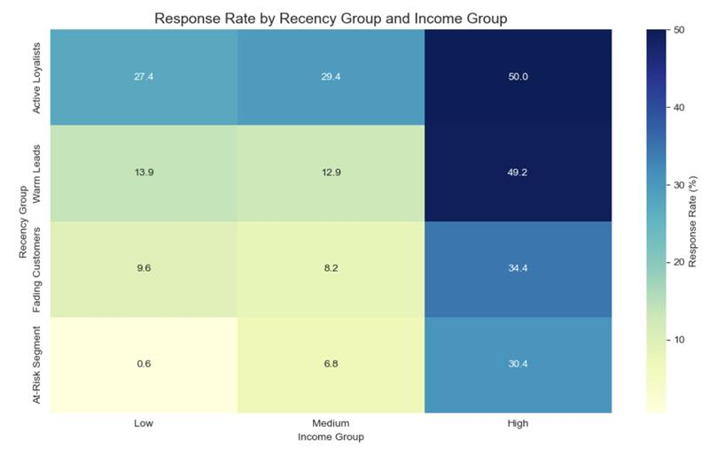
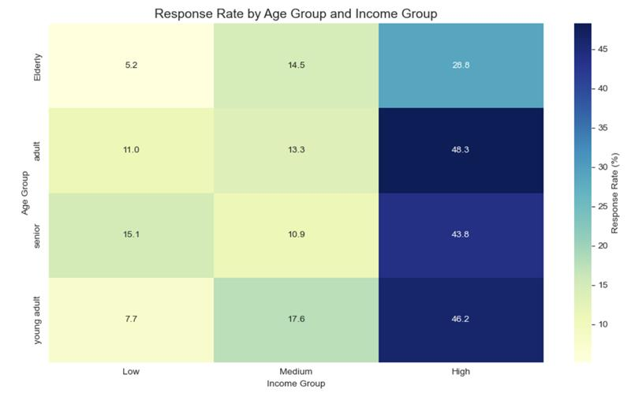
Exploratory Data Analysis
Active loyalist customers with high income have the highest response rate of 50%, making them ideal targets for personalized and high priority campaigns.
Customers having high income shows the consistent performance across all the purchase modes having acceptance rate around 41%.
Campaigns should focus marketing efforts on high-income customers with frequent web visits and leverage personalized digital campaigns.
Adult customers with high income achieves the highest acceptance rate of 48.3% and low income customers shows the lowest acceptance rates across all the age groups especially the elder customers with 5.2% rate.

Slide 9
Exploratory Data Analysis
Active loyalist customers with high income have the highest response rate of 50%, making them ideal targets for personalized and high priority campaigns.
Customers having high income shows the consistent performance across all the purchase modes having acceptance rate around 41%.
Campaigns should focus marketing efforts on high-income customers with frequent web visits and leverage personalized digital campaigns.
Adult customers with high income achieves the highest acceptance rate of 48.3% and low income customers shows the lowest acceptance rates across all the age groups especially the elder customers with 5.2% rate.

Slide 10
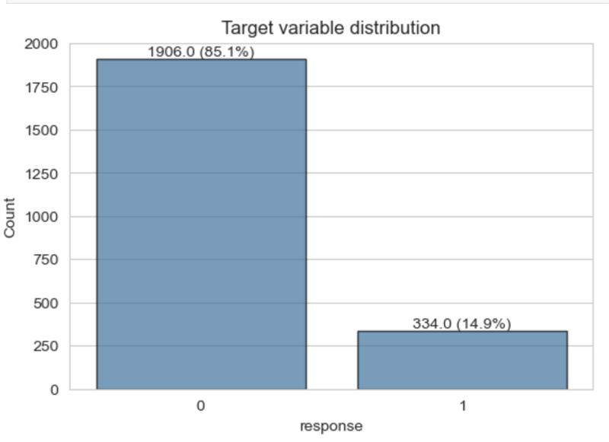
Exploratory Data Analysis
Target feature (response) is highly imbalanced with 85.1% negative classes and 14.9% positive classes.
Imbalance will be handled with the help SMOTE technique.

Slide 11
Data Preprocessing
Missing values in feature “income”.
Dropped features with constant values (z_costcontact, z_revenue) and unique identifier feature “id”
Handling missing values by Median Imputation on feature “income”
Feature Engineering on features age, recency, income, dt_customer, marital status, education.

Slide 12
Models and Evaluation
.
Logistic Regression showed the highest AUC (0.8897) and precision (0.8643) making it effective for identifying true positives in imbalanced datasets.
Random Forest delivered the best balance in F1-Score (0.8334) and accuracy (0.8281) which indicates good overall performance.
Decision Tree performed moderately with F1-score (0.8153)) but had the lowest AUC (0.6998), signaling weaker separability.
XGBoost had competitive precision (0.8399) but slightly lower recall and F1-Score, indicating more room for tuning.
Model | Accuracy | Precision | Recall | F1-Score | AUC
Logistic Regression | 0.7902 | 0.8643 | 0.7902 | 0.8137 | 0.8897
Decision Tree | 0.8036 | 0.8317 | 0.8036 | 0.8153 | 0.6998
Random Forest | 0.8281 | 0.8398 | 0.8281 | 0.8334 | 0.8151
XGBoost | 0.7768 | 0.8399 | 0.7768 | 0.7993 | 0.822

Slide 13
Models and Evaluation (With Hyper Parameter tuning)
.
Logistic Regression with HP achieves an excellent AUC (0.8917) and strong precision, making it reliable for class separation.
Decision Tree with HP provides good accuracy but a relatively low AUC (0.6972), indicating limited predictive power.
Random Forest with HP provides a well-balanced performance across all metrics, making it a robust and consistent model.
XGBoost with HP outperforms all models with the highest F1-score (0.8509) and accuracy (0.8482), ideal for precise and scalable predictions.
Model | Accuracy | Precision | Recall | F1-Score | AUC
Logistic Regression with (HP) | 0.8013 | 0.87 | 0.8013 | 0.823 | 0.8917
Decision Tree with HP | 0.8103 | 0.8298 | 0.8103 | 0.8188 | 0.6972
Random Forest with HP | 0.8281 | 0.8398 | 0.8281 | 0.8334 | 0.8151
XGBoost with HP | 0.8482 | 0.8539 | 0.8482 | 0.8509 | 0.8335

Slide 14
Summary
XGBoost with hyper parameter tuning achieved the highest overall performance with an F1-score of 0.8509, accuracy of 0.8482, and a strong AUC of 0.8335. This shows that the model has a strong balance between correctly identifying positive responses while minimizing false positives and false negatives.
Considering the base model Logistic regression with hyperparameter tuning also showed the highest AUC of 0.8917 and precision of 0.87, but its F1-score was lower (0.823) compared to XGBoost with hyperparameter tuning (0.8509) highlighting that it is less balanced for this particular classification task.
Random forest also demonstrated strong and stable results with F1 score of 0.8334 and highest mean F1 score of 0.9219 when compared with XGBoost with Hyper parameter tuning outperformed in the overall performance metrics.
Decision Tree has lower AUC values of 0.699 indicating limited power in classifying the classes when compared to other models

Slide 15
Conclusion
From a Business perspective we can conclude that XGBoost with hyperparameter tuning provides most accurate and balanced predictions for identifying customers likely to respond to marketing campaigns.
Because of its strong precision and recall it enables precise customer targeting and reduces unnecessary marketing efforts while boosting engagement rates which helps the business to optimize the effectives of the campaign to obtain higher returns on investment.
Future Scope
Performance of the model can be further enhanced by implementing advanced techniques like cost-sensitive learning to account for the imbalance in misclassification impact.
Feature selection methods such as Recursive Feature Elimination and Regularization techniques, can help simplify the model while preserving accuracy.

Slide 16

Thank
You

