Slide 2
Predicting In-Vehicle Coupon Acceptance
Group 11
Rushika Badri Prasad
Trupti Shailendra Gandhi
Girish Sunkadakatte Chandrappa

Slide 3
Problem Statement
Predict whether a customer will accept an in-vehicle coupon based on demographic, contextual, and behavioral factors to help businesses optimize marketing strategies and improve engagement.

Slide 4
Dataset Description
The dataset comprises 12,684 observations and 26 features, including both categorical and numerical variables from various domains, aimed at understanding the factors influencing coupon redemption behavior.
Category | Features
Demographic | Gender, Age, has_children, Education, Income, maritalStatus, Occupation
Behavioral | Bar, CoffeeHouse, CarryAway, RestaurantLessThan20, Restaurant20to50
Coupon Characteristics | Coupon, Expiration
Environmental Factors | Destination, Passenger, Time, Weather, Temperature
Proximity Information | toCouponGEF_5min, toCoupon_GEQ15min, toCoupon_GEQ25min
Navigational Features | direction_same,direction_opposite
Target Variable | Y

Slide 5
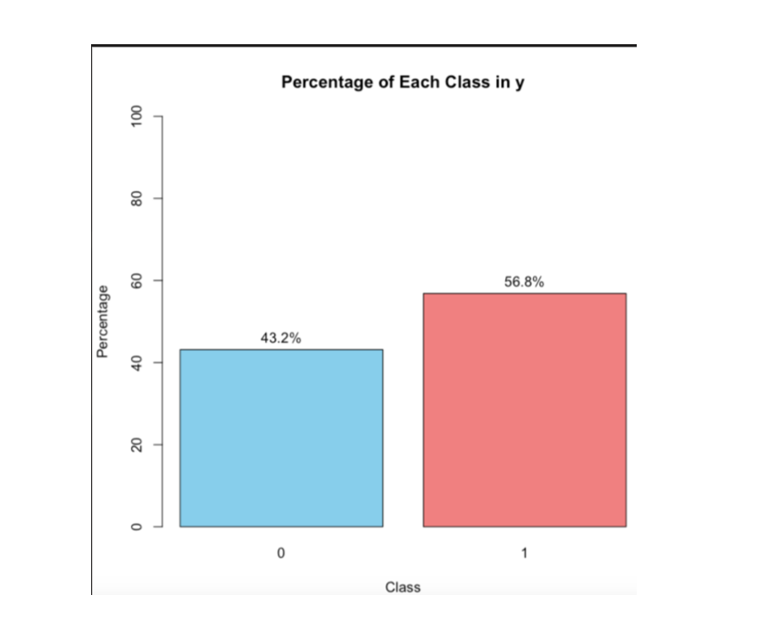
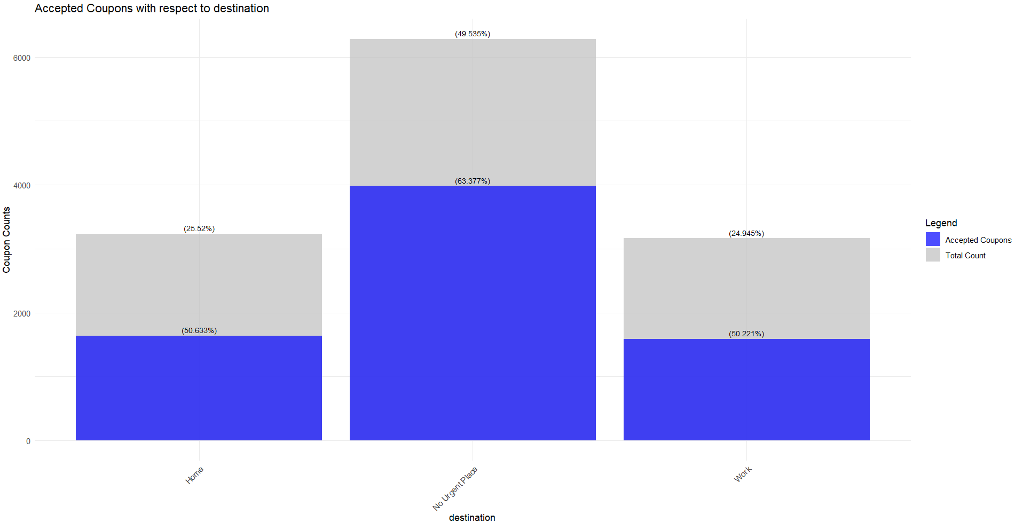
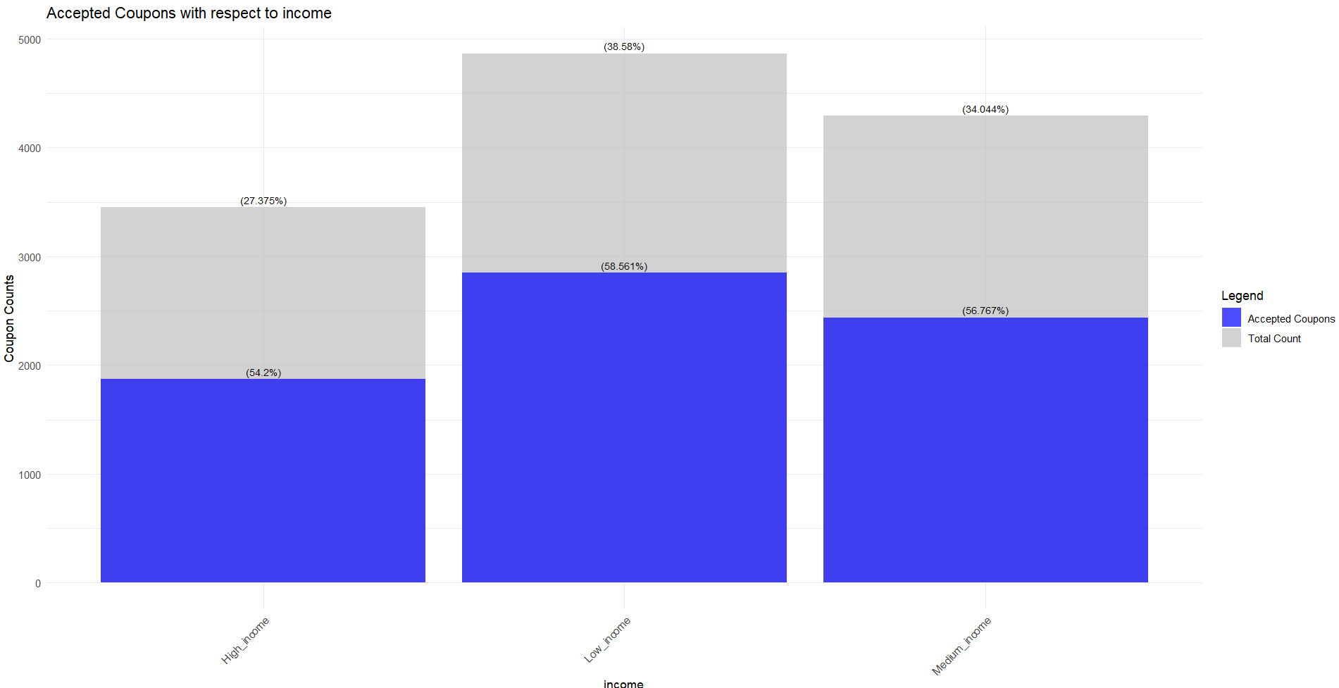
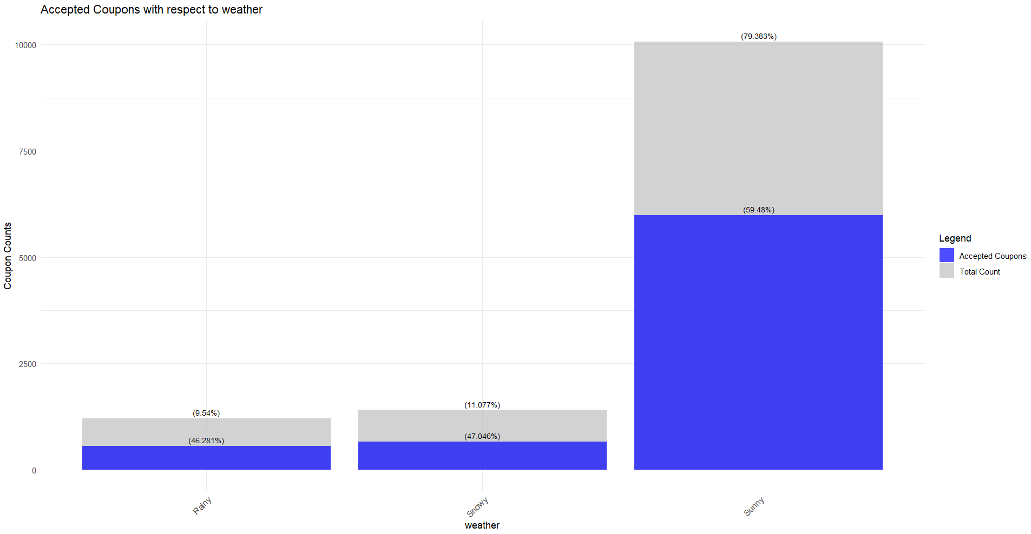
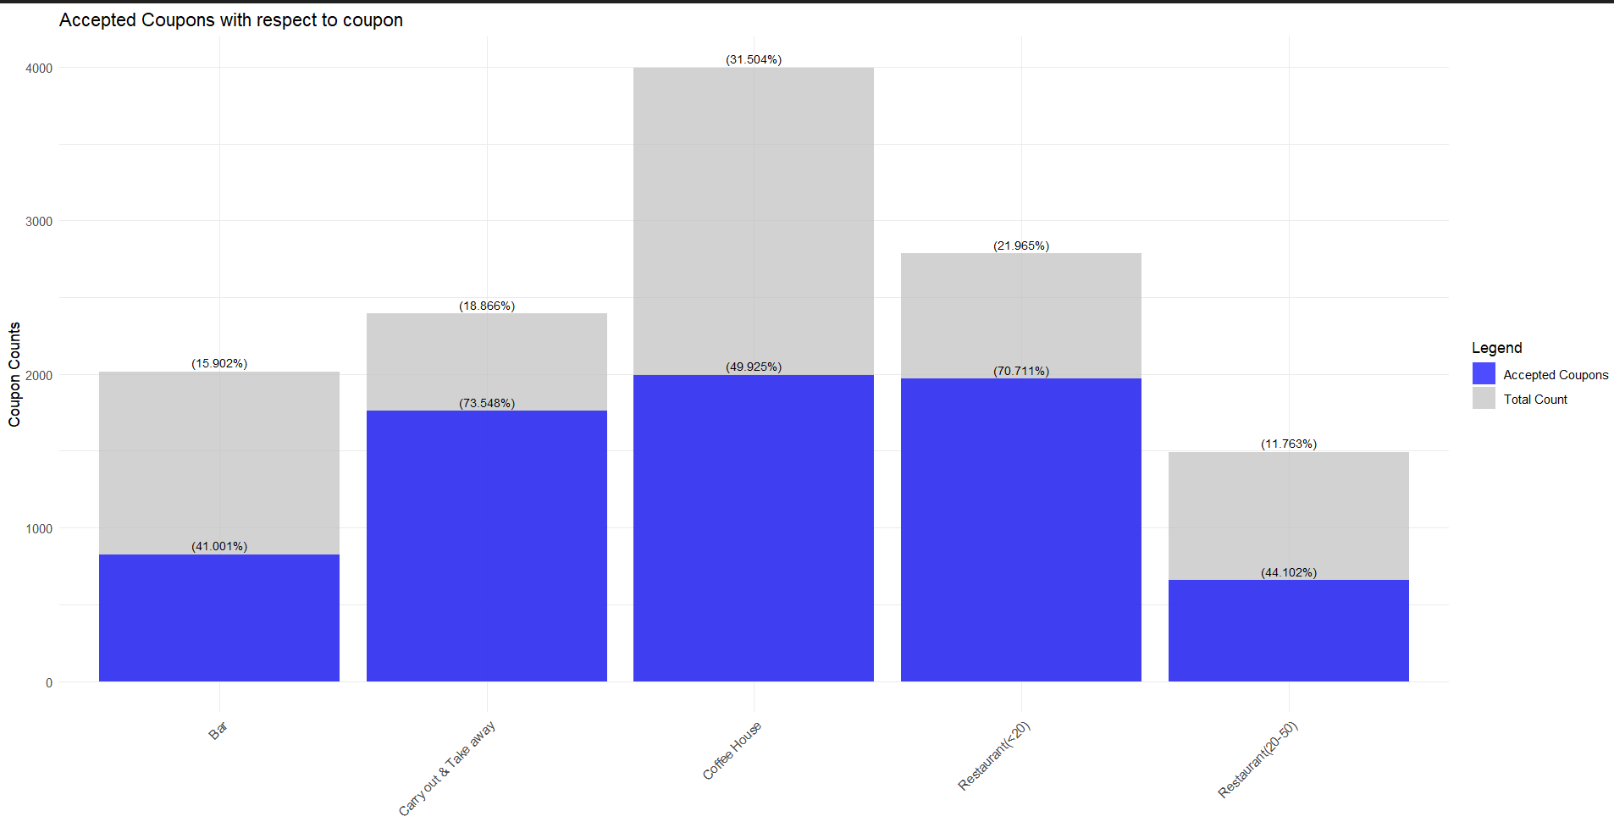
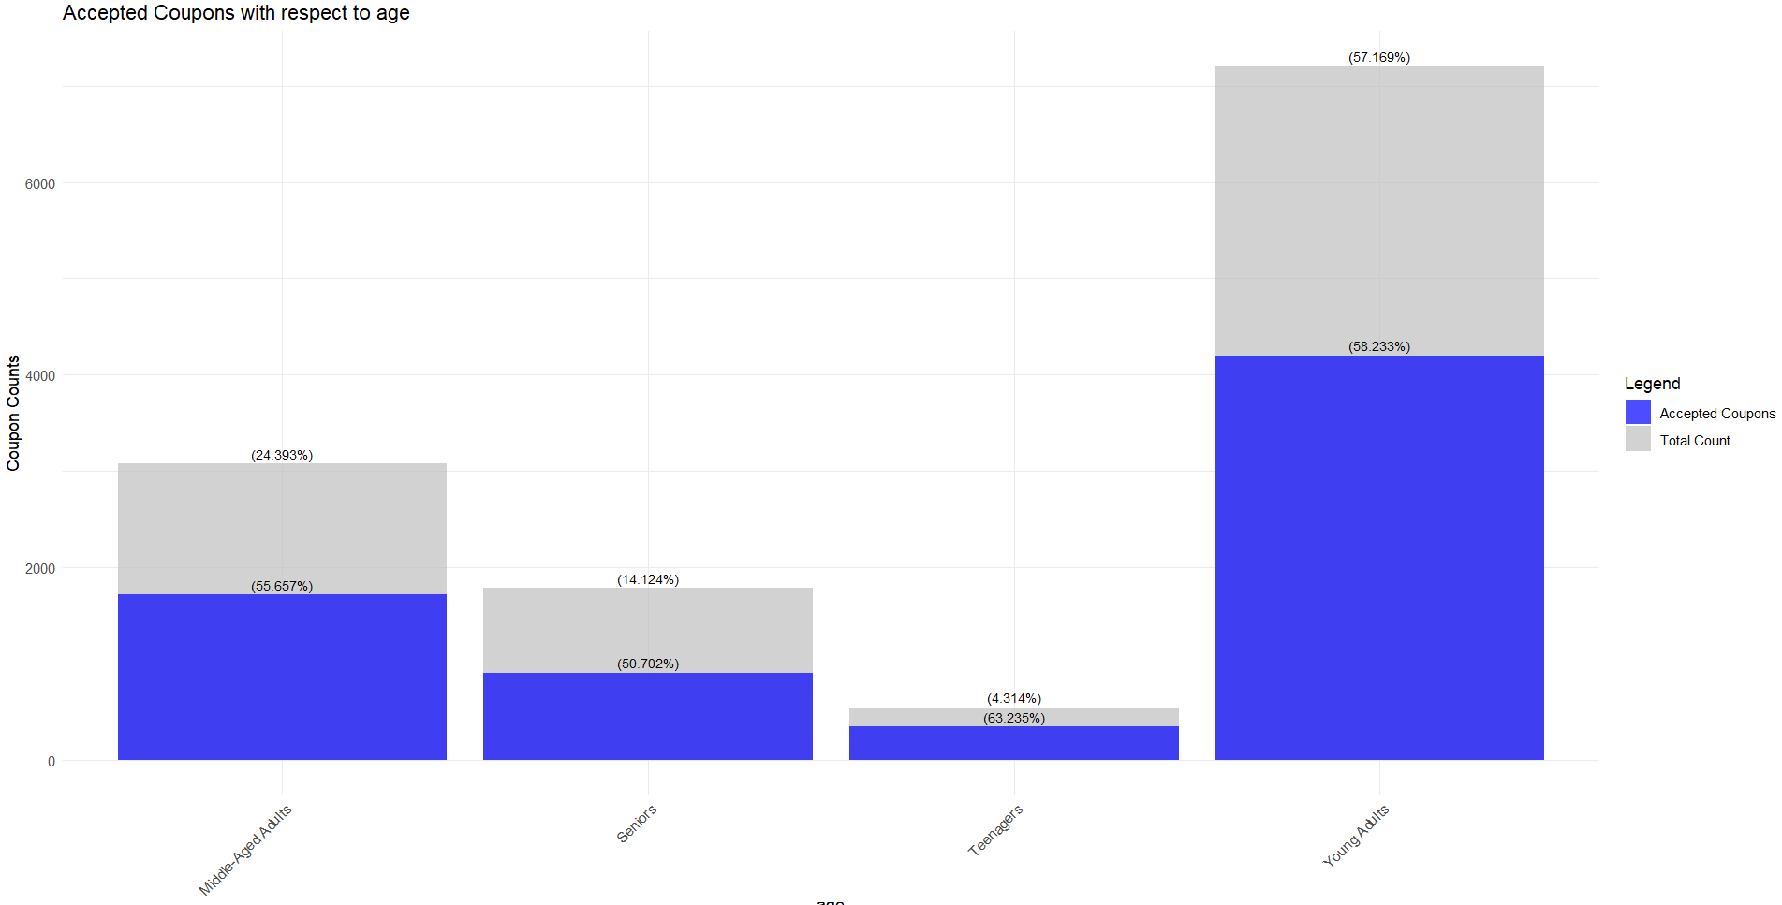
Exploratory Data Analysis
Coffee House coupons are the most frequently offered, with the highest acceptance rates for Carry Out & Take Away and Restaurant (<$20) coupons, while Bar coupons have the lowest acceptance rate.
Most users are young adults, highest acceptance rate is observed on both teenagers and young adults.
Most common weather is “Sunny” and shows the highest coupon acceptance.
Majority of users are from low and medium-income groups, which also have the highest coupon acceptance rates.
Coupons are most accepted when users have destination 'No Urgent Place’.
Target variable is balanced in nature.

Slide 6
Exploratory Data Analysis
Coffee House coupons are the most frequently offered, with the highest acceptance rates for Carry Out & Take Away and Restaurant (<$20) coupons, while Bar coupons have the lowest acceptance rate.
Most users are young adults, highest acceptance rate is observed on both teenagers and young adults.
Most common weather is “Sunny” and shows the highest coupon acceptance.
Majority of users are from low and medium-income groups, which also have the highest coupon acceptance rates.
Coupons are most accepted when users have destination 'No Urgent Place’.
Target variable is balanced in nature.

Slide 7
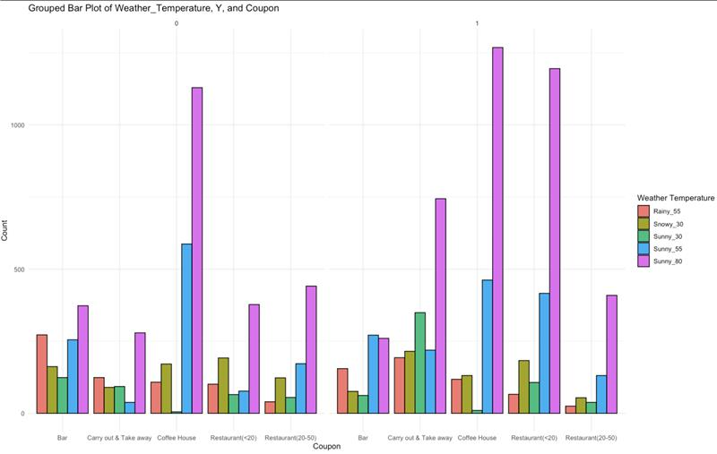
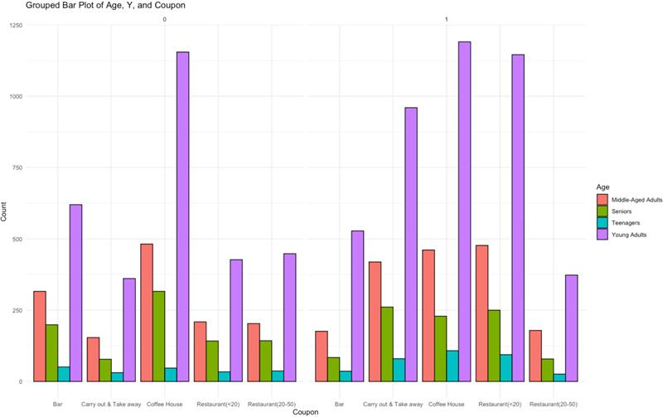
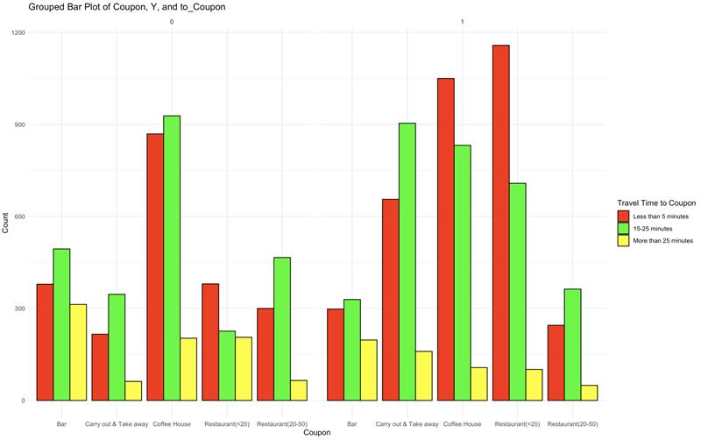
Exploratory Data Analysis
Coupons are most accepted in sunny weather, with "Restaurant (<20)" and "Carry out & Take away" being accepted more frequently than rejected.
Young adults have the highest coupon acceptance rates, while seniors and teenagers show significantly lower acceptance regardless of the coupon type.
"Coffee House" and "Restaurant (<20)" coupons are most accepted with travel times under 5 minutes, while coupons requiring over 25 minutes of travel are rarely accepted.

Slide 8
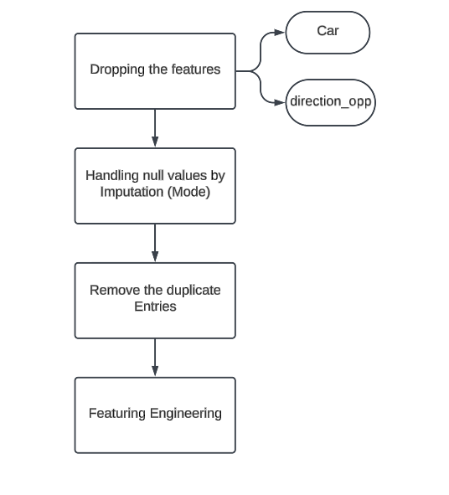
Data Preprocessing
Missing values in feature car (99.14%).
Redundancy in Data : direction_opp
Handling missing values by Mode Imputation.
Feature Engineering.
Features | Details
to_coupon_geq5min to_coupon_geq15min to_coupon_geq25min | to_coupon
age | Teenagers Young Adults Middle Aged Adult Seniors
Occupations | Into Different Categories
Income | Low_Income Medium_Income High_Income

Slide 9
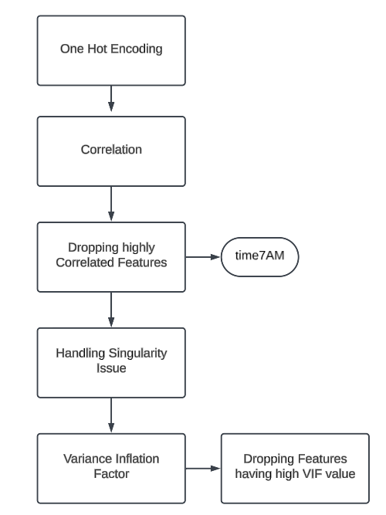
Data Preprocessing
Time7AM and destination_passengerWork_Alone is highly correlated.
Observed singularity issue for destination_passengerWork_Alone.
Feature Selection by VIF(VIF <0.5)

Slide 10
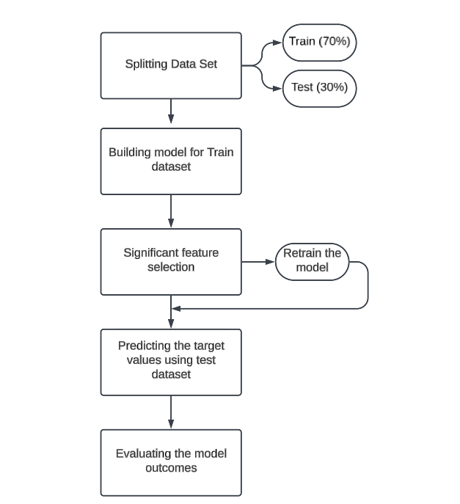
Models and Evaluation
Logistic regression demonstrates balanced training and testing accuracy, showing good generalization but lower sensitivity.
LDA has better sensitivity than logistic regression but slightly worse testing accuracy, indicating possible overfitting.
QDA shows a significant drop in accuracy from training to testing, indicating overfitting, despite its slightly better sensitivity
Models | Sample Accuracy
Logistic Regression | Training – 68.57% Test – 64%
LDA | Training – 69.29% Test – 62.33%
QDA | Training – 87.29% Test – 63.67%
Models | Sensitivity | Specificity | Positive Prediction | Negative Prediction
Logistic Regression | 52.24% | 73.49% | 61.40% | 65.59%
LDA | 61.19% | 63.25% | 57.34% | 66.88%
QDA | 64.18% | 63.25% | 58.50% | 68.63%

Slide 11
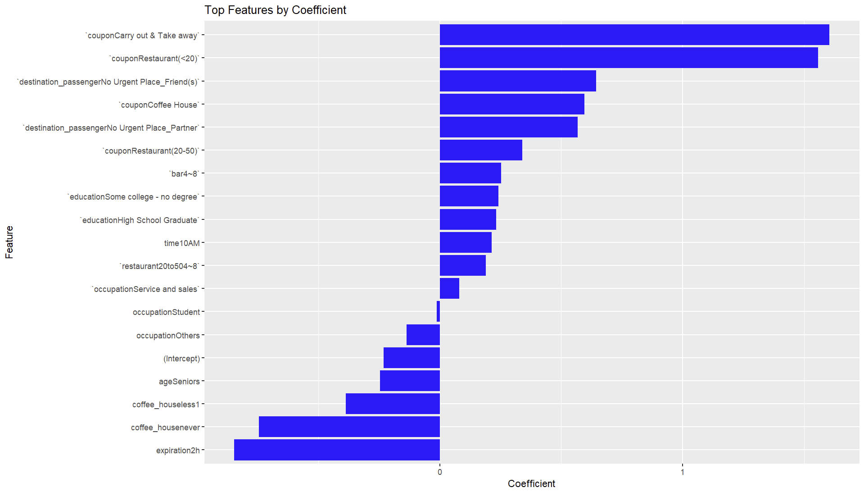
Feature Importance

Slide 12
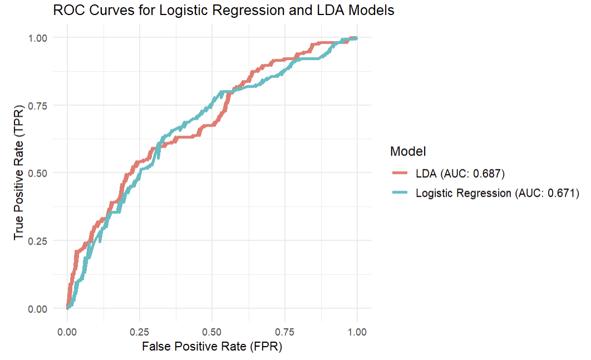
ROC Curve

Slide 13
Summary and Conclusion
Logistic Regression achieves the best balance with 68.57% training accuracy and 64% test accuracy, demonstrating strong generalization.
LDA performs better on sensitivity (61.19%) but shows a drop in test accuracy (62.33%), suggesting potential overfitting.
QDA has the highest training accuracy (87.29%) but struggles with test accuracy (63.67%) due to significant overfitting.
Logistic Regression is preferred for its balanced and generalizable performance.

Slide 14
Future Scope
Explore Random Forest or XGBoost for improved accuracy.
Extend to multi-class classification for coupon names.
Enhance performance with advanced feature engineering/selection.
Leverage larger datasets for better results.
Models | Dataset Accuracy | Sample Accuracy
Logistic Regression | Training – 68.49% Test – 67.47% | Training – 68.57% Test – 64%
LDA | Training – 69.09% Test – 67.31% | Training – 69.29% Test – 62.33%
QDA | Training – 73.18% Test – 70.07% | Training – 87.29% Test – 63.67%

Slide 15
References
Dataset: https://archive.ics.uci.edu/static/public/603/in+vehicle+coupon+recommendation.zip
Research Paper: https://jmlr.org/papers/volume18/16-003/16-003.pdf
https://github.com/dikaaka/In-Vehicle-Coupon-Recommendation-Project/blob/main/STAGE%200/FINAL%20PROJECT%20-%20STAGE%200.pdf
https://www.kaggle.com/code/maherabdelllatif/invehicle-coupon-recommendation

Slide 16

Thank
You

